Slide 1
Biomechanics of Hip and Knee
Replacement
Sebastian Dawson-Bowling
MA, MSc, LLM, FRCS(Tr&Orth)
Consultant Orthopaedic Surgeon

Slide 2
Introduction
Understanding biomechanics of hip and knee is crucial to enable surgical preservation/restoration of functional anatomy
Longevity of prostheses likely to compromised if normal biomechanics not preserved
Free body diagrams frequently asked in basic science viva
Principles of how to do THR/TKR also commonly comes up
Level required is generalist not revision specialist

Slide 3
1.HIP

Slide 4
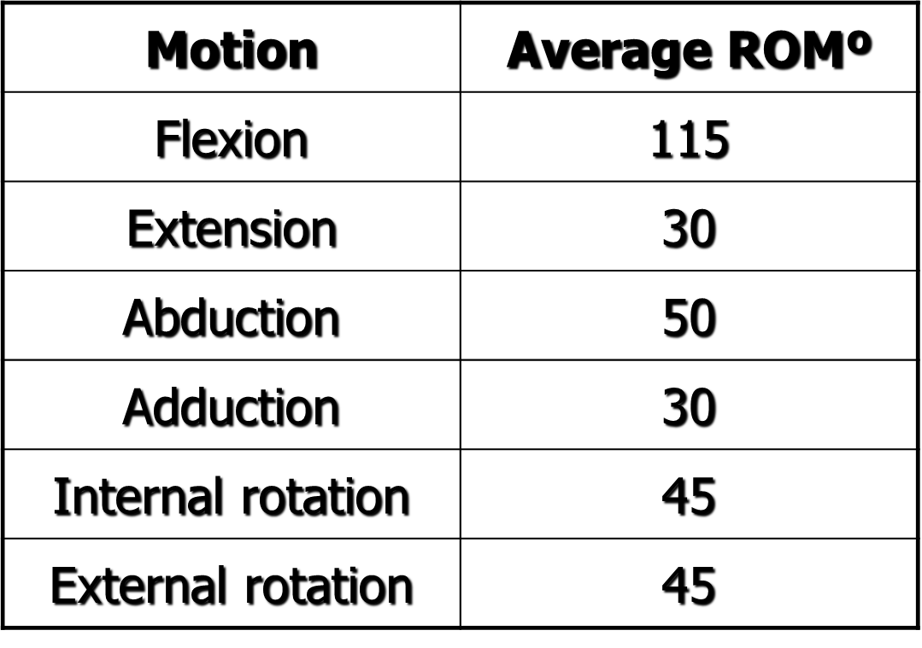
Expected range of motion in hip joint

Slide 5
Expected range of motion in hip joint

Slide 6
Hip kinetics
During stance phase of gait cycle, joint reaction force R can = 3-6x body weight
Up to 10x when running/climbing stairs
Largely results from contraction of muscle groups around hip
Primarily abductors – which are…?
Understanding free body diagram crucial to understanding hip biomechanics

Slide 7
Hip free body diagram

Slide 8
Hip free body diagram
Moment (M) is defined as the tendency of a force to twist or rotate an object
M = Fd
If A=25mm, B=125mm:
-25G_{y} + 125W =0 (because hip not moving)

Slide 9
Hip free body diagram
If -25Gy + 125W =0;
Gy =5W
If Fy =0 (sum of forces is zero);
-Gy -Wy +Ry =0
Ry =6W
R = Ry (cos30º)
Ry =4-5W

Slide 10
Altering A:B ratio
↑ratio A:B causes ↓R
How can this be achieved?

Slide 11
Increasing A:B achieved by:
Medialising acetabulum (↑B)
Lateralising gtr. trochanter (↑ A)
- ↑ offset
- trochanteric osteotomy (Charnley)
- varus osteotomy
Trendelenburg gait – effectively reduces distance B and thus reduces abductor force

Slide 12
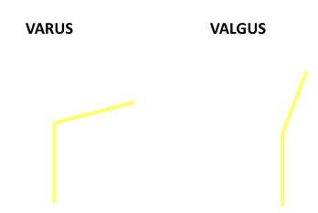
Femoral osteotomies:

Slide 13
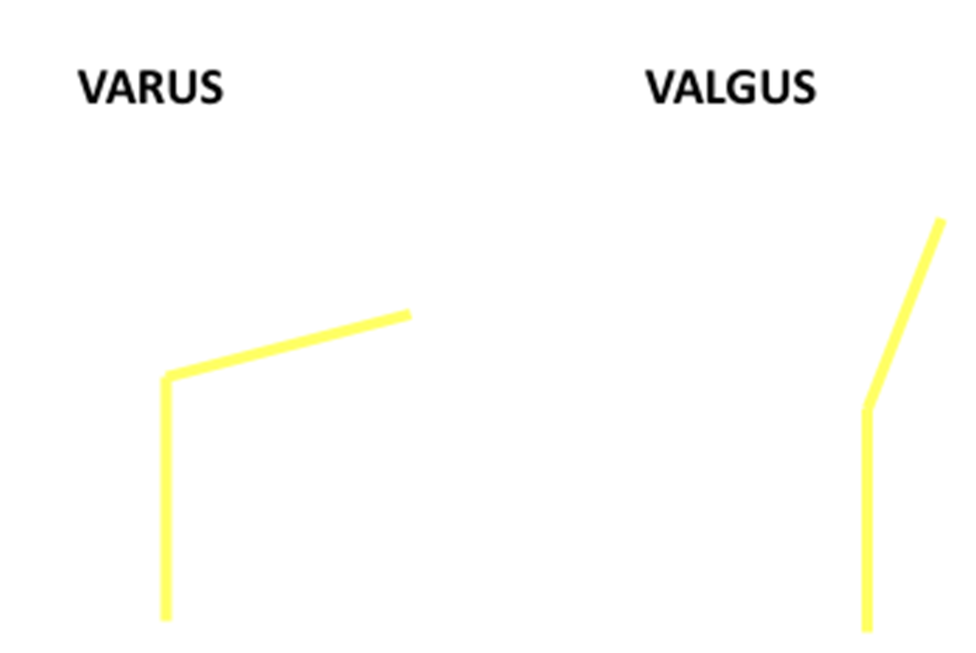
Femoral osteotomies:
VARUS
↑abductor lever arm
Horizontalises abductors pull
↑joint congruency
Medialises R

Slide 14
Femoral osteotomies:
VALGUS
Lengthens abductors

Slide 15
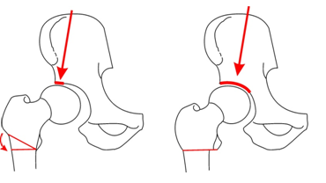
Femoral osteotomies:
VALGUS
Lengthens abductors
↑weight-bearing S.A. by causing lateral capital drop osteophyte to become weight-bearing

Slide 16
Principles of Total
Hip Replacement
Charnley medialised cup, lateralised trochanter and used small head
However, soft medial cancellous bone necroses with subsequent potential loosening
Trochanteric non-union also a concern
Thus now considered better to preserve bone stock (also important for subsequent revision surgery)

Slide 17
Factors affecting hip stability
Dislocation rates after primary hip vary from 0-9.5%
Higher after revision THR, or conversion from NOF# fix^{n.}
Can broadly be attributed to Patient, Surgeon or Implant factors

Slide 18
Implant factors
1º arc range = ROM before impingement/levering out
Main determinant is head:neck ratio
For given neck size, larger head allows greater 1º arc range before impingement/potential dislocation
Repeated impingement also increases risk of component damage – esp. with ceramic bearings

Slide 19
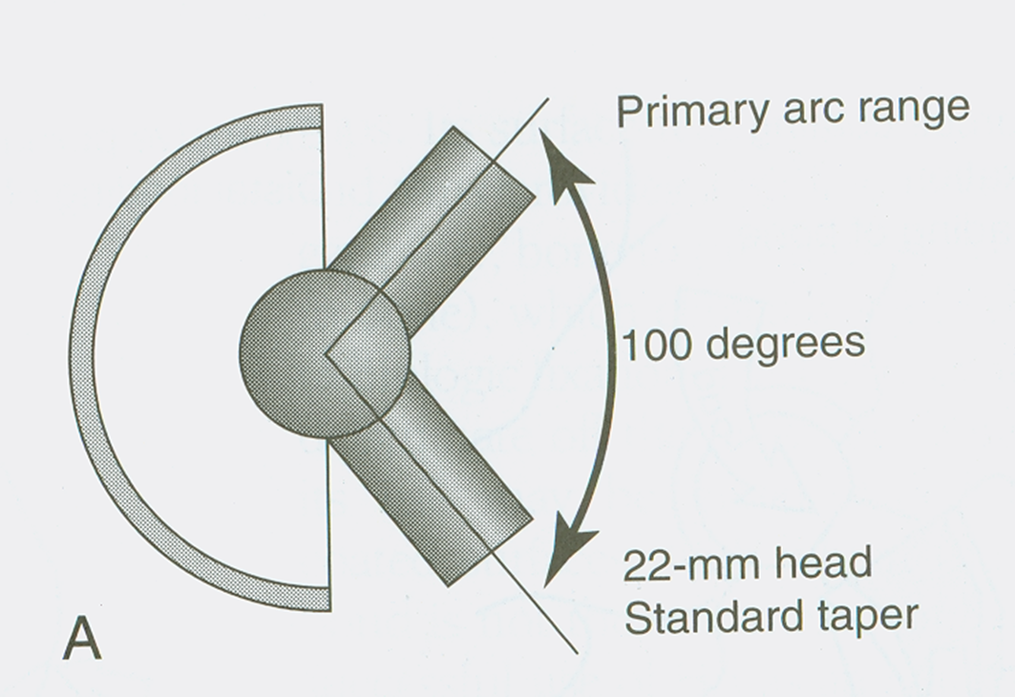
Effect of head/neck ratio on 1º arc range

Slide 20
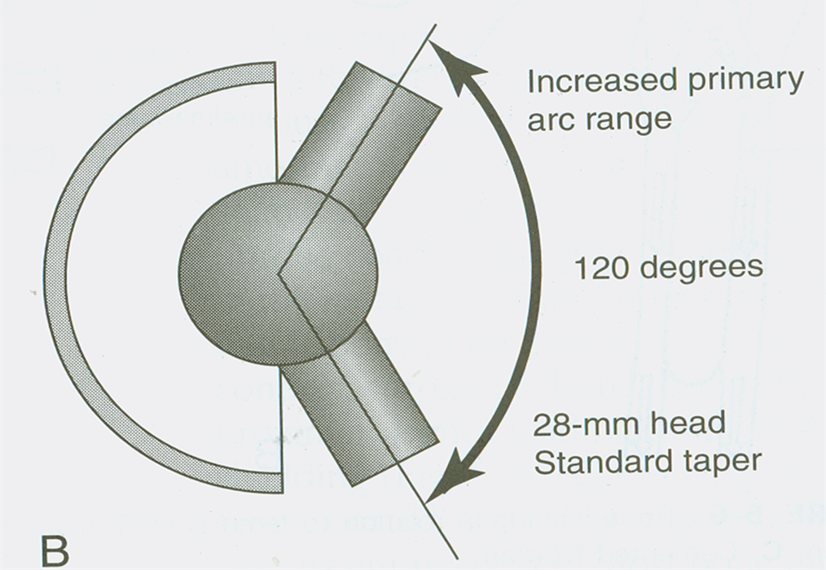
Effect of head/neck ratio on 1º arc range

Slide 21
Head excursion
Excursion or ‘jump’ distance = how far head must travel from full seating to dislocation (½ x head diameter)
Charnley’s 22mm head would only have to travel 11mm to dislocate
A modern 36mm head has to travel 18mm
(Note though some issues with larger heads esp. increased volumetric wear)

Slide 22
Head size therefore influences stability through two independent mechanisms

Slide 23
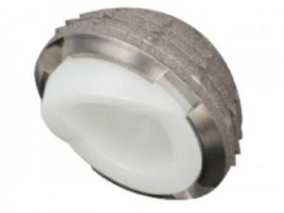
Other implant related factors affecting stability
Hooded liners – may increase stability in a given direction but reduced 1º arc range

Slide 24
Other implant related factors affecting stability
Hooded liners – may increase stability in a given direction but reduced 1º arc range
Narrow neck taper – increases head:neck ratio
Constrained liner – used if (e.g.) severe soft tissue dysfunction; but v. limited 1º arc range causes repeated impingement with likelihood of early failure of bone-cement-implant interface

Slide 25
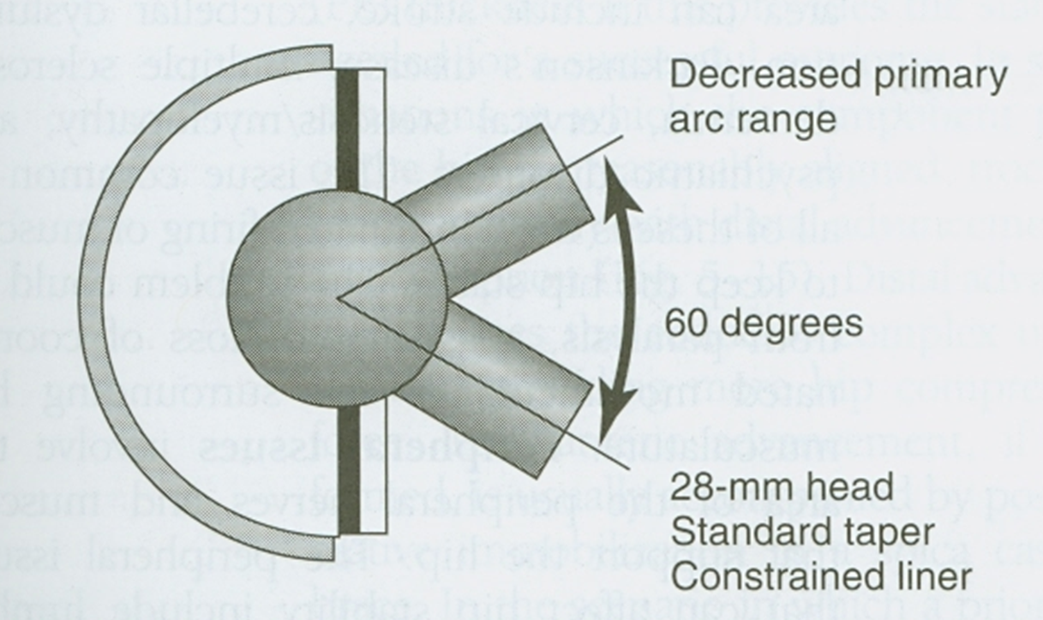
Constrained liner

Slide 26
Surgeon factors
Component alignment
Soft tissue tensioning
Clearly choice of implant is ultimate also a surgeon factor (though often with interference from managers and others…!)

Slide 27
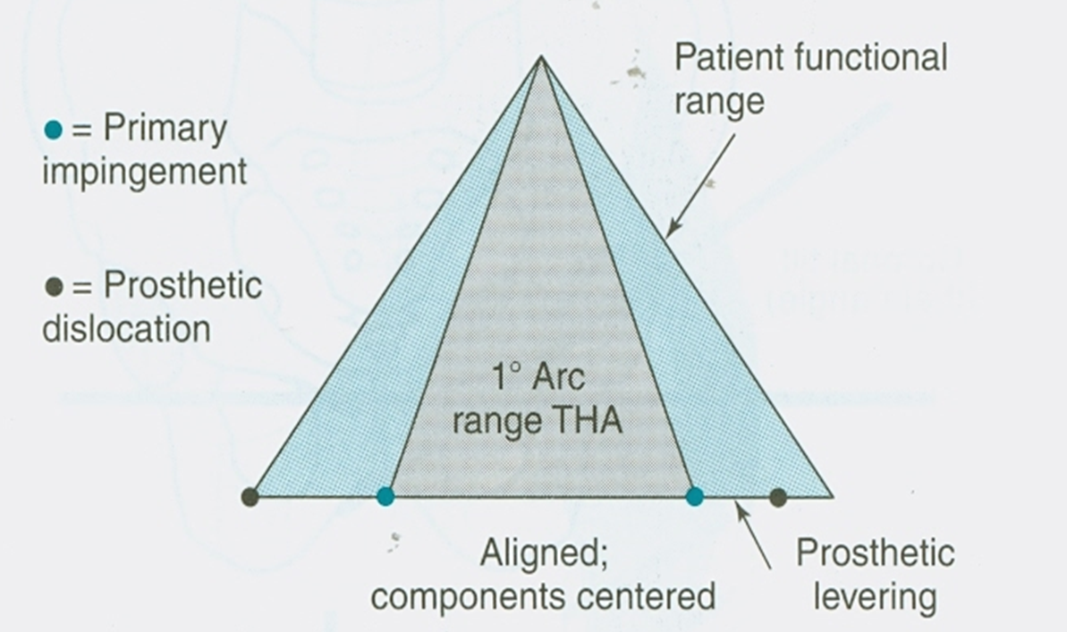
Graphical representation of alignment & stability

Slide 28
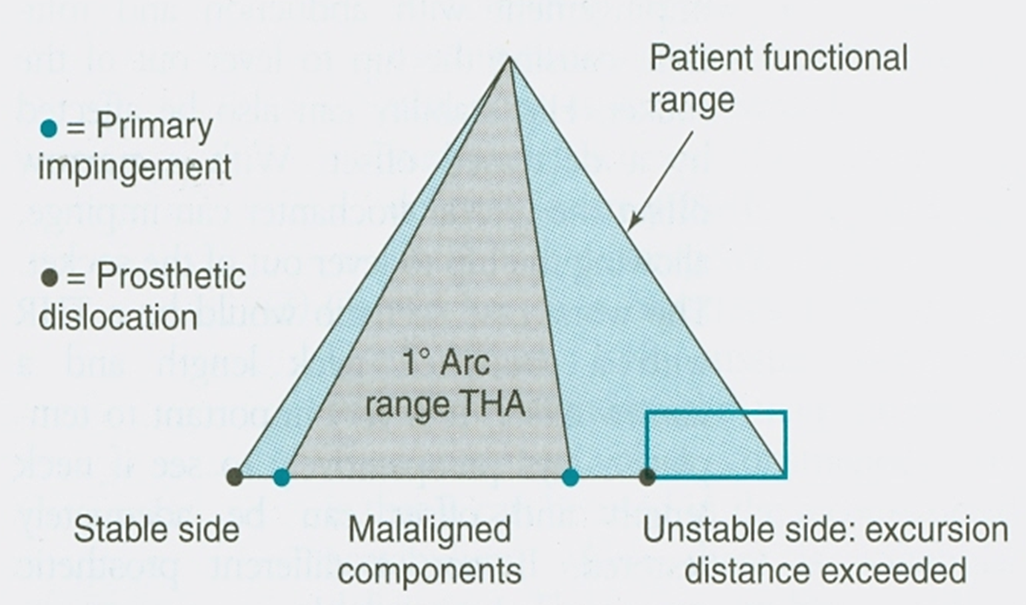
Graphical representation of alignment & stability

Slide 29
‘Optimum’ positioning
Matter of surgeon preference
Acetabular anteversion 15-30°
35-45°coronal tilt
Femoral anteversion 10-20° (mean≈15 in native hip)
Surgical approach will affect exact component positioning)

Slide 30
Soft tissue tensioning
Offset is key determinant due to effect on abductor function
Low offset results in poor abductor function and reduced stability
Can also result in trochanteric impingement with resultant dislocation

Slide 31
Soft tissue tensioning
Broad guideline might be 37.5mm in ♀ and 44mm in ♂
Best option is to restore preoperative anatomy (eg. pre-op. templating)
Note that increasing offset/neck length may come at expense of higher stress transfer at component tip, and greater strain on the medial cement mantle

Slide 32
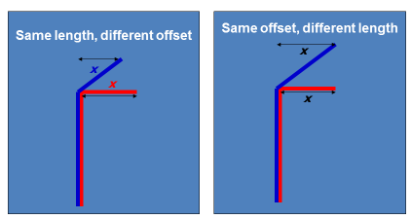
Offset, neck angle & neck length are interrelated

Slide 33
Choice of surgical approach
Each has potential pro & cons
Posterior approach popular amongst hip surgeons but criticised because of concerns over dislocation and sciatic nerve injury
Both avoidable with accurate surgical technique

Slide 34
Choice of surgical approach
Direct lateral (with trochanteric osteotomy), Watson-Jones, modified Hardinge approach all run risk of damaging/defunctioning abductor complex
Anterior gaining popularity – but long learning curve, only demonstrable benefit to date is mildly better function at 6 weeks (plus ability to screen intraoperatively)

Slide 35
Choice of surgical approach
Need to be able to describe all common approaches in both general adult and basic science viva
If you can give ‘tips’ it gives the impression you have actually done it, not just learnt from book
E.g. ‘I would then ask my assistant to internally rotate the leg’

Slide 36
Patient factors
CNS dysfunction
Peripheral neuropathy/myopathy
High BMI
Poor compliance with post-op. instructions (although hip precautions shown to confer slower rehabilitation with no reduction in dislocation)

Slide 37
Fixation method
Highly controversial and subjective – for the exam you can say whatever you like provided you can support it with some ort of evidence (esp. NJR)
A safe bet might be to talk about the Exeter stem

Slide 38
Acetabular fixation
Cemented component generally only an option with polyethylene
Strongest hold shown to be achieved with 3 large keyholes & preservation of subchondral plate
Variety of designs but must not be at expense of mantle; flange gives best longevity

Slide 39
Acetabular fixation
Uncemented may be press-fit (hoop stresses) or line-to-line
Some are ‘peripherally expanded’ requiring over-reaming (e.g. Trident)
Screws – matter of surgeon preference
No evidence for any of these principles being superior; need to be familiar with one so you can talk about it

Slide 40
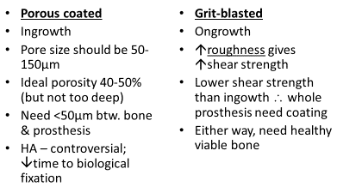
Cementless femoral fixation

Slide 41
Polished v. unpolished stems
Polished taper – ‘slides down’ as cement undergoes creep (definition?)
Cement and bone both best at withstanding compressive forces – outstanding Exeter results

Slide 42
Polished v. unpolished stems
Unpolished: composite beam – all interfaces fixed, gives high shear, low compressive forces (similar to uncemented); hence poorer unpolished Exeter results
However, other systems (e.g. Stanmore) excellent results

Slide 43
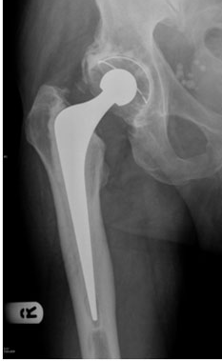
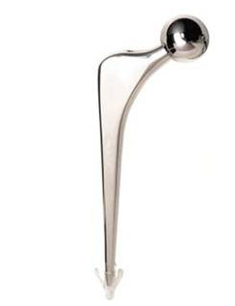
Polished v. unpolished stems

Slide 44
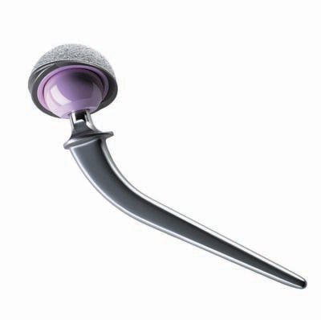
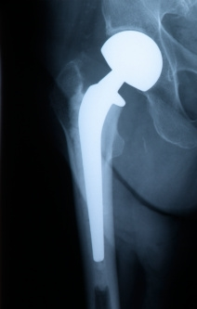
Polished v. unpolished stems

Slide 45
Stress shielding
Loss of bone density in prox. femur
Stem stiffness single biggest determinant
A product of implant size, design and material
Partially reducible by limiting porous coating to proximal section of stem only

Slide 46
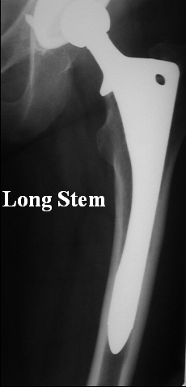

Slide 47
Stress shielding
Less common but still possible with cemented stems
Not shown to affect survival but can cause problems with subsequent revision THR

Slide 48
To summarise:
Abductors support pelvis during single stance phase
Their pull is closer to the centre of the femoral head than the body centre of gravity so contraction force (pulling down on iliac wing) must be greater than body weight, giving R =4-6 x W
Any measure bringing abductor pull away from, or centre of gravity towards, femoral head will reduce R

Slide 49
What factors affect stability after THR?
Patient factors – N-M. disease, non-avoidance of hip precautions, etc.
Surgeon factors – surgical approach, implant positioning
Implant factors – head size, offset

Slide 50
2.KNEE

Slide 51
How many degrees of freedom are there in native knee movement?

Slide 52
How many degrees of freedom are there in native knee movement?
SIX
– Rotation in three planes
– Translation in three planes

Slide 53
Requirements of TKR
15-20°rotation
5-10°varus/valgus motion
Flexion requirements:
– walking; 65°
– walking upstairs; 95°
– rising from chair; 110°
Certain religious and ethnic cohorts require deeper flexion for prayer

Slide 54
Distal femoral anatomy
Anatomical axis of femur is ~6°of valgus from the mechanical axis
Condyles project posteriorly, almost flush with the anterior cortex of the femur
Allows clearance in flexion
Medial condyle bigger than lateral
Produces valgus in extension, femoral external rotation in flexion

Slide 55
Proximal tibial anatomy
Anatomical axis of tibia is in ~3°varus from mechanical axis line
Plateau is in ~3°varus relative to anatomical axis of tibia

Slide 56
What happens as the knee flexes and extends?
Previously thought to be a ‘four bar linkage’ system
– ACL
– PCL
– Tibial bar
– Femoral bar

Slide 57
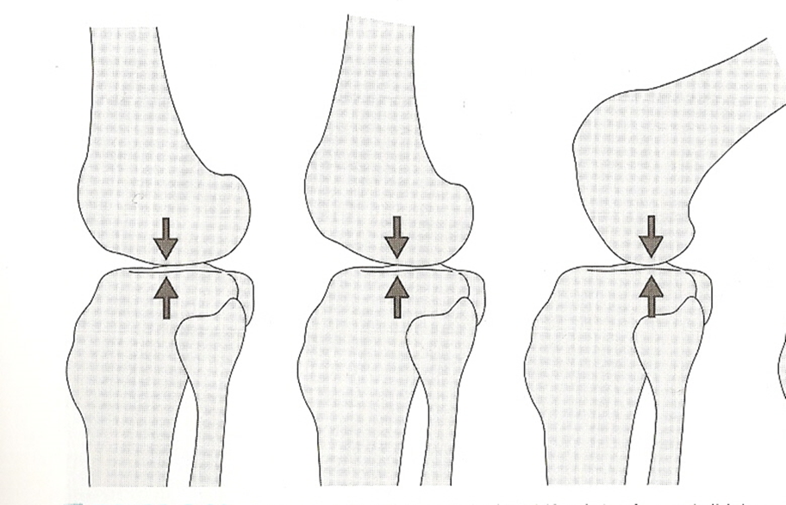
Concept of rollback now understood
As knee flexes, femur rolls backwards on tibia
– a bit like a wheel

Slide 58
What functions does rollback achieve?

Slide 59
What functions does rollback achieve?
Improves moment arm of extensor mechanism
Allows deep flexion

Slide 60
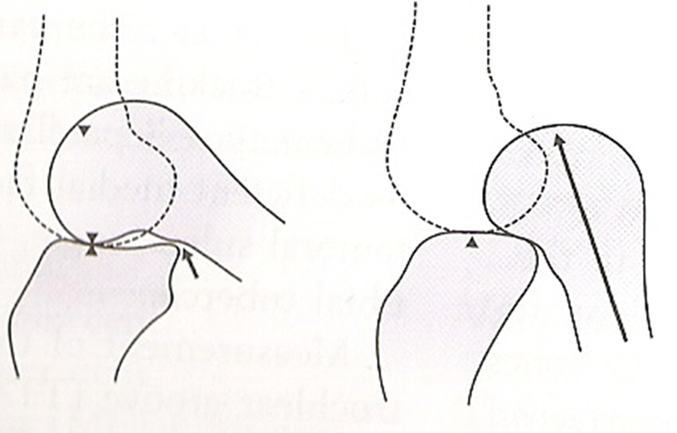
Flexion achieved with/ without rollback

Slide 61
Reality is a combination of rollback/4-bar linkage
Kinematics controlled largely by PCL
Rollback is pronounced in lateral compartment
Medial compartment more like a ball & socket joint
Up to 1cm rollback medially in deep flexion
Thus during flexion, tibia internally rotates w.r.t. femur

Slide 62
And in extension….
Conversely the femur rolls forward and ‘screws home’ during terminal extension
i.e. tibia externally rotates w.r.t. femur
This ensures that knee is locked during stance phase

Slide 63
So what else is there to discuss?
– surely all knee prostheses can just be designed to roll back and rotate during flexion to replicate these biomechanical advantages

Slide 64
TKR design is a compromise
Rollback is possible with many PCL-retaining systems
If this varies between lat./med. compartments rotation can also occur
Comes at the expense of reduced conformity
– Is this a problem?

Slide 65
‘Round on flat’ TKR
Tibial component fairly flat; condylar-shaped femoral component rolls over it
Very limited contact area
Allows considerable amount of rollback/rotation between femur and tibia
Comes at a cost…

Slide 66
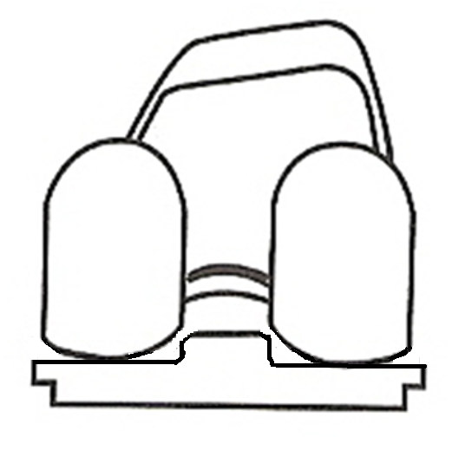
‘Round on flat’ TKR
↑contact stresses
↓stability in all planes
↑lift-off/slamdown
Increases risk of P.E. wear, delamination, catastrophic failure

Slide 67
Another way is to think of a ball on a flat surface – lots of movement but high contact stress

Slide 68
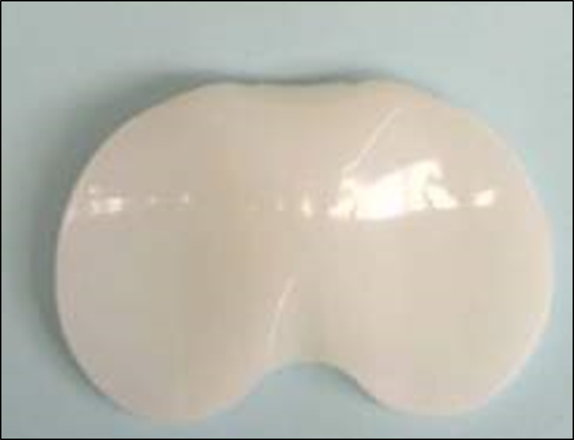
You start off with this…

Slide 69
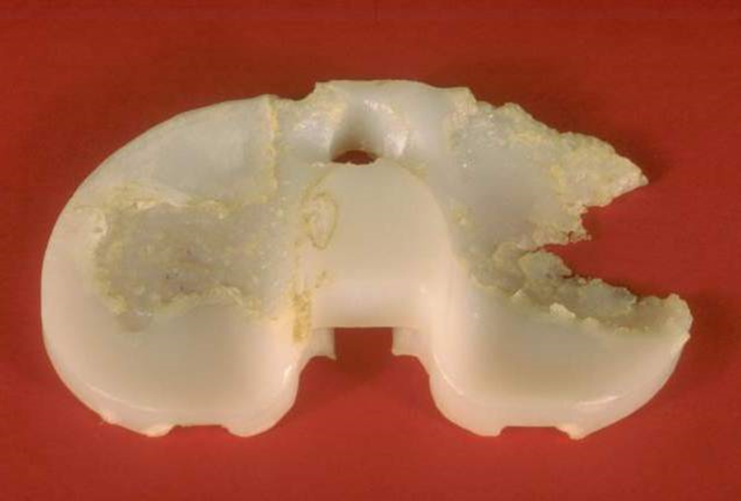
…but you end up with this

Slide 70
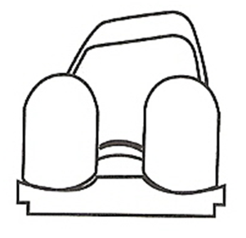
Conversely, with a ‘rounded’
(conforming) tibial tray
↓contact stresses
↑stability in all planes
↓lift-off/slamdown

Slide 71
Going back to our ball image; if the ball sits in a concavity
– high surface area, low stress

Slide 72
So why isn’t increased conformity – with its associated reduced contact stresses – the answer?

Slide 73
Increasing contact surface area
(by increasing conformity) comes at the expense of reduced movement between ball and bearing surface

Slide 74
Increasing contact surface area
(by increasing conformity) comes at the expense of reduced movement between ball and bearing surface

Slide 75
In other words…
High level of conformity between tibial and femoral sides greatly increases contact surface area
Thus stresses at articular surface hugely reduced – along with P.E. wear
But this too comes at a cost

Slide 76
In other words…
Conformity=constraint
– allows virtually no rollback
Femur still ‘tries’ to rollback, tibia still ‘tries’ to internally rotate, flexion limited
Generates huge forces (esp. shear) at bone cement-implant interface → failure

Slide 77
The answer? – compromise
Intermediate contact surface area
Intermediate contact stress
Intermediate inherent constraint
Intermediate interface stresses
Some surgeons favour mobile bearing TKR as means of simultaneously addressing issues of rotation/rollback/conformity

Slide 78
Mobile bearing knees
Polyethylene has concave articulating surface superiorly, underside is flat and move freely over polished metal tibial tray
Allow tibio-femoral rotation
Have high conformity; reduced contact stresses at the metal-polyethylene articulation
Create much lower shear stresses across the bone-cement-prosthesis interface

Slide 79
This means that
The patient feels the knee moving ‘physiologically’ whilst remaining stable
Deep flexion is retained
The polyethylene shouldn’t fail nearly so quickly
The implant fixation shouldn’t fail nearly so quickly
BUT…

Slide 80

Mobile bearing TKRs have consistently higher revision rates than fixed bearing implants
(though remember that revision is a very crude endpoint…)

Slide 81
PCL retaining vs. posterior stabilised
No right answer
If retaining, need to be mindful of PCL; may get it
– too tight
– too loose
– just right
Theoretically more normal kinematics
Some evidence of more normal kinematics with cruciate sacrifice (Udomkiat et al, Clin Orth 2000)

Slide 82
Issues with cam/post
Square peg in a square hole subject to rotational forces
Peg will deform due to creep
Stress transferred to locking mechanism
Once incompetent leads to backside wear

Slide 83
Indications for PS knee
Patellectomy
Rheumatoid arthritis
Fixed varus / valgus knee
Flexion contracture >15°
Excessive roll-back (tight in flexion after MCL & post capsule release)
Insufficient roll-back (lax PCL, posterior sag with trial in-situ)

Slide 84
Increasing levels of constraint
UKR
Mobile bearing total knee
CR total knee
PS total knee
Highly conforming condylar total knee
Rotating hinge
Fixed hinge

Slide 85
Patellofemoral joint
Contact area btw. femur & patella greatest from 20-60°flexion
4 functions of native patella:

Slide 86
Patellofemoral joint
Contact area btw. femur & patella greatest from 20-60°flexion
4 functions of native patella:
– provide congruent surface against femur
– fulcrum to augment quads power
– strong linkage in quads tendon
– protection of knee against direct trauma
Optimal PFJ tracking essential to successful outcome following TKR

Slide 87
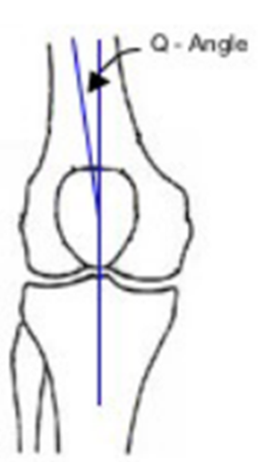
Optimising PFJ tracking
Q-angle; angle between 2 lines:
– ASIS to centre of patella
– centre of patella to tibial tubercle
Excessive Q-angle compromises PFJ tracking post-TKR

Slide 88
Optimising PFJ tracking
Tibial component should be in E.R. (internally rotates tibia, so tibial tubercle is medialised)
Femoral & tibial components should both be slightly lateralised
Patellar button should be medialised (allows patella to sit laterally so ↓Q-angle)

Slide 89
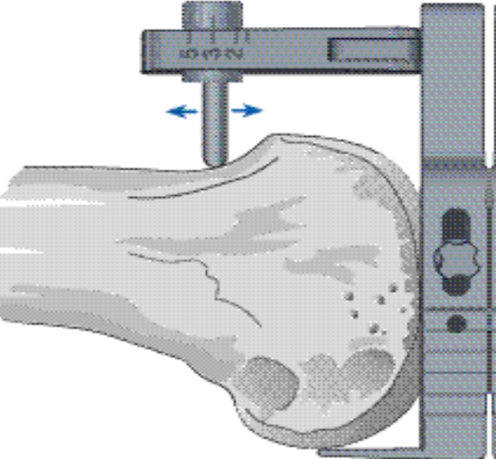
Anterior vs. Posterior referencing

Slide 90
Anterior referencing
Fixed amount of anterior bone resected, posterior condylar resection varied to accommodate size
‘Impossible’ to notch femur
Also ensures PFJ not overstuffed
Tend to down-size, will increase flexion gap
Potential risk of insufficient posterior condylar offset and mid-flexion instability

Slide 91
Posterior referencing
Fixed flexion gap; amount of bone resected anteriorly varies btw. sizes
Maintains flexion/extension space equality
Exact femoral size no problem
In between sizes must compromise
Small notches not a problem, big ones are
Post. referencing; up-size to avoid notching; risk of ‘overstuffing’ patello-femoral joint

Slide 92
To summarise
Low conformity allows rollback and tibial internal rotation as the knee flexes, but at the expense of poorer wear properties
Greater conformity provides better wear characteristics, but at expense of increased shear forces between TKR, cement and bone
Cruciate retaining v. sacrificing – no right answer though need to know specific indications
PFJ tracking crucial to successful outcome

Slide 93
Further reading:
Freeman M, Pinskerova. The movement of the normal tibio-femoral joint. J Biomech 2005;35:68-75
Macquet P. Biomechanics of the Knee. Springer 2012 (2nd Edition)
Morgan H, Battista V, Leopold S. Constraint in primary total knee arthoplasty. J Am Acad Orthop Surg 2005;13:515-24
Urwin et al. Gait analysis of fixed bearing and mobile bearing total knee prosthese during walking. Knee 2014;21(2):391-5

Slide 94
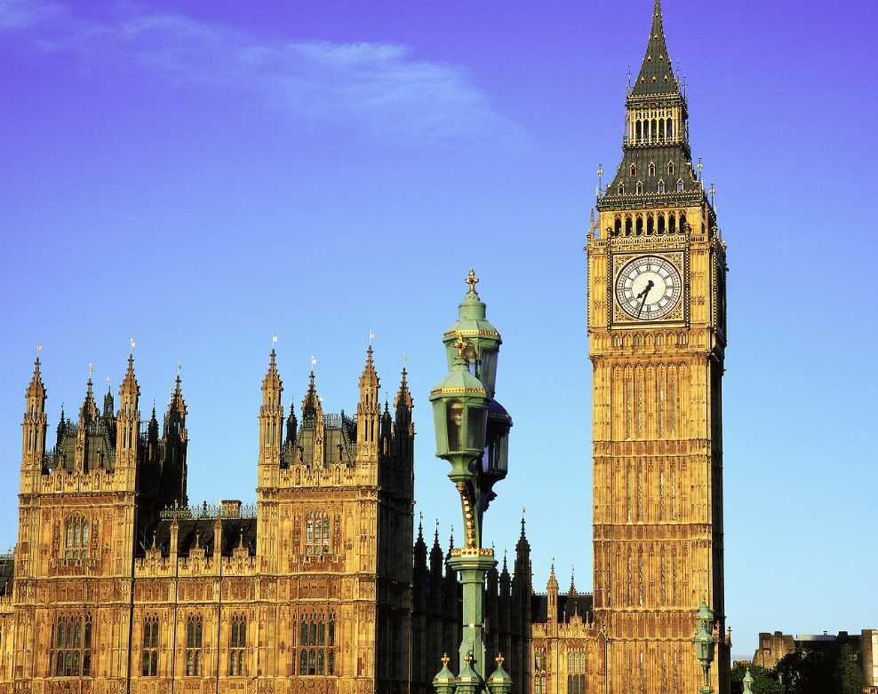
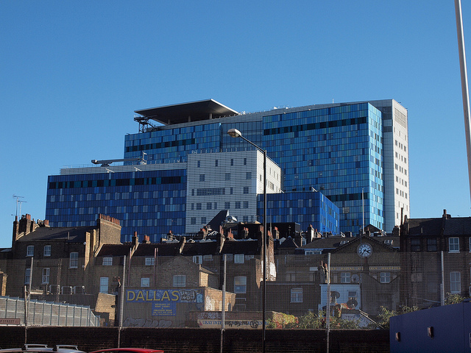
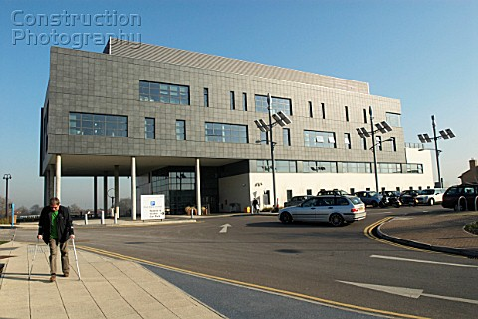
ANY QUESTIONS?

Slide 95
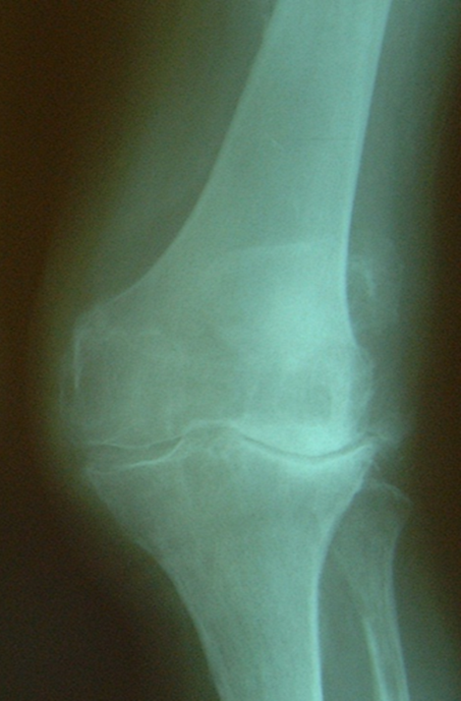
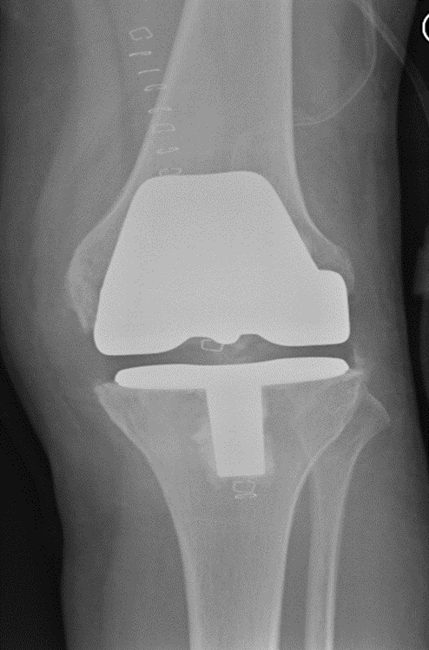

Thankyou for listening

