Slide 1
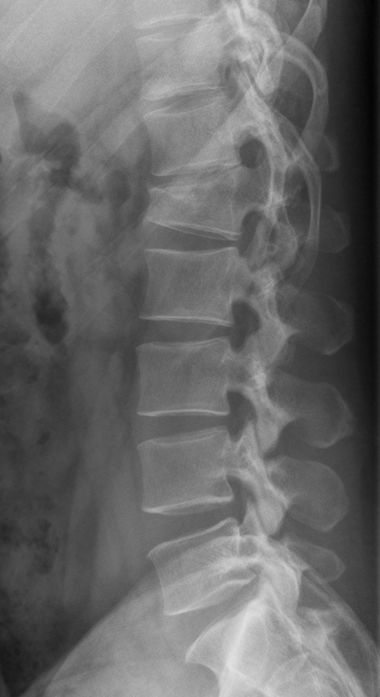
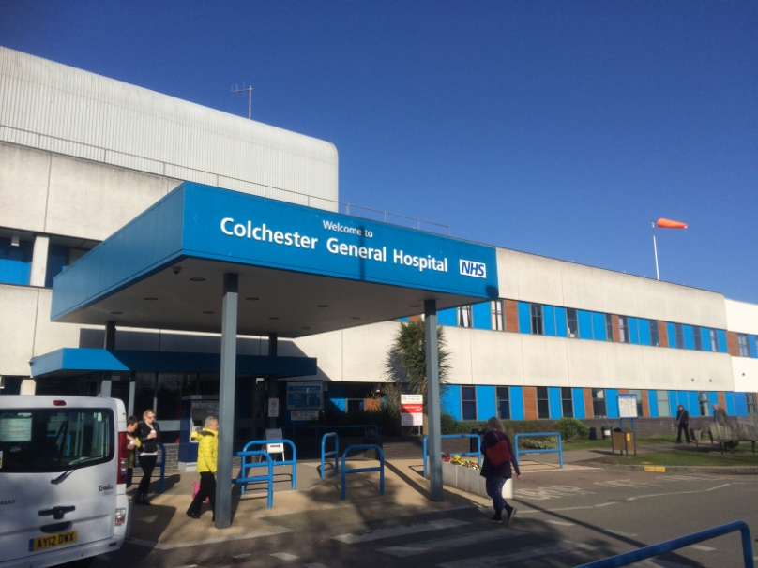
TLSO bracing in thoracolumbar fractures
- An audit of practice
Iris HY Kwok Mohammed Al-Azzawi Sivakolundu P Suresh
Mark Blackman
Department of Trauma and Orthopaedics
Colchester General Hospital

Slide 2
Introduction
Thoracolumbar fractures
The commonest site of spinal injuries (30-60%)
M:F = 4:1
52% occurs between T12 and L1
Associated injuries occur in up to 50% of patients (eg. Head injuries, intrabdominal viscera, pulmonary, vascular etc)
Types:
Wedge, compression, burst, dislocation
Treatment guided by fracture stability

Slide 3
Conservative treatment of thoracolumbar fractures
Indications:
No neurological deficit
‘Stable’ injuries: acceptable alignment, compression <50% of vertebral body height, angulation <20°
Significant medical comorbidities, poor bone quality
Analgesia, bedrest, mechanical thromboprophylaxis
Thoracolumbosacral orthosis (TLSO) bracing
– recommended 3/12 in total
Rehabilitation and PT

Slide 4
Issues with conservative treatment
Complications from prolonged bed rest
Complications from bracing
eg. Pressure areas, resp function
↑hospital LOS (brace care on discharge)

Slide 5
Guidelines
None!

Slide 6
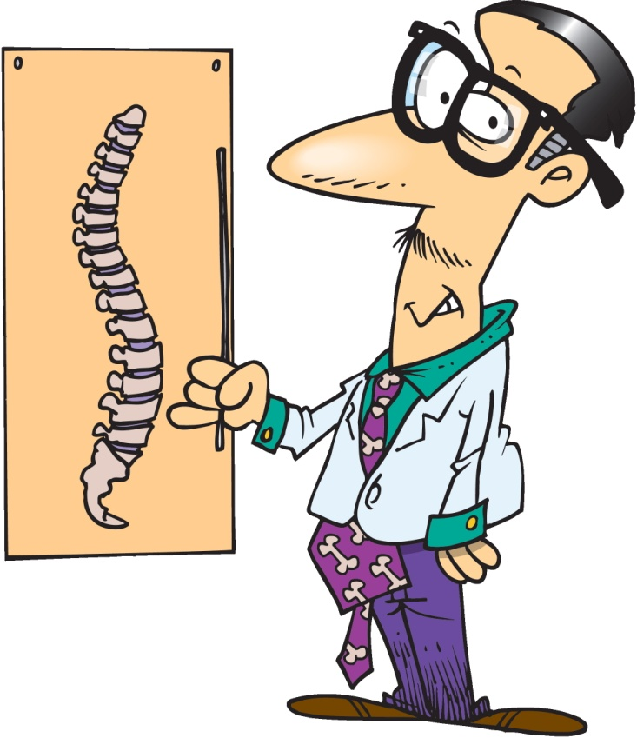
Aim
Audit current practice
Caseload and patient demographics
Nature of spinal injuries
Length of bed rest
Hospital LOS
Complications of treatment

Slide 7
Methodology
All patients admitted with thoracolumbar fractures
17-month period (Feb 2014 - June 2015)
Review of patient notes
Review of radiological investigations on PACS
Exclusion criteria:
Surgery
Contraindication/inability to tolerate bracing
Death
Inclusion criteria:
Conservative treatment with TLSO bracing
Notes:
Contraindiations/inability to tolerate bracing: other injuries eg rib fractures, body habitus, other medical comorbidites (eg. Palliative care for ca)

Slide 8
Results
69 patients admitted with thoracolumbar fractures
11 patients excluded
58 patients
Notes unavailable for 7 patients
51 patients analysed

Slide 9
Results (n = 51)
25M: 26F
Mean age 60 yrs old (range, 17-95)
Frequency
Fracture level

Slide 10
No. of columns disrupted

Slide 11
Results (cont’d)
Associated injuries (5):
Sternum, distal radius, ribs, fibula, scalp laceration
Continguous spinal fractures (2)
% vertebral height collapse
Pre-brace mean: 31% (range, 5 to 50)
Post-brace mean: 38% (range, 5 to 85)
Mean increase in collapse 7%
% vertebral body height collapse
= (Average height of 2 adjacent vertebrae - Height of fractured vertebra)/ Average height of 2 adjacent vertebrae x 100%

Slide 12
Results (cont’d)
Mean no. of days of strict bed rest: 7 days (range, 0 to 43)
i.e. Time from admission to TLSO fitting
(Exception: non-compliant patients with unstable injuries)
Mean hospital LOS: 15.8 days (range, 0 to 114)
Complications (9)
UTI (6)
LRTI (1)
Bowel pseudo-obstruction, conservatively managed (1)
Massive PE (1)
Notes:
Contraindiations/inability to tolerate bracing: other injuries eg rib fractures, body habitus, other medical comorbidites (eg. Palliative care for ca)

Slide 13
Discussion points
1. Do we all agree with our current treatment regime?
(? Strength of evidence for bracing)
Is it feasible to expedite fitting of TLSO braces to reduce time of bed rest?
If prolonged strict bed rest is required, when is it ‘safe’ to start clexane?
(Lack of) Support of TLSO use for the elderly on discharge – significantly increases hospital LOS
Suggestions for improvement?

Slide 14
References:
Chapman JR, Oskouian RJ (2014). Nonoperative care or noncare for thoracolumbar spine fractures? Questioning the unthinkable. The Spine Journal 14:2565-7
Chang V, Holly LT (2014). Bracing for thoracolumbar fractures. Neurosurgical focus, 37(1), E3
Giele BM, Wiertsema SH, Beelen A et al. (2015). No evidence for the effectiveness of bracing in patients with thoracolumbar fractures. Acta Orthopaedica 80:2, 226-32
Bailey CS, Urquhart JC, Dvorak MF et al. (2014). Orthosis versus no orthosis for the treatment of thoracolumbar burst fractures without neurological injury: a multicenter prospective randomized equivalence trial. The Spine Journal 14: 2557-64
BMJ Best Practice: ‘Thoracolumbar spine trauma’
http://bestpractice.bmj.com/best-practice/monograph/820/treatment/step-by-step.html

