Slide 1
Surgical Approaches to the Shoulder
Mr O. Obakponovwe
ST3
RLH

Slide 2
Approaches to the Shoulder
Open Vs Arthroscopic
Open Approaches;
Anterior (Deltopectoral)
Lateral
Posterior
Anterolateral

Slide 3
Approaches to the Shoulder
Patient Position
Supine
Sandbag
30* head elevation
Beach Chair
Torso/ Hip positions
Head strap

Slide 4
Approaches to the Shoulder
Deltopectoral approach:
Indications;
-Proximal humerus fractures
-open soft tissue reconstructions
Shoulder arthroplasty
Incision:
- Landmarks: Coracoid, Deltopectoral grove

Slide 5
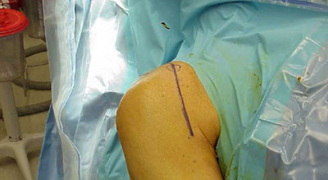
Approaches to the Shoulder

Slide 6
Approaches to the Shoulder
10-15cm incision
Tip of coracoid distally following the deltopectoral grove
Internervous plane: Axillary/ Pectorial nerves
Superficial dissection
Deltopectoral fascia
Cephalic vein “strip of fat” mobilised
Retract deltoid and Pec major

Slide 7
Approaches to the Shoulder
Deep dissection
Short Head Biceps and coracobrachialis retracted medially
Fibers of the subscapularis
Anterior joint capsule
Structures at risk
Musculocutanoeus (5-8 cm distal to coracoid)
Axillary n (distal to subscapularis tendon)
Cephalic vein

Slide 8
Approaches to the Shoulder
Lateral Approach(Deltoid splitting)
Access/Indications:
Lat. Proximal Humerus
Rotator cuff
Subacromial space
No internervous plane

Slide 9
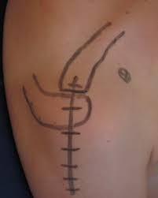
Approaches to the Shoulder

Slide 10
Approaches to the Shoulder
5cm incision: tip of the acromion distally
Superficial dissection
Split deltoid in line with fibers
Stay suture distal end of incision
Deep dissection
Expose/ excise the subacromial bursae
Expose the rotator cuff and proximal humerus

Slide 11
Approaches to the Shoulder
At risk structures
Axillary nerve
Runs 5-7cm distal to the acromion
Second window for more distal access

Slide 12
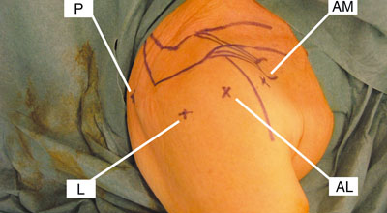
Approaches to the Shoulder
Arthroscopic

Slide 13
Approaches to the Shoulder
Arthroscopic
Position
Beach chair ( advantage: convert + venous pressure)
Lateral decubitus
Traction +/-
Portals
Primary (P/A/L)
Secondary portals

Slide 14
Approaches to the Shoulder
Arthroscopic
Posterior Portal;
- Primarily a viewing portal
2cm inferior/ 1cm medial to PLC of acromion
Trocar direction: lateral coracoid
Anterior portal;
Both viewing and working portal
Made under direct vision
Needle lateral to coracoid / anterior to ACJ

Slide 15
Approaches to the Shoulder
Arthroscopic
Lateral Portal;
- Access subacromial area
1-2cm distal to lateral edge of acromion
Through deltoid
Risks
-Arise from poor portal placement
Posterior: Axillary n(inferior)/ Suprascapular n(medial)
Anterior: Cephalic v (lateral)/ Musculo. N(inferior)

Slide 16
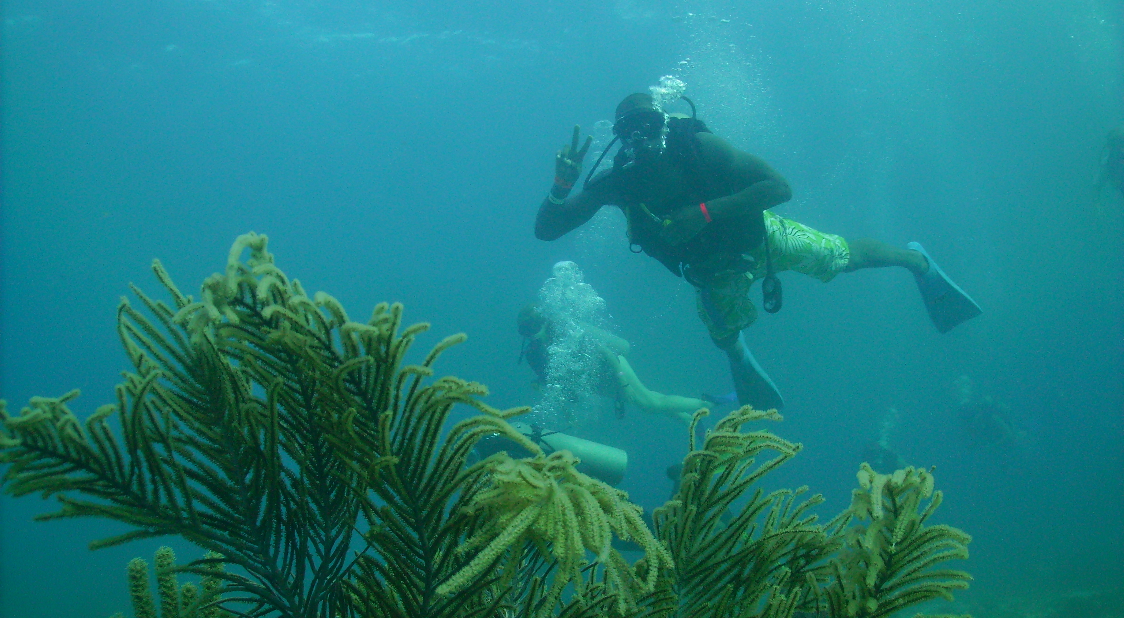
Approaches to the Shoulder
Thank you

