Slide 1
Current Concepts in Prehospital Trauma Care
20th November 2012
Combined ED / Ortho Teaching
Notes:
Welcome
Background
Passion for PHC and Trauma
Why? 40000 pts per year, age 1 – 5, sad thing report after report shows how bad it is

Slide 2
Aim
Background to who / what shapes prehospital care
Spotlight few specific issues
Contextualise with international comparisons
History

Slide 3
History
1946 NHS Act
  Local authorities were required to provide ambulances 'where necessary'.
1966 Millar Report
  Treatment as well
Hospitals go back a long way
  Eg Barts 1123
  Medical Act 1858
    List doctors, control medicines

Slide 4
Ambulance Service Provision
1946 - 1974
  County council / Home office
After 1974
  Ambulance service within the NHS

Slide 5
Take home message……..
Heritage, understanding and capability of PHC………. lags behind in-hospital practice
Important consequences for the patient

Slide 6
General Medical Council
Regulates medicine in UK via Medical Act 1983
2011 PHEM became legal sub-specialty 2011
  Emergency Medicine
  Anaesthesia
Hon Professor of Trauma & Prehospital Emergency Medicine
  Prof David Lockey

Slide 7
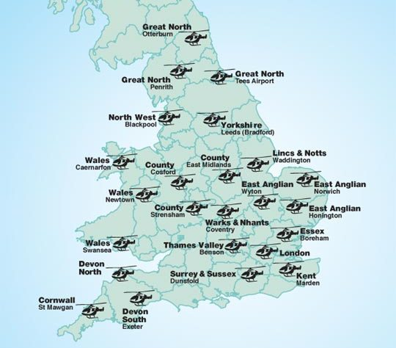
UK “network”
16 air ambulance charities
24 helicopters
Total UK coverage
Day light service
17,500 missions per year
£25 million

Slide 8
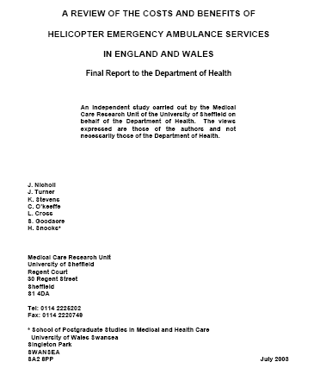
Cost QALY £6-20,000
Below NICE £30,000 threshold
Assumes no other benefits

Slide 9
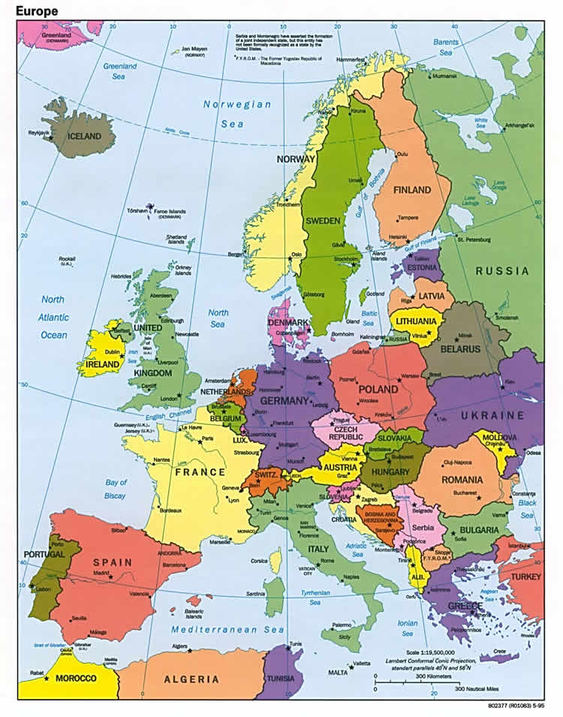
Europe:
Dominated by doctor led (often consultant delivered) PHC

Slide 10
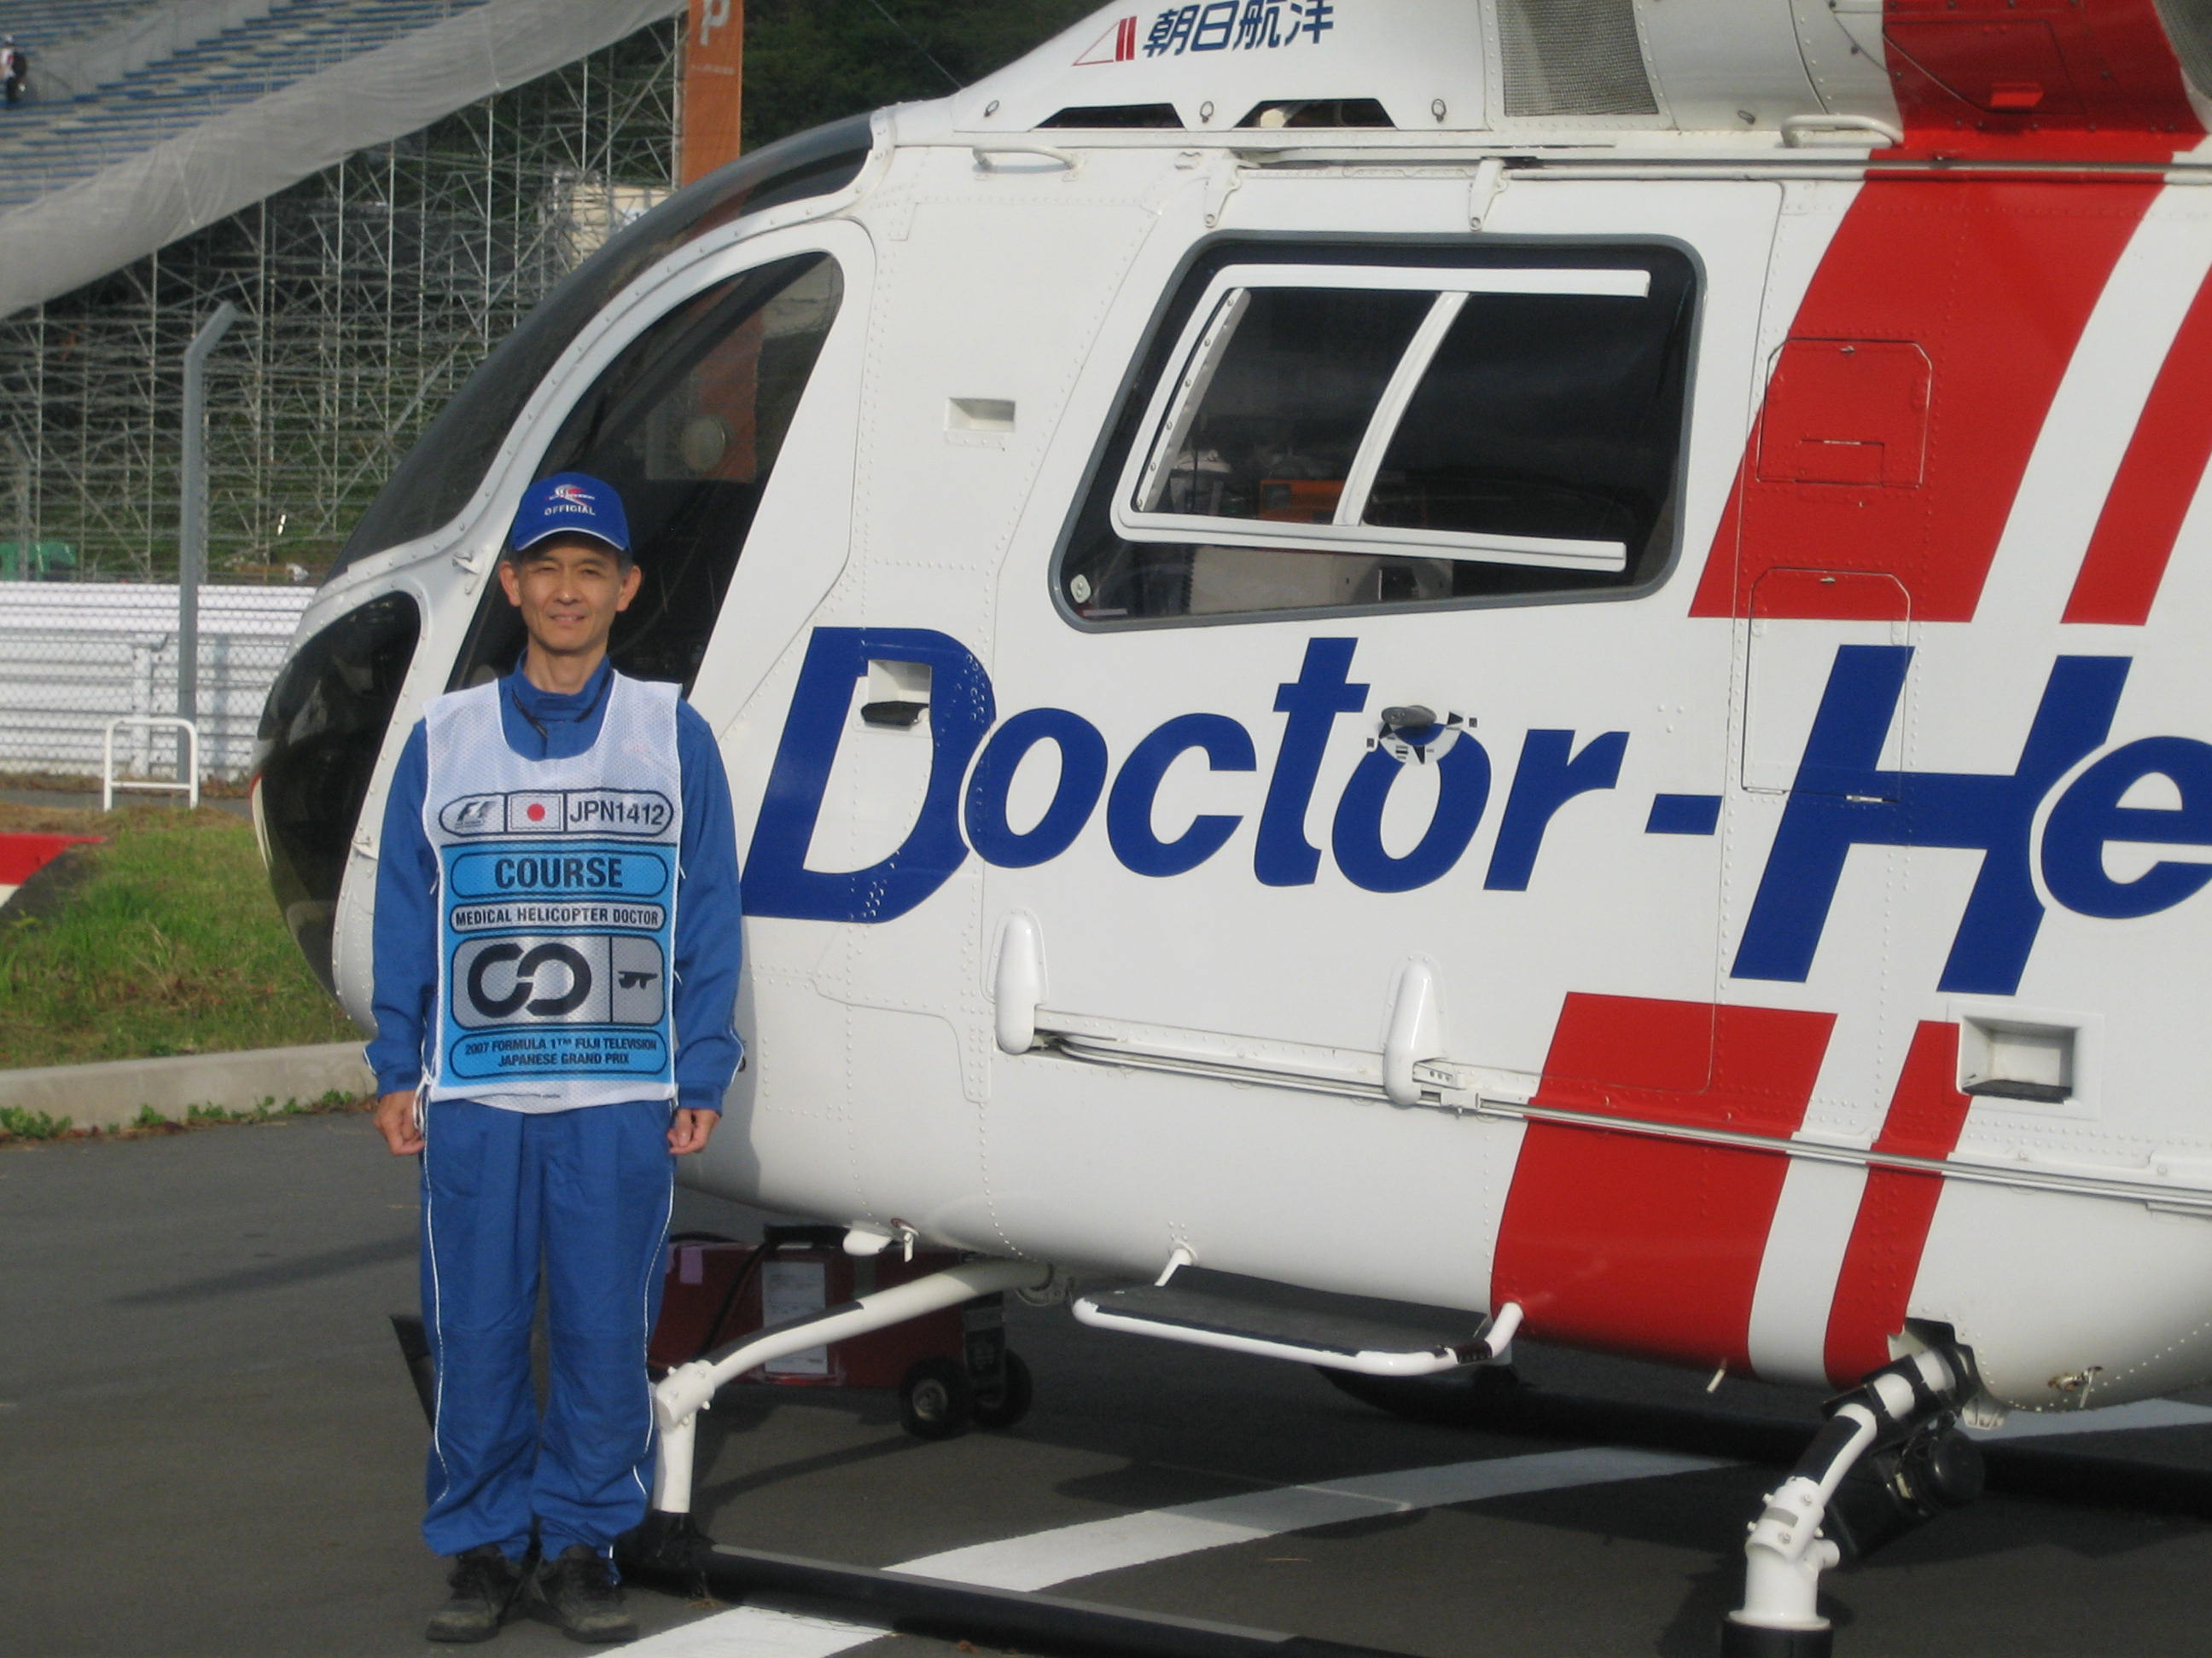
Notes:
Surgeon, aneasthetist, Intensivist

Slide 11
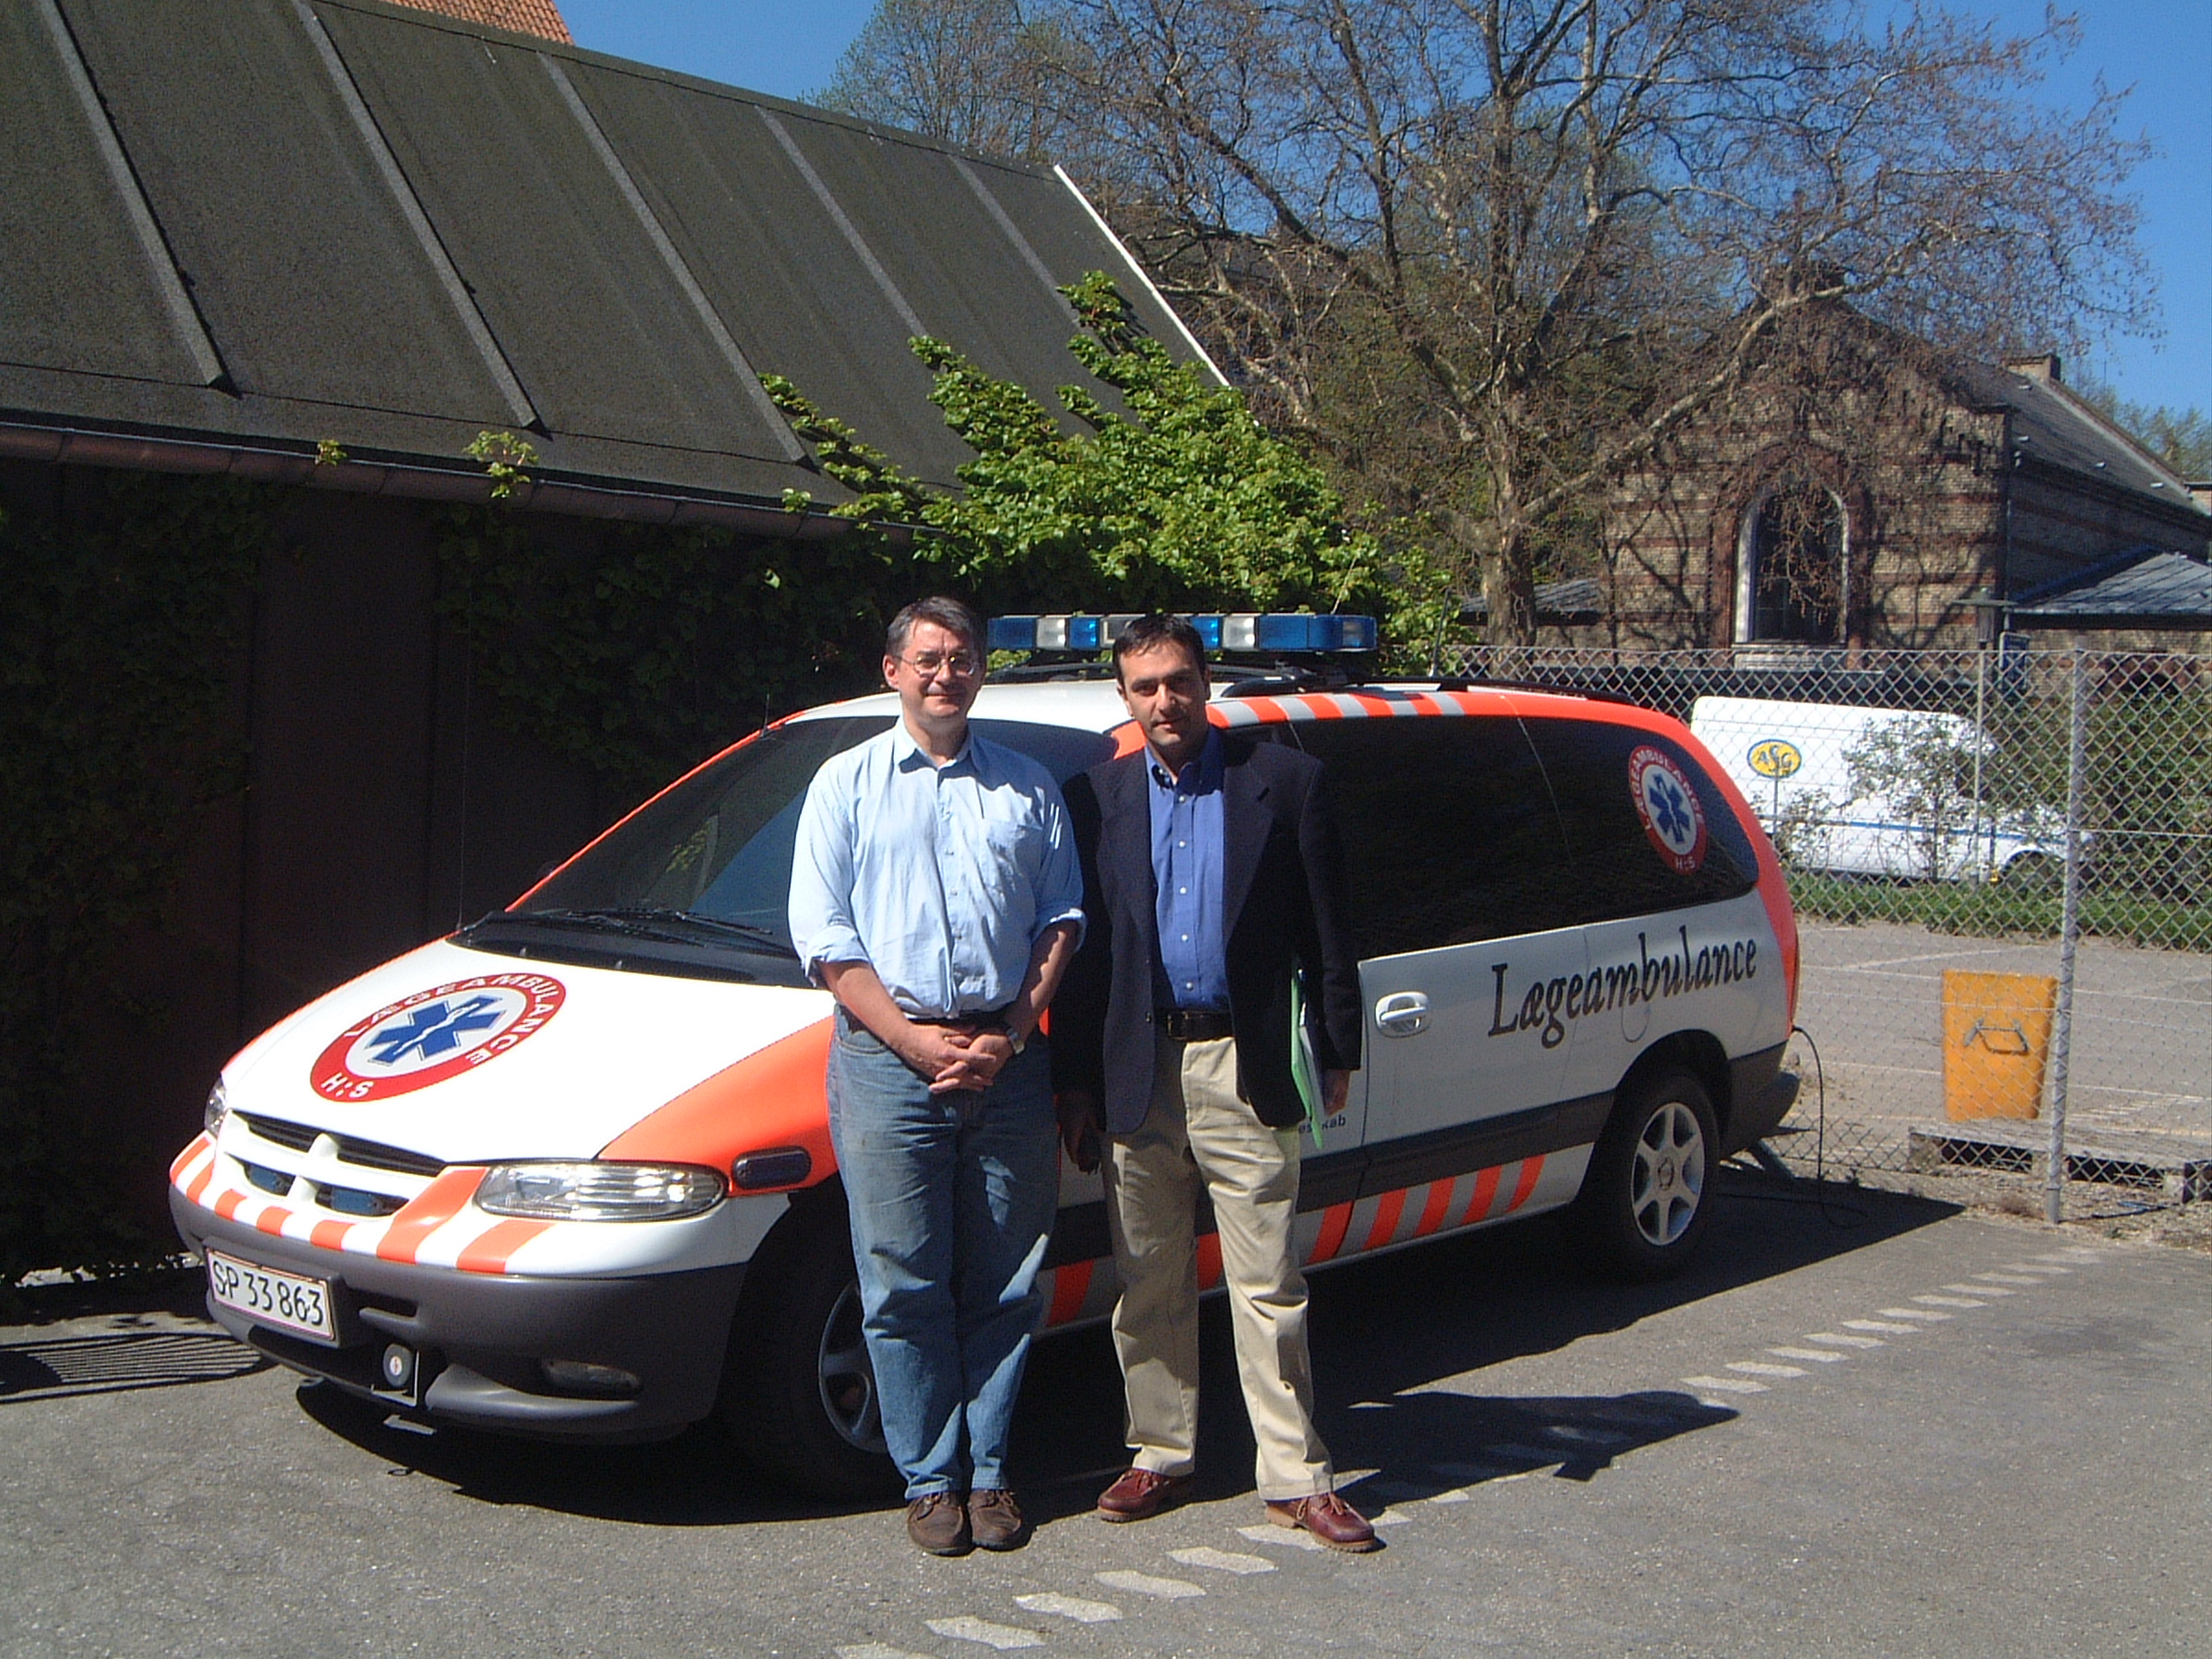
Notes:
ITU for 3 years before car service

Slide 12
Golden Hour

Slide 13
Prehospital Time:

Slide 14
Some specific issues….

Slide 15
Bleeding

Slide 16
Relationship between patient movement , handling and bleeding

Slide 17
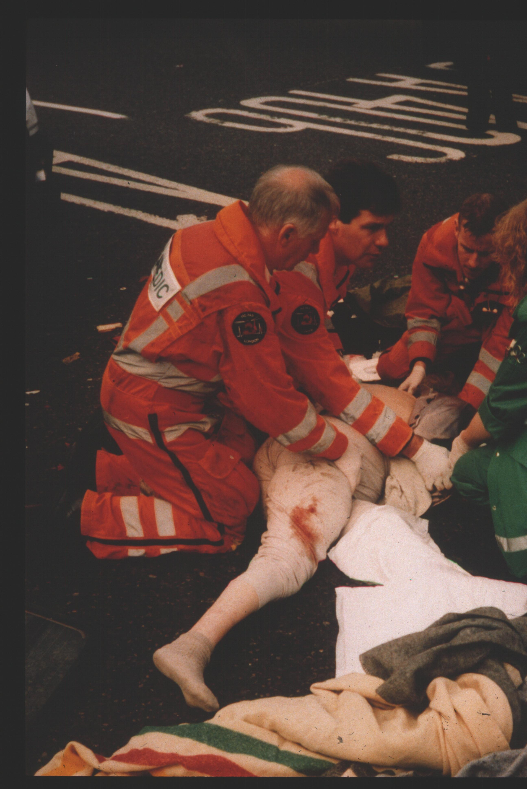
Moving patient like this associated with a fall in BP

Slide 18
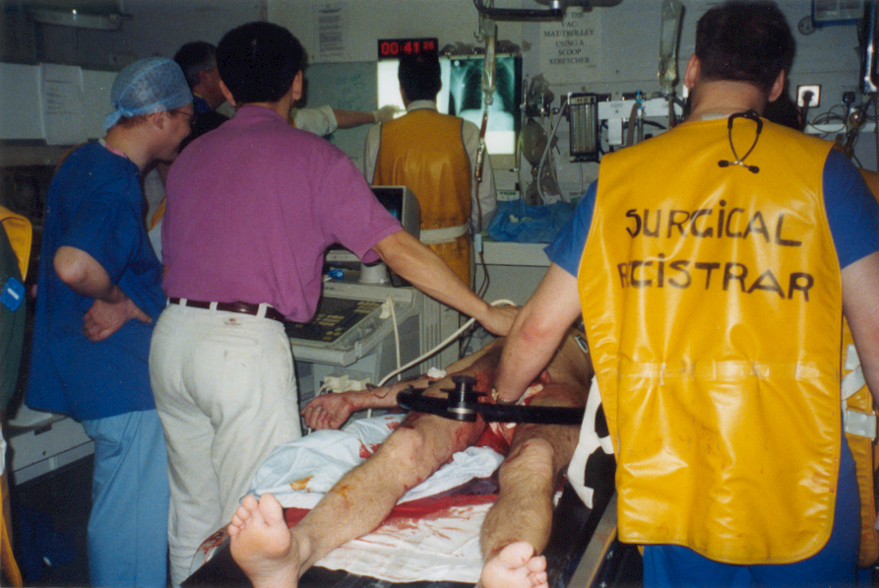
ATLS “springing” of the pelvis
Produced falls in BP

Slide 19
In resus characteristic times when BP fell
packaging for scanner
Log rolling
spinal examination

Slide 20
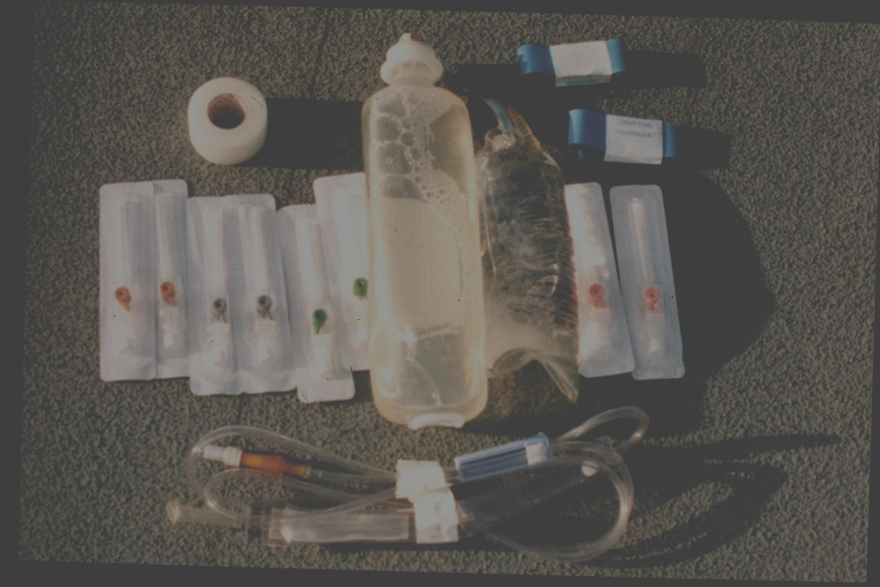
?
“Not an issue just top them up with some gelo”!!??

Slide 21
Moving patients was not good

Slide 22
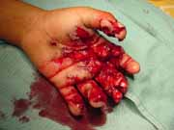

Slide 23
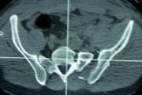

Slide 24
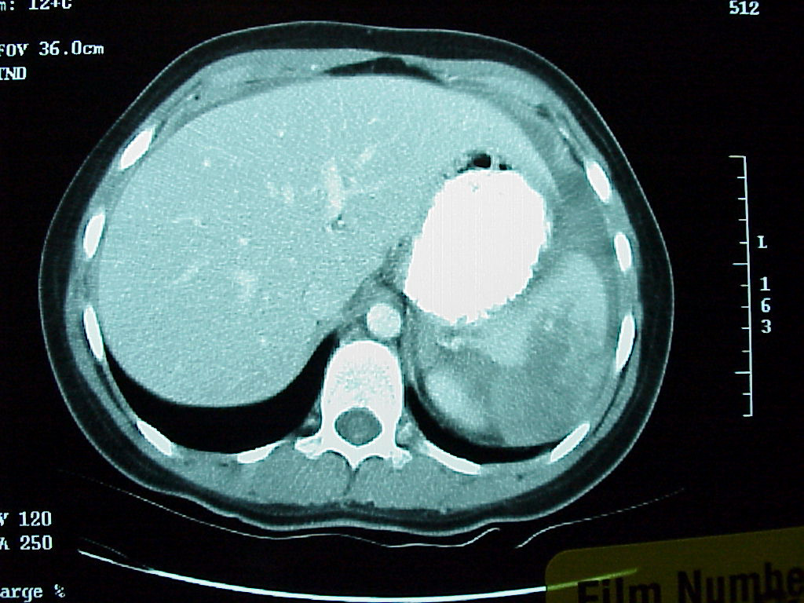

Slide 25
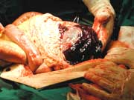

Slide 26
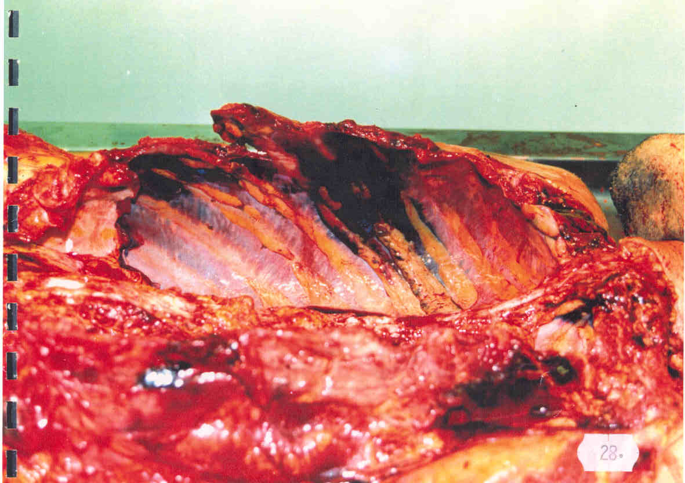

Slide 27
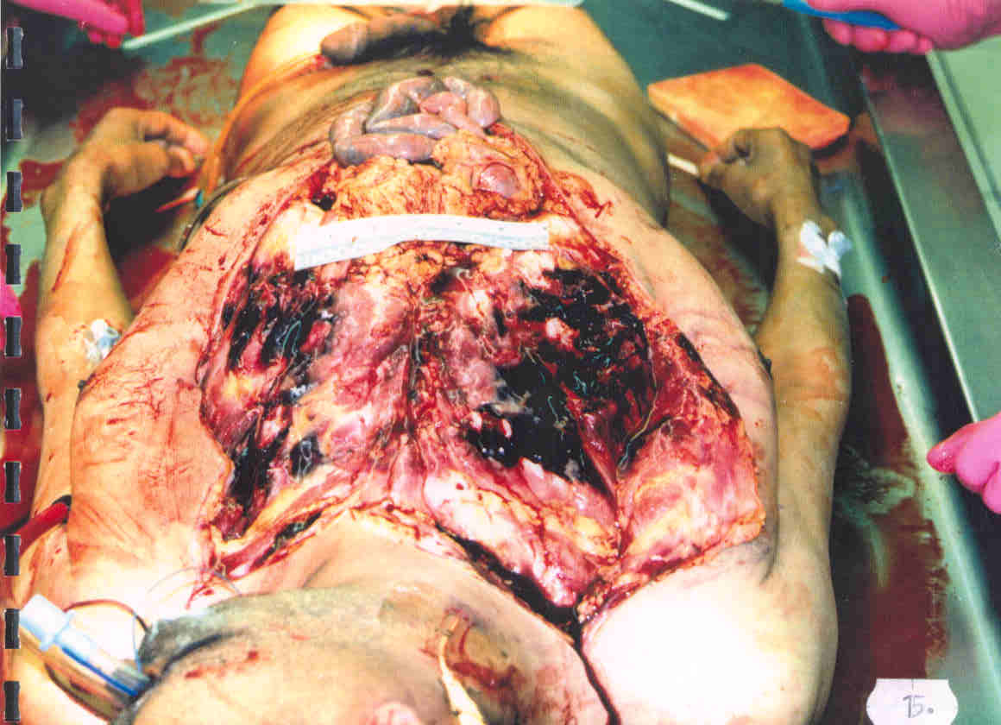

Slide 28
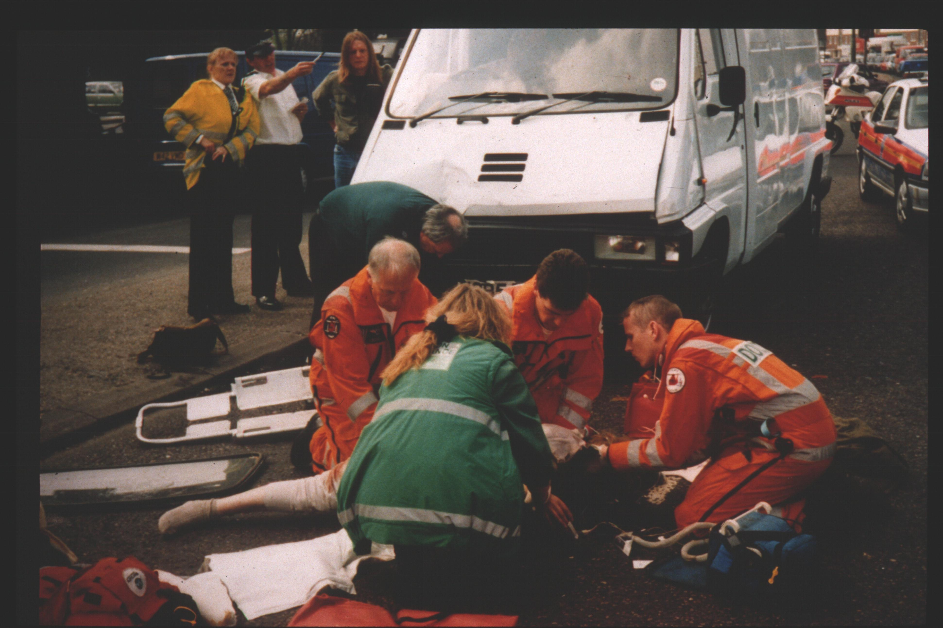
Case study

Slide 29
150 degrees of motion

Slide 30
Net effect
Dislodgement of clot
Loss of tamponade
Movement at
Sacro iliac joint
Fall in blood pressure

Slide 31
RSI
On Spinal Board
150º
90º
90º
Total = 330º
At hospital
On Spinal Board
90º
90º
Grand Total = 510º

Slide 32
Could things be better?

Slide 33
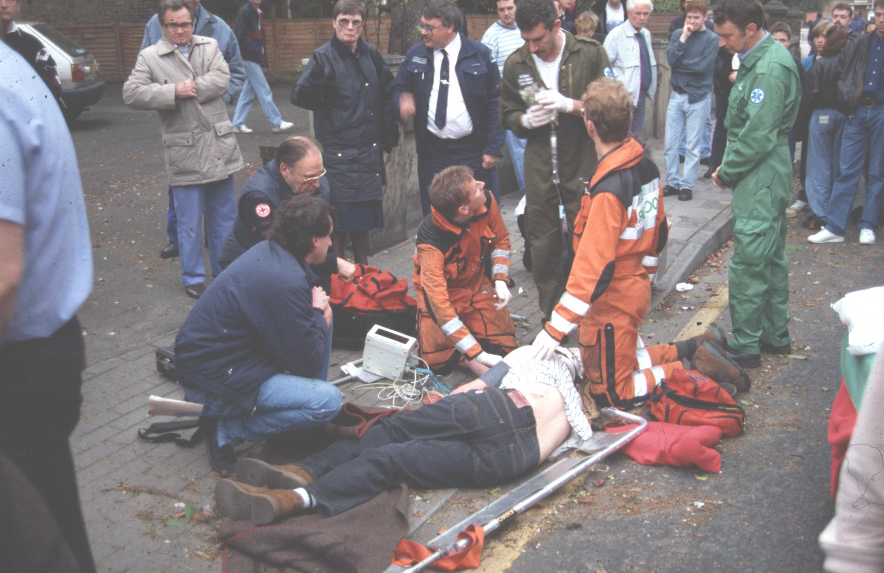
Roll onto half a scoop blade when ready to RSI

Slide 34
RSI
Left blade in
Right blade in
150º
10º
10º
At hospital
On scoop
Counter traction
Left blade out
Right blade out
Total = 170º
Total = 170º
0º

Slide 35
Board and early roll
510 degrees
70% reduction in movement
Scoop and delayed roll
170 degrees

Slide 36
Handling:
Should be based on patient need
Recognises the whole of the patient pathway
Not what suits individual practitioners

Slide 37
Handling Strategy
Promote clots
Promote clot stability
Recognise the first clots probably the best
Is part of haemorrhage control policy
Is part of IV fluids policy

Slide 38
Pre-hospital Blood Pressure
“Permissive approach”
  Large number animal studies
  Limited number human studies
Aim for systolic BP of 80mmHg
  (100mgHg with neuronal injury)
250ml boluses crystalloid
  moving toward blood

Slide 39
  Effect of blood pressure on hemorrhage volume and survival
  in a near-fatal hemorrhage model incorporating a vascular injury.
  Stern SA, Dronen SC, Birrer P, Wang X
  Department of Emergency Medicine, University of Cincinnati College of Medicine, Ohio.

Slide 40
Stern et al
27 pigs fully instrumented
Aortotomy wire for uncontrolled haem
Volume resuscitated to 40,60 80 MAP

Slide 41
Results (n= 27)

Slide 42
Many studies with different definitions of hypotensive resus:
To 50% of normal MAP
Delay in timing of normal volume resus
Delay and volume difference 1-3ml/kg
CI to 60 cf 100% baseline
No fluid cf 30-60ml/kg
Not necessarily trying for normal indices

Slide 43
Features of Normal (High) Volume Resuscitation in Animal Work
Higher blood loss
Higher mortality
Increases BP and CO but not perfusion
True for arterial, venous and parenchymal uncontrolled haemorrhage)

Slide 44
Compelling Feature of Literature
Heterogeneous animal population
Heterogeneous methodology
Heterogeneous definition
Produce similar results

Slide 45
Possible Theories
Raising the blood pressure antagonises clot formation or “pops the clots”
HVR promotes hypothermia which effects coagulation
Dilutes clotting factors
Increased cytokine release

Slide 46
Immediate versus delayed fluid resuscitation for hypotensive patients with penetrating torso injuries.
Bickell WH, Wall MJ Jr, Pepe PE, Martin RR, Ginger VF, Allen MK, Mattox KL
Department of Emergency Services, Saint Francis Hospital, Tulsa, Okla.
N Engl J Med 1994 Oct 27;331(17):1105-9.

Slide 47
Bickell: Results (n=598)

Slide 48
  Delayed fluid resuscitation of head injury and uncontrolled hemorrhagic shock.
  Bourguignon PR, Shackford SR, Shiffer C, Nichols P, Nees AV
  Department of Surgery, University of Vermont College of Medicine, Burlington 05401, USA.
  “Cerebral pressure autoregulation is sufficiently intact following head injury to maintain regional cerebral oxygen delivery without fluid resuscitation”

Slide 49
NICE Guidance - Prehospital
Adults and children
Includes poly trauma (ie some heads)
Fluids with loss of radial pulse blunt
Fluids with loss of central penetrating
Fluid = 250ml crystalloid bolus

Slide 50
cABC or ABC
Military concept
  Assessment & treatment priorities at the point of wounding
Applicability to civilian population unclear

Slide 51
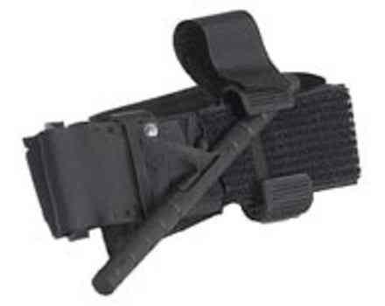
Tourniquets
Military experience
  Blast experience
? a real effect
  AIS for amputation
  Personal experience
Penetrating injury

Slide 52
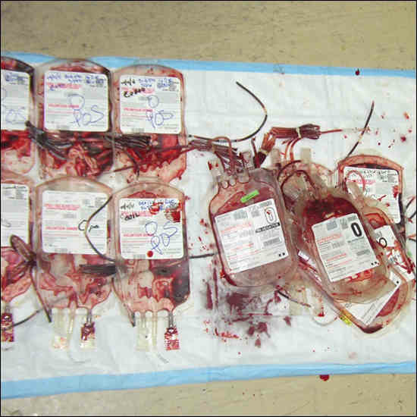
Prehospital Blood
Coagulopathy starts at scene
Aggressive coagulation management
Code Red
  Prehospital notification

Slide 53
Collars / Spinal Immobilisation
Standard of care

Slide 54
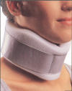
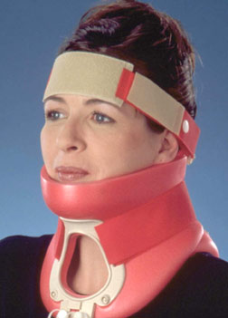



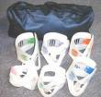
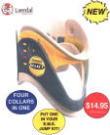


Splintage devices - collars

Slide 55
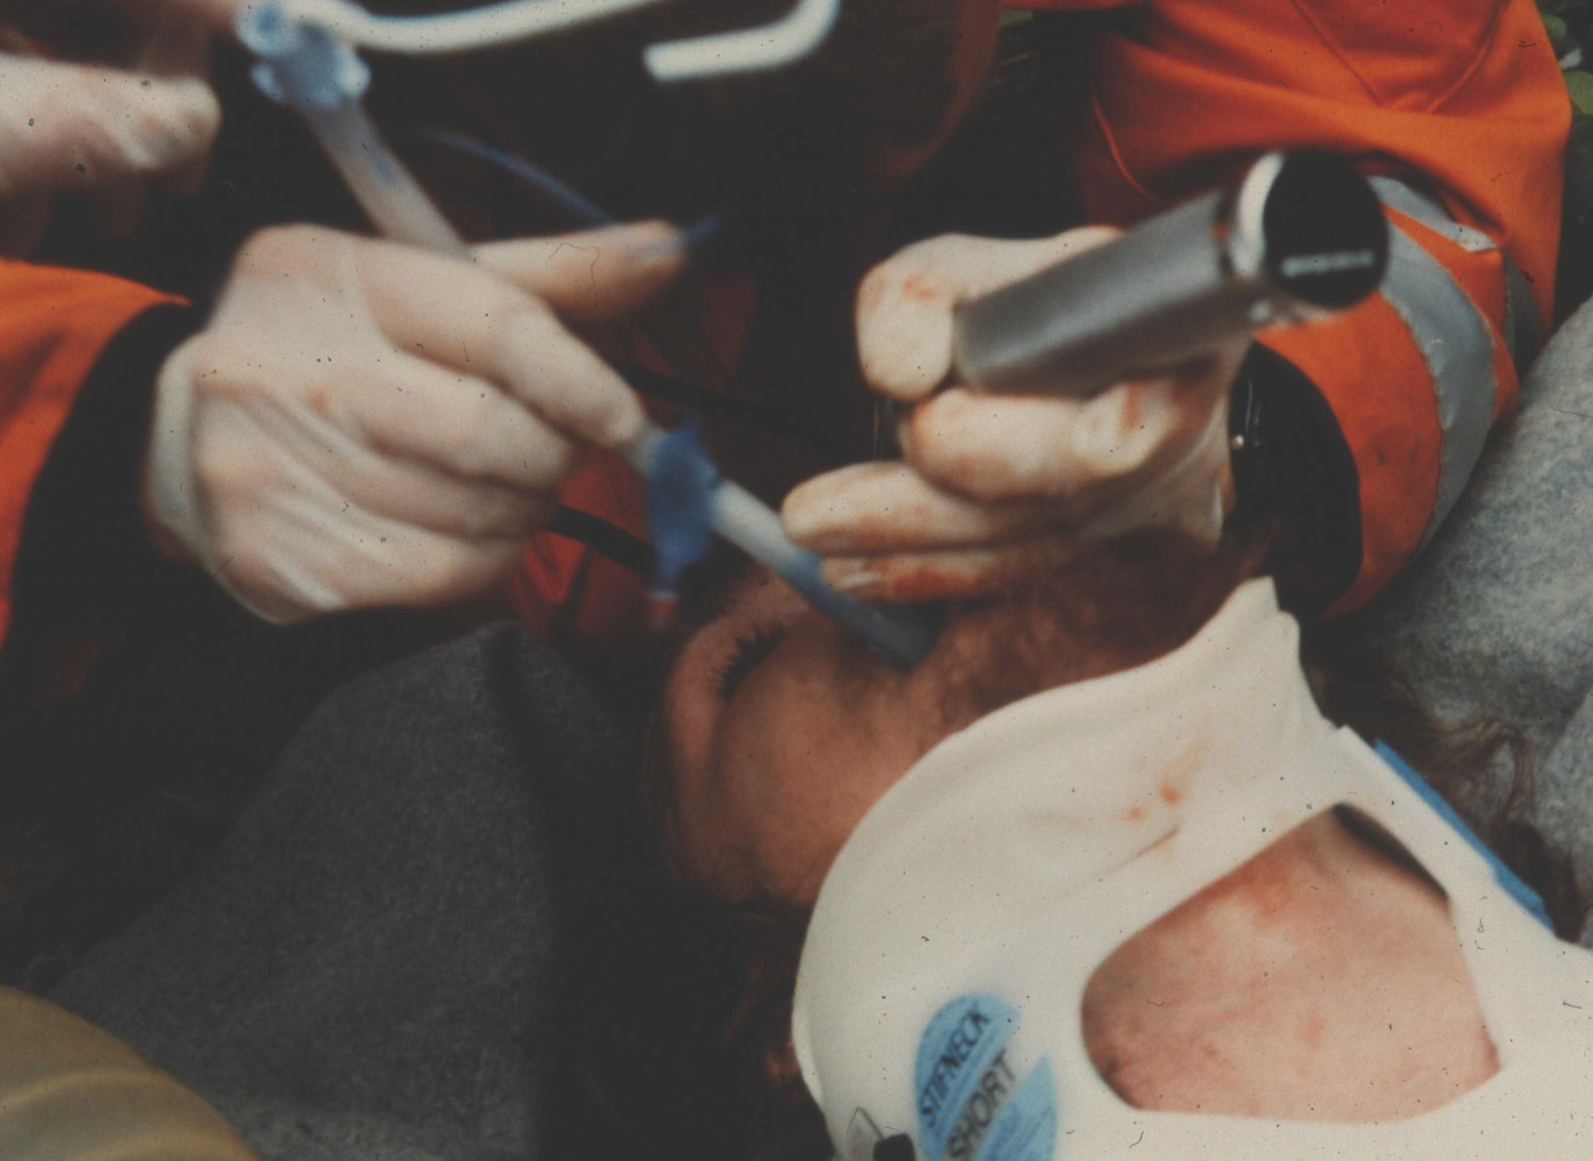
Rigid Cervical Collars (RCC)
Clinical assessment
Goniometry
Photography
Radiography
Cinematography
CT / MRI
80 – 90% reduction
in c spine movement

Slide 56

Rigid Cervical Collars + other
90 - 95% reduction
in c spine movement
Other = KED, RED, Short spinal board

Slide 57
Collars
Evidence base is weak

Slide 58
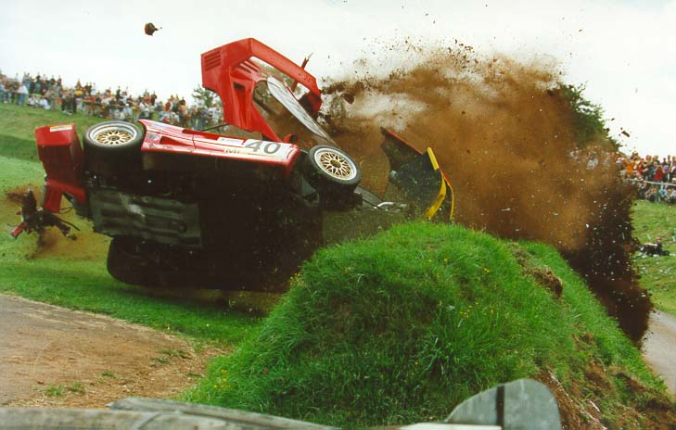
Displacement of cervical spine is maximal at time of impact
Hauswald M. Curr Opin Crit Care 2002; 8: 566-570
Notes:
It is intuitive that the maximal movement of the cervical occurs at the moment of impact.
Careful movement is unlikely to create more displacement.
Cases of deterioration do occur during transport, but these more likely associated with reduced spinal cord perfusion and/or oedema

Slide 59
How important is movement?
Dog study indicates need compression of > 50% of cord diameter for > 1 hr for permanent injury
  Delamarter RB. J Bone Joint Surg Am 1995;77:1042-9
Notes:
Risk of injury to the spinal cord is probably a legend – but cord is at risk from poor patient positioning and low perfusion pressure

Slide 60
Side Effects
Pressure necrosis
Airway obstruction

Slide 61
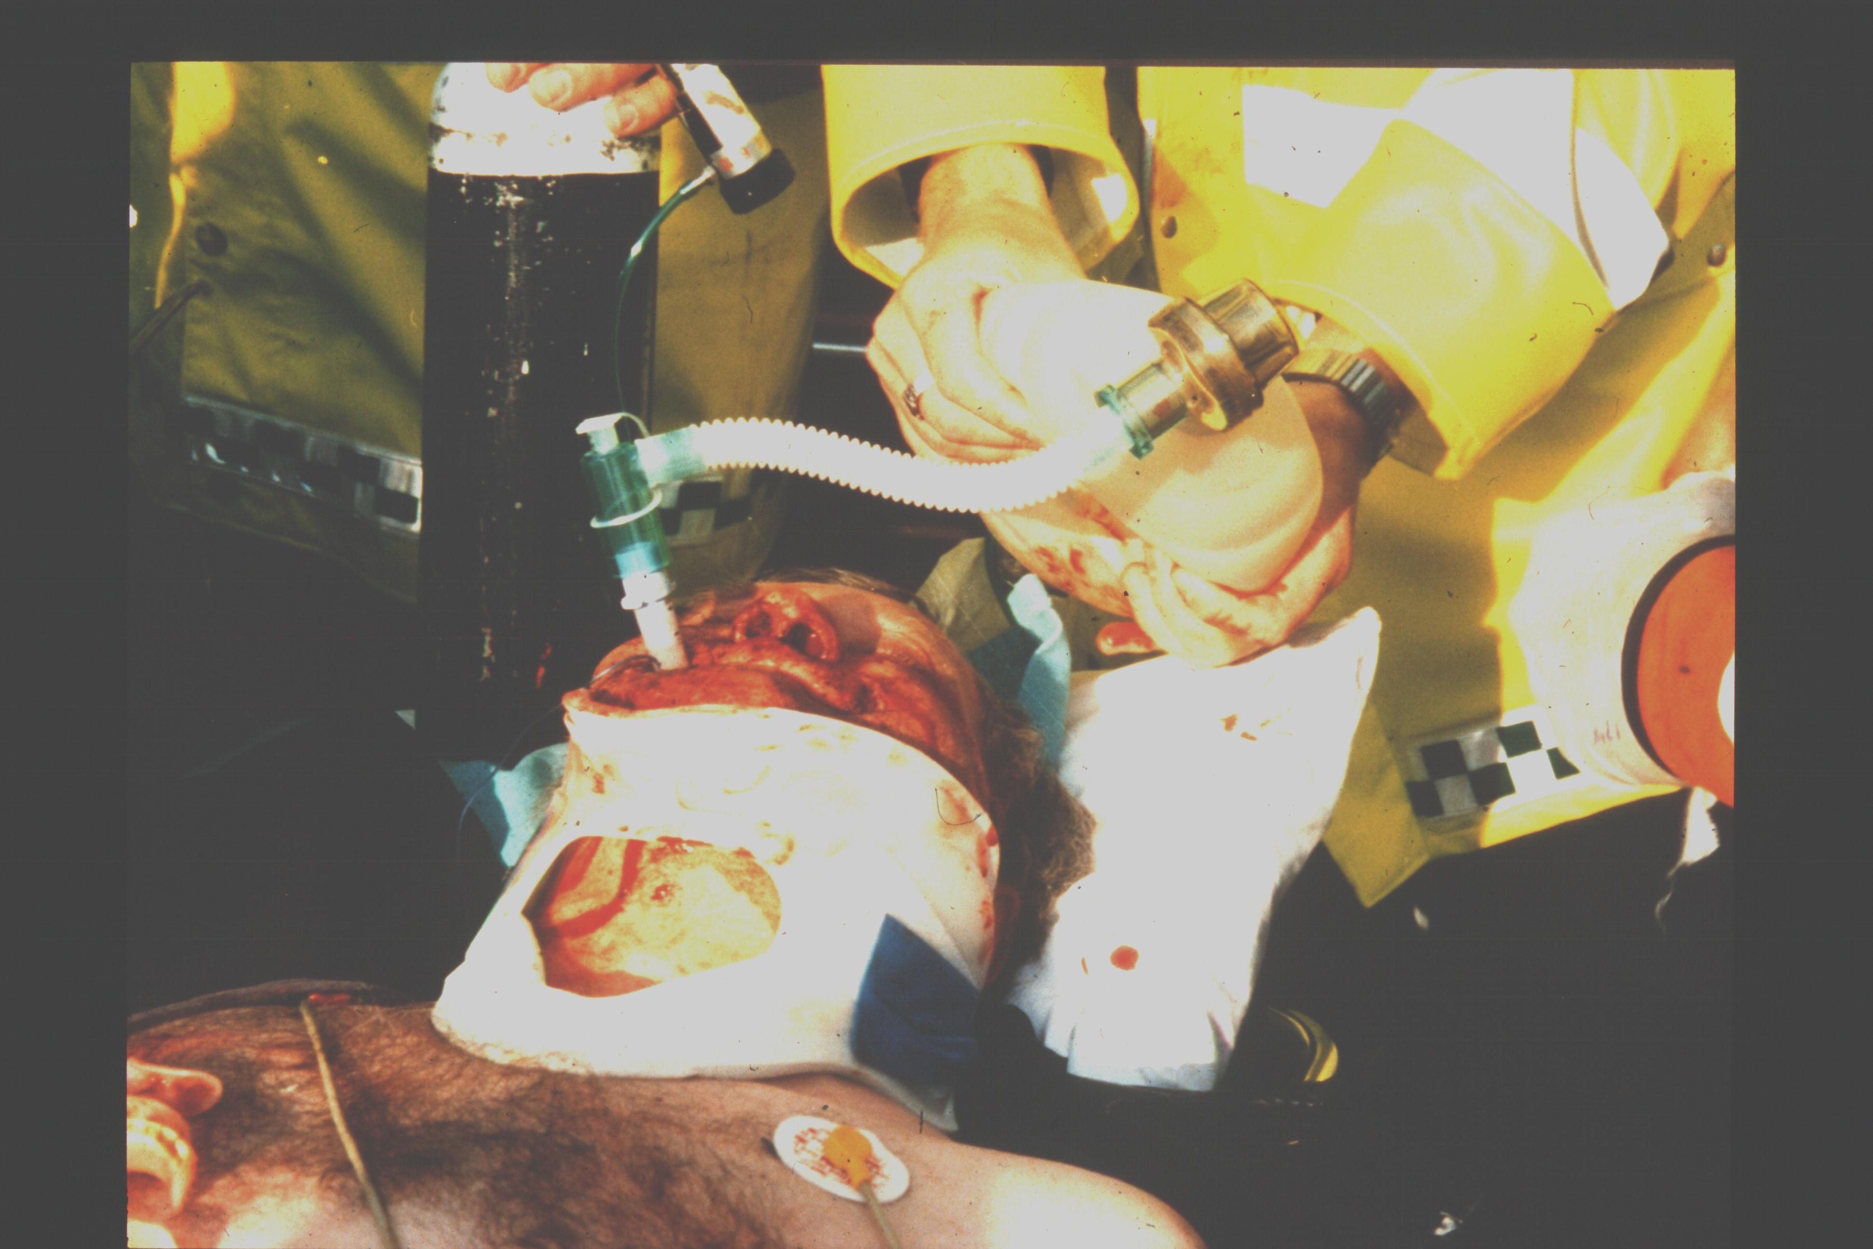
Side Effects RCC – Raised ICP

Slide 62
Side Effects – Raised ICP
Kuhnigk H. Effect of external cervical spine immobilisation on intracranial pressure. Aktuelle Traumatologie 1993; 23: 350 – 353
No effect
Davies G, Deakin C, Wilson A. The effect of a rigid collar on intracranial pressure. Injury. 1996; 27 647 -9
4 mmHg rise
Hunt, K et al. The effects of rigid collar placement on intracranial and cerebral perfusion pressures. Anaesthesia. 56(6):511-513, June 2001
4 mmHg rise
Ho A et al. Rigid Cervical Collar and Intracranial Pressure of Patients with Severe Head Injury. Journal of Trauma-Injury Infection & Critical Care. 53(6):1185-1188, December 2002

Slide 63
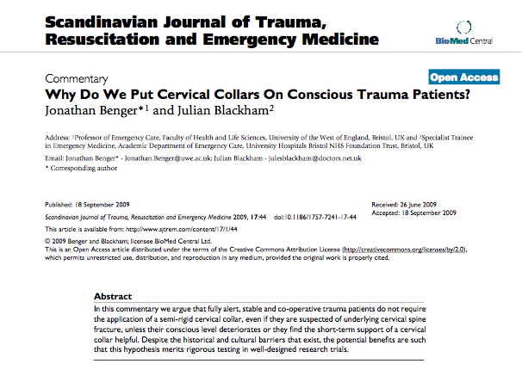

Slide 64
Collars
Standard of care
Evidence is weak
  Hauswald et al
Being questioned
  Walk patients out of cars
    If well enough
    Not trapped

Slide 65
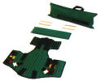
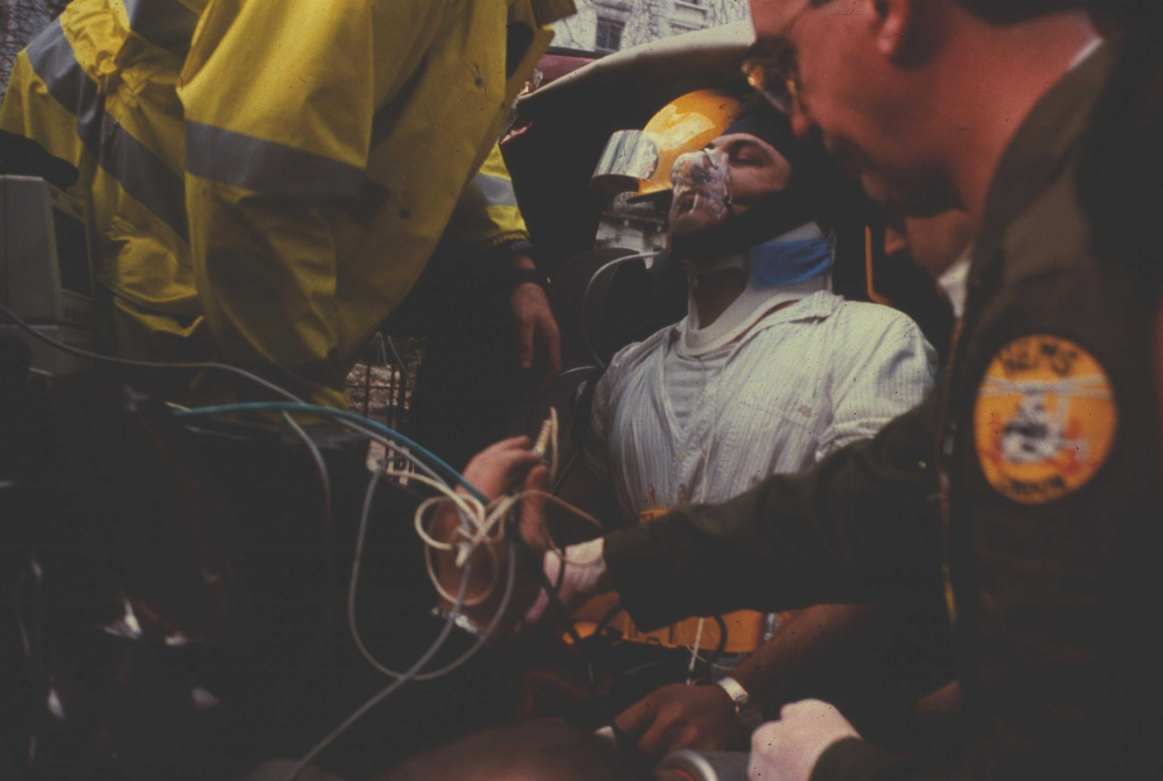
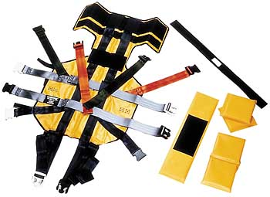
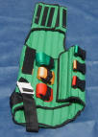
Splintage Devices – eg KED

Slide 66
Side effects KED
Impaired:
FVC
FEV1
FEV/ FVC
FMEF
Bauer D, Kowalski R. Effect of spinal immobilization devices on pulmonary function in the healthy, non-smoking man. Ann Emerg Med. 1988 Sep;17(9):915-8

Slide 67
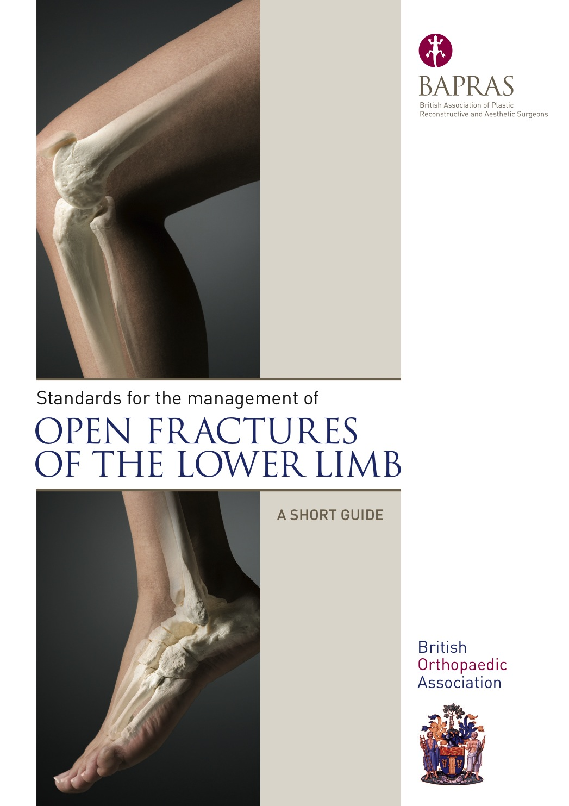

Slide 69
Pelvic Binders
JRCALC 2009 Update

Slide 70
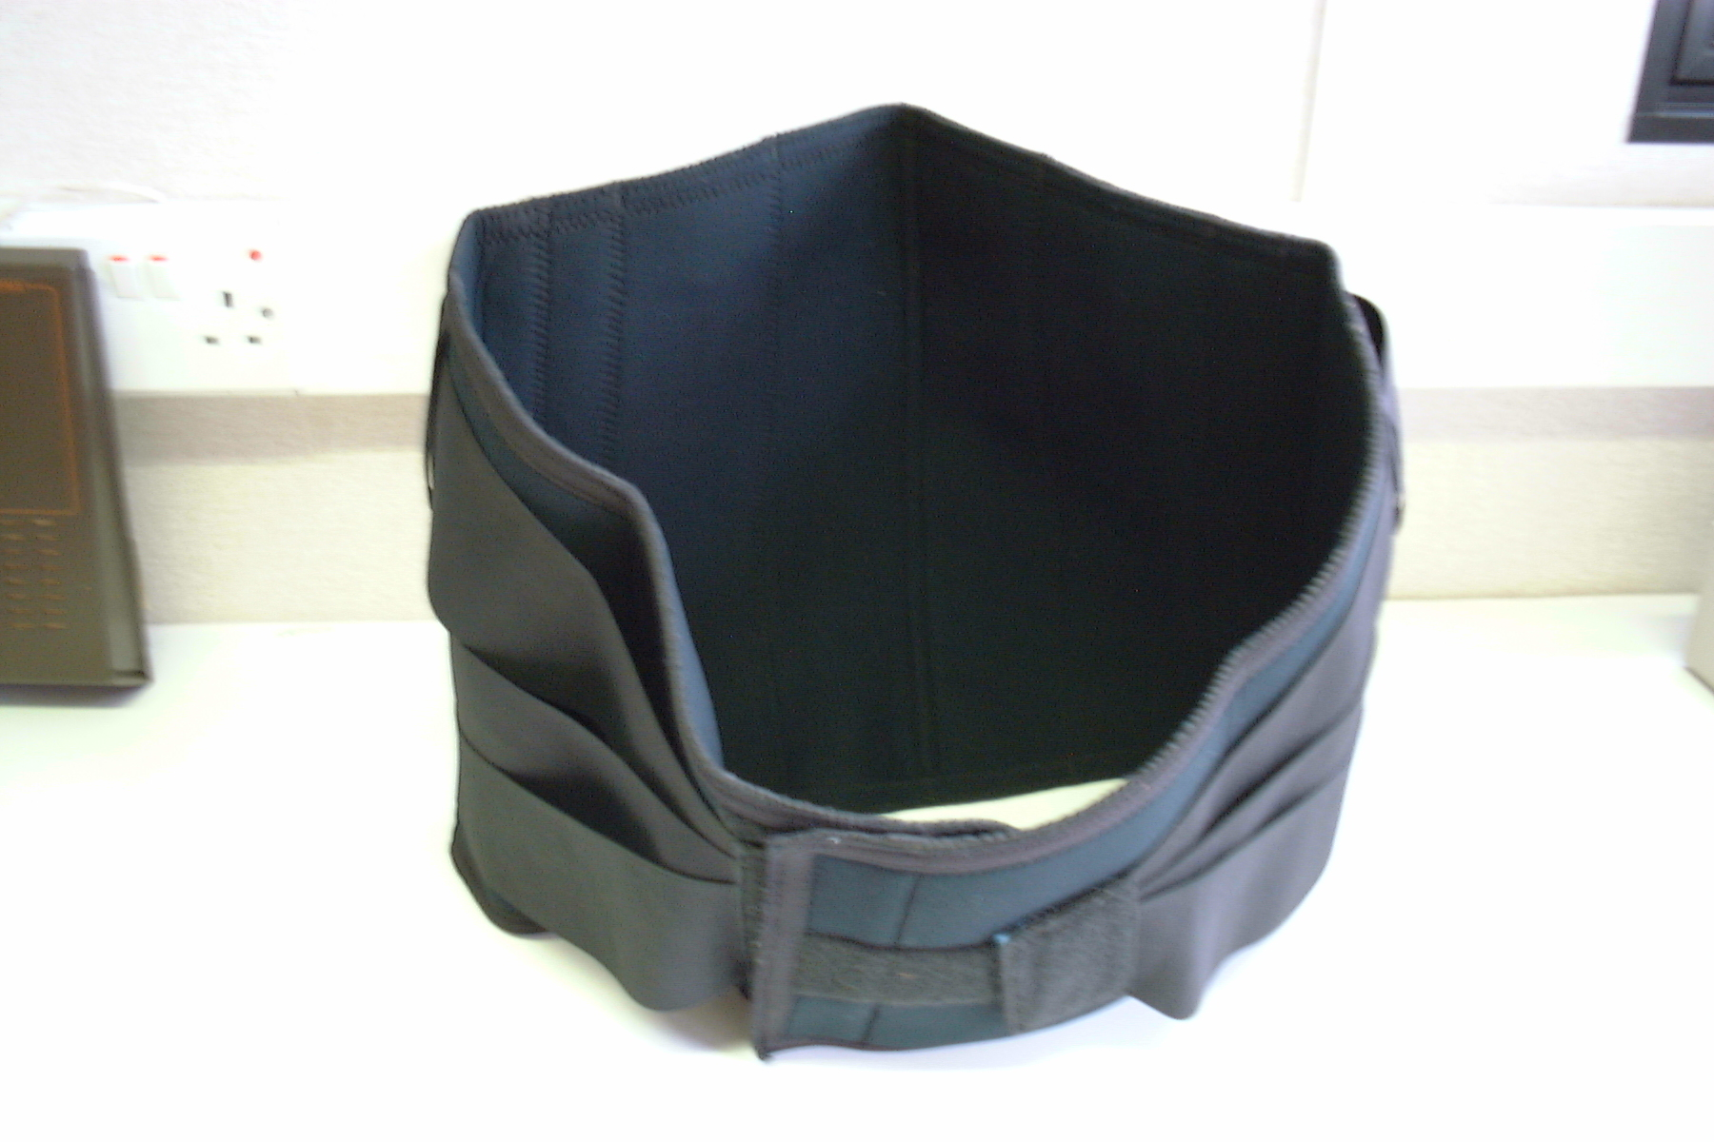

Slide 71
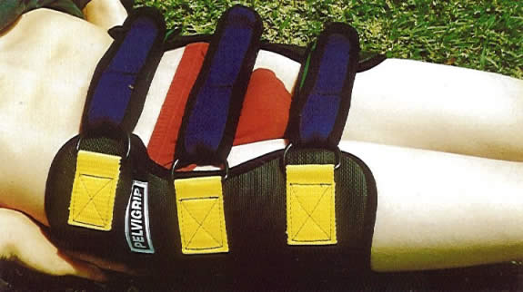

Slide 72
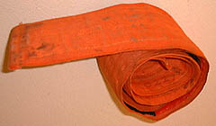
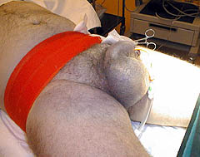
Geneva Belt

Slide 73
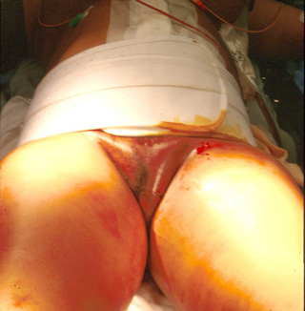
Dallas Binder

Slide 74
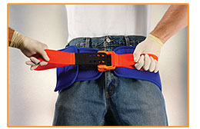
Sam Sling

Slide 75
Do they work ?
Probably
A bit
Close the pelvic basin
Marker effect
No evidence

Slide 76
Resuscitative Thoracotomy - Prehospital
Part of prehospital resuscitation
Case series reported from:
  London
  Hampshire
  Spain
  Brazil
  Australia
  USA

Slide 77
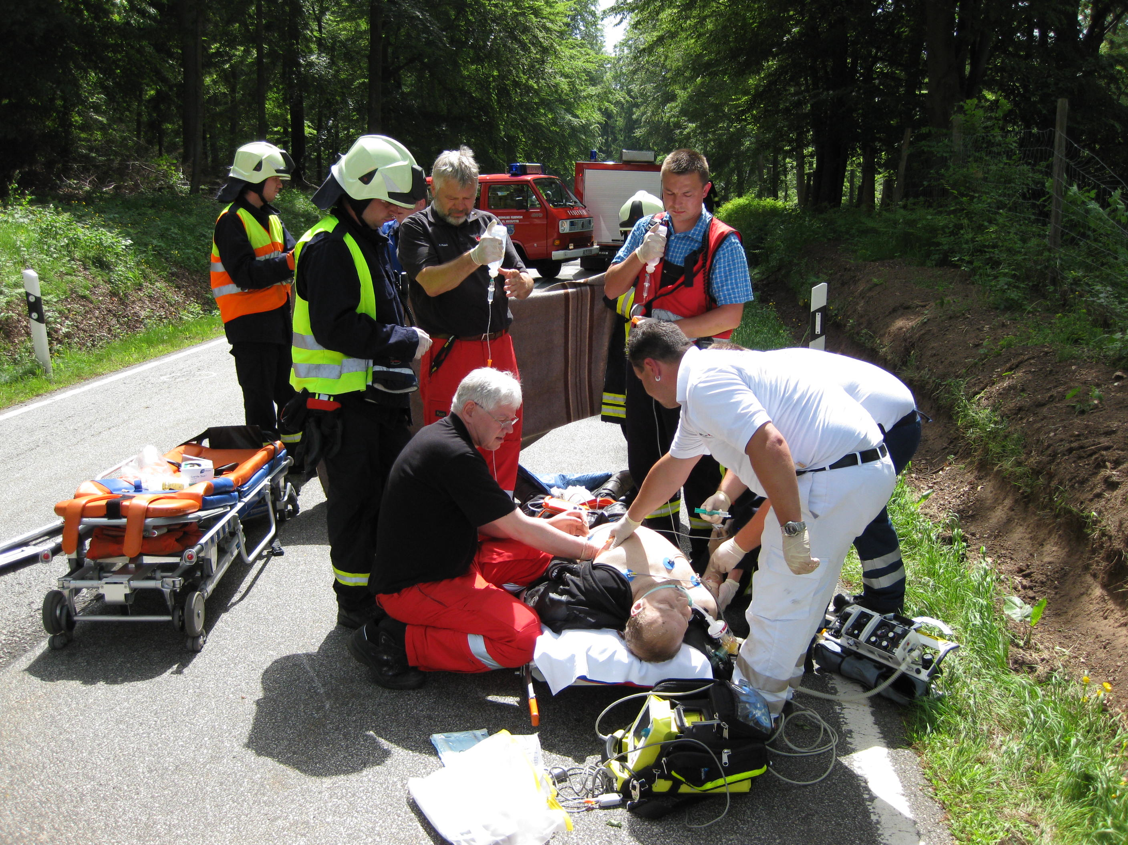

Slide 78
EPR
Emergency Preservation Resuscitation
“Suspended Animation”

Slide 79
“Suspended Animation”
30 years development
Systematic research
  2 US centres incl Safar institute
Temp and rate of cooling
Rate of warming
Types of fluids
Blunt / penetrating models
120 mins of no flow with good recovery

Slide 80
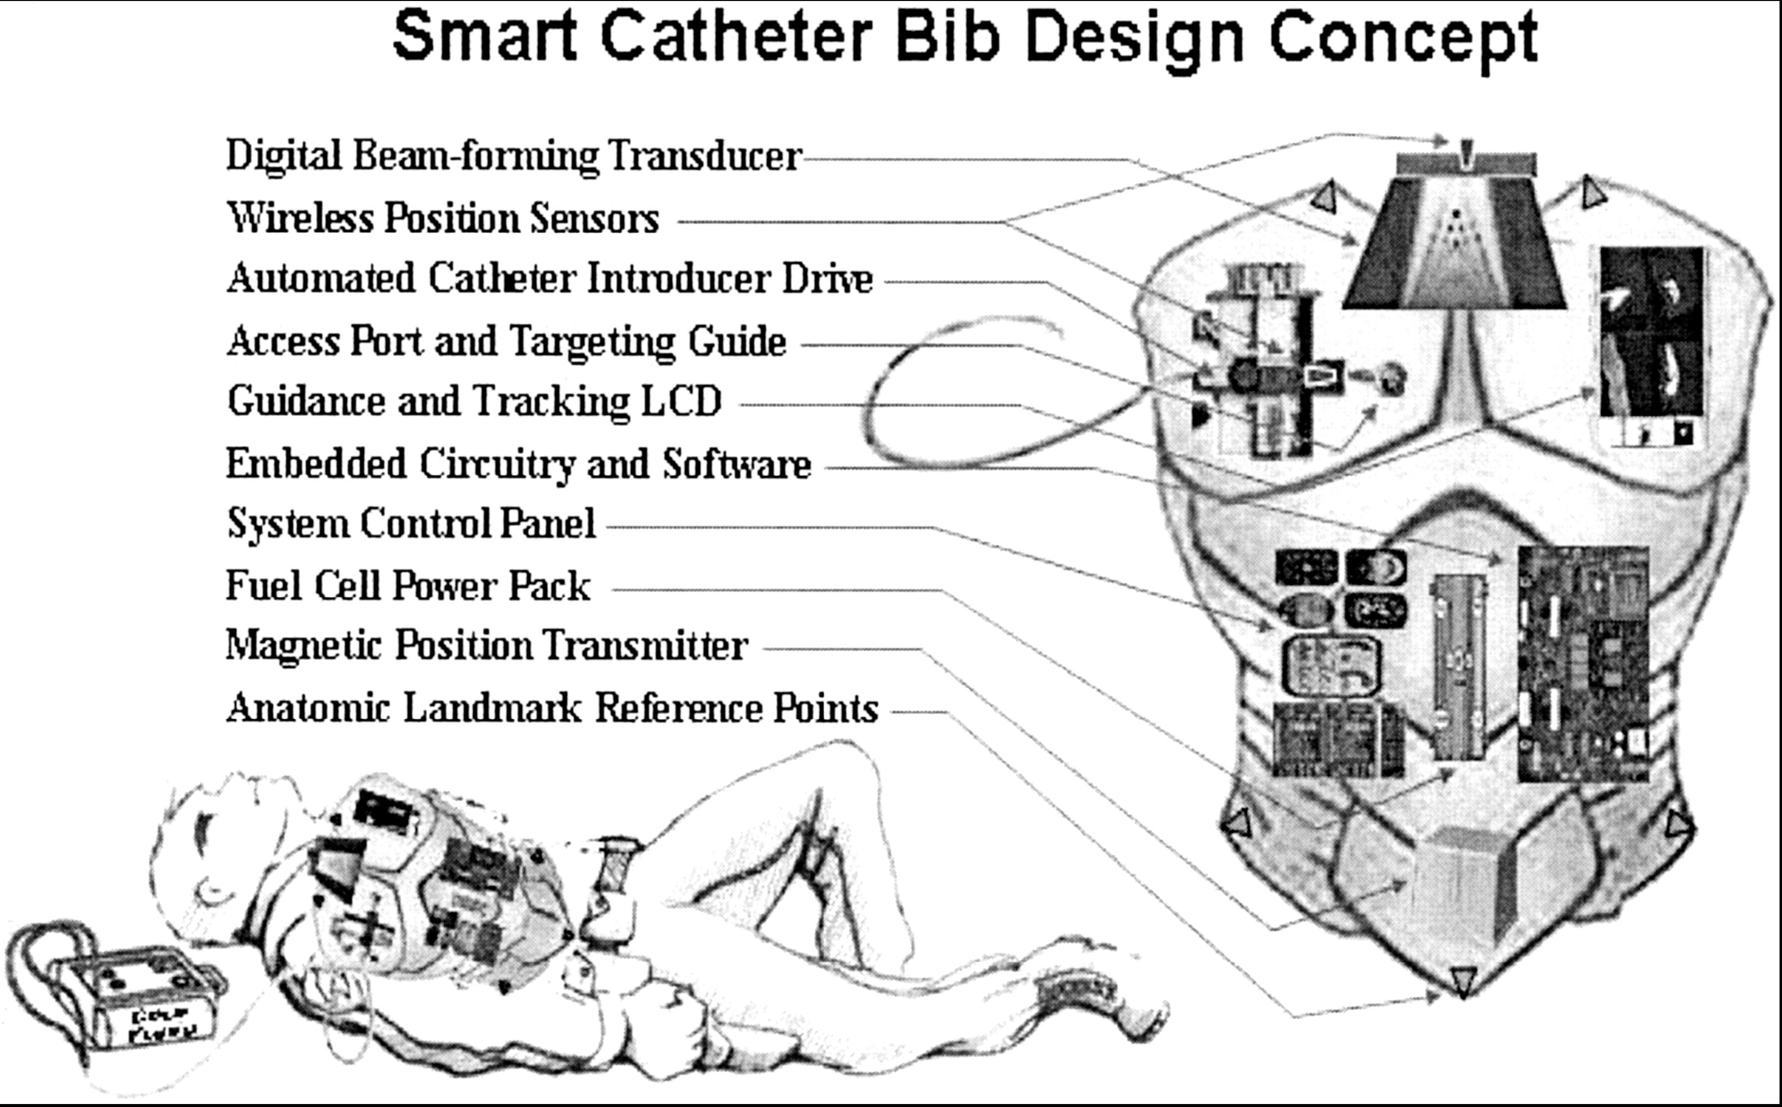
Lyn Yaffe et al. Crit Care Med. 2004

Slide 81
Thank You

