Slide 1
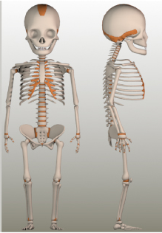

Fractures of the Paediatric Upper Limb
Viva
Mr Kyle James
Consultant Paediatric Orthopaedic Surgeon

Slide 2
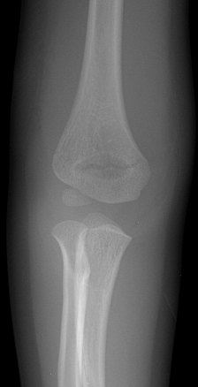
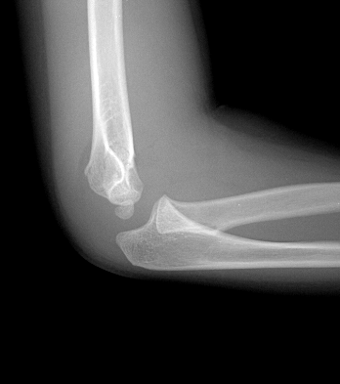
Case 1
3 YR OLD
Fall from Slide
What is the diagnosis & Management?

Slide 3
Grade 1 Supracondylar
Collar & Cuff
Have to flex > 120 deg
Check Pulse and instructions for swelling
Remove in 3 weeks

Slide 4
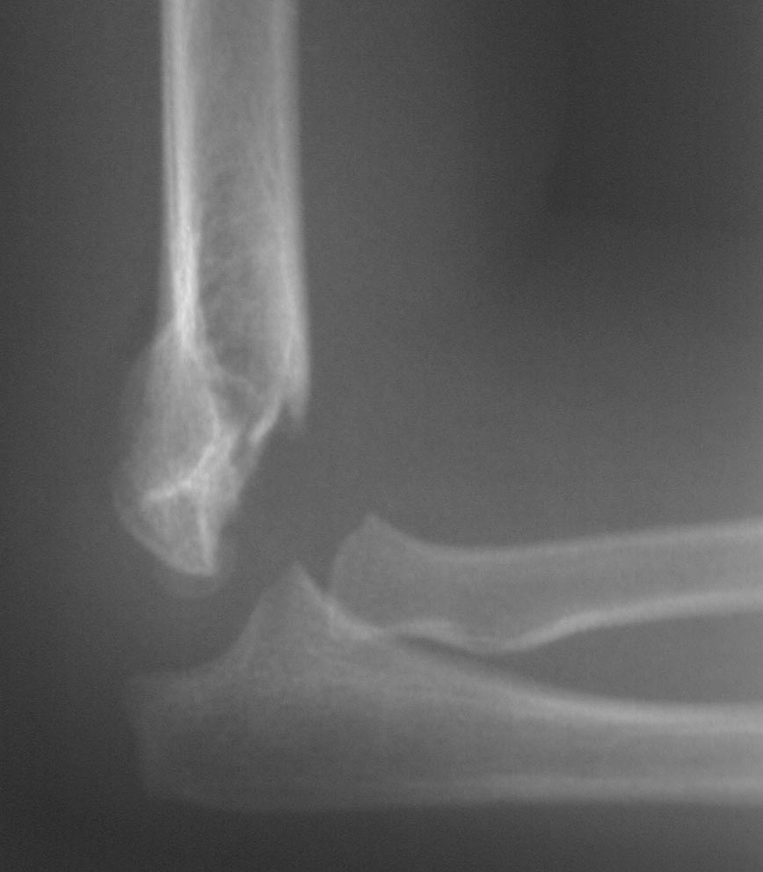
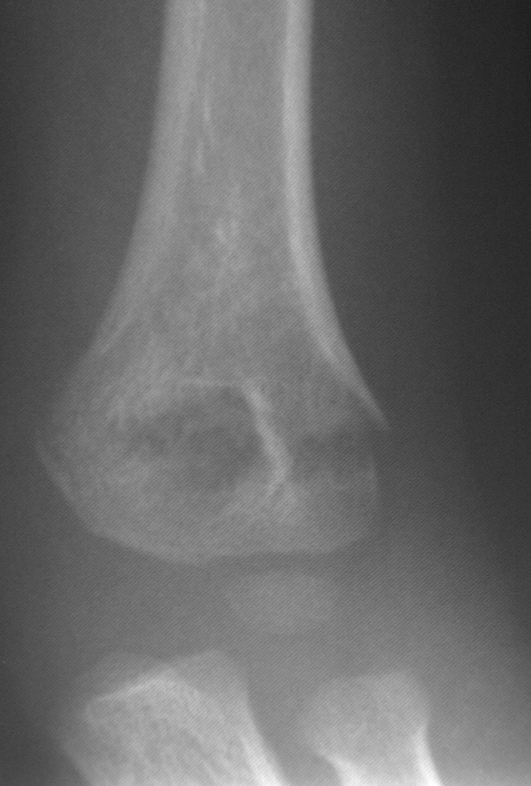
Case 2
What is your management?
A: Closed Reduction without pinning
OR
B: Closed Reduction and Pinning
Notes:
Question to everyone – hands up CR no pin – then hands up CR and pin
Ask one re No Pin – how do you decide it is acceptable and if it is stable

Slide 5
Grade 2 Supracondylar Elbow
OPTION A: CLOSED REDUCTION ALONE
Acceptable: No medial impaction
Notes:
Key points to decided acceptability to closed reduction are
1] No medial impaction – as this can result in late varus

Slide 6
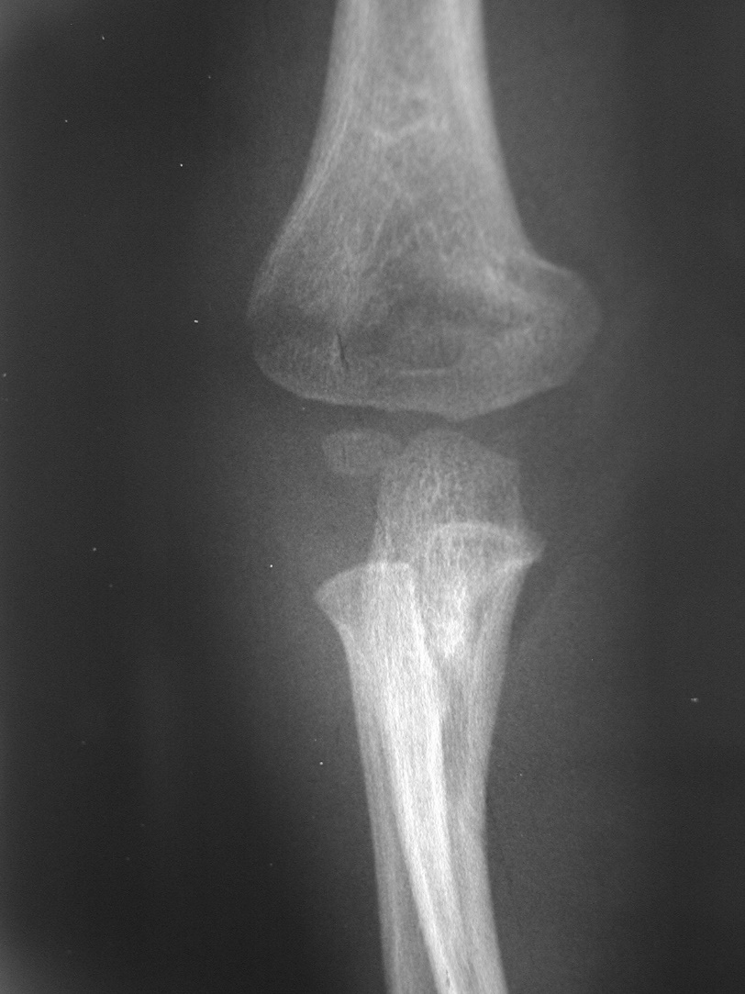
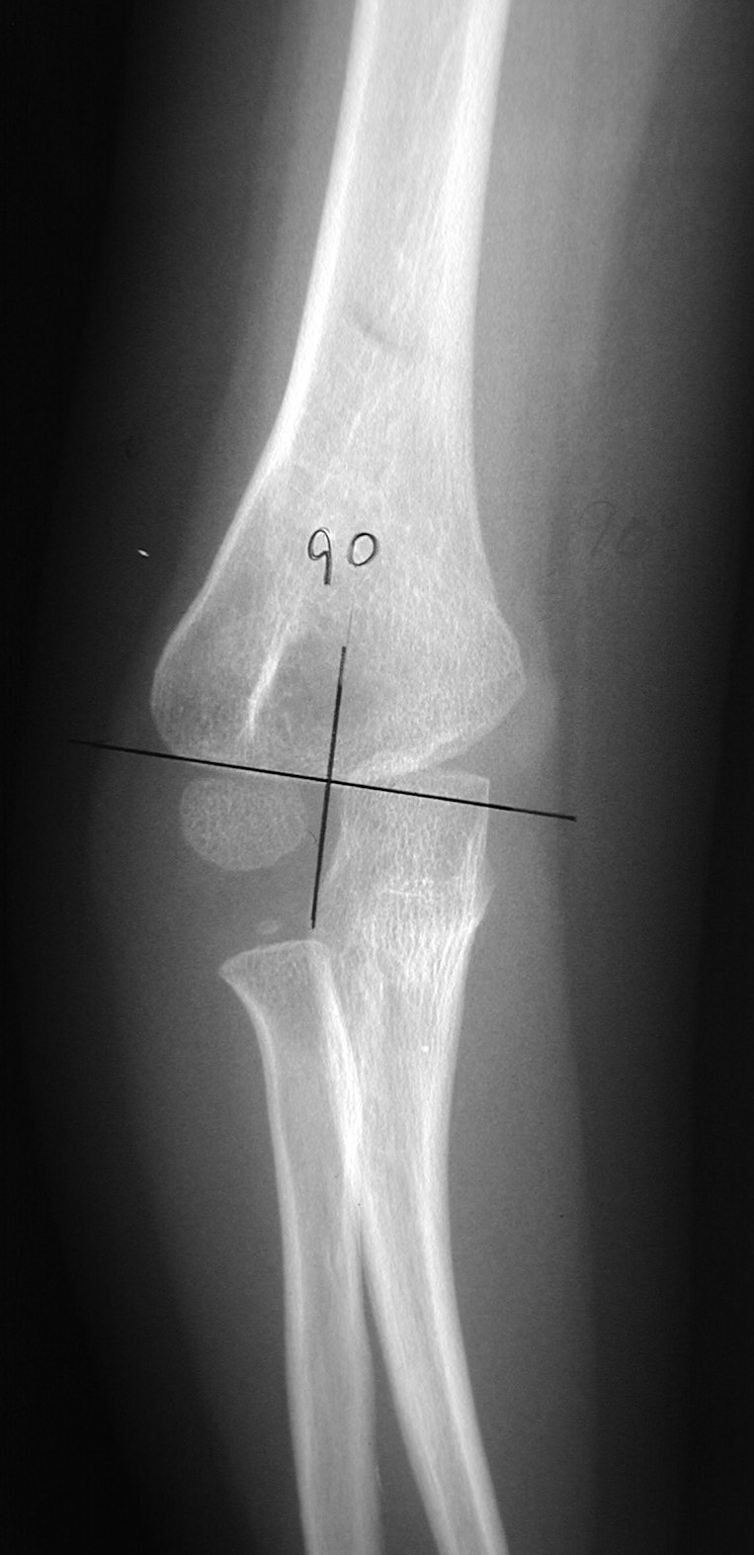
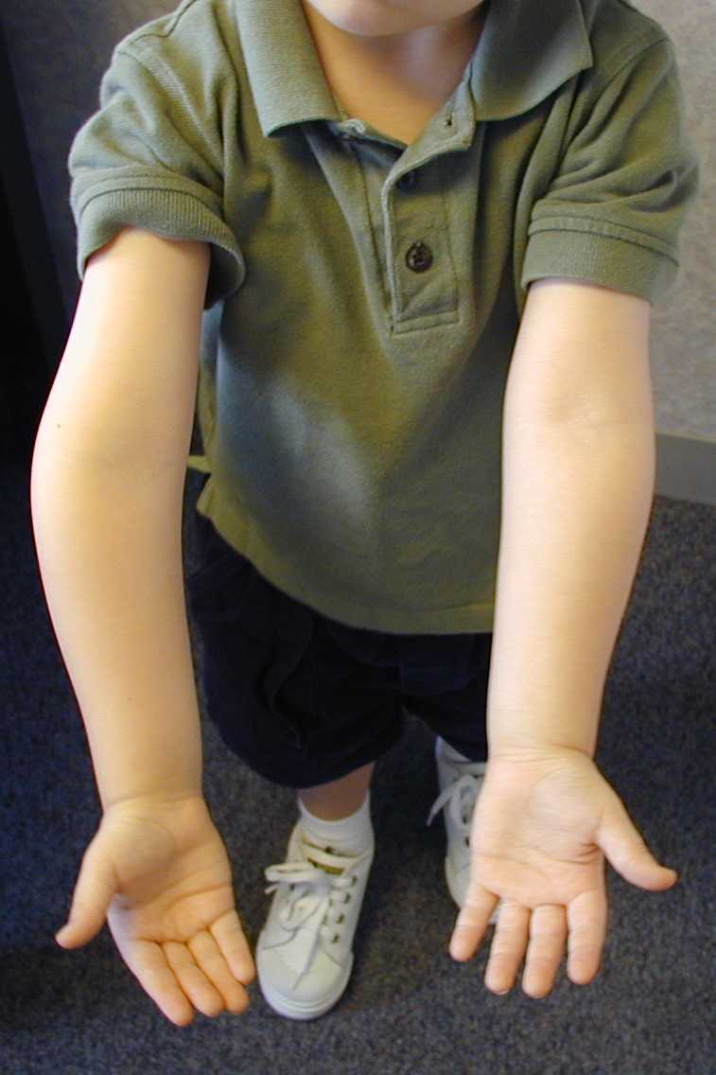
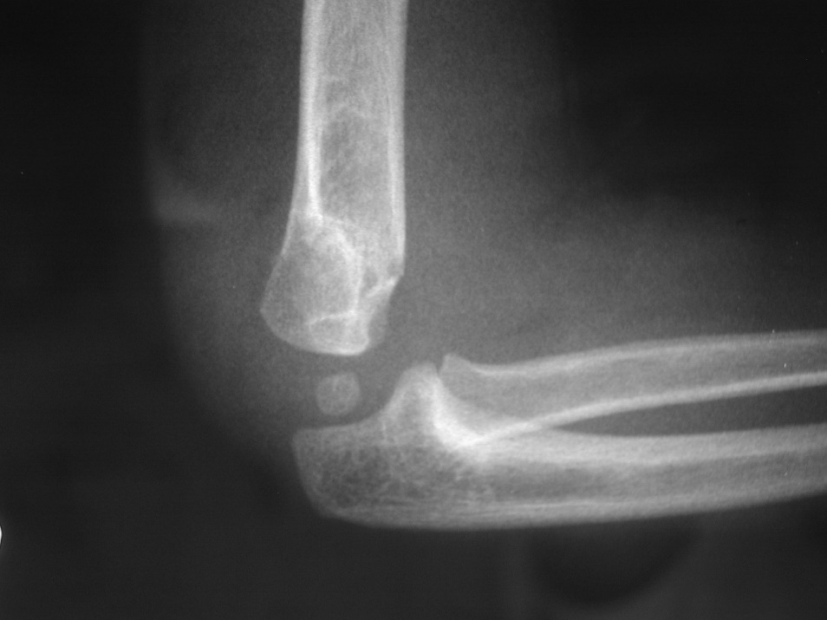

Slide 7
Grade 2 Supracondylar Elbow
OPTION A: CLOSED REDUCTION ALONE
Acceptable: No medial impaction
Remodelling potential
  5 deg in coronal plane
  10 deg in sagittal plane
  translation remodels well [Persiani et al. JPO B 2012, 21:115–120]
Notes:
2]. Remodelling is possible in young child under age 6

Slide 8
Grade 2 Supracondylar Elbow
OPTION A: CLOSED REDUCTION ALONE
Acceptable: No medial impaction
Remodelling potential
Stable (internal rotation / extension)
  Pinning results in less loss of reduction
  To avoid Malunion (NNT 20)
  To have a better range (NNT 7)
  Low complication rate (wire removed at 3 weeks)
Skaggs DL, Sankar WN, Albrektson J, Vaishnav S, Choi PD, Kay RM: How safe is the operative treatment of Gartland type 2 supracondylar humerus fractures inchildren? J Pediatr Orthop 2008;28(2):139-141.
Notes:
Stability check – int rotation view lateral, assess how much flexion is safe
Retrospective Cohort Study of 189 grade 2 fractures – pinning is safe and reliable.

Slide 9
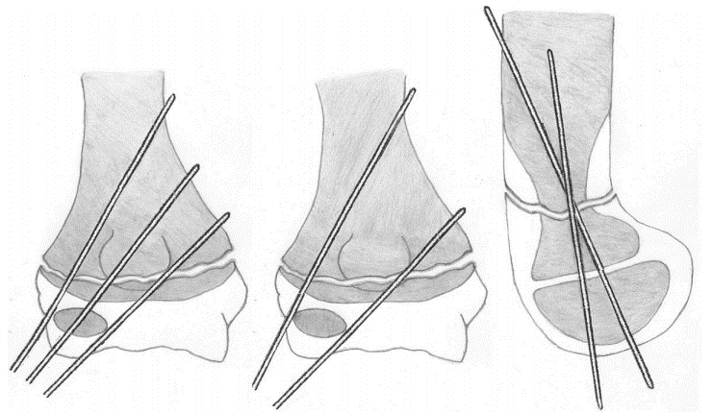
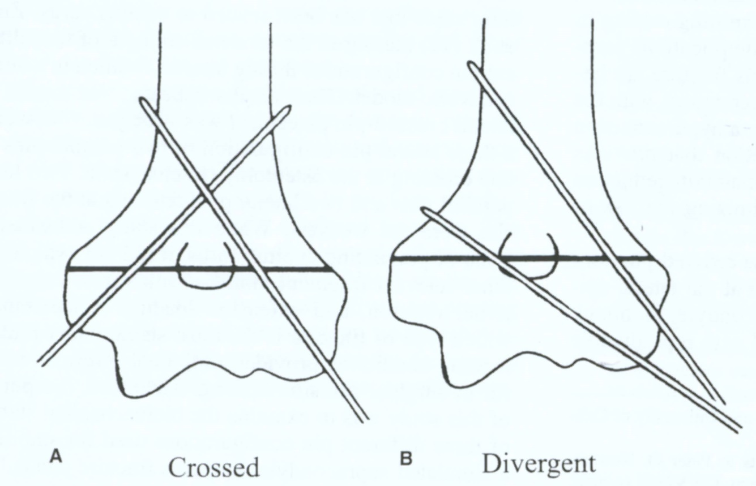
OPTION B: Closed reduction and Pinning
WHICH WIRE CONFIGURATION?
Notes:
Reg For Option B:
You decide to pin fracture – what wire configuration do you use and why?

Slide 10
Wire configuration
Cross wire stronger configuration biomechanically.
Lateral wires less chance of iatrogenic nerve injury but this is less of a problem if a small medial incision is used.
1/3 stable with 2 wire, the 2/3 with 3 wires and then the rest need additional medial wire.
Kocher MS, Kasser JR, Waters PM, et al: Lateral entry compared with medial and lateral entry pin fixation for completely displaced supracondylar humeral fractures in children: A randomized clinical trial. J Bone Joint Surg Am 2007;89(4):706-712.
Zenios M, Ramachandran M, Milne B, Little D, Smith N: Intraoperative stability testing of lateral-entry pin fixation of pediatric supracondylar humeral fractures. J Pediatr Orthop 2007;27(6):695-702.

Slide 11
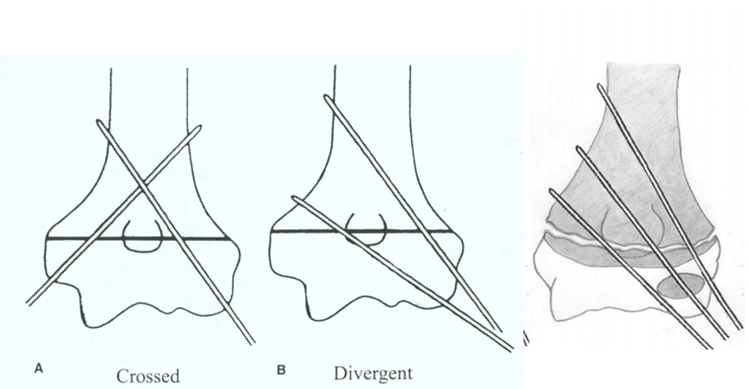
Wiring Tips
KEY is fracture Anatomy & Stability testing
Buttress columns if comminution present
Divergent lateral wires
Stability test = IR view And Extension
Releasing incision if lateral pins too close
Medial incision always
Splint in 60 to 70 deg flexion
Remove wires at 3 weeks = less infection

Slide 12
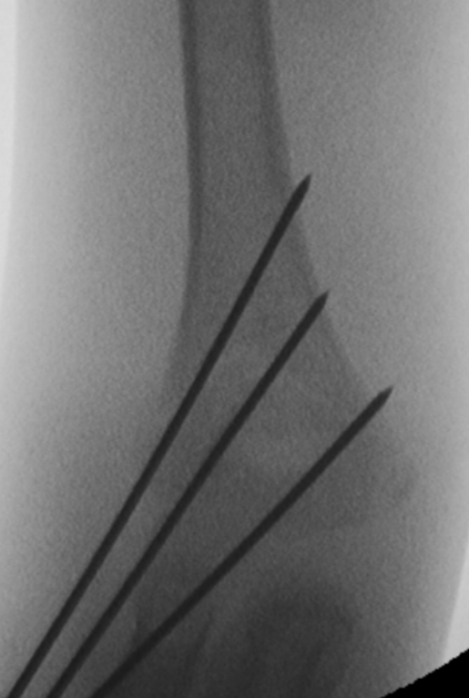
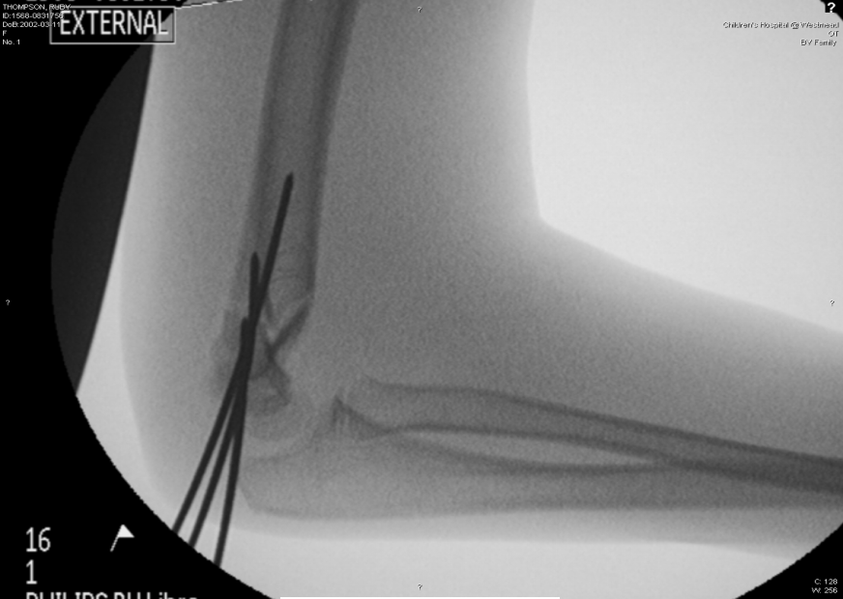
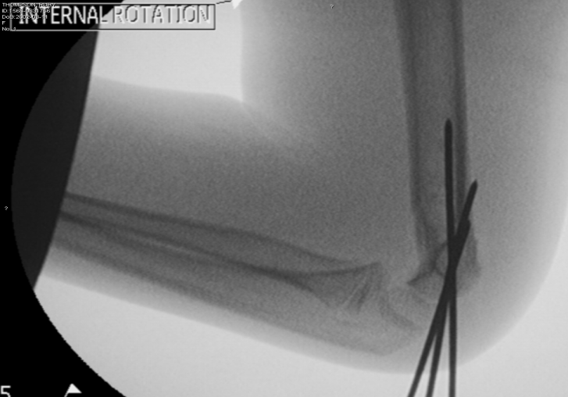
Stability Testing

Slide 13
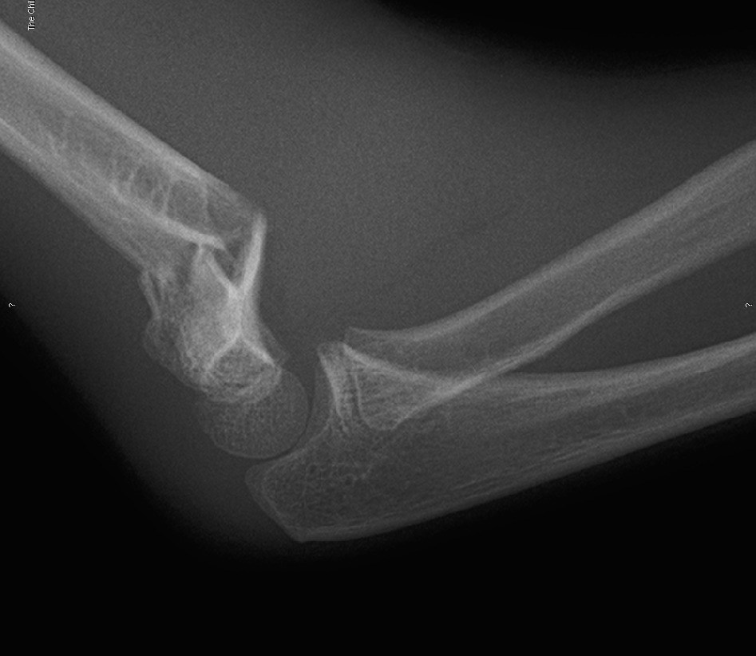
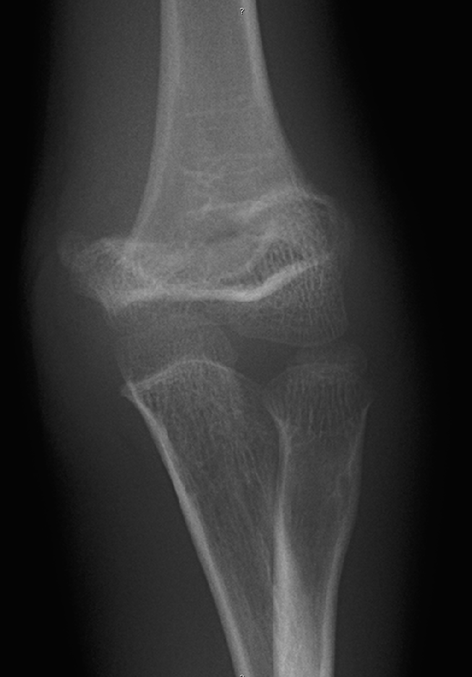
Case 3
How do you examine neurovascular status in a child?
What is the commonest nerve injury in this fracture?
How long does it take for ROM to return?
Notes:
Asked to see a child in A&E who sustained supracondylar fracture.

Slide 14
Displaced supracondylar
Nerve Injury
1]Anterior interosseous > ext type
2] Ulnar >flexion type /posterolateral or Iatrogenic ulnar - remove pin ?+/- exploration (common sense approach re: exploration
3] Radial posteromedial - most likely transected nerve
Recovery 3 -6month then EMG.
Elbow stiffness after treatment
94% return to motion by 6months can improve up to 1yr - lose some terminal range
Reza Omid, Paul D. Choi and David L. Skaggs. Supracondylar Humeral Fractures in Children.
J Bone Joint Surg Am. 2008;90:1121-1132
Zionts et al. Clin Orthop Relat Res (2009) 467:2007–2010

Slide 15
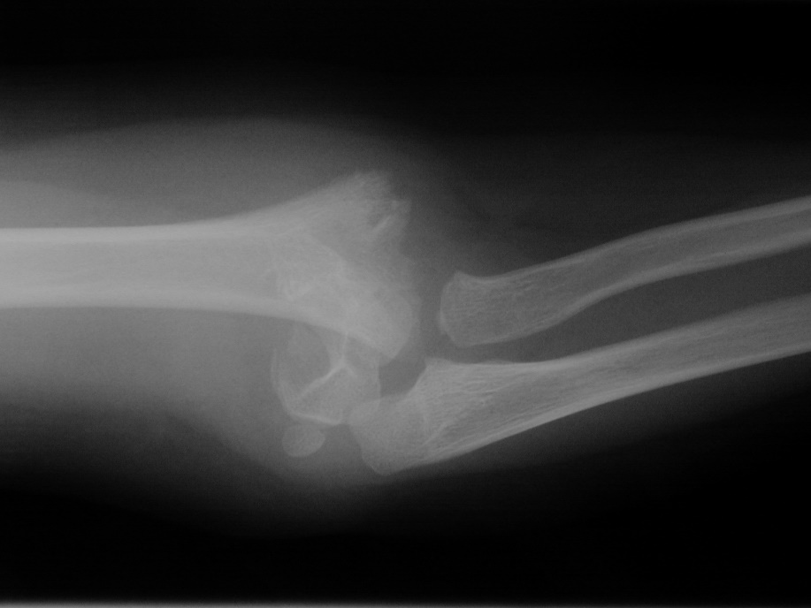
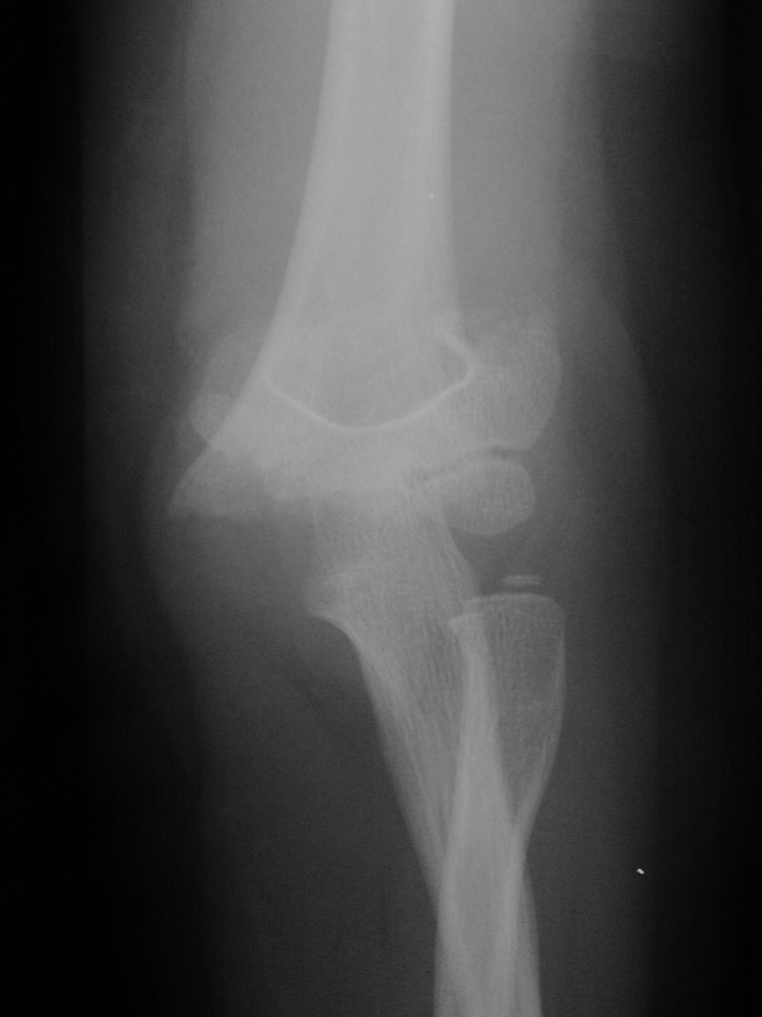
Case 4
5 yo presents with fall from climbing frame –
There is no pulse. What is your management?

Slide 16
Pulseless Supracondylar Fracture
5-10% of displaced supracondylar have vascular impairment at presentation
Absence of a palpable pulse in a child is a marker of vascular injury
Regardless of whether hand is warm, pink or if flow demonstrated on doppler?
When to do? - URGENT worse outcomes after 24hrs
Where to do? – Surgical Experience +/- Vascular Support
Meta-analysis:
84% vascular injury in pale pulseless
70% vascular injury in pink pulseless
91% patent at 2 years after vascular repair (vein patch)
White L, Mehlman CT, Crawford AH. Perfused, pulseless, and puzzling: a systematic review of vascular injuries in pediatric supracondylar humerus fractures and results of a POSNA questionnaire. J Pediatr Orthop. 2010 Jun;30(4):328-35

Slide 17
Pulseless
Pink / Perfused
Pale / No Perfusion
Reduce & Fix
No Gap
Open Bandage at elbow/ wrist
Assess & Observe 24-48hrs
Doppler if worried
Safety net at discharge (late thrombosis)
F/u at one week
Vascular Centre
Reduce & Fix
Reassess
Explore if no perfusion
Assessing perfusion : Same colour, temp, cap refill as uninjured side, observe for 48hrs. Arrange Colour Doppler at elbow to assess artery if concerned.
Warn parents of signs of compartment syndrome post discharge - late thrombosis is rare but potential complication

Slide 18
Case 4
5 yo presents with fall from climbing frame
You failed closed reduction – what approach for open reduction?

Slide 19
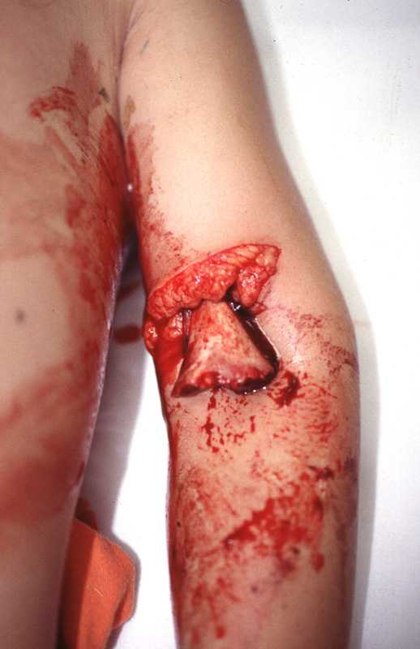
Open Reduction Approach
NOT Posterior
Either med / lateral or anterior be able to talk through
My Preference is anterior
Button holed brachialis prevent reduction
Bone subcutaneous
Easy to extend

Slide 20
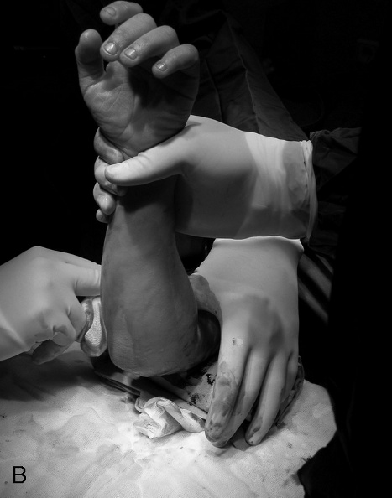
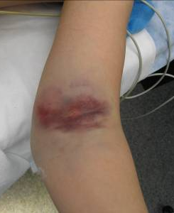
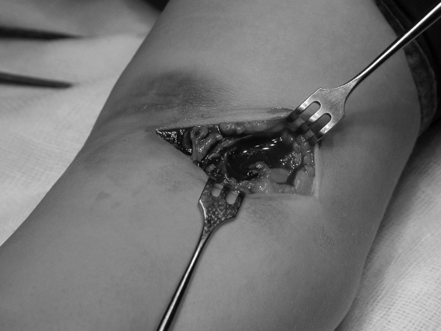
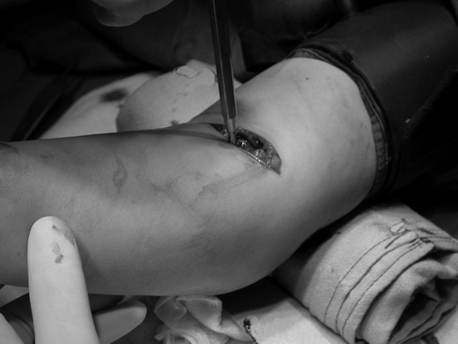
Anterior Approach
Failed closed reduction - pucker still present - bone under skin.
Need assistant {sometimes 2 If vessel injured}.
Align distal fragment with prox in med /lat plane
Incision prox elbow crease
Onto bone - blunt dissection / retract brachialis
Incise and release periosteum proximally to aid reduction
Use ring spike or homan to reduced distal fragment onto proximal through fracture site.
Medial and lateral wires whilst holding reduction with finger.

Slide 21
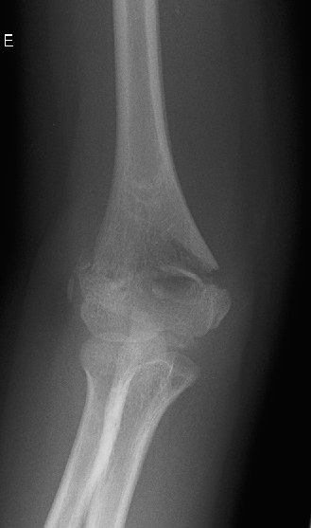
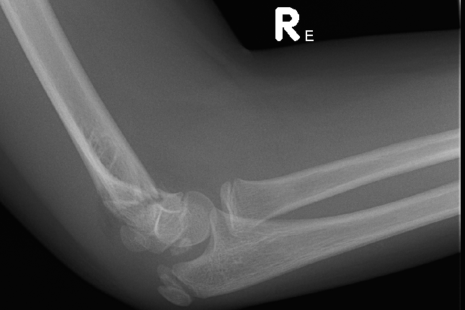
Case 5
10 year old – fall from flying fox / zip wire?
What is different in your management?

Slide 22
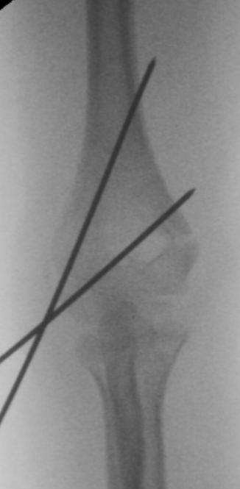
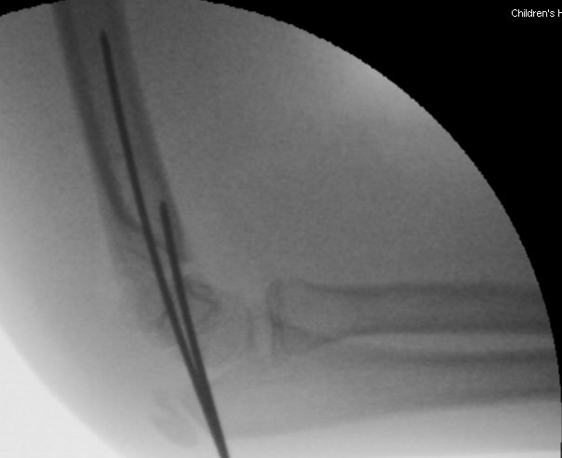
Flexion Supracondylar / Older Patient
5% of supracondylar #
periosteal stripped = more unstable
Need assistant
Rotate C arm not arm for lateral
Pull wires at 4 weeks - cast 6 weeks.

Slide 23
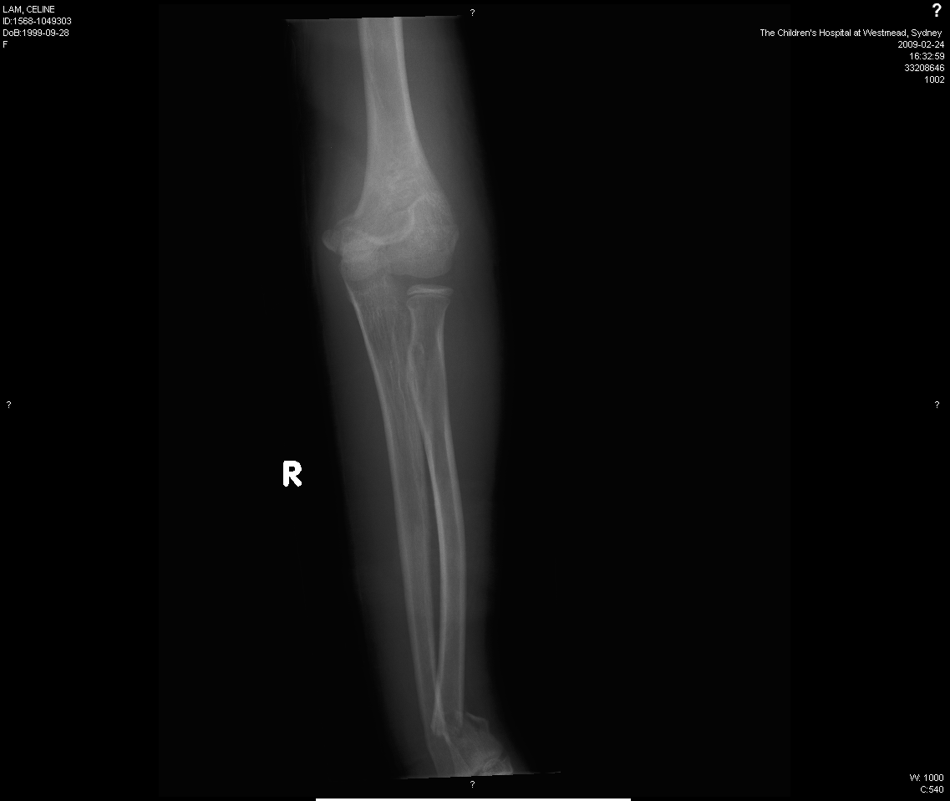
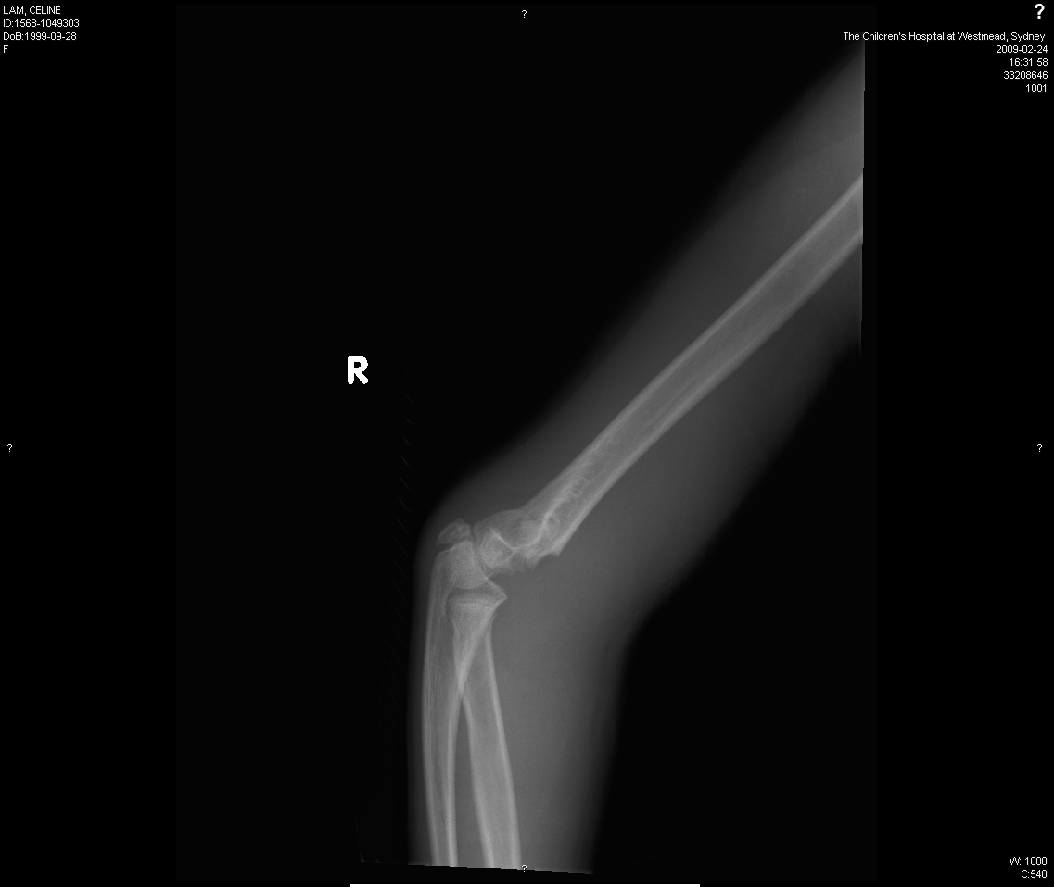
Case 6
?Management
9 y.o.

Slide 24
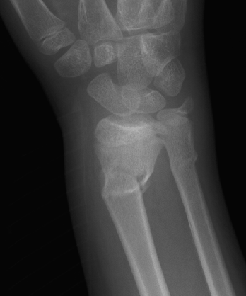
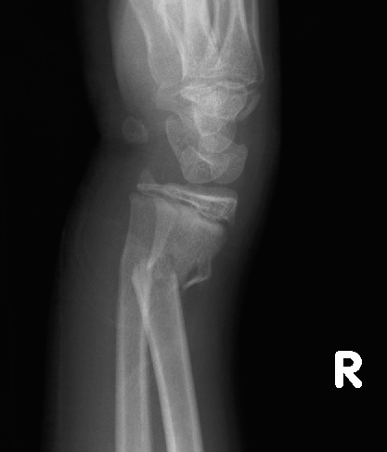
Floating elbow
9 y.o.

Slide 25
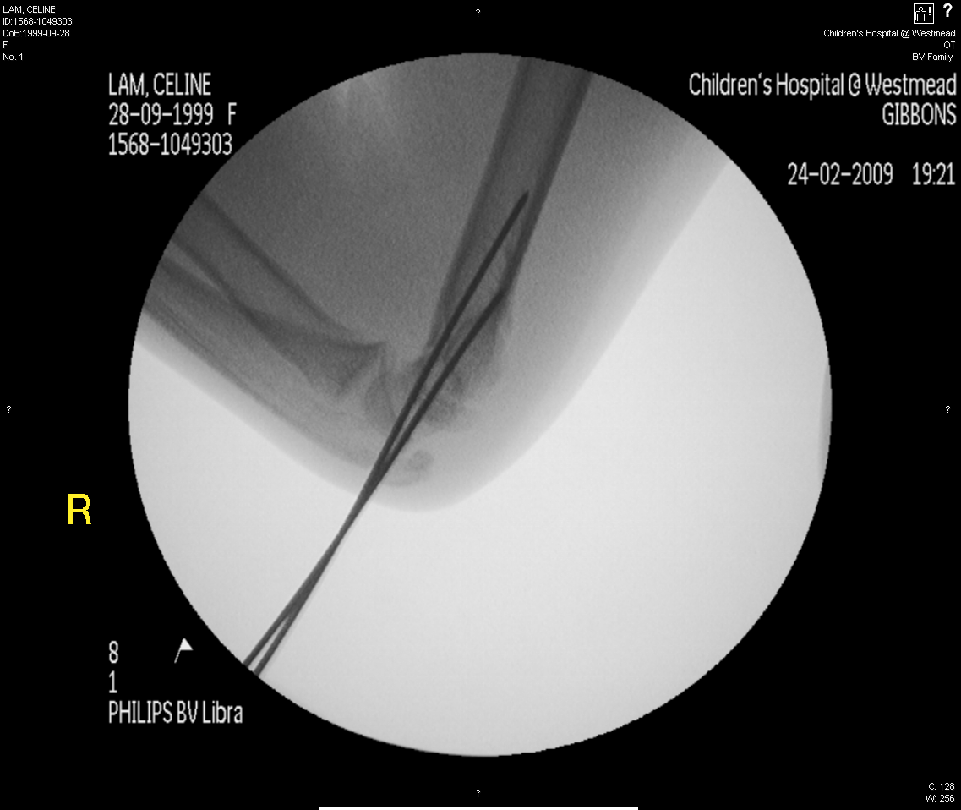
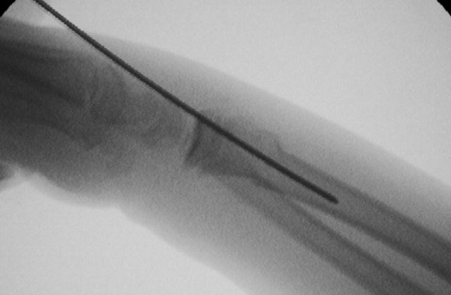
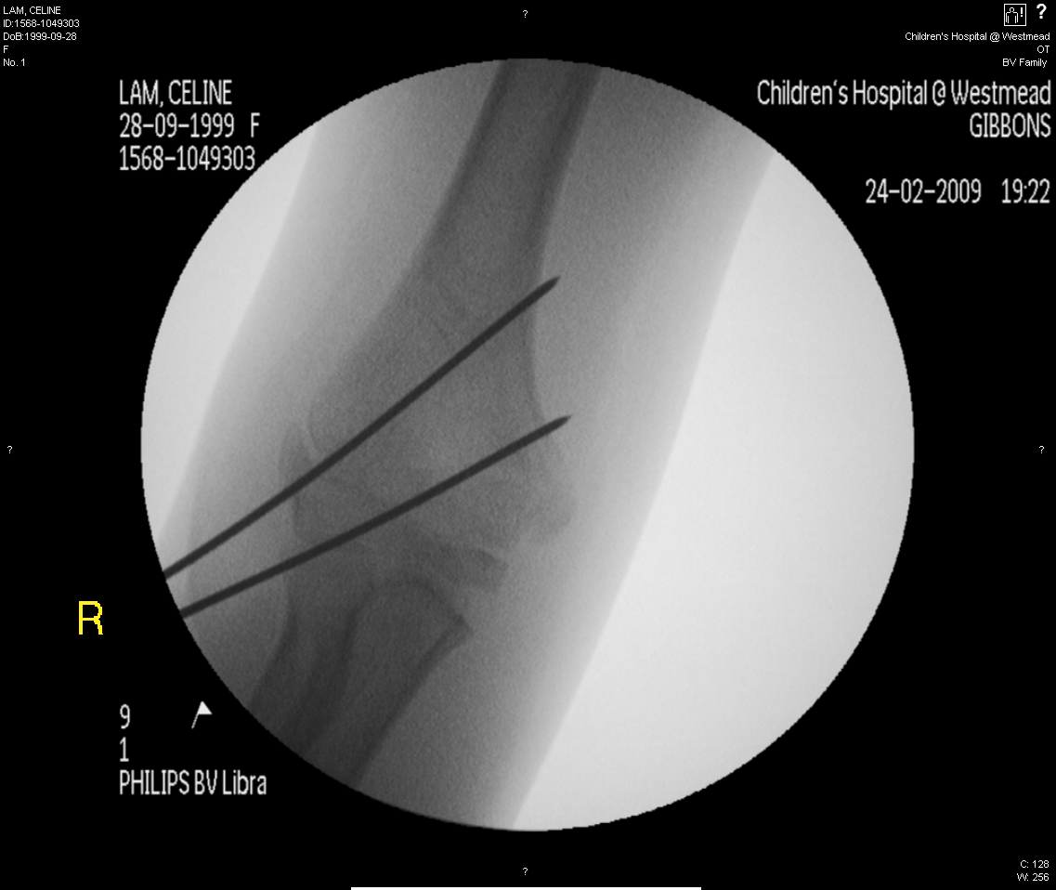
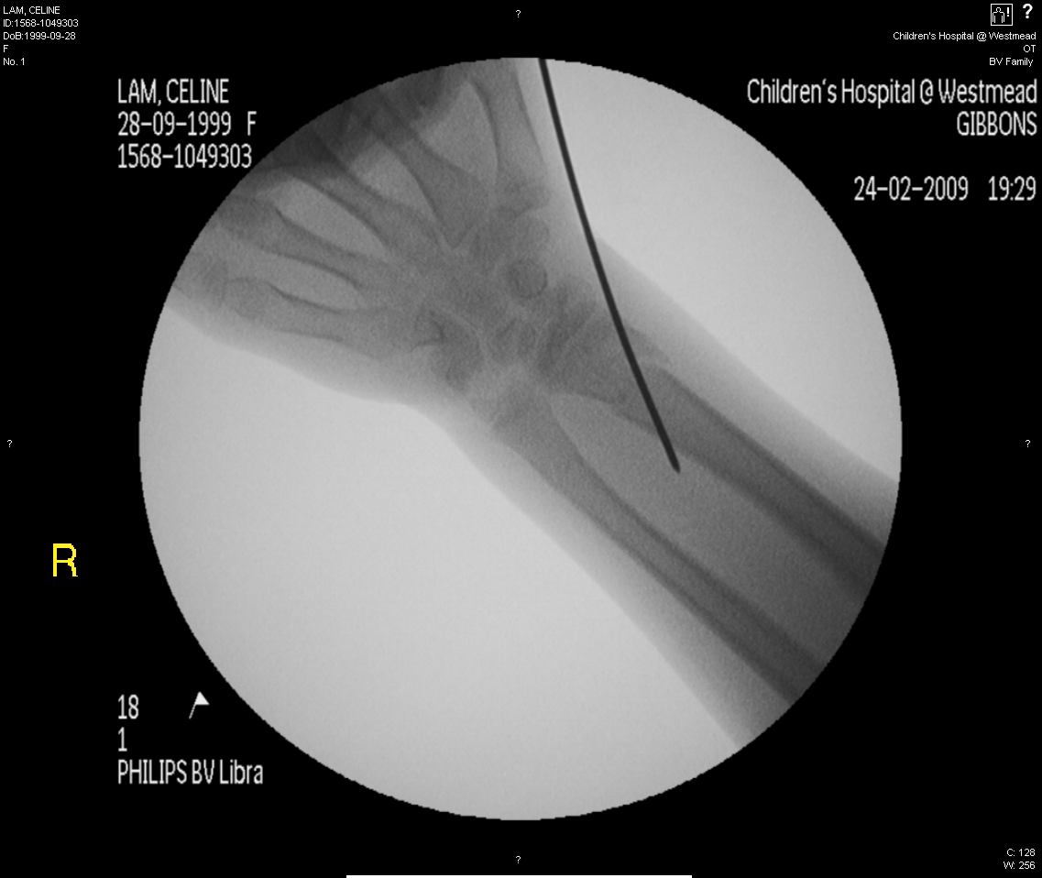
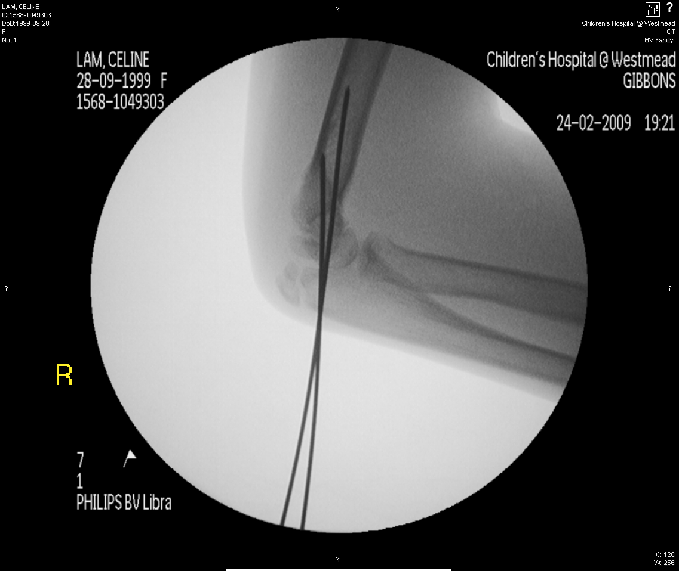
Floating Elbow
Treat with same degree of cautions as pulseless
increased risk of compartment syndrome.
Fix elbow then distal radius.

Slide 26
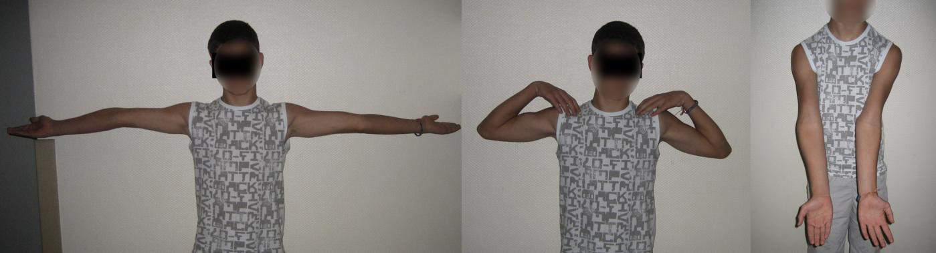
Case 7
13 yo boy – previous injury age 4 years. ?What is the problem and your management?

Slide 27
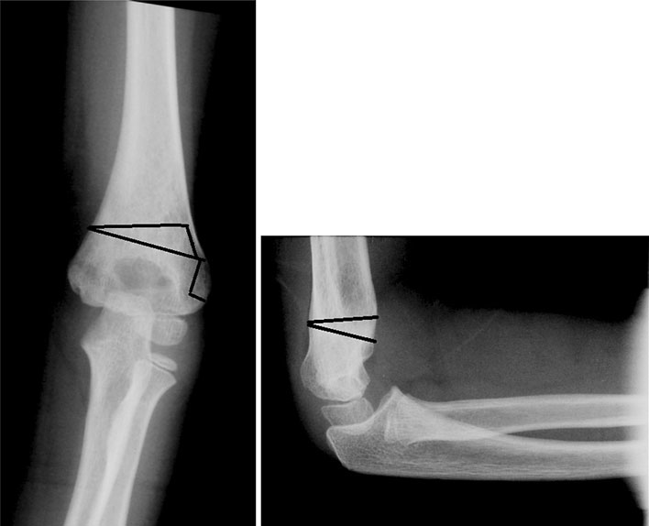
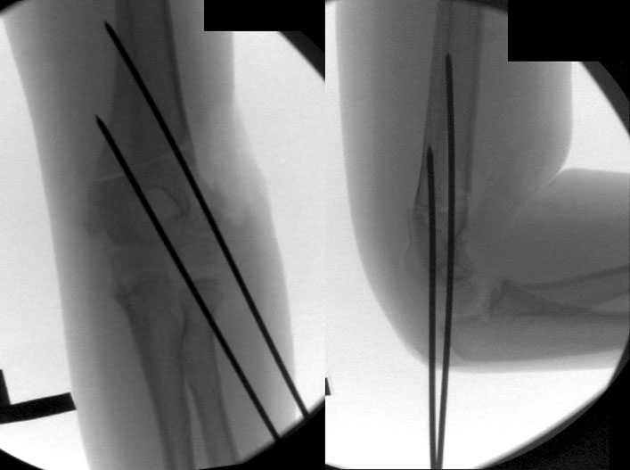
Cubitus Varus
Cosmetic Deformity > functional problem.
>20 deg can result in late posterolateral instability and tardy ulnar nerve palsy.
Treatment:
Simple Lateral closing wedge (French) - prominent lateral bump
Modified Step Cut (Wiltse type) - most used
Dome osteotomy
Timing - wait for minimum of 2 years.
Approach - lateral or posterior
Osteotomy + Fixation

Slide 28
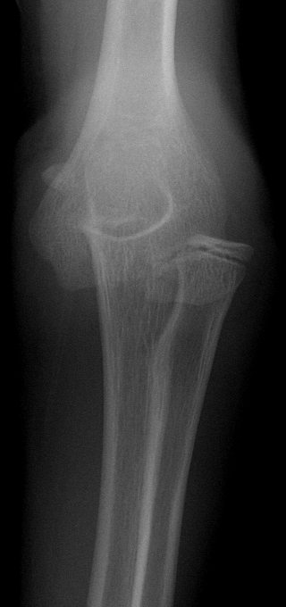
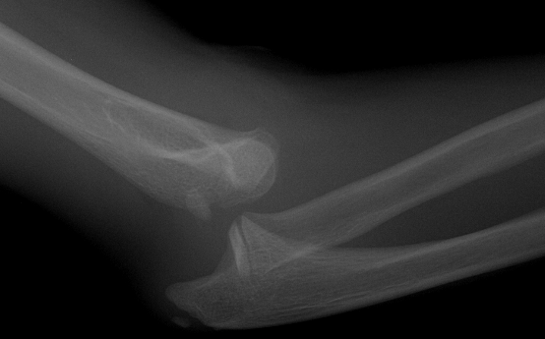
Case 8
10 year old – fall off trampoline
Diagnosis? Management?

Slide 29
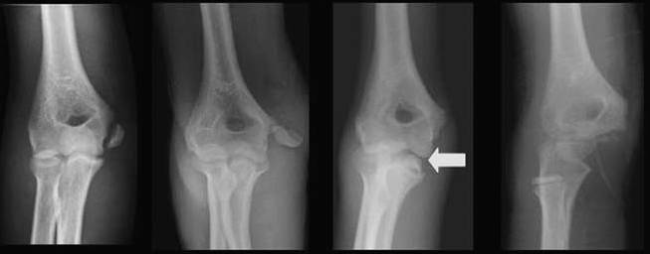
Medial Epicondyle Fracture
Displacement is underestimated on xray (CT study displacement =10mm)
Surgical intervention is well supported but based on Level 3 evidence only.

Slide 30
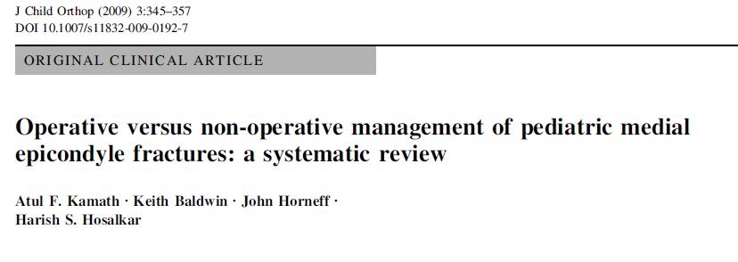
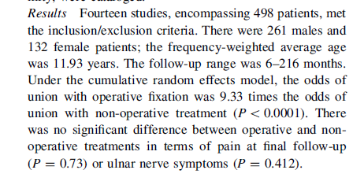
Medial Epicondyle Evidence
Meta-analysis:
Union 93% in op vs 49% non-op
BUT
No difference in pain

Slide 31
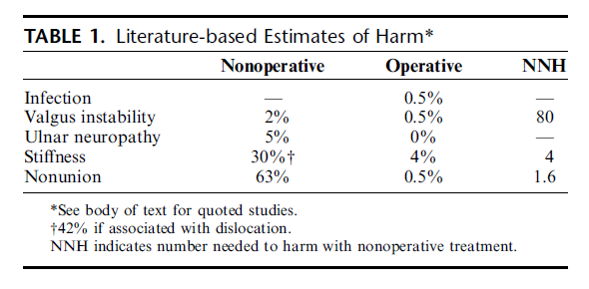
Medial Epicondyle Evidence
SUMMARY
2 right answers
Pragmatic approach
Surgery for incarcerated
Fix with screw
Non-op – important is to mobilise early 3 weeks – most non-union are not painful long term.
Mehlman and Howard J Pediatr Orthop Volume 32, Number 2 Supplement, September 2012

Slide 32
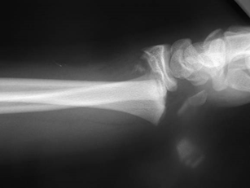
Case 9
10 yo Fall sustaining this injury presenting with tingling in his fingers?
What are your indications for pinning?
What tips would you give a trainee about pinning physeal injuries?

Slide 33
Distal Radial Physeal Injuries
Indication for Pinning
‘‘Floating elbow’’ injuries.
Neurovascular compromise associated with distal radius and ulnar fractures.
Relative indication >30 degrees angulation, >50% displacement.
TIPS
Smooth wire, less than 2mm, reduce passes, perpendicular to the physis

Slide 34
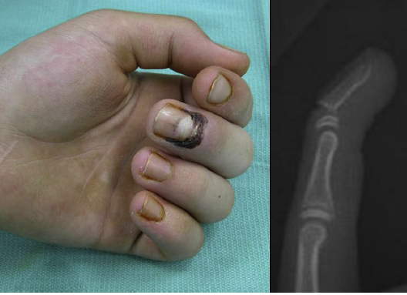
Case 10
11 yo caught finger in door
What is the diagnosis and Management?

Slide 35
Seymour fracture
SH I /II fracture of the distal phalanx
avulsion of the proximal edge of the nail from the eponychial fold
Open fracture
Unrecognised = osteomyelitis, nail deformity, growth disturbance
Treatment
removal of the nail plate, irrigation and debridement of the fracture,
removal of the incarcerated nail bed from the fracture, reduction of the fracture
repair of the nail bed +/- pinning
Antibiotics

Slide 36
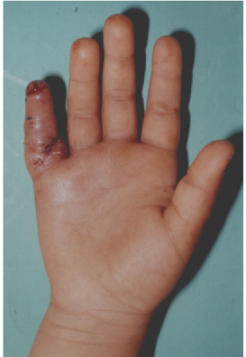
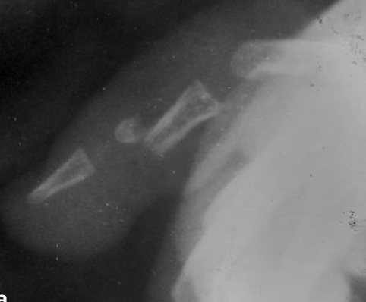
Case 11
4 yo caught little finger in toy chest, laceration washout and closed in A&E?
What is your management?

Slide 37
Paediatric Phalangeal Neck Fracture
Non-union and AVN common

Slide 38
Questions?

