Slide 1
Upper cervical spine injuries
Dr Mitchell Hansen
Consultant Neurosurgeon & Spine Surgeon
John Hunter & John Hunter Childrens’ Hospitals, Newcastle Australia
Lake Macquarie Private, Lingard Private, Mater, Newcastle Private and Westmead Private Hospitals

Slide 2
Disclosures
Nil relevant

Slide 3
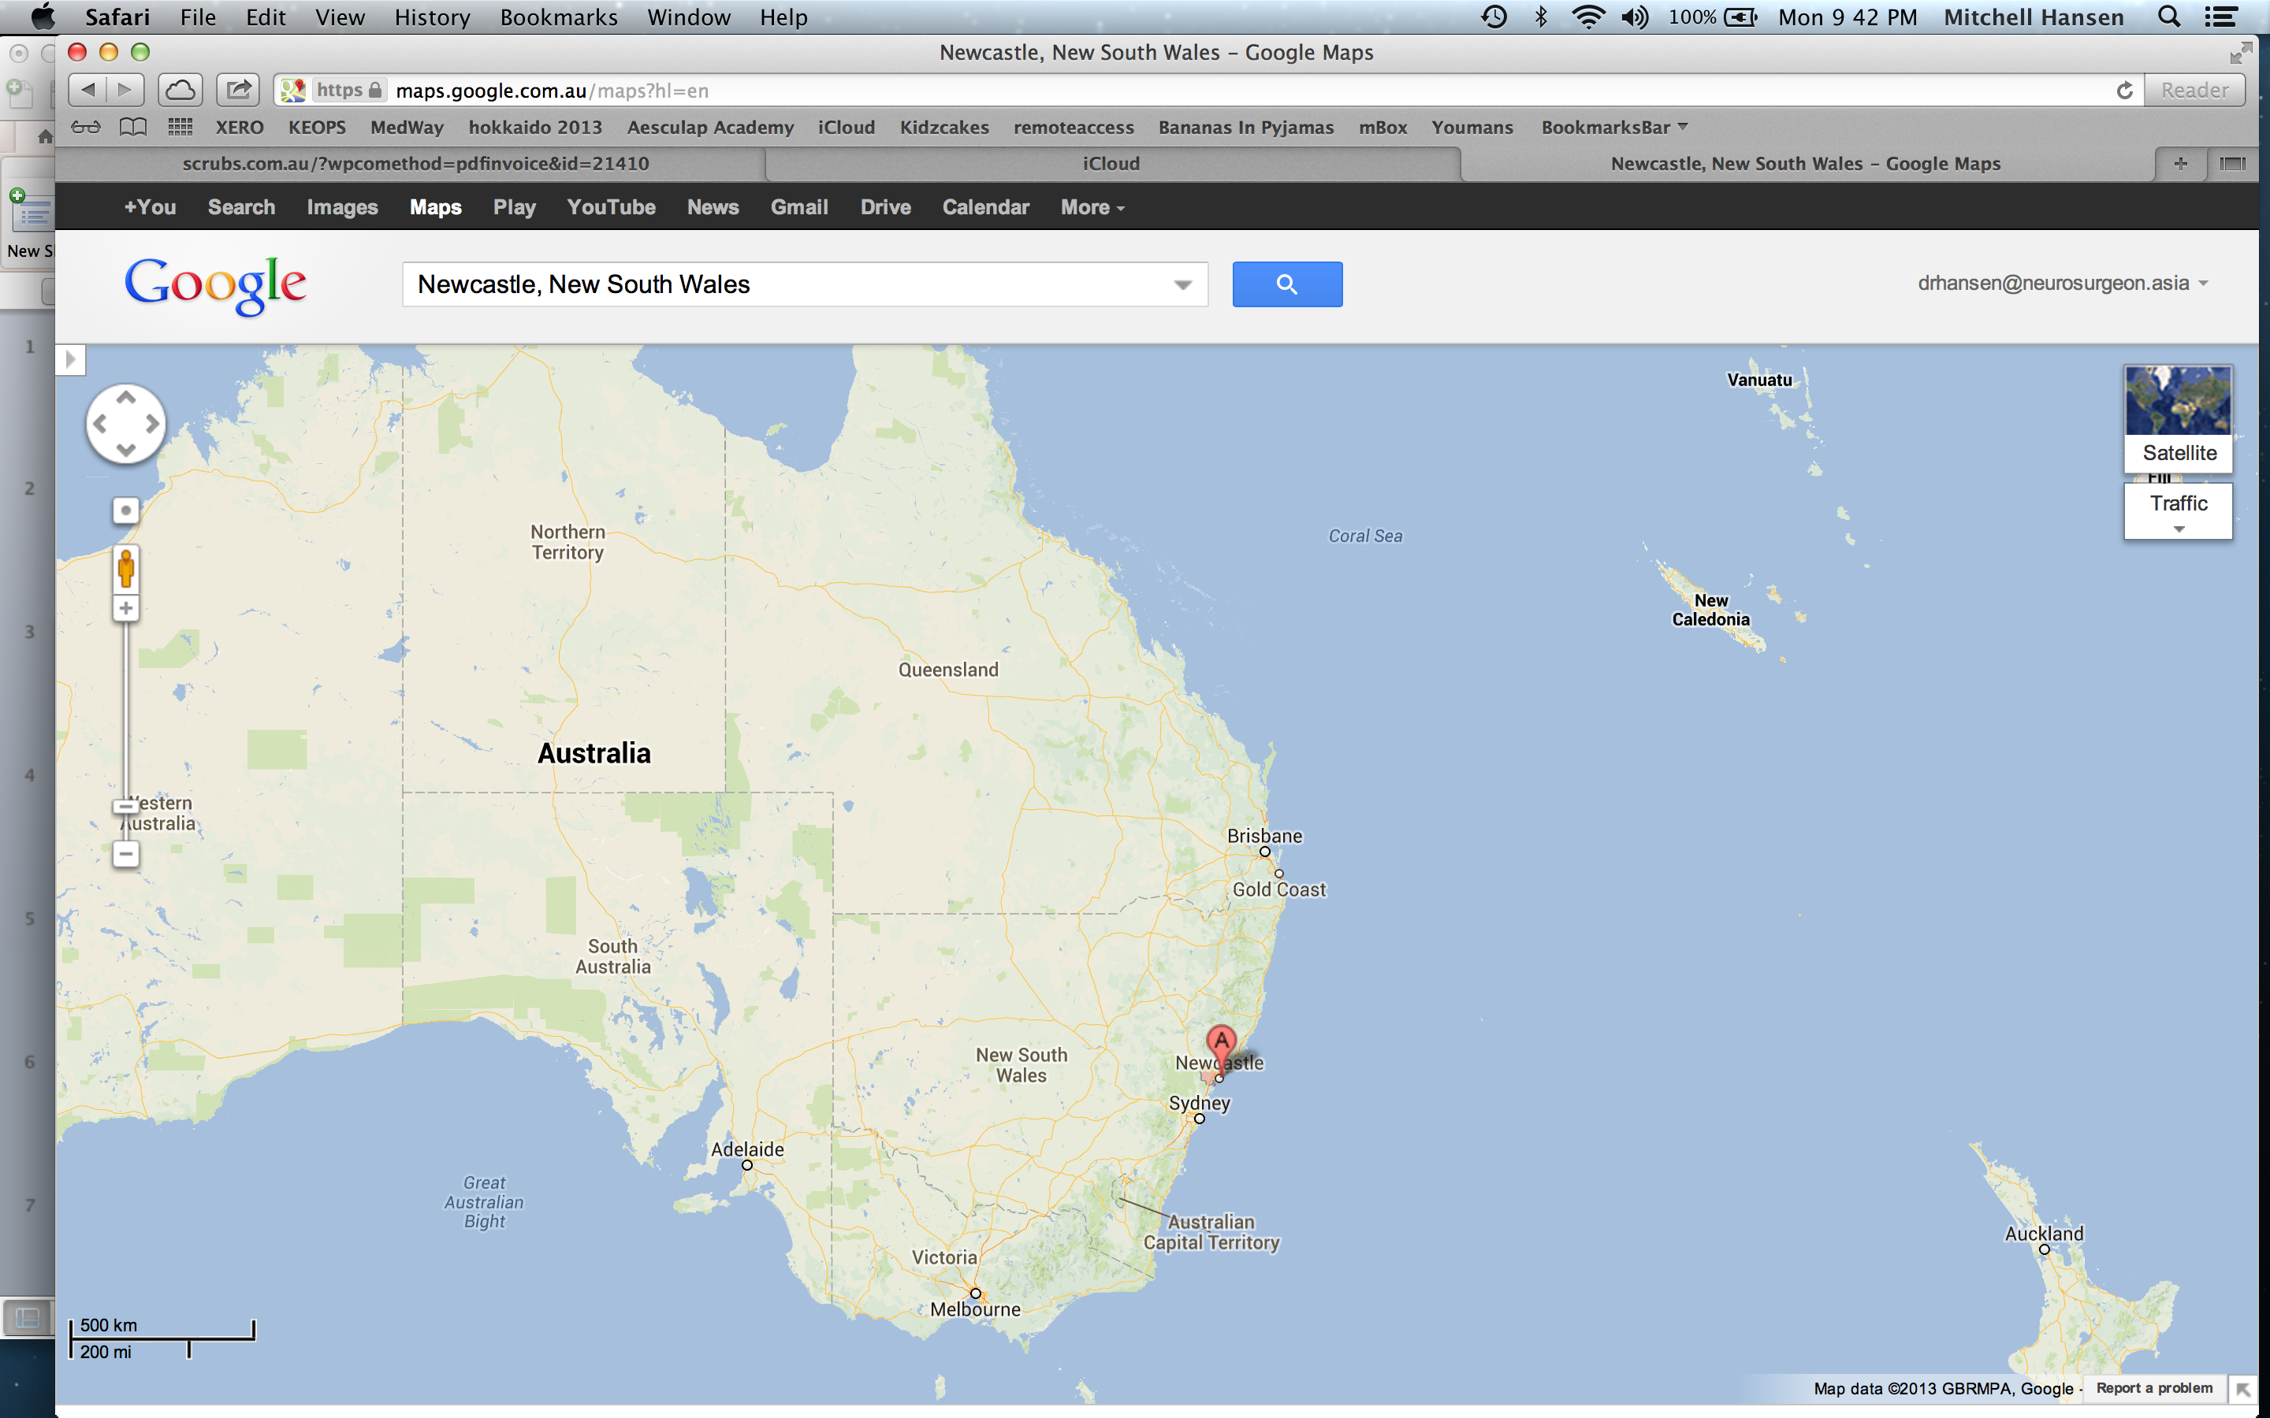

Slide 4
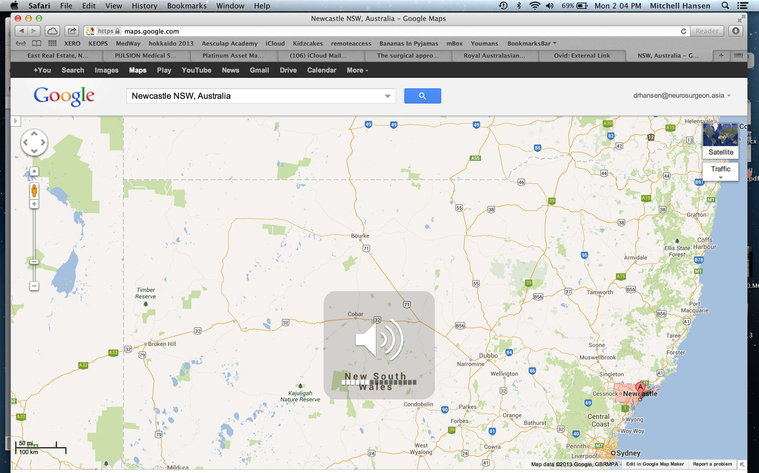

Slide 5
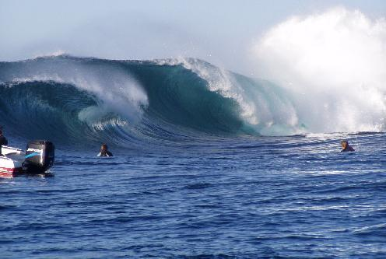

Slide 6
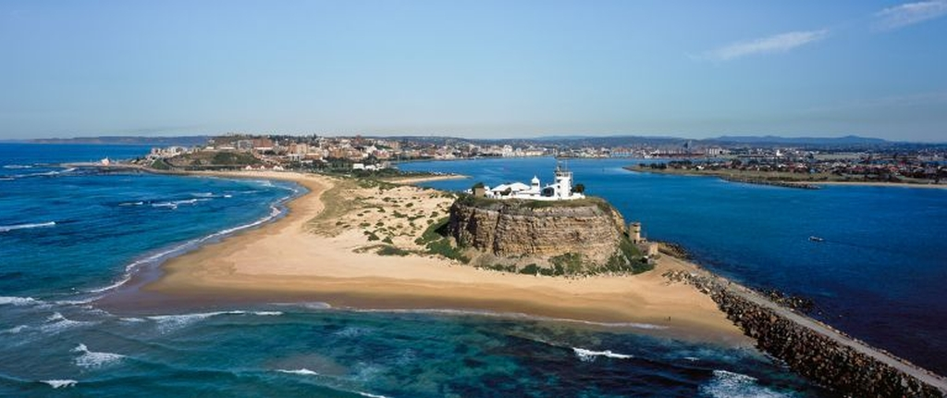

Slide 7
Outline
Anatomy of cervical spine
  Bony
    Occiput
    Atlas
    Axis
    Subaxial
  Vascular
    Carotid and Vertebral
    Arterial supply of Spine
  Neurological
    Cord
    Nerves

Slide 8
Outline
Description of injuries
Management of injuries
  Operative
  Non-operative (not conservative!)

Slide 9
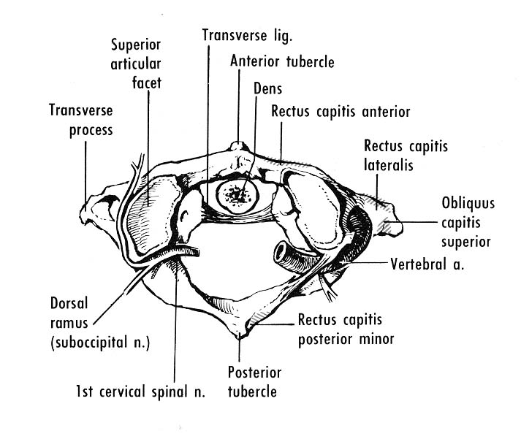

Slide 10
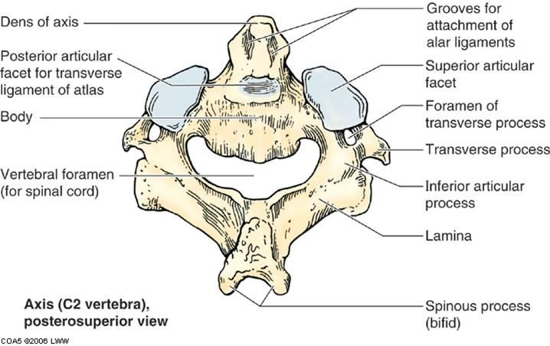

Slide 11
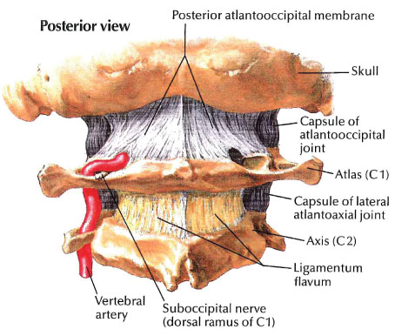

Slide 12
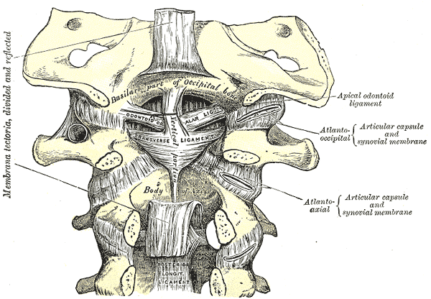

Slide 13
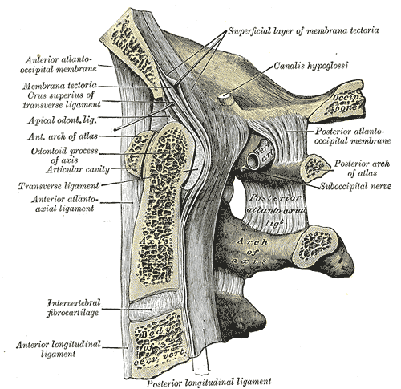

Slide 14
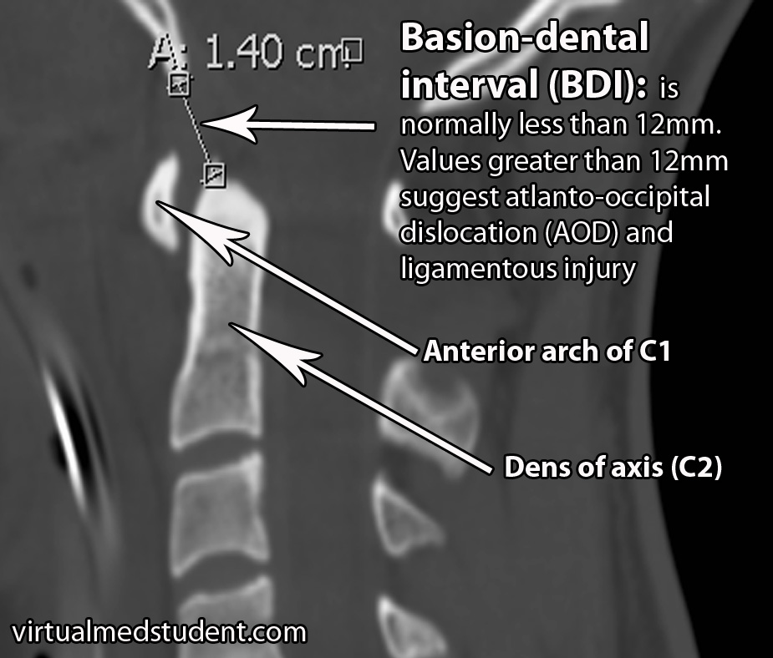

Slide 15
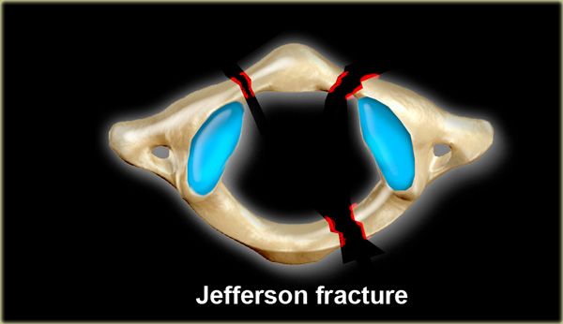
Atlas fractures

Slide 16
Odontoid Fractures
Odontoid process
  Type 1
  Type 2
  Type 3
Hangman’s variants

Slide 17
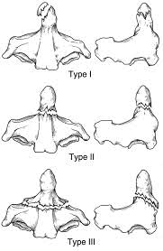
Odontoid Fractures
Type I- immobilization- Miami- J 8 weeks
Type II- surgical/non-surgical management
Type III- immobilization-Miami-J/Halo 8 weeks

Slide 18
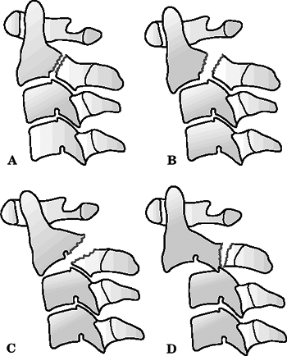
Hangmans Fracture
Effendi then modified by Levine & Edwards
Type 1
  Nondisplaced, no angulation; translation <3 mm; C2-C3 disc intact (29%); relatively stable
Type 2
  Significant angulation at C2-C3; translation >3 mm; most common injury pattern; unstable; C2-C3 disc disrupted (56%)
Type 2a
  Avulsion of entire C2-C3 intervertebral disc in flexion with injury to PLL, ALL intact; results in severe angulation; unstable; traction contraindicated
Type 3
  Rare; severe angulation and translation with unilateral or bilateral facet dislocation of C2-C3; unstable

Slide 19
First Case
65yo female who presented post drunken fall. Awoke following morning with severe posterior high cervical pain but no neurological deficit. Known history of lung and breast cancer.

Slide 20
First Case

Slide 21
First Case
Imaging showed a type 3 (minimal involvement of C2 body) peg fracture. Lucency within the peg raised the possibility of metastatic involvement.
Management Options?
  Non-Surgical?
  Surgical?
    Managed with a C1-4 fusion with bone graft. Discharged home.

Slide 22
First case

Slide 23
First Case

Slide 24
Second case
39yo male polytrauma, fell off a 10m bridge at work landing on concrete.
Sustained atlanto-occipital subluxation with comminuted C1 lateral mass fracture
Splenic laceration requiring splenectomy
Traumatic SAH managed conservatively
Left pneumohaemothorax with flail segment requiring ICC
Fractures of the L scapula
T4 VB managed conservatively.

Slide 25
Second case
Management Options?
  Non-surgical?
  Surgical?
    Atlanto-occipital subluxation managed with 0-C2 fusion.
Discharged home after 2 weeks

Slide 26
Post-operatively

Slide 27
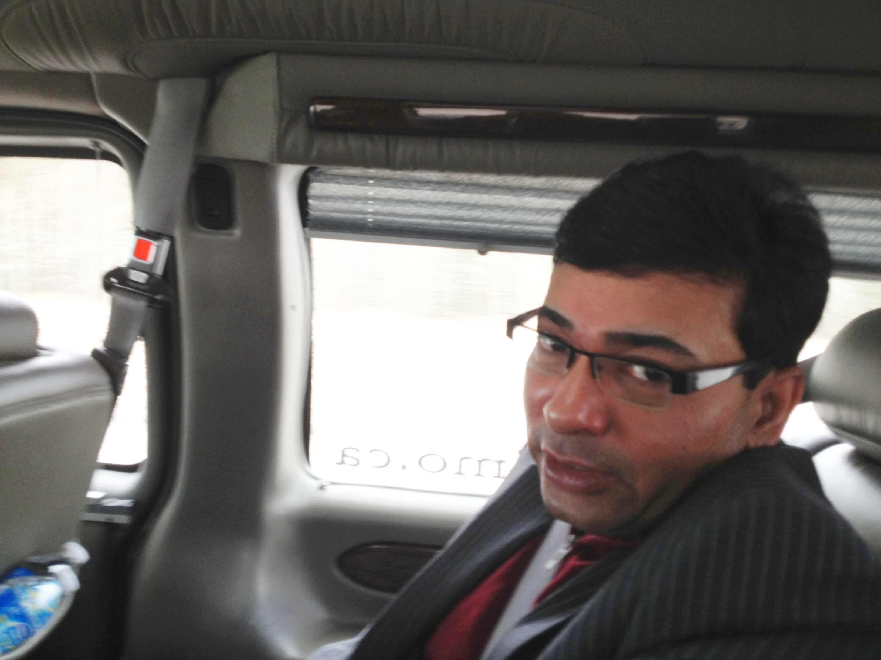

Slide 28
Third Case
73yo male from Coffs Harbour (400 km from Newcastle) chopping branches with a chainsaw when a branch fell on his head. Presented with posterior cervical pain and no neurological deficit.

Slide 29
Third Case

Slide 30
Third Case
Imaging showed a Hangmans variant C2 fracture with comminuted involvement of the body, and multiple subaxial injuries including spinous process fractures of C3 and C7.
Management Options?
  Non-Surgical
  Surgical
    Managed with a C1-3 posterior fusion. Transferred to Coffs Harbour for ongoing convalescence.

Slide 31
Third Case

Slide 32
Fourth Case
65yo male transferred from Port Mac after falling from the roof of a semi-trailer
sustaining a type 2 peg fracture with no neurological deficit and a distal left radial fracture managed with ORIF
Management options?
  Non-surgical
  Surgical

Slide 33
Fourth Case
Managed with an odontoid screw.

Slide 34
Fourth Case
Follow up?
6 weeks post-op had an asymptomatic osteolysis with periprosthetic lucency on plain XR.
Underwent O-C2 fusion

Slide 35
Conclusions
Anatomy of upper cervical spine is complex
Complexity gives large possible number of different injuries of various stabilities
Many options for management of most injuries

