Slide 1
The Resuscitation Room
20 November 2012
Dr Gareth Grier
Consultant in Emergency Medicine and Pre-hospital Care

Slide 2
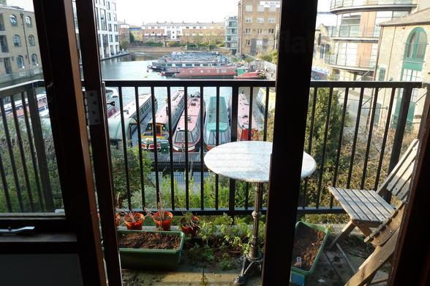
Case

Slide 3

Case

Slide 4
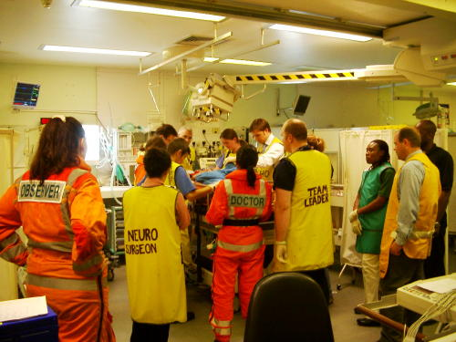
Notes:
4

Slide 5
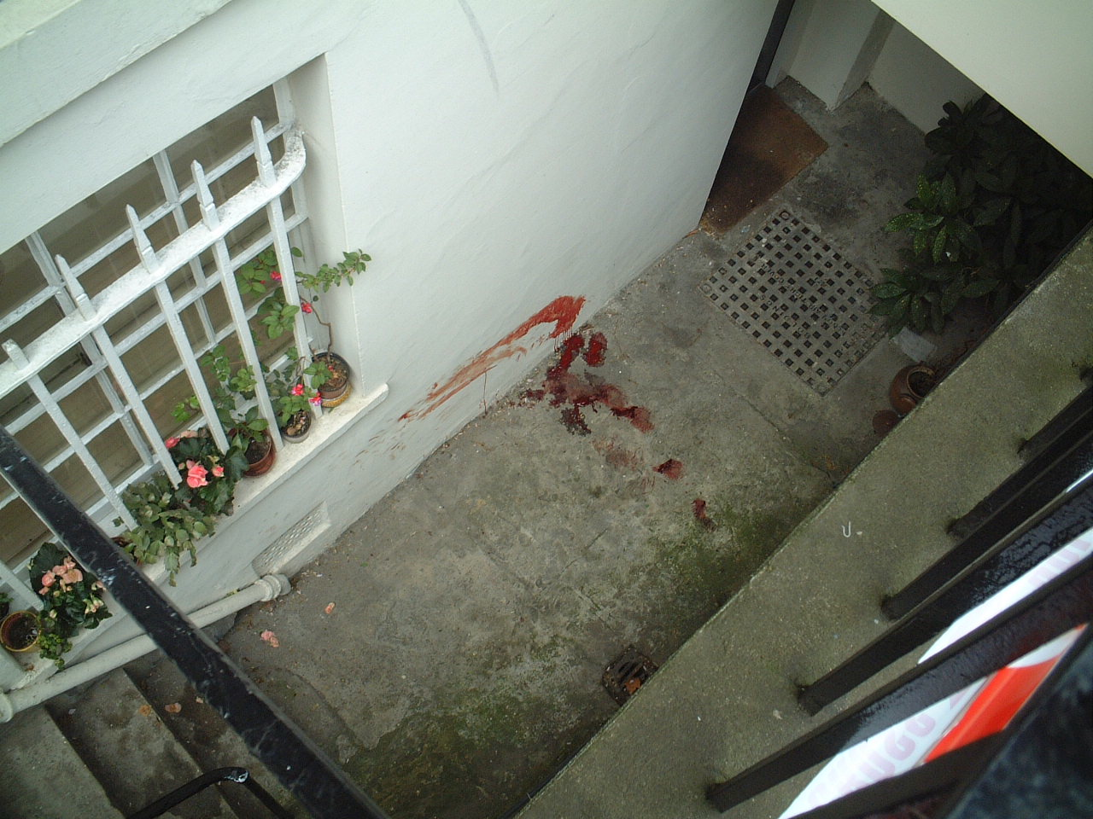

Slide 6
Fall from height - injuries
Calcaneus
Tibial plateau
Acetabulum
Spinal fractures
Others?

Slide 7
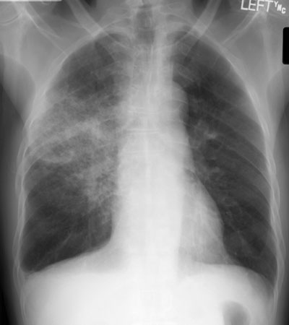
Notes:
7

Slide 8
58 year old lady
THR 3 weeks ago
Antibiotics for ‘skin’ infection in hospital
Discharged
To GP with increasing pain in the hip
Fevers – thinks she has the ‘flu’

Slide 9
Medical school

Slide 10
Trauma patients
Consultation is flawed
Patients are intoxicated (20-60%) / drugs
Patients have multiple sites of pain
Circulating ‘adrenaline’
HEMS - Anaesthetic

Slide 11
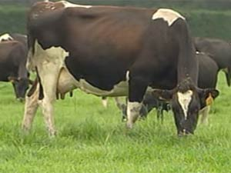

Slide 12
Trauma Consultation
Mechanism
Prediction of injuries
Imaging to prove or disprove injuries
Management plan

Slide 13
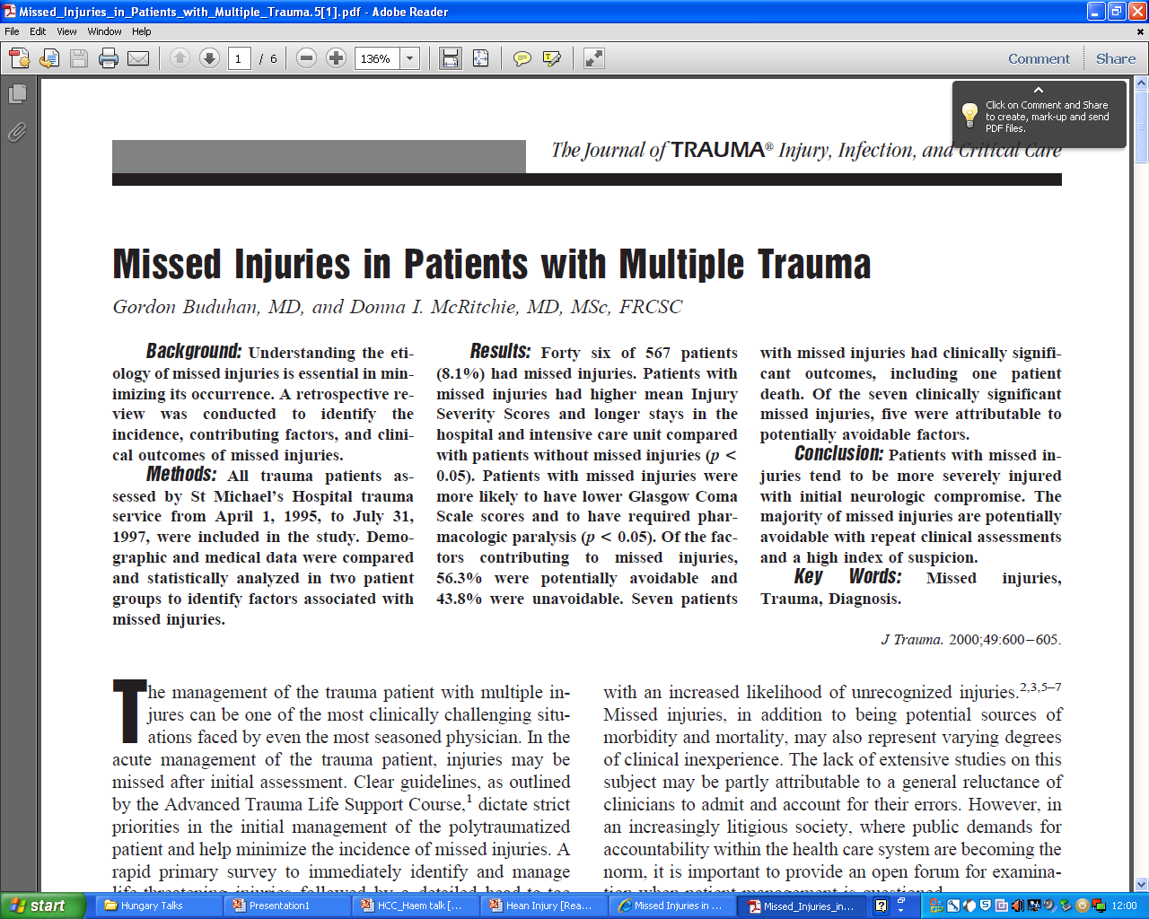

Slide 14
Key message
Targeted imaging for trauma patients

Slide 15
Notes:
15

Slide 16
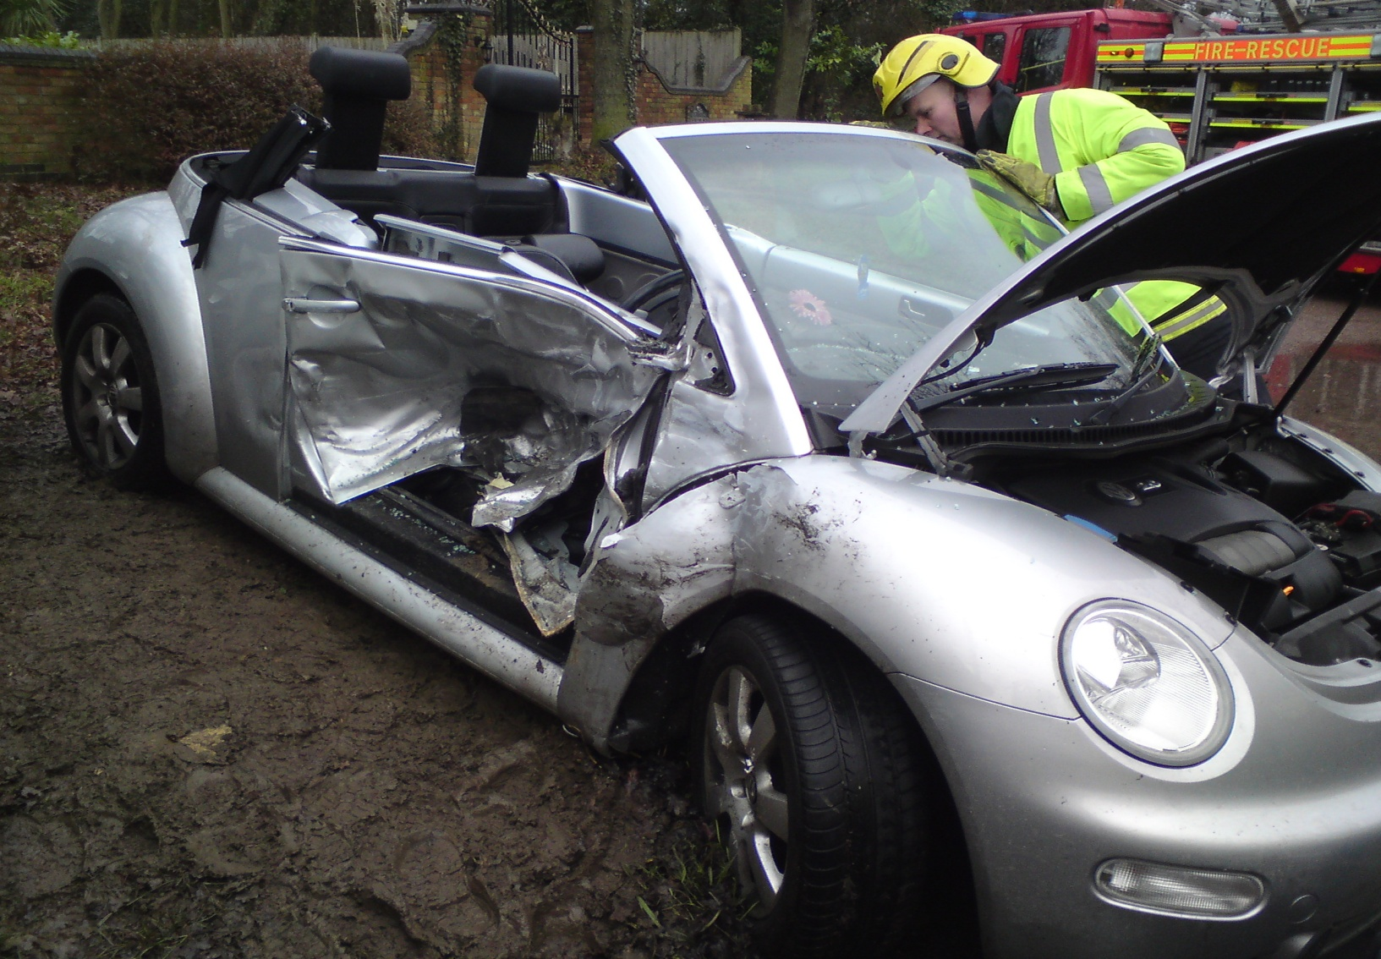

Slide 17
HR 110
BP 90
RR 12
SATS 100
Chest normal
Head normal
GCS 12

Slide 18
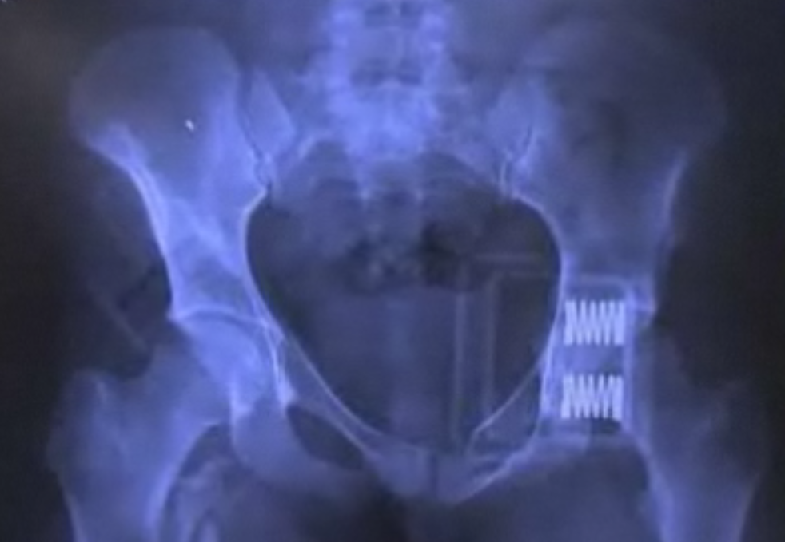
The bony x-rays are markers of vascular injury in the first stage

Slide 19
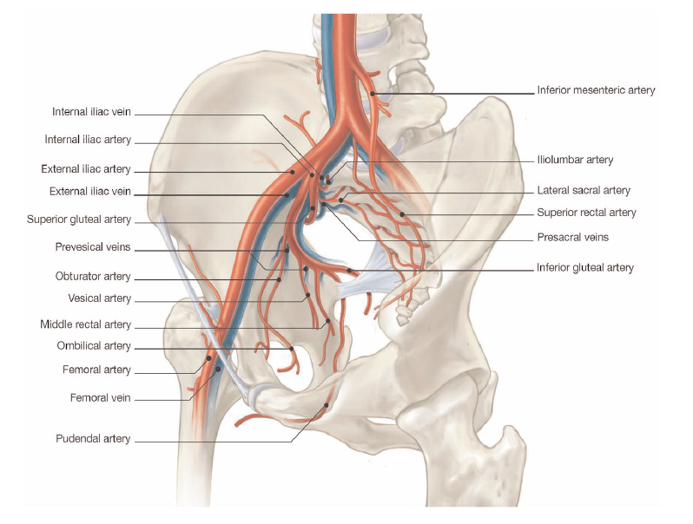

Slide 20
Do you want a CT scan of the pelvis?
HR 110
BP 90
RR 12
SATS 100
Chest normal
Head normal
“GCS” 12

Slide 21
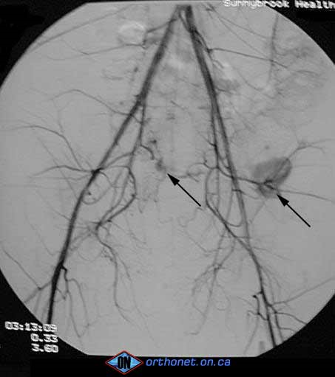
Do you want a CT scan?

Slide 22
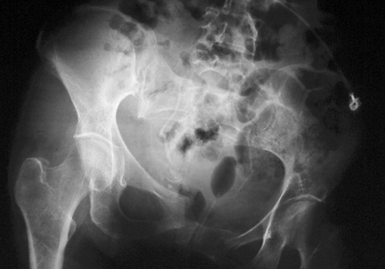
HR 110
BP 70/30
“GCS” 7

Slide 23
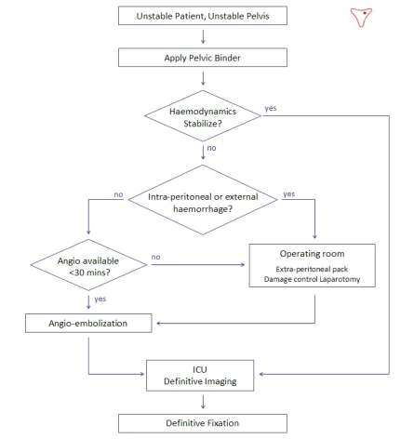
Bottom line

Slide 24
Notes:
24

Slide 25
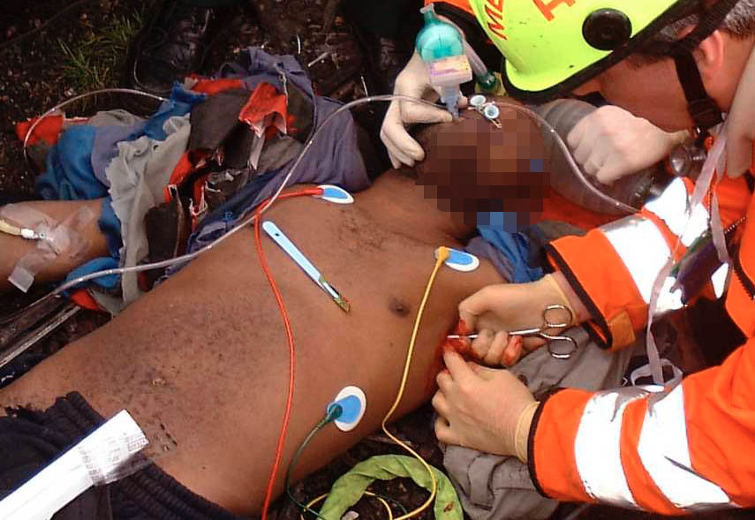
Thoracostomy
18 year old
Hit by a car
Severe head injury

Slide 26
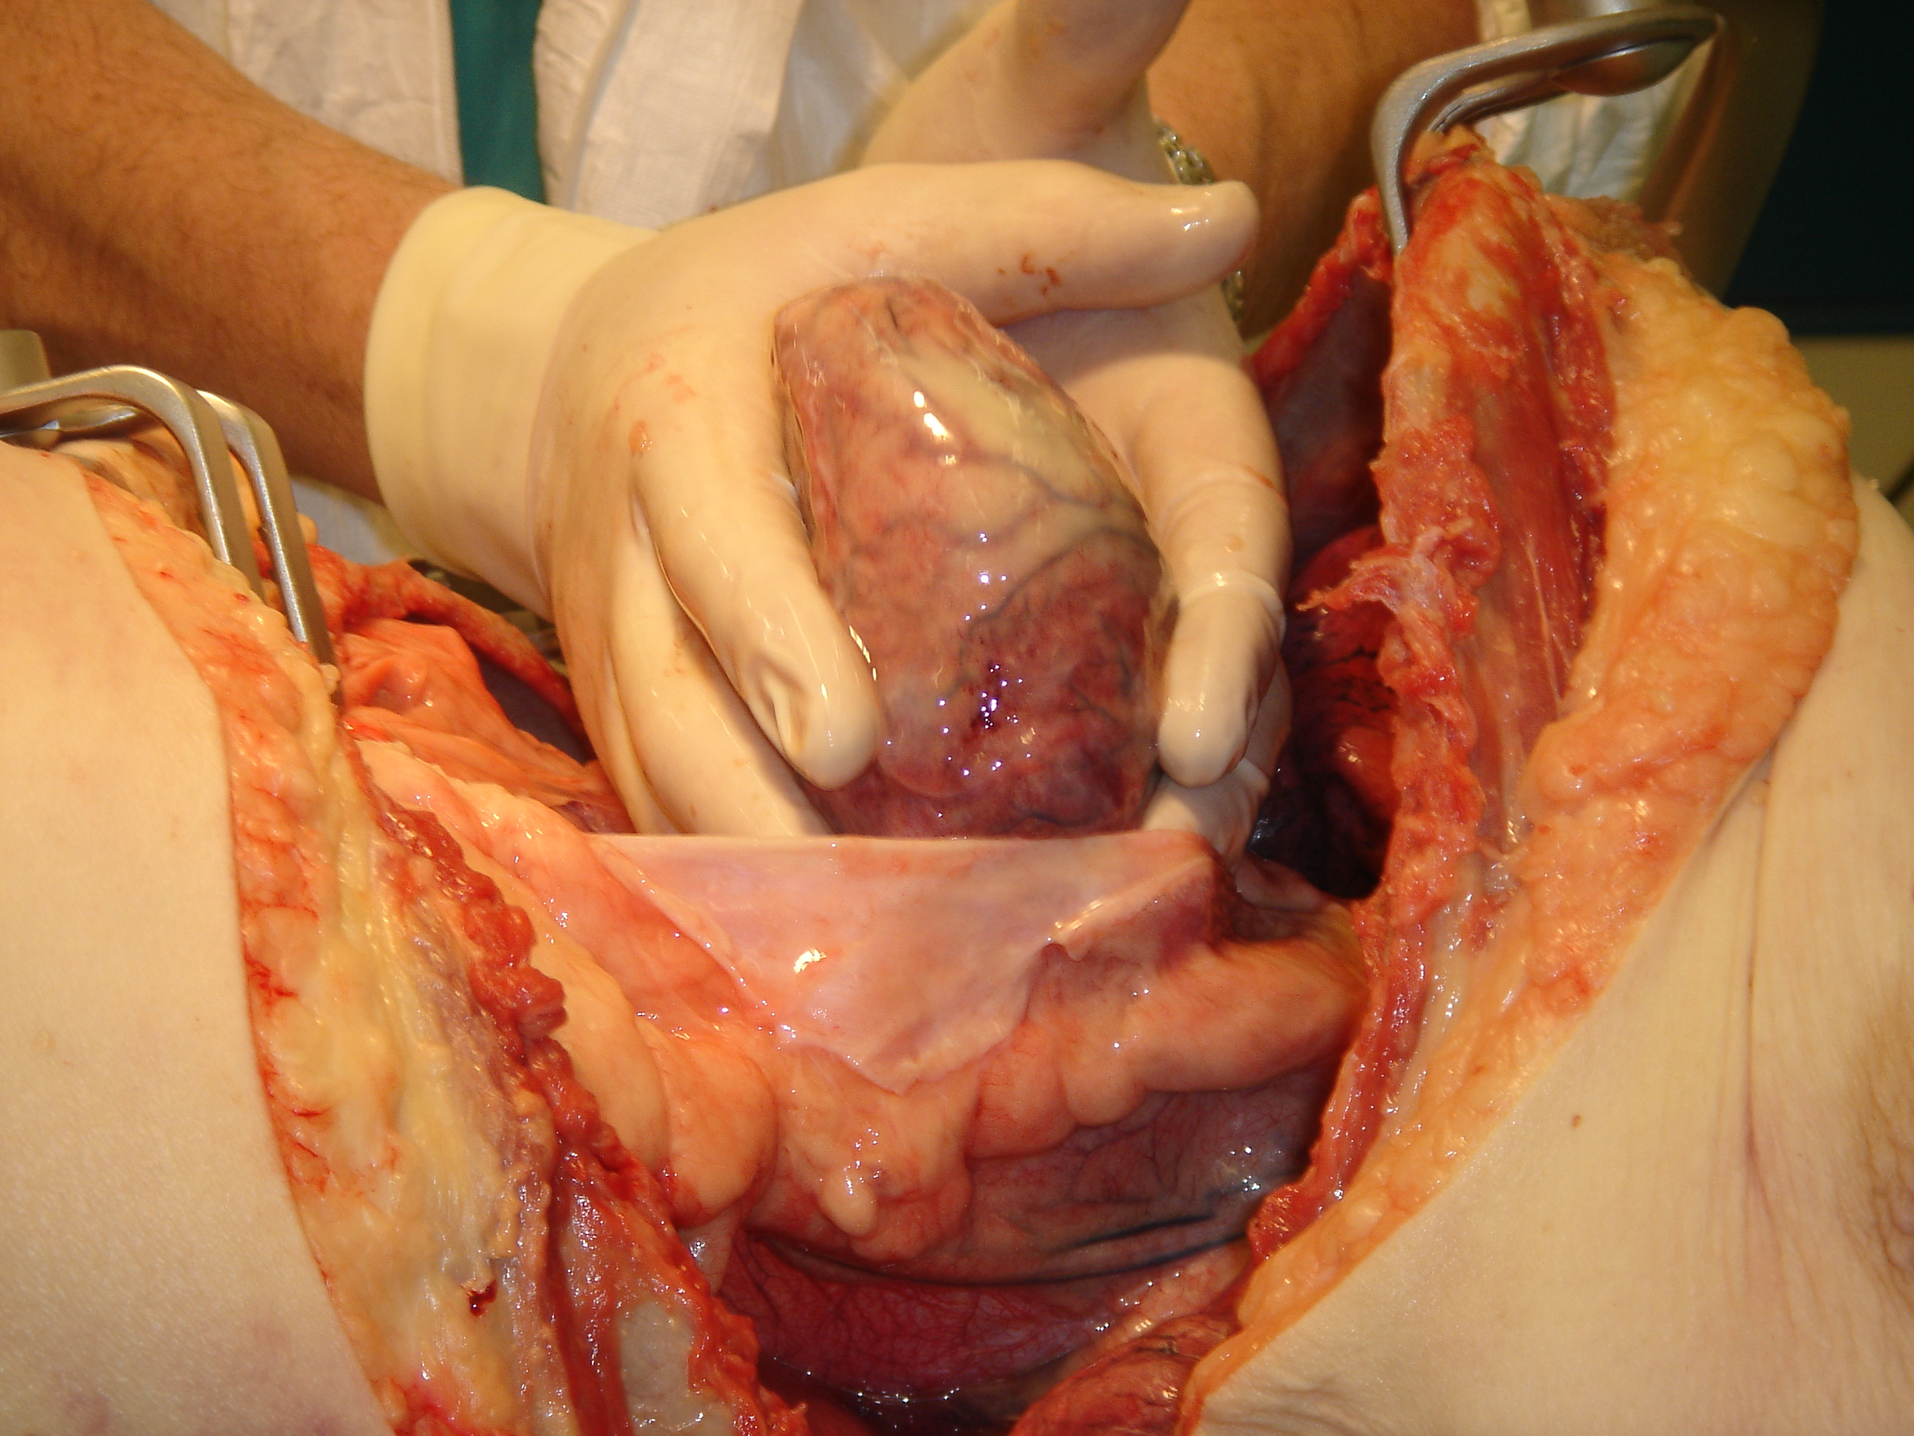
Notes:
26

Slide 27
What are the indications for an emergency department thoracotomy?
What is going wrong in the picture?
Are you ready to do / help with a thoracotomy

Slide 28
Notes:
28

Slide 29
Thoracotomy –ED
“Emergent”
“Emergency”
“Resuscitative”
“Emergency ‘bedside’ thoracotomy
“Cardiac arrest”

Slide 30
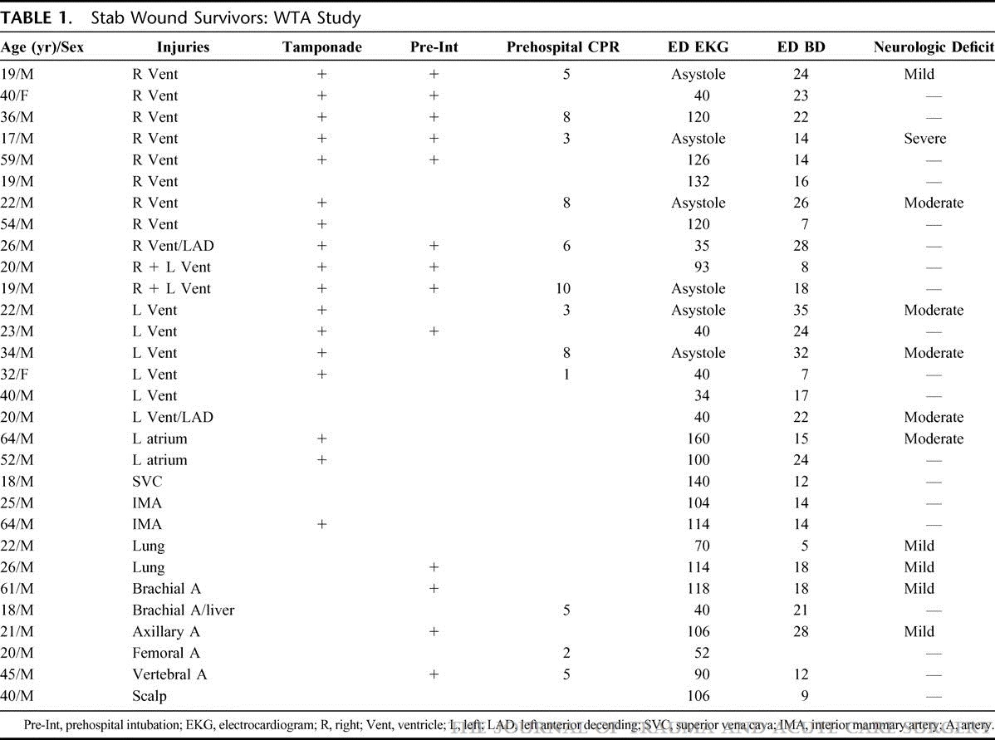
Emergency Department Thoracotomy – Penetrating Trauma
TABLE 1. Stab Wound Survivors: WTA Study
Defining the Limits of Resuscitative Emergency Department Thoracotomy: A Contemporary Western Trauma Association Perspective
Moore, Ernest E. MD; Knudson, M. Margaret MD
Journal of Trauma-Injury Infection & Critical Care:
February 2011 - Volume 70 - Issue 2 - pp 334-339
30

Slide 31
Emergency Department Thoracotomy – Penetrating Trauma
TABLE 1. Stab Wound Survivors: WTA Study
31

Slide 32
Emergency Department Thoracotomy – Penetrating Trauma
TABLE 1. Stab Wound Survivors: WTA Study
32

Slide 33
Emergency Department Thoracotomy – Penetrating Trauma
TABLE 1. Stab Wound Survivors: WTA Study
33

Slide 34
Emergency Department Thoracotomy – Penetrating Trauma
TABLE 1. Stab Wound Survivors: WTA Study
34

Slide 35
Emergency Department Thoracotomy – Penetrating Trauma
TABLE 1. Stab Wound Survivors: WTA Study
35

Slide 36
Emergency Department Thoracotomy – Penetrating Trauma
TABLE 1. Stab Wound Survivors: WTA Study
36

Slide 37
Emergency Department Thoracotomy – Penetrating Trauma
TABLE 1. Stab Wound Survivors: WTA Study
37

Slide 38
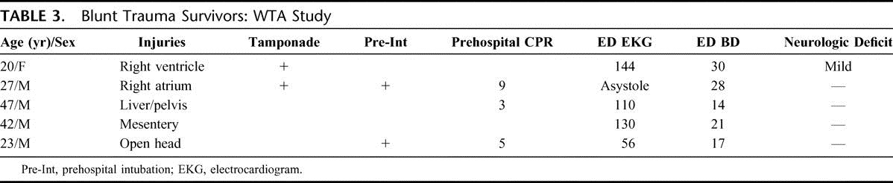
Blunt trauma?

Slide 39
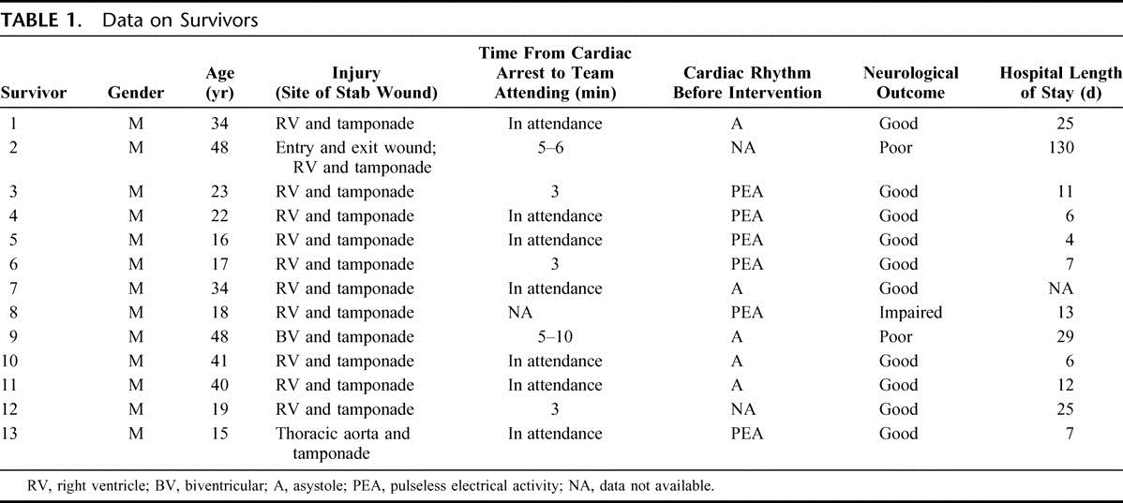
Davies GE, Lockey D Journal of Trauma-Injury Infection & Critical Care:
May 2011 - Volume 70 - Issue 5 - pp E75-E78
39

Slide 40
Myths
Cardiac tamponade
Distended neck veins?
Muffled heart sounds?
Low blood pressure?

Slide 41
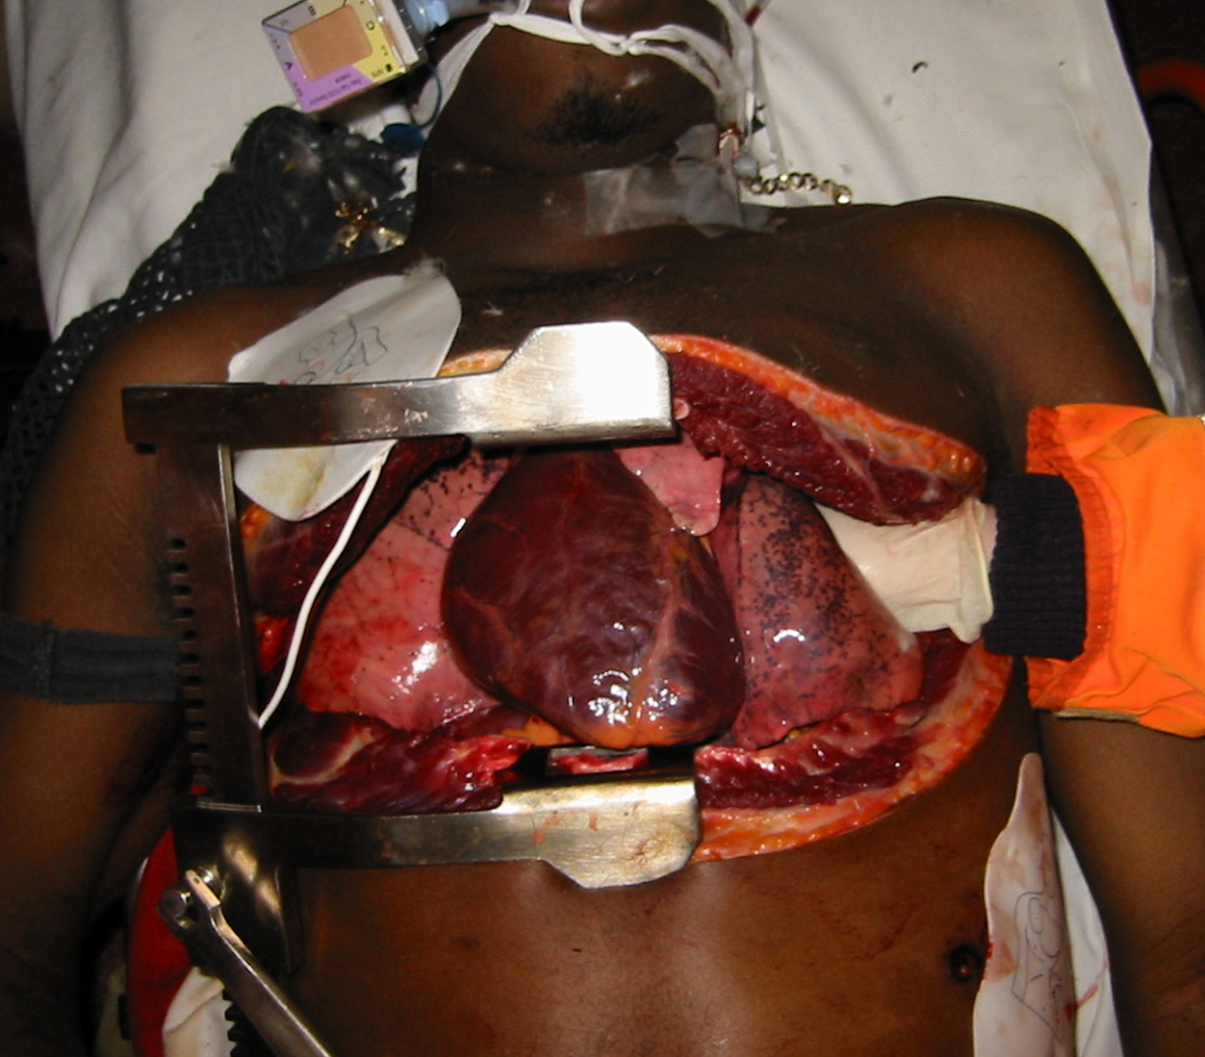

Slide 42
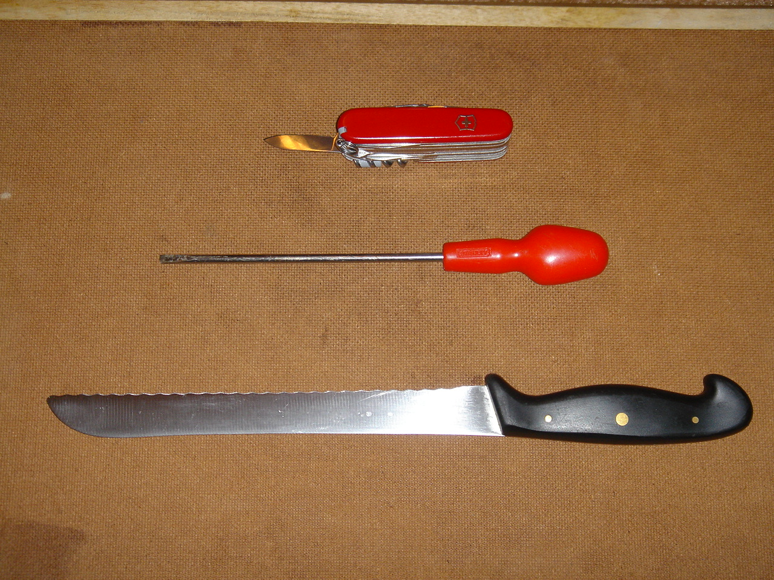

Slide 43
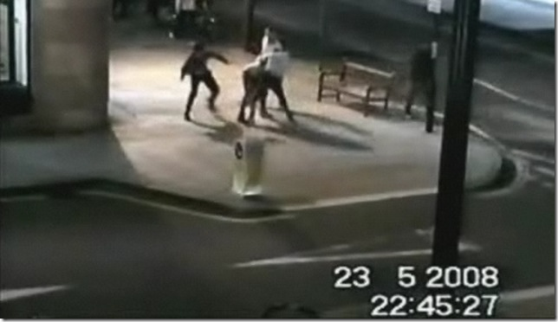

Slide 44
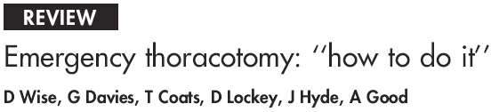
Emergency Medicine Journal
2005 22:22-24

