Slide 1
The Principles of Imaging- Spine
Dr.Sujit Vaidya,Consultant Radiologist
Barts and the London NHS Trust,
London

Slide 2
Teaching points…
Who needs imaging?
What imaging do I get?
How to I interpret these images?
What do I actually make of the scans?

Slide 3
What are the red flags ?
Age : <20 or >50
Non mechanical pain
Malignancy, steroids, HIV, significant past history
Wt loss, unwell
Neurology or structural deformity
Persistent night pain
Saddle anesthesia/sphincter disturbances

Slide 4
What Imaging do you use??
Plain films
CT/SPECT
MRI
Bone scans

Slide 5
Clear advantages of MRI
Multiplanar capability
Detail
No ionising radiation

Slide 6
Problems?
Supine
Contraindications- pacemakers
Cost!

Slide 7
What are the routine sequences?
Sagittal T1
Sagittal T2
Axial T1/T2
STIR

Slide 8
Wait…..What’s T1 and T2 ???
Two key points:
Water is low on T1 and bright on T2
Fat is bright on both

Slide 9
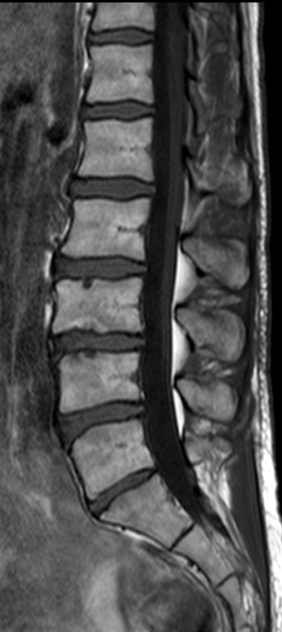
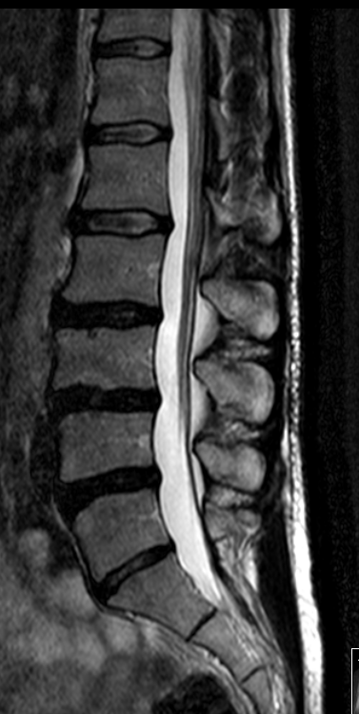
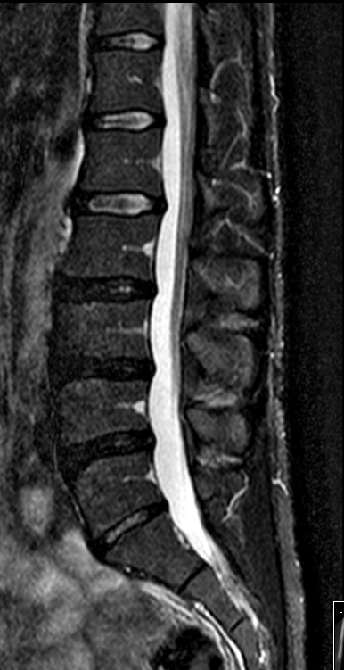
Notes:
Normal three sequence sag

Slide 10
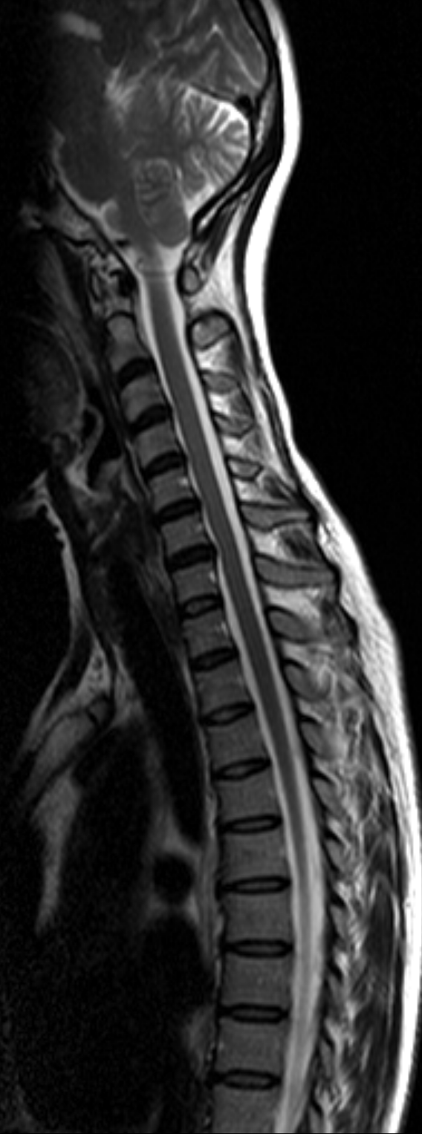
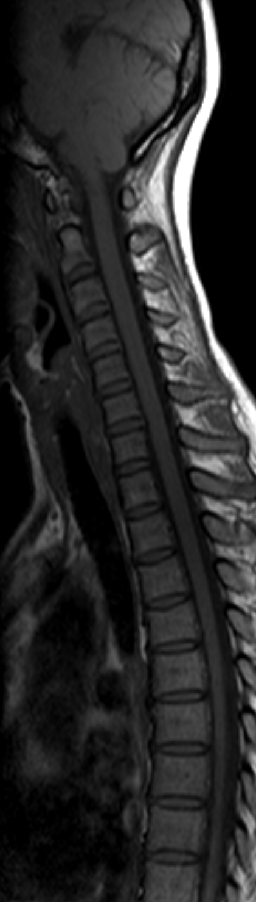
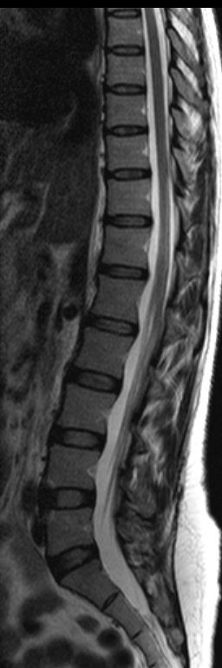
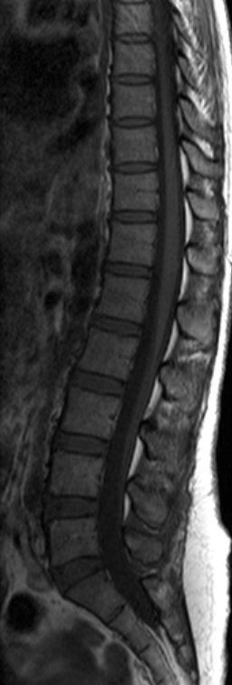
Sag T2
Sag T1
Sag T2
Sag T1
Notes:
Normal

Slide 11
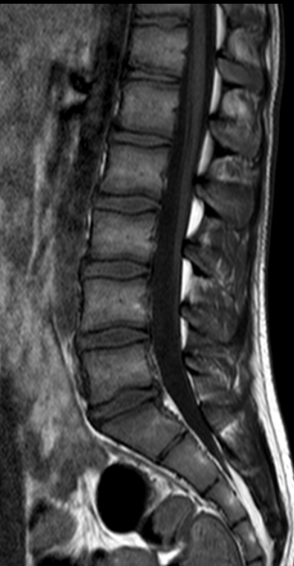
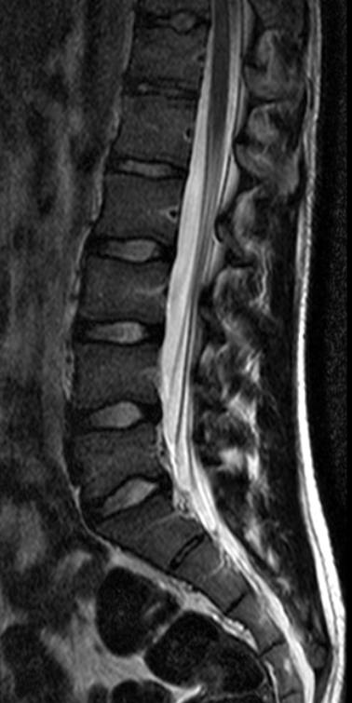

Slide 12
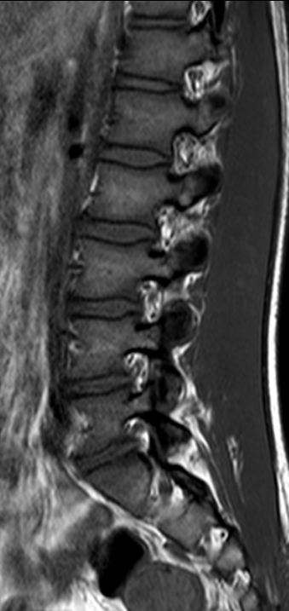
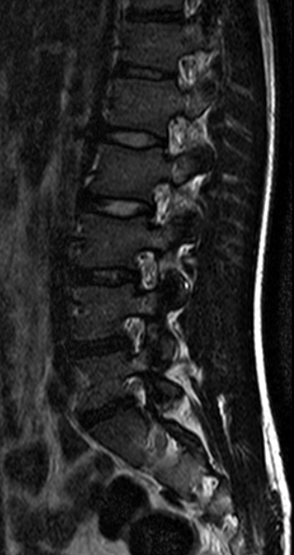

Slide 13
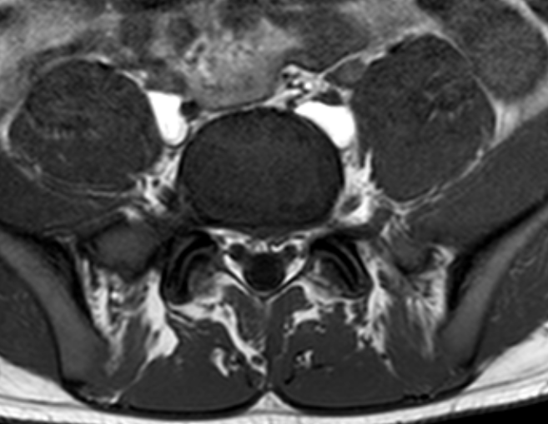
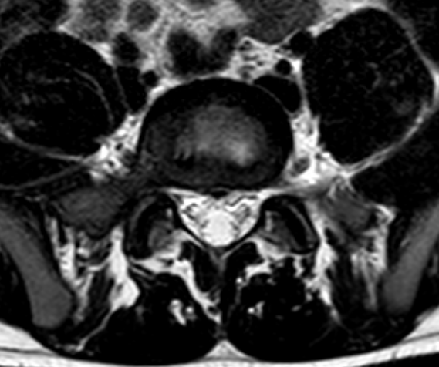

Slide 14
So..the things to look for are…
Vertebral bodies: Height
Alignment
Marrow signal
Discs: Dessication,loss of height
Bulge,protrusion etc
Canal: Size,
Cord,roots,signal
Facets,flavum and paraspinal soft tissues

Slide 15
Case 1:Check the height
Elderly lady, complains of low back ache following a slip and fall last week

Slide 16
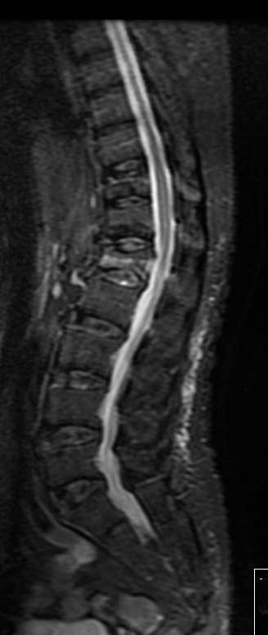
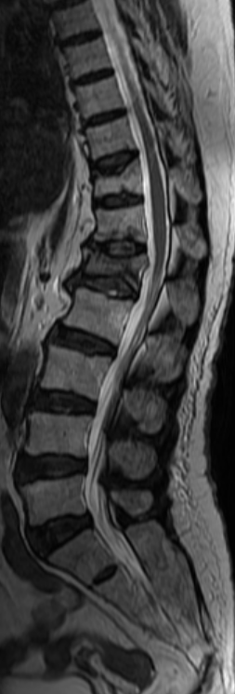
Notes:
Osteoporosis

Slide 17
Osteoporotic compression
Elderly population, history of trivial trauma
Thinning of the trabeculae without focal bone loss
Cortical destruction is absent
Band like edema

Slide 18
Case 2- Height
40 year old , male patient, presents with chest pain and upper back pain

Slide 19
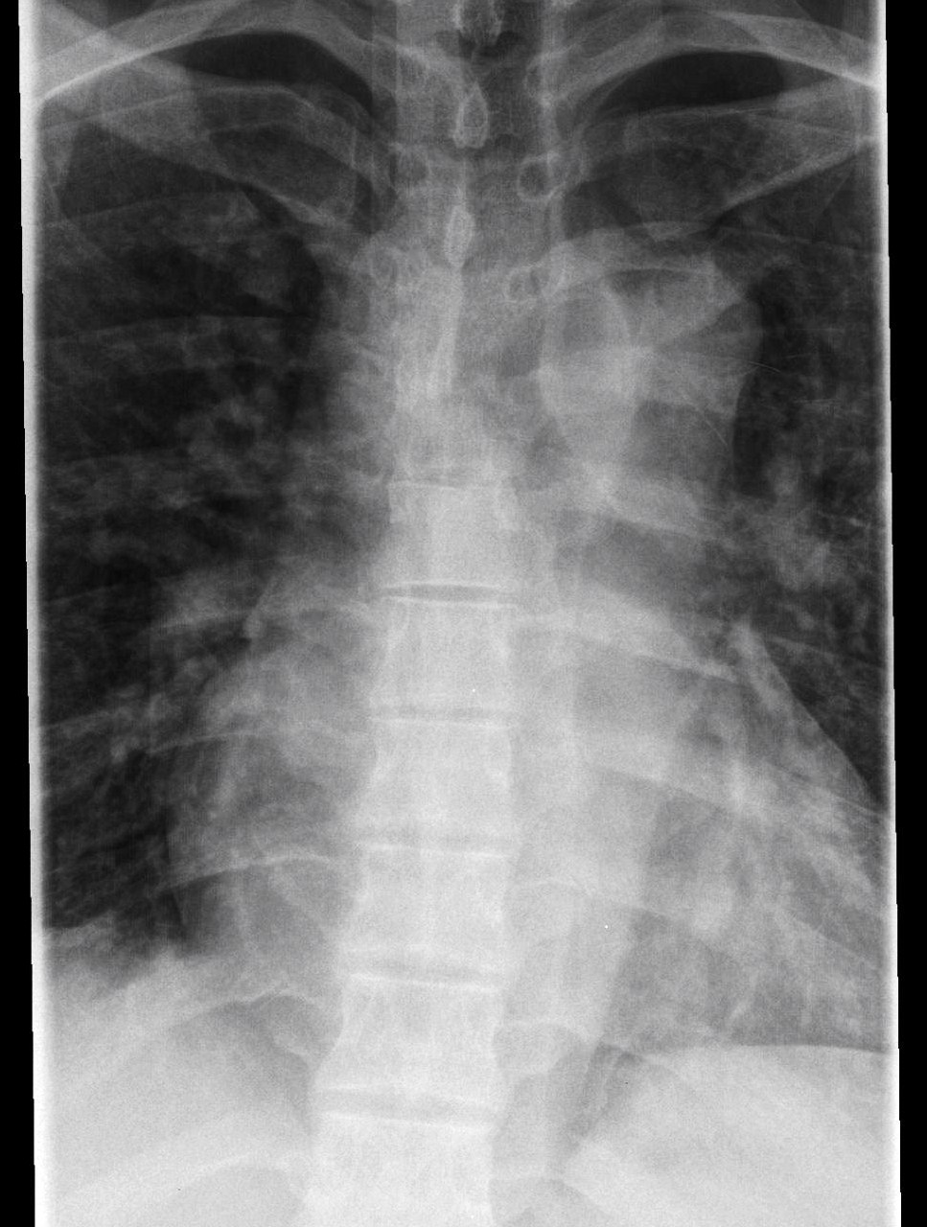
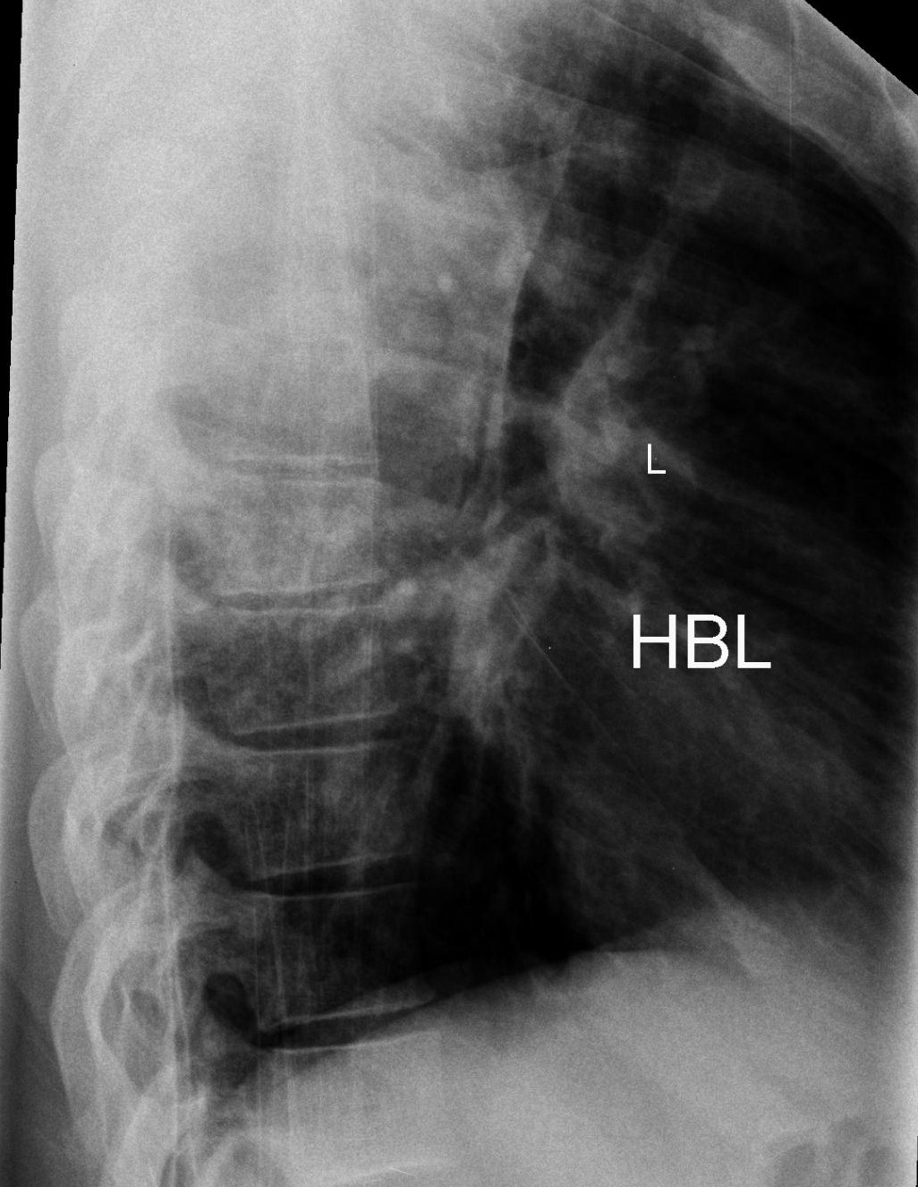

Slide 20
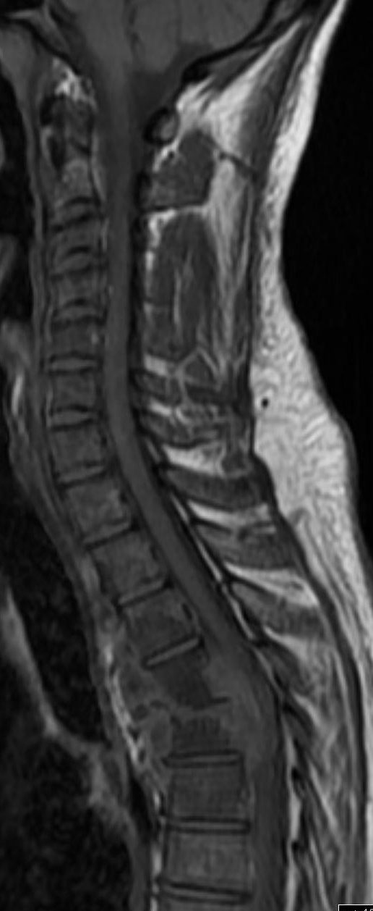
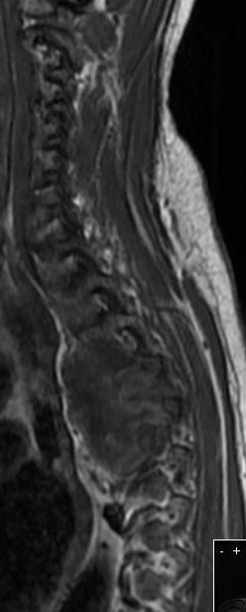
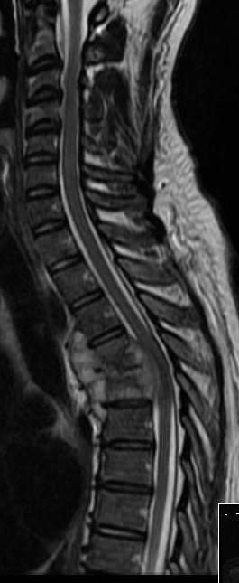
Sag T1
Sag T1
Sag T2

Slide 21
Pathologic compression
Trabecular or cortical bone destruction
Round or diffuse marrow abnormality
Multiple vertebrae
Paraspinous soft tissue

Slide 22
Marrow Imaging
The marrow is an organ!
Normal marrow in the child is CELLULAR
It progressively turns FATTY, in adulthood

Slide 23
Marrow Imaging…contd
What is marrow reconversion?
What is marrow infiltration?
How do I differentiate them?

Slide 24
Sag T2
Sag T1
Sag T2
Sag T1
Notes:
Normal

Slide 25
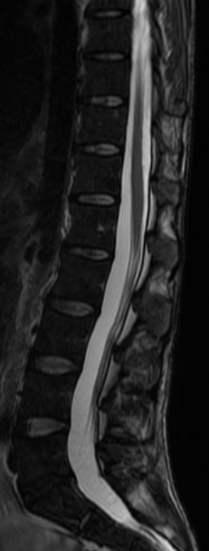
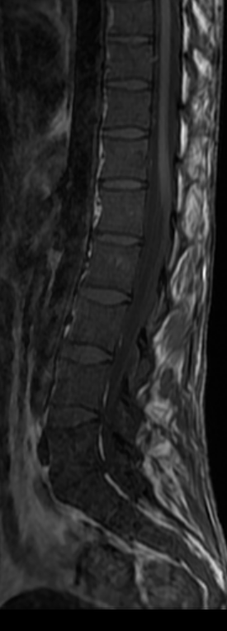
Sag T2
Sag T1
Sag T2
Sag T1
Notes:
Dark marrow

Slide 26
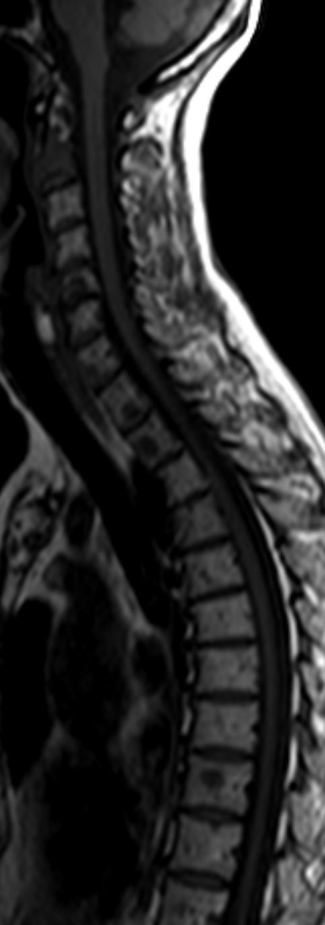
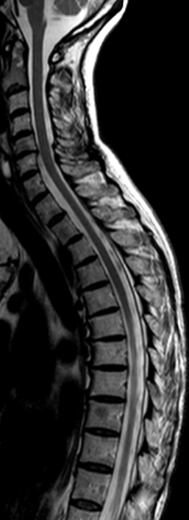
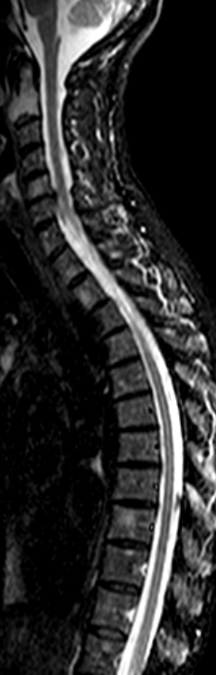
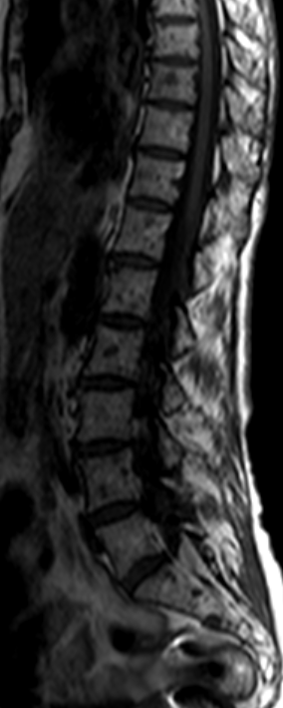
Sag T1
Sag T2
STIR
Sag T1

Slide 27
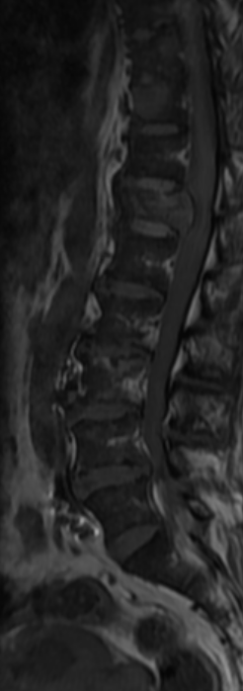
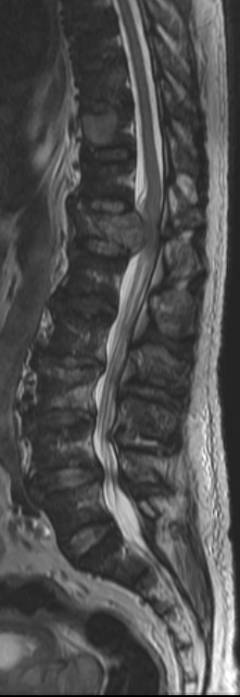
Sag T1
Sag T2

Slide 28
Top differentials for multiple vertebral involvement
Metastasis
Myeloma/Lymphoma
Infection-TB

Slide 29
Metastasis
Osteolytic metastasis
Osteoblastic metastasis
Breast, lung,kidney, thyroid, nasopharynx,GI
Low on T1 , BRIGHT on T2 and STIR
Prostate,carcinoid,bladder
Low on T1 and T2, may show bright signal on STIR

Slide 30
Case 3 -Alignment
Young adult, complains of low back ache

Slide 31
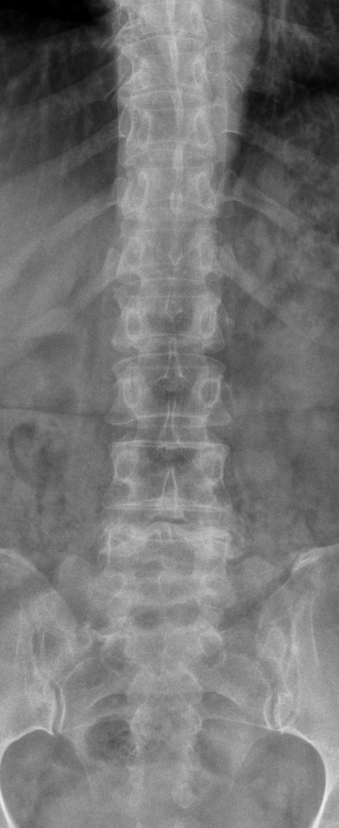
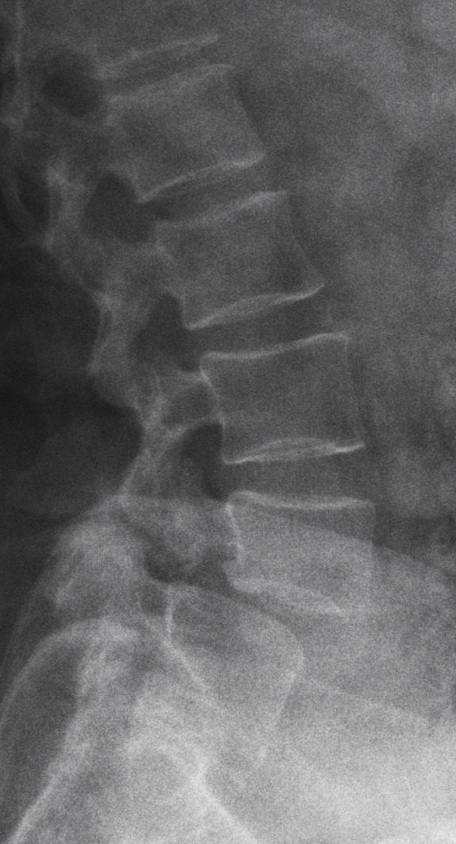

Slide 32
Spondylolisthesis...
Displacement of one vertebral body relative to another
Commonly isthmic (due to fatigue or stress fracture of the pars) or degenerative.
Can occur with or without spondylolysis

Slide 33
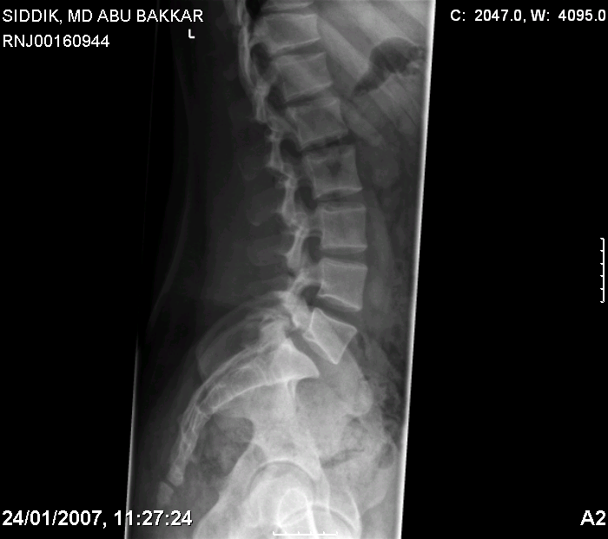
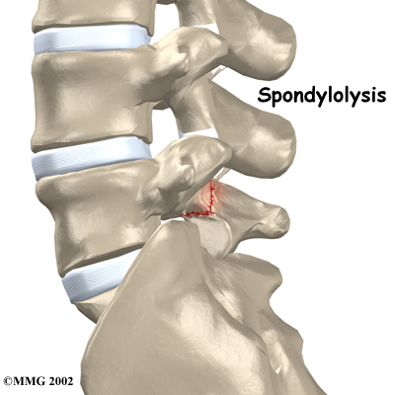
Spondylolysis

Slide 34
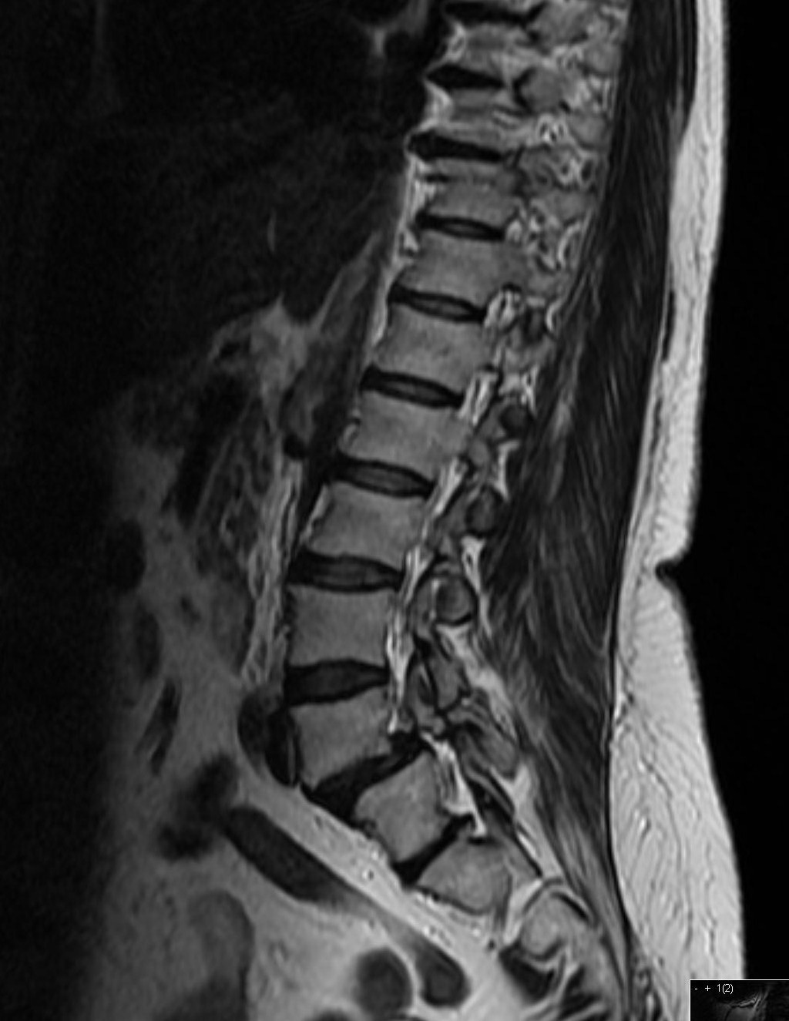
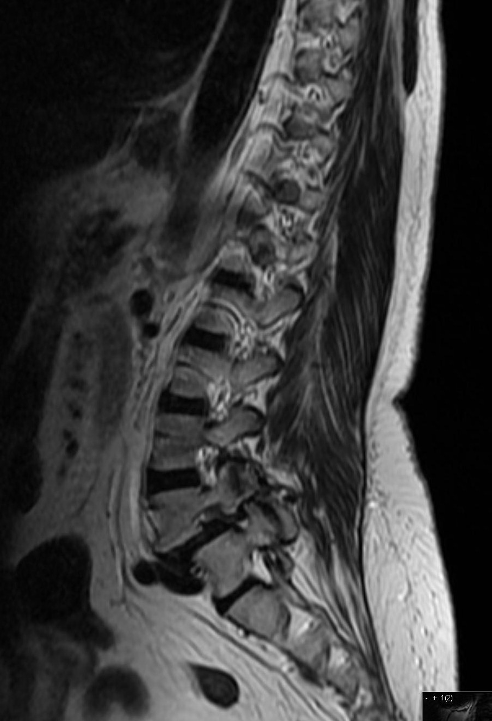

Slide 35
Spondylolisthesis....
spondylolysis
Degenerative
L4/5,common
Wide canal sign not present
Look for severely degenerate facets and disc dessication
L5/s1, 90%,the rest at L4/5
Wide canal sign present
20% may have UNILATERAL pars defects

Slide 36
So, on imaging....
Grade the listhesis...<25% -Grade I, <50%- Grade II....
Look for lysis...oblique xrays may help
Pseudobulge/ focal herniations

Slide 37
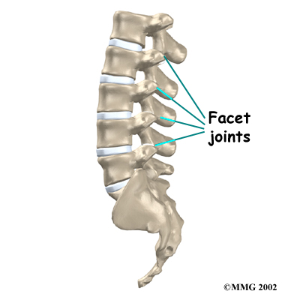
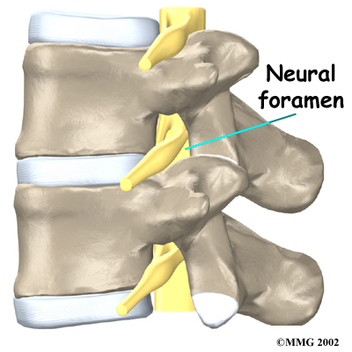
Discs

Slide 38
Disc disease- is it significant?
Correlation with clinical findings
  64% of asymptomatic adults had disc disease on MRI. Jensen et al 1994
  Disc herniation in 28% Boden et al 1990
Natural history of disc herniation
63% got >30% smaller
48% got > 70% smaller Bozzao 1992

Slide 39
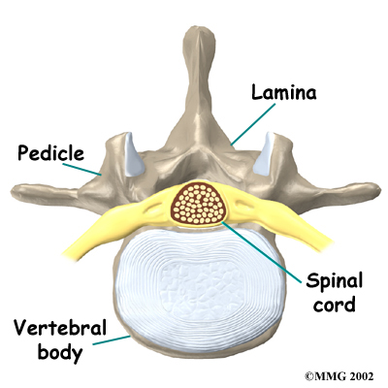
Cross section of disc

Slide 40
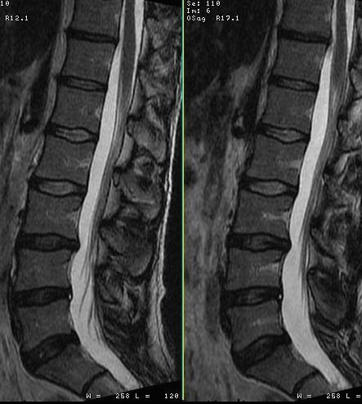
Normal anatomy
Nucleus/annulus
Intranuclear cleft
Basivertebral veins

Slide 43
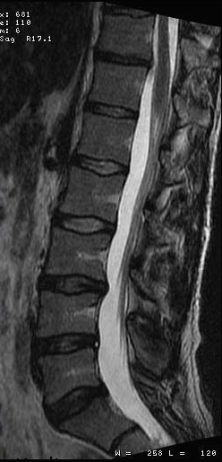
Disc disease
Dehydration of discs with age.
Vertebral endplates fissure- Modic changes
Annular tears.

Slide 44
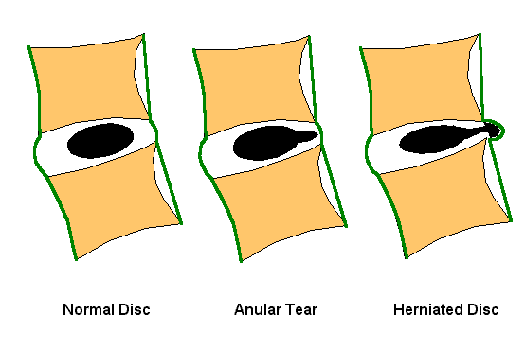

Slide 45
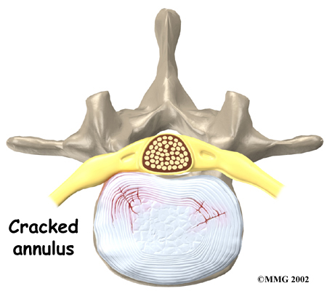
Annular tear

Slide 46
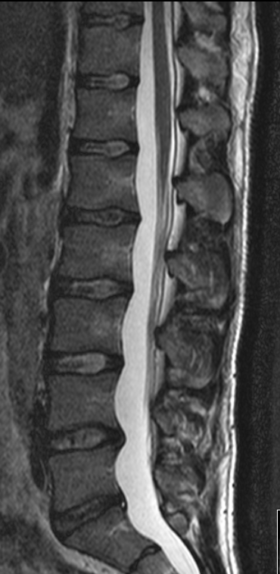
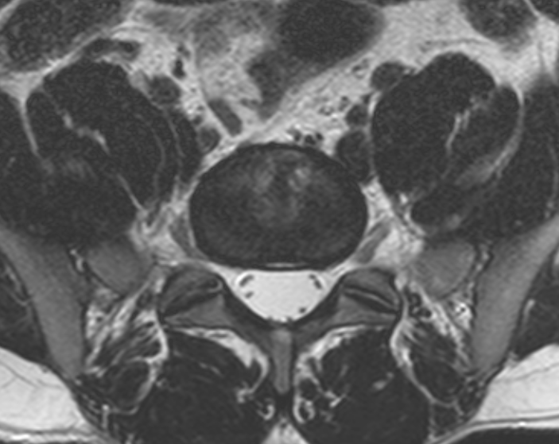

Slide 47
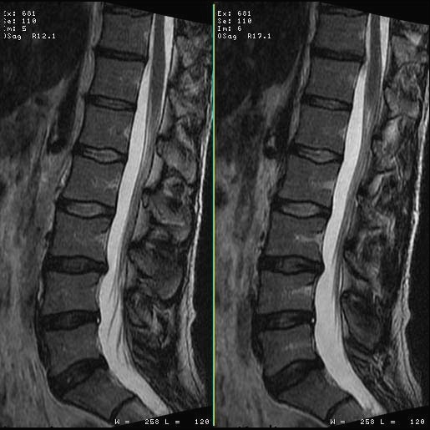
Disc terminology
Dehydration
Bulge; circumferential
Protrusion; eccentric, <3mm .
Herniation; >3mm
Extrusion; nucleus extends thro’ annulus
Free fragment; detached from parent disc

Slide 48
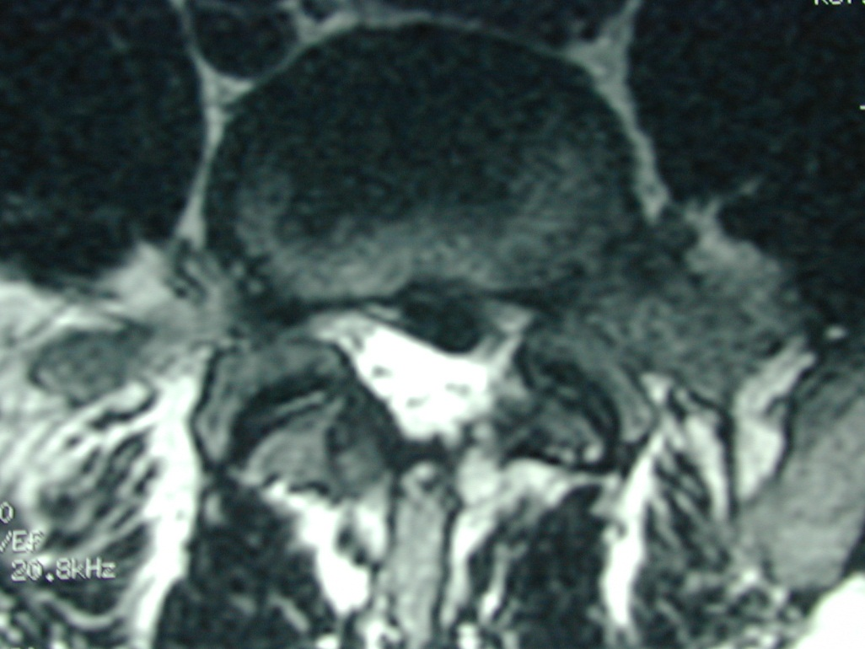
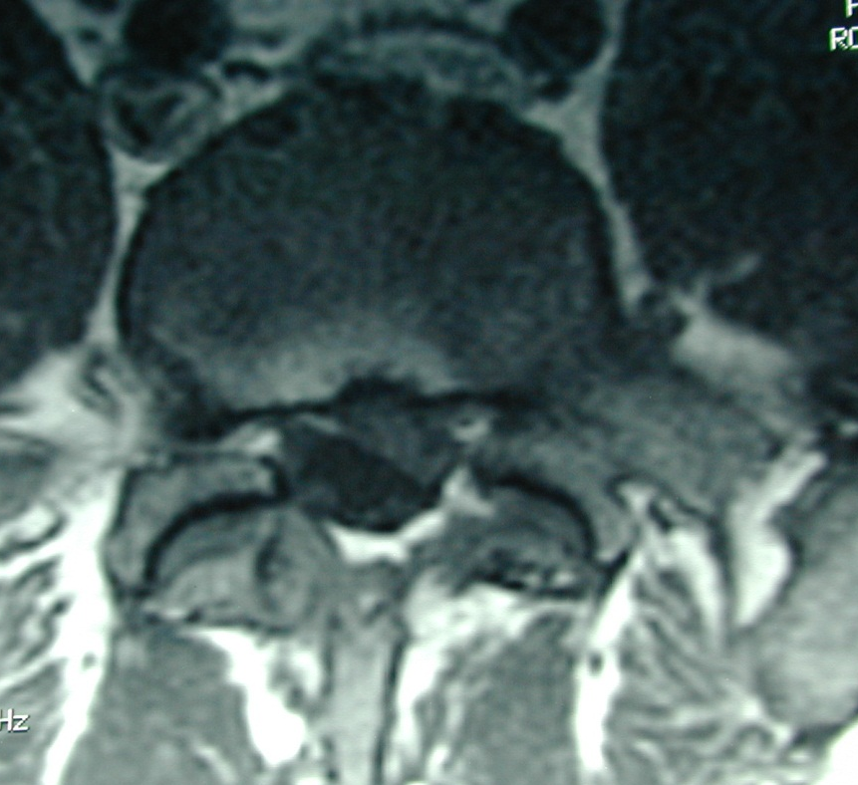
Disc herniation

Slide 49
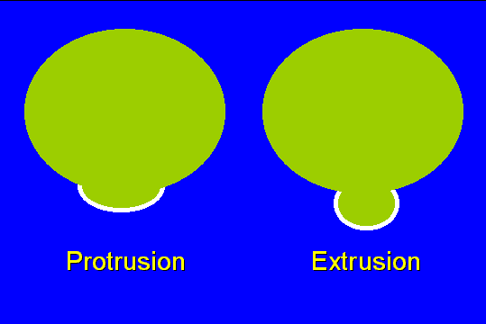

Slide 50
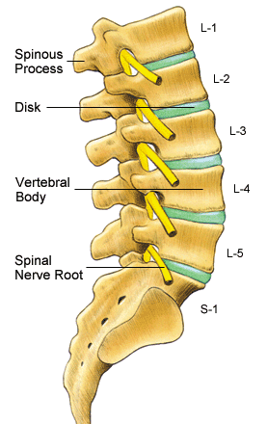
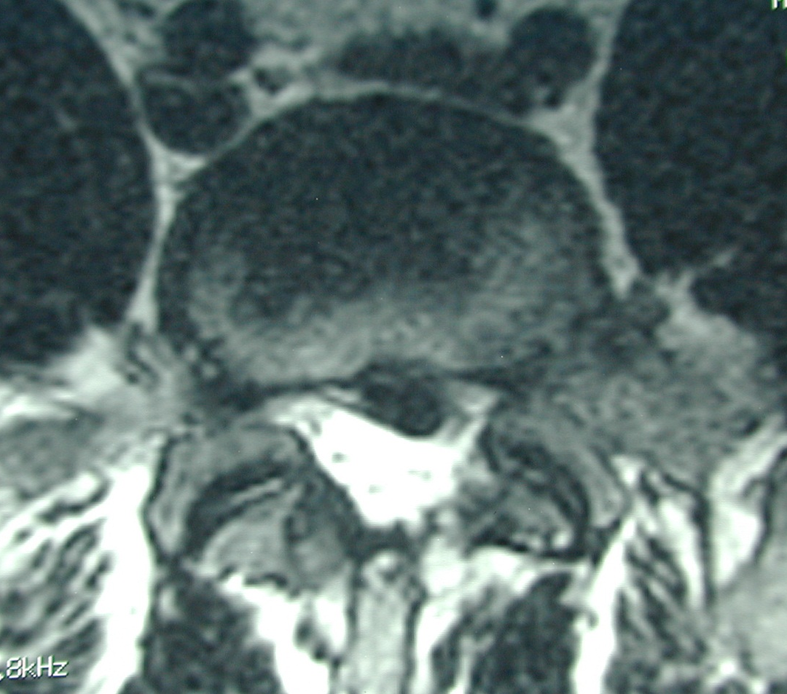
Nerve root compression
L5
5/1
S1

Slide 51
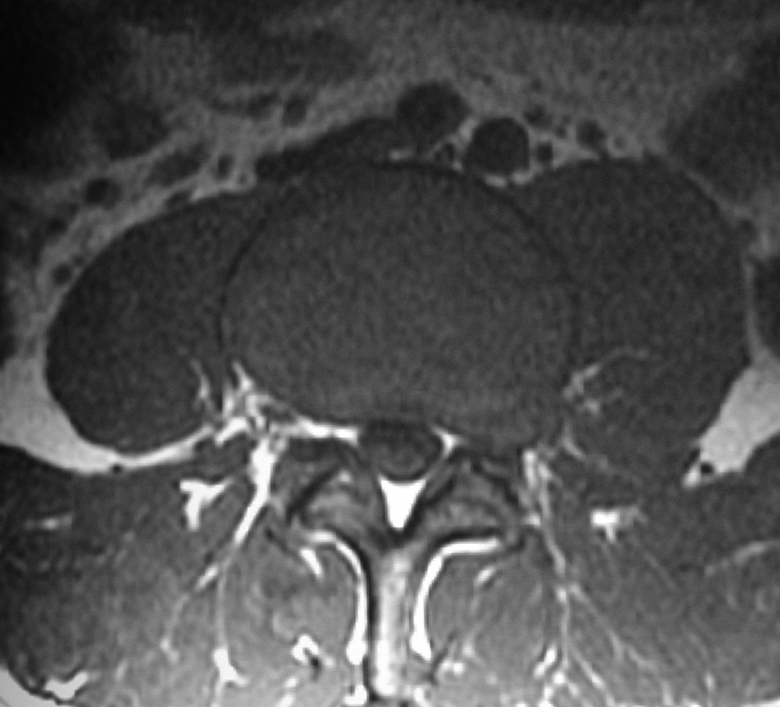
Lateral disc protrusion
Axial T2 or T1
Parasagittal
Affects exiting root of level above

Slide 52


Notes:
Protrusion midline

Slide 53


Notes:
Protrusion rt lateral

Slide 54


Notes:
Protrusion

Slide 56




Notes:
Extrusion

Slide 57
Case 5- Disc
Rugby tackle, shooting pain in the left leg, decreased sensation in the left L4- S1

Slide 58


Slide 59



Slide 60


Slide 61
Disc degeneration
Remember sequestration!

Slide 62

Sequestration
May be higher T2 signal
Migrate up or down
May be subligamentous

Slide 63


Free fragments
May be higher T2 signal
Migrate up or down
May be subligamentous

Slide 64

Free fragments

Slide 65




Canal Stenosis
Notes:
Canal stenosis

Slide 66

Spinal stenosis
Lateral recess stenosis
Foraminal stenosis
  parasagittal

Slide 67

Spinal stenosis
Lateral recess stenosis
Foraminal stenosis
  parasagittal

Slide 68
The Facet joints and flavum

Slide 69


Notes:
Normal facet joints

Slide 70




Slide 71
Case 5
Low grade fever, weight loss, upper back pain

Slide 72
Sag T1
Sag T1
Sag T2

Slide 73
Infective spondylitis....
Spine = 2-5% of all osteomyelitis
Progressive, but may have insidious onset
Pain is constant, no relief from rest

Slide 74
Infection.....
Hematogenous spread, most common
Arterial route:
Metaphyseal bone near ALL has an end-arteriole, making it susceptible to bacteremia.
Segmental arteries usually supply two adjacent vertebral bodies and intervening disc.

Slide 75
Infection....
TB
Pyogenic
Older patients
Lower lumbar spine
Subchondral bone affected first
Posterior elements-less common
Younger patients
Midthoracic/ thoracolumbar
Endplate and disc involvement
Large abscess out of proportion to vertebral involvement

Slide 76
Case 6
Young male, neck pain

Slide 77



Slide 79



Slide 80


Slide 81
Seronegative spondyloarthropathy
Early to mid adulthood
Most cases are mild, limited to the SIJs
Present with low backache,greatest in the morning
Increased risk of fracture with ankylosis

Slide 82
Seronegative spondyloarthropathy
SI joint erosions or ankylosis, is the best imaging clue
Corner erosions,
Ossification of the outer fibres of the annulus and the ALL
Start with PLAIN FILMS!

Slide 83



Slide 84


Slide 85


Sag T2

Slide 86
Spinal canal and cord lesions
Common-
Schwannomas
Meningiomas
Metastasis
Ependymomas

Slide 87


Notes:
Meningioma- four months history of ll weakness and sensory level at T10

Slide 88


Notes:
Meningioma- four months history of ll weakness and sensory level at T10

Slide 89



Notes:
Meningioma- four months history of ll weakness and sensory level at T10

Slide 90
Meningioma
90% are intradural and extramedullary
Enhance!
Dural tail

Slide 91



Slide 92




Slide 93
Ependymoma
Enhancing cauda equina mass
Well circumscribed and intensely enhancing

Slide 94
To recap…what do you look for?
Vertebral bodies: Height, alignment, marrow
Discs: dessication/bulge/protrusion
Spinal canal: cord, roots, CSF
Facets, ligamentum flavum, paraspinous soft tissue

Slide 95
Take home points…
Look at Xrays if you can. Get some history!
Organise a template to approach MRI images

Slide 96

Thank you for attention!

