Slide 1
Subaxial cervical spine injuries
Dr Mitchell Hansen
Consultant Neurosurgeon & Spine Surgeon
John Hunter & John Hunter Childrens’ Hospitals, Newcastle Australia
Lake Macquarie Private, Lingard Private, Mater, Newcastle Private and Westmead Private Hospitals

Slide 2
Disclosures
None since the last talk

Slide 3
Outline
Injuries
  Vascular
  Neurological
  Fractures
Case studies

Slide 4
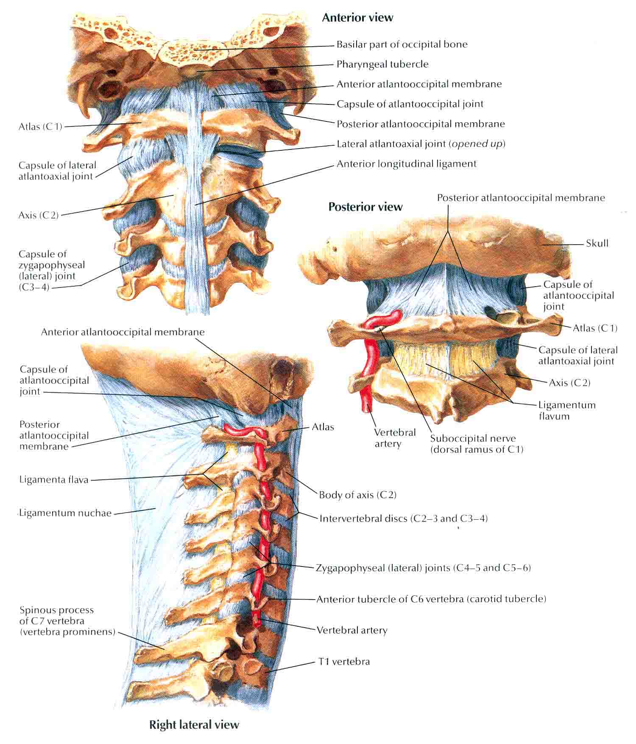

Slide 5
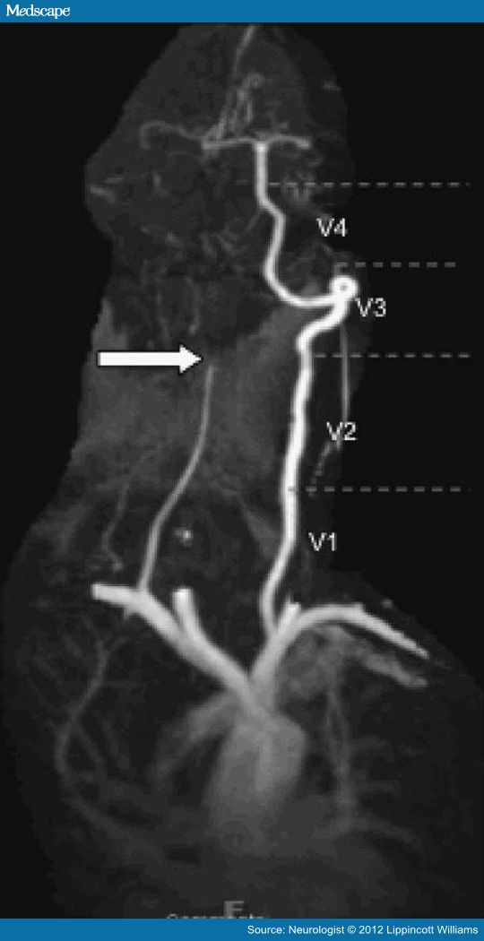

Slide 6
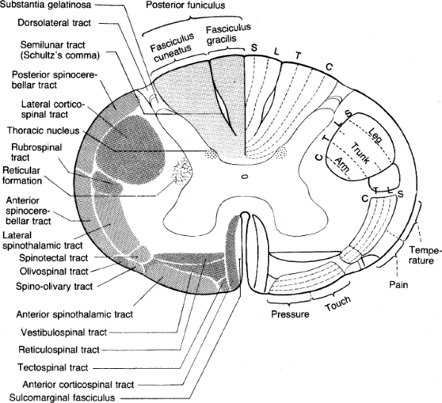

Slide 7
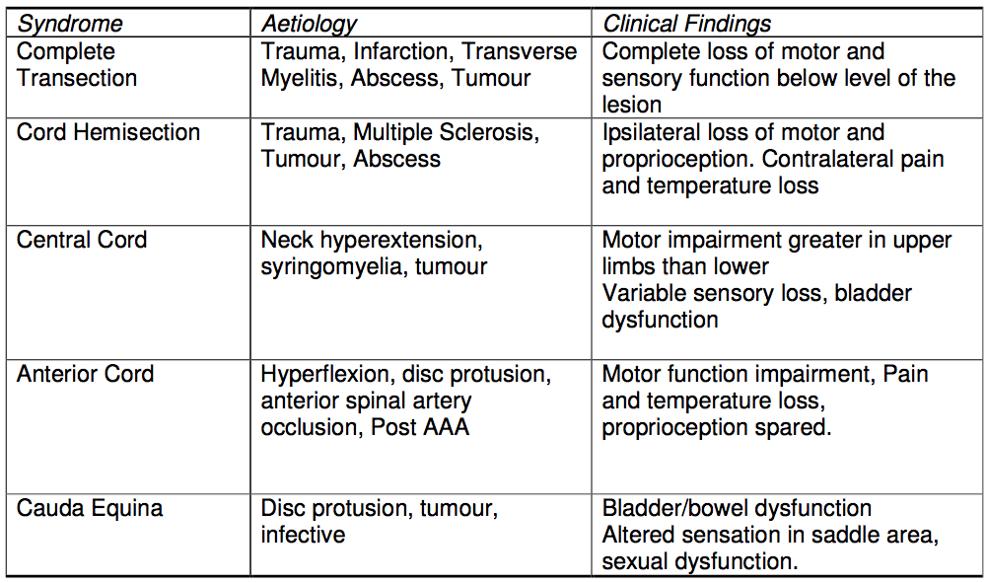

Slide 8
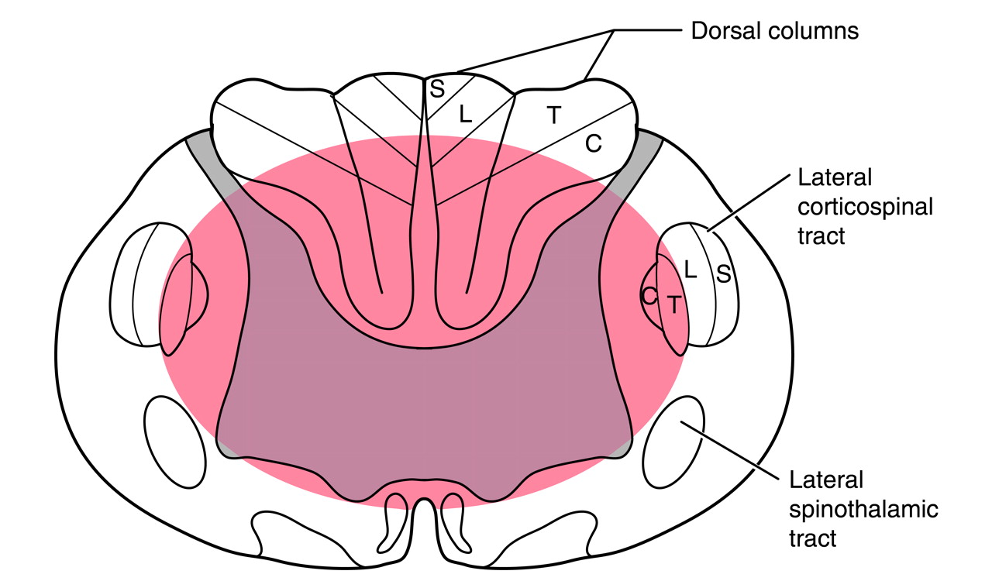
Nowak et al., JAAOS 2009; 17:756-65

Slide 9
Sub-axial Injury Classification (SLIC)

Slide 10
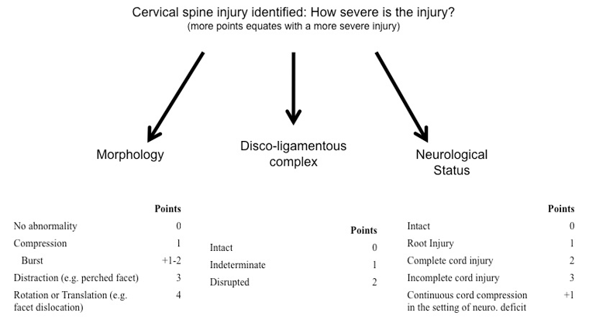
Sub-axial Injury Classification (SLIC)

Slide 11
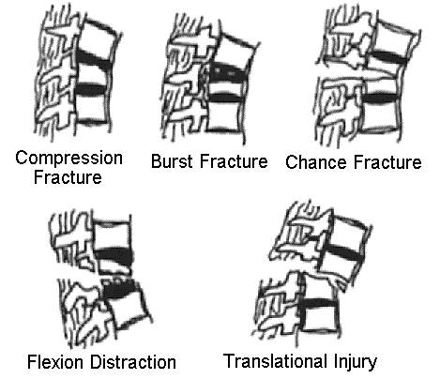

Slide 12
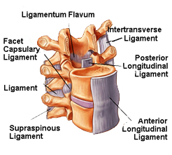

Slide 13
Tumours
Primary or Secondary
Bony, extradural or intradural
Stable or unstable

Slide 14
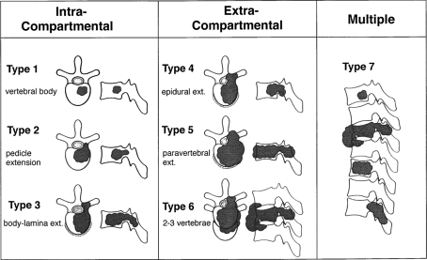
Tomita., et al. Surgical strategy for spinal metastases. Spine. 2001;26:298–306.

Slide 15
Revised Tokuhashi Prognostic Score
 | Score 0 | Score 1 | Score 2 | Score 3 | Score 4 | Score 5
KPS (%) | 10-40 | 50-70 | 80-100
Extraspinal mets | ≥3 | 1-2 | 0
Vertebral mets | ≥3 | 2 | 1
Visceral mets | Unremovable | Removable | None
Primary Site | Lung | Liver | Other | Kidney | Rectum | Breast
Palsy | Frankel A,B | Frankel C,D | Frankel E
Scores for the six individual criteria above are added to provide a total score up to a maximum of 15
12-15 excisional surgery, 9-11 palliative surgery, ≤8 conservative
Tokuhashi Y, et al. A revised scoring system for preoperative evaluation of metastatic spine tumor prognosis. Spine. 2005;30:2186–2191.

Slide 16
Case 1
37yo male, fell off a pushbike at around 40km/hr sustaining a 15min LOC at the scene. Awoke with 3/5 strength, worse distally than proximally.
Imaging showed cord signal change opposite the C5/6 disc space.
Management?
  Non-surgical
  Surgical

Slide 17
Case 1
SLIC
  Morphology
    Nil # 0
  DLC
    Indeterminate 1
  Neurology
    Incomplete cord 3
  Total 4
Managed conservatively with collar immobilisation.
7/52 post fall and his strength was at 4+/5, now able to dress and feed himself.

Slide 18
Case 2
17yo male passenger in middle back seat involved in a roll over MVA at 80km/hr. Complained of posterior cervical pain and heaviness to R arm. Weak wrist flexion and grip strength

Slide 19
Case 2

Slide 20
Case 2
Imaging showed a C4 burst fracture and cord signal change
SLIC
  Morphology
    Burst 2
  DLC
    Indeterminate 1
  Neurology
    Incomplete cord 3
  Total 6
Managed with a C4 corpectomy.
Discharged home Day 2 post surgery – arm/hand strength normal, slight paraesthesia

Slide 21
Case 3
40 M MVA driver. Crashed into a tree at 40km/h. Restrained. Trapped in car. Very combative and abusive on scene. Requiring sedation for agitation with large doses haloperidol and midazolam.
PMHx: IVDU (currently on methadone), previous spinal shotgun injury.
Drowsy. Complaining of neck + right shoulder/clavicular pain. Sedation limiting neurological exam.

Slide 22
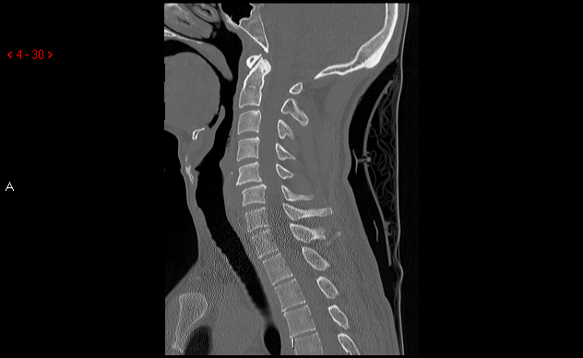
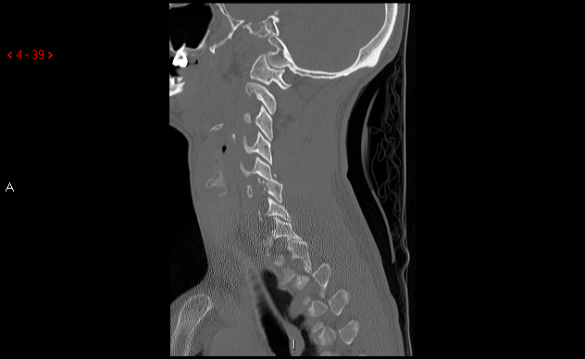
Case 3

Slide 23
Case 3
Right C6 pedicle # with extension to the R C5/6 & C6/7 facets with R C5/6 dislocation.
SLIC
  Morphology
    Rotation/Translation 4
  DLC
    Disrupted 2
  Neurology
    ???? ?
  Total 6?
Managed with C5/6 ACDF followed by posterior C5-6 lateral mass and C7 pedicle screw fusion

Slide 24
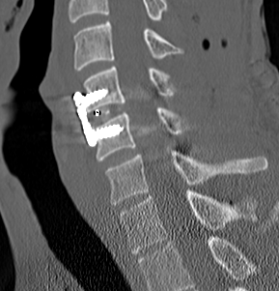
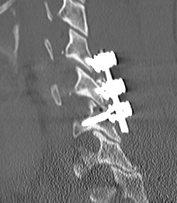
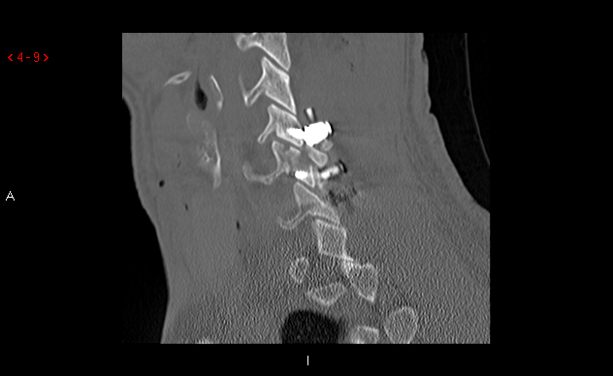
Case 3

Slide 25
Case 4
49yoF post fall in a group home. Complaining of neck pain. Incidental finding of a sellar mass
Normal neurological examination

Slide 26
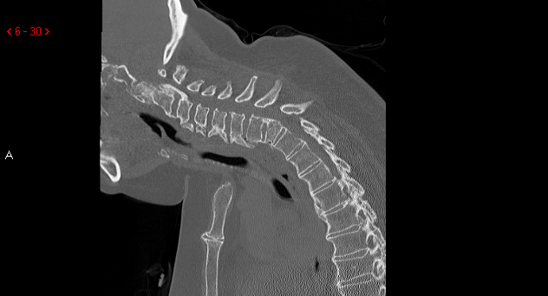
Case 4

Slide 27
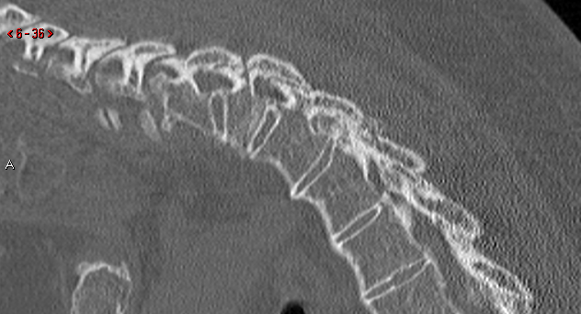
Case 4

Slide 28
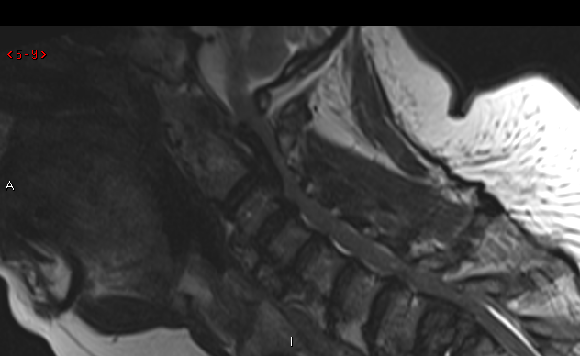
Case 4

Slide 29
Case 4
Diagnosis?
  Ankylosing spondylitis
  DISH
  OPLL
  Fracture T1
SLIC
  Morphology
    Distraction 3
  DLC
    Disrupted 2
  Neurology
    Nil 0
  Total 5

Slide 30
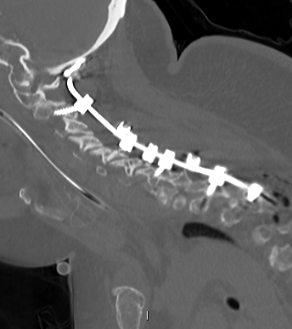
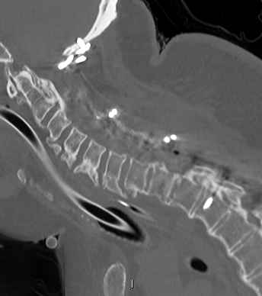
Case 4

Slide 31
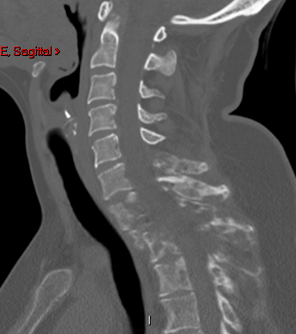
Case 5
42 F with right axillary and back pain. Previous lumpectomy and axillary node clearance for breast ca.
C6-T4 involvement

Slide 32
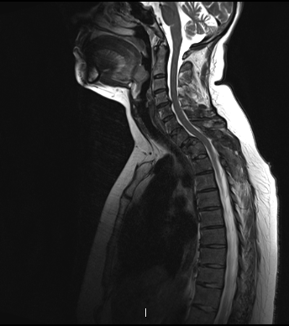
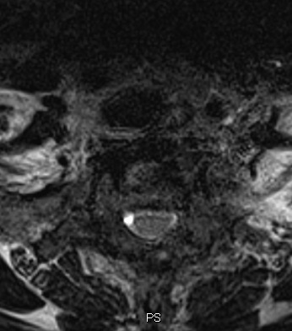
Case 5

Slide 33
Case 5
Treatment options?
  Non-surgical
    Immobilisation
    Radiation
  Surgical
    Tokuhashi score 11- palliative surgery

Slide 34
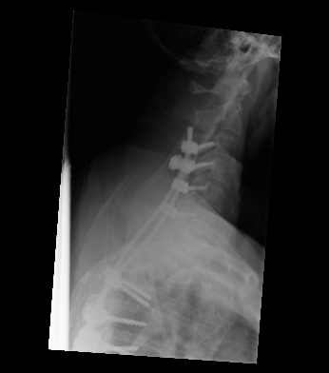
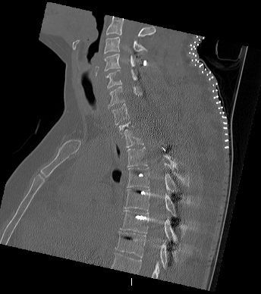
Case 5

Slide 35
Conclusions
Management is not straight forward
For every 10 spine surgeons there are 12 plans

Slide 36


Slide 37
