Slide 1
Spine Biomechanics

Slide 2
Objectives
Discuss specifics in the biomechanics of each spinal region

Slide 3
Cervical
Occipito-cervical joint
Atlanto-axial joint
C2-3 joint
Subaxial cervical spine

Slide 4
Cervical
Occipito-cervical joint
Atlanto-axial joint
C2-3 joint
Subaxial cervical spine
Notes:
Nodding = flexion extension
In all other planes they articulate and function as a fixed segment
Occipital condyles convex, atlatial sockets concave. These are held in place by really strong ligaments so for rotation to happen, there has to be translation of one condyle.

Slide 5
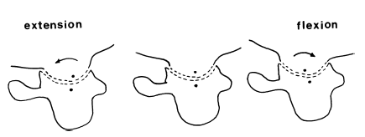
Cervical
Occipito-cervical joint
Atlanto-axial joint
C2-3 joint
Subaxial cervical spine
Nodding
Notes:
Nodding = flexion extension
Occipital condyles convex, atlantial sockets concave. These are held in place by really strong ligaments so for rotation to happen, there has to be translation of one condyle.
In all other planes they articulate and function as a fixed segment

Slide 6
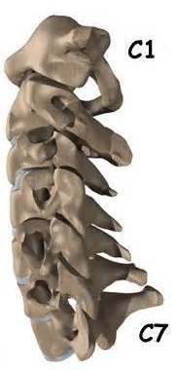
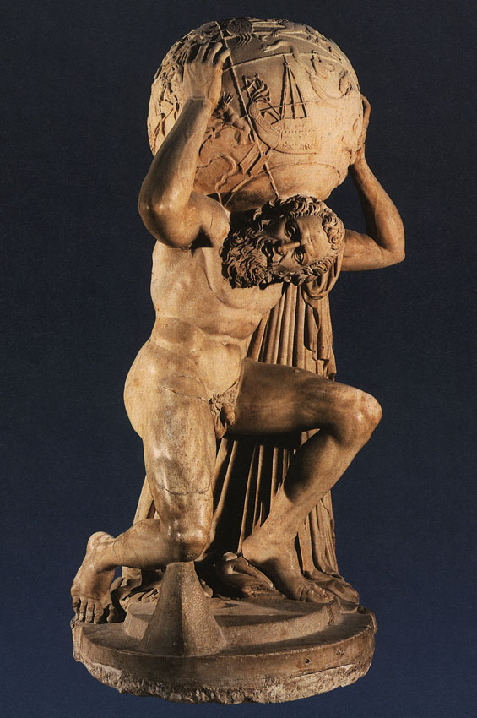
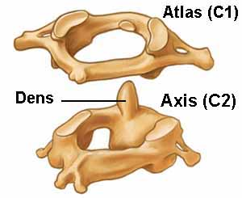
Cervical
Occipito-cervical joint
Atlanto-axial joint
C2-3 joint
Subaxial cervical spine
Notes:
The Atlas' chief peculiarity is that it has no body, it is ring-like, and consists of an anterior and a posterior arch and two lateral masses which are big and bulky to support the head.
The most distinctive characteristic of this axis is the strong odontoid process ("dens") which rises perpendicularly from the upper surface of the body.
6

Slide 7
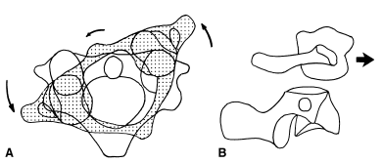
Cervical
Occipito-cervical joint
Atlanto-axial joint
C2-3 joint
Subaxial cervical spine
Rotation
Notes:
Median joint – Between arch and odontoid peg
Lateral joint – Between lateral mass of atlas and axis
ROTATION:
Anterior arch of atlas pivots on odontoid process and slides around its ipsilateral aspect; at the median AA joint
Meanwhile, at lateral AA joint the ipsilateral lateral mass of the atlas slides backwards and medially while the contralateral lateral mass
slides forwards and medially

Slide 8
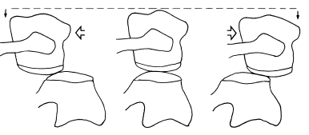
Cervical
Occipito-cervical joint
Atlanto-axial joint
C2-3 joint
Subaxial cervical spine
Rotation
Notes:
Both articular cartilages are convex: therefore the joint is biconvex
Spaces formed either side are filled with meniscoids.
Neutral – atlas summit rests on axis convexity.
As atlas rotates:
- Ipsilateral facet slides down post slope of axis facet
- Contralateral atlantial facet slides down anterior axial facet
Therefore as axis rotates, it descends.

Slide 9
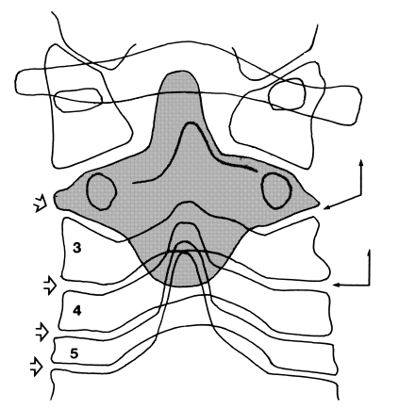
Cervical
Occipito-cervical joint
Atlanto-axial joint
C2-3 joint
Subaxial cervical spine
Notes:
Was considered part of subaxial spine until it was discovered that the superior articular processes at the lower ends are orintated transversely whereas at C2/3 they face superiorly, posteriory and are medially inclided at 40 deg.
Forms a socket for the root of C2 vertebra.
Direction of coupling in lateral flexion is opposite to the remaining subaxial vertebrae.
C2 rotates away from the axis of rotation of rest of the subaxial cervical vertebrae in lateral flexion.

Slide 10
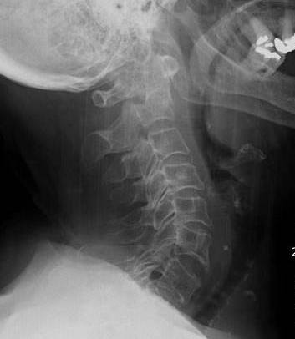
Cervical
Occipito-cervical joint
Atlanto-axial joint
C2-3 joint
Subaxial cervical spine
Flexion - extension
Notes:
Articulate through IV discs in front and facets behind.
Antero-inferior body hangs down forming a lip
Anterio-superior body slopes down and forwards and the plane of the disc is oblique to long axis of vertebra
- This favours flexion-extension

Slide 11
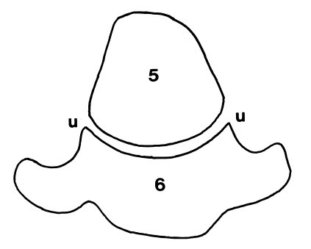
Cervical
Occipito-cervical joint
Atlanto-axial joint
C2-3 joint
Subaxial cervical spine
Flexion – extension
Rotation
Notes:
The posterior ends of the vertebral bodies form an ellipsoid joint between the convexity of the vertebral body above and the concavity of the posterior end of the body below, this culminates in the uncinate processes bilaterally.
Uncinate process = This bony part prevents posterior linear translation movements of the vertebral bodies) and limits lateral flexion
So, cervical joints are saddle joints: Flexion, extension and rocking side to side

Slide 12
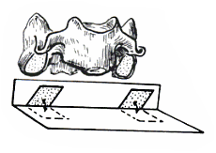
Cervical
Occipito-cervical joint
Atlanto-axial joint
C2-3 joint
Subaxial cervical spine
Flexion – extension
Rotation
Notes:
Facet joints are coronaly angulated, i.e. 45 deg to the transverse plane
Favours flexion / extension but means that rotatioin is possible in a plane perpendicular to the axis of the facet joints.
12

Slide 13
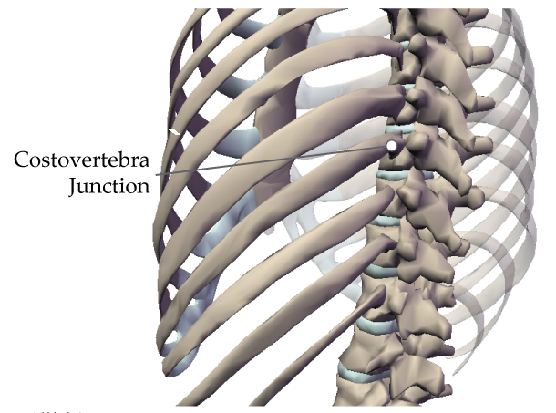
Thoracic
Least mobile
Notes:
Least mobile owing to articulations with ribs
Demifacets superior and inferior to the disc articulate with rib heads as a synovial joint – protect against lateral flexion – when excised in canine models more lateral flexion is possible
Shit ROM may be to protect narrow canal. Narrow canal which makes T spine prone to space occupying pathologies.

Slide 14
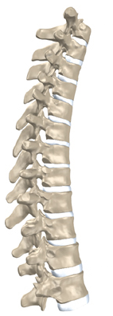
Thoracic
Kyphotic
Notes:
Kyphotic
Anterior height of the vertebral body is lesser than the posterior end in the thoracic spine
therefore bodies under COMPRESSION and posterior arches in TENSION
Bone fails in compression therefore common to get anterior wedge fractures

Slide 15
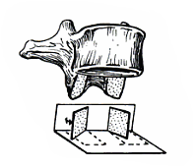
Thoracic
Relatively coronal facets
Notes:
The thoracic facets oriented in the coronal plane. Thus, thoracic facets allow primarily lateral bending and axial rotation.
Coronal facets prevent translation BUT @ T11/12 the facets become transitional and therefore more oblique in saggital plane

Slide 16
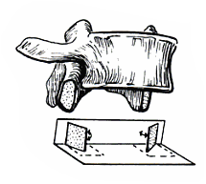
Lumbar
Facets: Right angles to transverse plane
        45 ° to frontal plane
Notes:
i.e. saggital orientation
Allows flexion / extension and lateral rotation
NO axial rotation

Slide 17
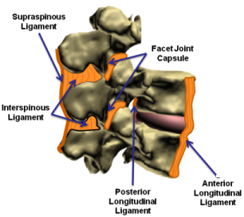
Lumbar
Large vertebral bodies
Notes:
Large bodies which can resist high loads
ALSO large, thick discs with tough fibro-cartilage with relatively posterior nucleus pulposis which means discs can counter large degrees of compression, tension and shear.
Discs and facets have a coupled function in load bearing.
Discs are loaded in flexion
Facet joints are loaded in hyperextension
Series of ligaments stabalise spine.
The greater the distance of the ligament from the COR, the greater the stresses applied to it, and therefore the greater it resists movement.
Therefore, ALL resists extension
Inter and supra-spinous ligaments resist flexion
Transverse ligaments resist lateral flexion

Slide 18
Take Home Messages
Cervical spine is split into 4 functional units which offer movement in different planes.
Thoracic spine relatively immobile due to rib articulations.
Thoracic kyphosis leads to compressive stresses on bodies and tensile stresses on facets / posterior elements.
Lumbar bodies and discs built to withstand significant forces.
Discs and facets have a coupled function in load bearing

Slide 19
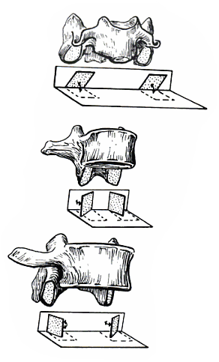
Take Home Messages
Orientation of facets

Slide 20
Notes:
http://books.google.co.uk/books?id=Q-oreNpkRlgC&pg=PA3&lpg=PA3&dq=orientation+of+facet+joint&source=bl&ots=V5MzOIJWSC&sig=7-ppPrNeIzDJ3L-TDM2WiSfqXs0&hl=en&sa=X&ei=GzPuUdavBKjP0AWZuIGIDg&ved=0CDMQ6AEwBw#v=onepage&q=orientation%20of%20facet%20joint&f=false

