Slide 1
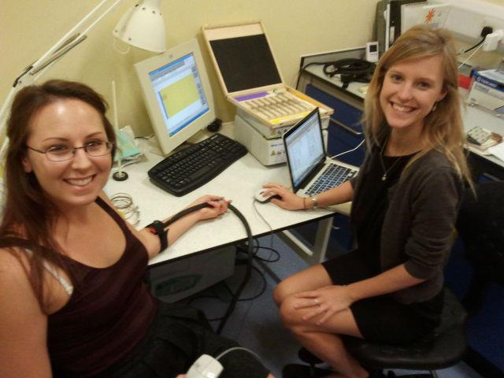


Quantitative Sensory Testing
Jessica O’Neill
UCL

Slide 2
Why do we need QST?
What is tested?
Is it useful?
Human surrogate models

Slide 3
Why do we need QST?
Patient somatosensory phenotyping
Using a standardised protocol
Pattern of symptoms may reflect underlying mechanisms
Full symptom profile aids diagnosis and management
Approaching mechanisms based treatment

Slide 4
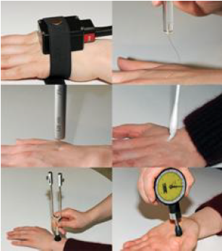
What is tested?
Rolke, 2006. QST Protocol:
Mechanical Detection Threshold
Mechanical Pain Threshold
Stimulus Response Function
  (Mechanical pain sensitivity and DMA)
Wind Up Ratio
Vibration Detection Threshold
Pressure Pain Threshold
Cool Detection Threshold
Warm Detection Threshold
Paradoxical Heat Sensation
Cold Pain Threshold
Heat Pain Threshold
Notes:
Explain how each test is done

Slide 5
Gain and loss of function
Small and large fibres
Cutaneous (and deep) pain
Test | Stimulus | Fibre
MDT | von Frey (0.25mN-512mN) | Aβ
MPT | Pinprick (8mN-512mN) | Aδ
S/R | Pinprick, CW, Brush | Aδ/ Aβ
VDT | Tuning Fork | Aβ
PPT | Algometer | Muscle Aδ/ C?
Thermals | Thermal Sensory Testing Device | C/ Aδ

Slide 6
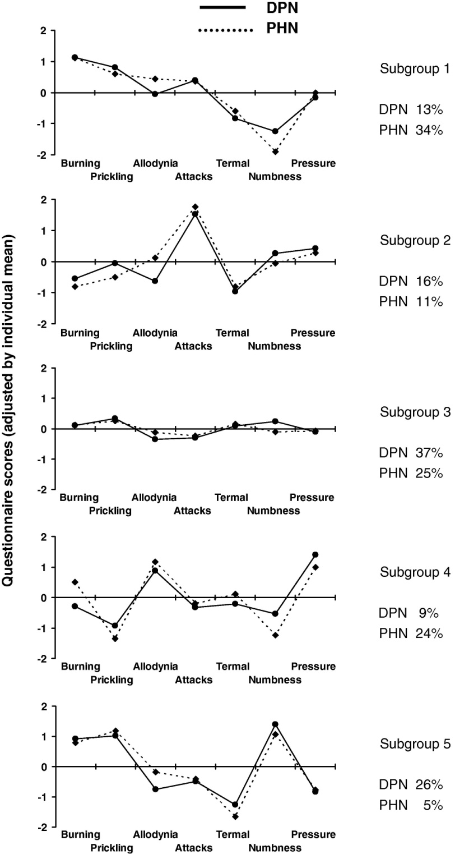
Is it useful?
Baron et al, 2009. 2100 DPN and PHN patients – subgroup by symptoms
Maier et al, 2010. 1236 neuropathic pain syndromes – subgroup by symptoms
Within diseases there are subgroups of patients which can be grouped by their patterns of symptoms
With 5 subgroups, 2 positive groups would not show overall efficacy in a trial
Simpson et al, 2010. Pregabalin HIV neuropathy – treats those with pinprick hyperalgesia

Slide 7
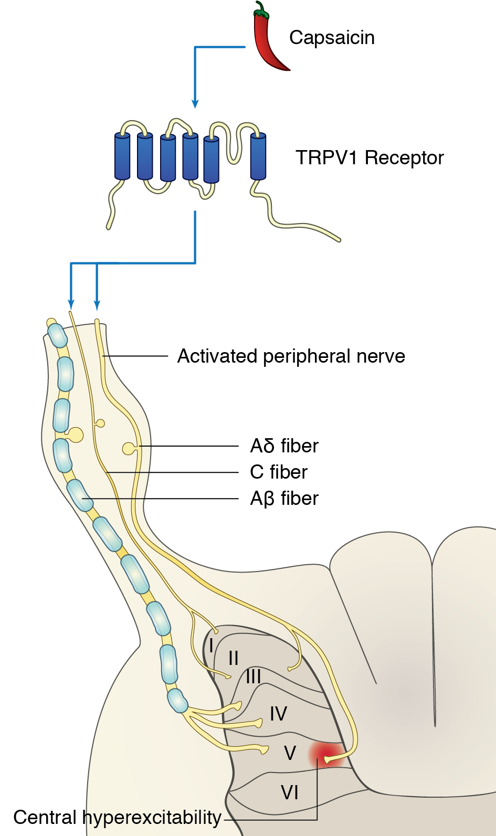
What do I do?
Assess surrogate models with known neurobiological mechanisms
Capsaicin – inducing peripheral/
central sensitisation
UVB – inducing peripheral
sensitisation

Slide 8
Summary
QST allows the creation of sensory profiles
Specific profiles may be linked to certain underlying mechanisms
This guides rational mechanism based treatments
We can explore which mechanisms result in which symptoms using human surrogate models

Slide 9
References
Rolke, R., W. Magerl, K. A. Campbell, C. Schalber, S. Caspari, F. Birklein and R. D. Treede (2006). "Quantitative sensory testing: a comprehensive protocol for clinical trials." European Journal of Pain 10(1): 77-77.
Rolke, R., R. Baron, C. Maier, T. R. Tölle, R. D. Treede, A. Beyer, A. Binder, N. Birbaumer, F. Birklein and I. C. Bötefür (2006). "Quantitative sensory testing in the German Research Network on Neuropathic Pain (DFNS): standardized protocol and reference values." Pain 123(3): 231-243.
Baron, R., T. R. Tölle, U. Gockel, M. Brosz and R. Freynhagen (2009). "A cross-sectional cohort survey in 2100 patients with painful diabetic neuropathy and postherpetic neuralgia: differences in demographic data and sensory symptoms." Pain 146(1-2): 34-40.
Maier, C., R. Baron, T. R. Tölle, A. Binder, et al. (2010). "Quantitative sensory testing in the German Research Network on Neuropathic Pain (DFNS): Somatosensory abnormalities in 1236 patients with different neuropathic pain syndromes." PAIN 150(3): 439-450.
Simpson, D. M., G. Schifitto, D. Clifford, T. Murphy, E. Durso-De Cruz, P. Glue, E. Whalen, B. Emir, G. Scott and R. Freeman (2010). "Pregabalin for painful HIV neuropathy A randomized, double-blind, placebo-controlled trial." Neurology 74(5): 413-420.

