Slide 1
Paediatric elbow injuries
RLH Teaching 05/08/14
A Mulligan
Mr K James

Slide 2
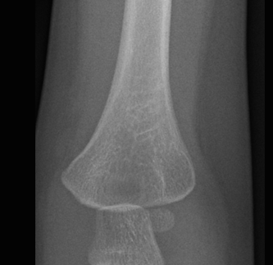
Paediatric Elbow Injuries
Supracondylar
  Gartland
Condylar
  Milch
  Jakob
Apophyseal
Transphyseal

Slide 3
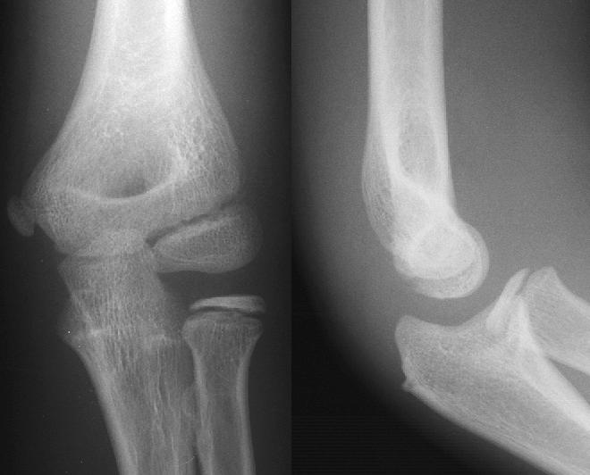
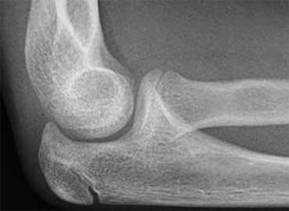
Elbow Xrays Lines and Angles
Shaft-Condylar Angle
Radio-capitellar line
Normal 64-81°
Coronoid Line
Anterior Humeral Line
Baumann’s Angle
Normal 30-40°
Notes:
Baumann’s Angle – Williamson, Jour Ped Orth Sept 1992 Normal Characteristics of the Baumann angle => Mean 72 degrees, range 64 to 81 degrees
Rockwood – no angle given
Wheeless – 80-85 degrees
Baumann E. Beitrage zur Kenntnis dur Frackturen am Ellbogengelenk. Bruns Beitr F Klin Chir 1929 146:50.
Dr Ernst Baumann has been credited with describing an angle that can be measured from radiographs taken of children's elbows. This article presents three variations in the definition of this angle that we found in the orthopaedic literature. Variation I is the angle between the long axis of the humerus and a line through the physis of the lateral condyle of the distal humerus. Variation II is the angle between the perpendicular to the long axis of the humerus and a line through the physis of the lateral condyle. Variation III is the angle between the line through the physis of the lateral condyle and a line connecting a point on the edge of the trochlea to a point at the lateral limit of the physis of the lateral condyle. By reading translations of two of Baumann's own articles, we have realised that he used variation I when assessing the radiographs. He did, however, believe that the reciprocal angle, variation II equalled the carrying angle of the elbow and this can be demonstrated by Fig. 1, which has been taken from an article that was published in 1929. The relationship between this angle and the carrying angle has since been proven to be more complex than Baumann believed. We recommend that a descriptive term such as the ‘shaft-physeal’ angle would cause less confusion and variation in the definition of this angle.

Slide 4
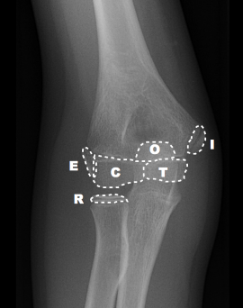
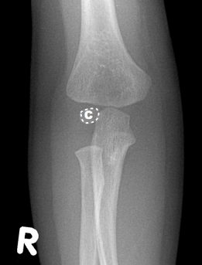
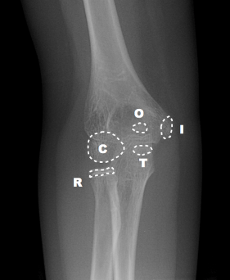
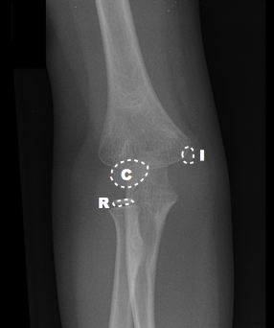
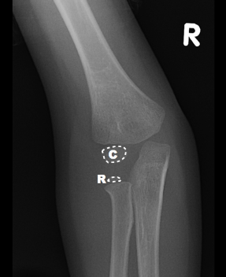
Elbow Xrays
CRITOL Ossification
Capitellum : 2 years
Radial head: 4 years
Internal Epicondyle: 6 years
Trochlea : 8 years
Olecranon: 10 years
Lateral epicondyle: 12 years

Slide 5
Paediatric Elbow Injuries
Supracondylar
  Gartland
Condylar
  Milch
  Jacob
Apophyseal
Transphyseal

Slide 6
Supracondylar Fractures
Fracture just proximal to the medial and lateral condyles of the distal humerus
Peak age of occurrence 5-7 years
M > F (64%)
30% of paediatric extremity fractures
60% of all elbow fractures in children
Nerve Injury 7%
Vascular Injury 1% (Up to 20% of displaced)

Slide 7
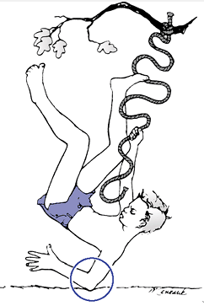
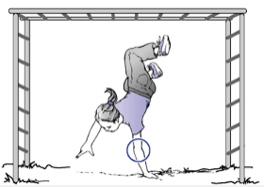
Supracondylar Fractures
Mechanism
Flexion Type
Extension Type
>95%
<2%

Slide 8
Supracondylar Fractures
Assessment
  Analgesia
  History
    Mechanism
    Associated Injuries
    NAI
  Examination
    Look, Feel, Move
  Investigations
    Radiograph

Slide 9
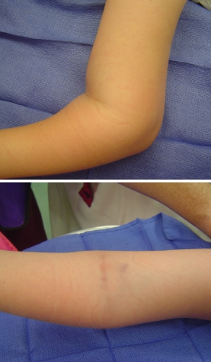

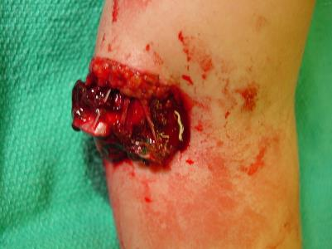
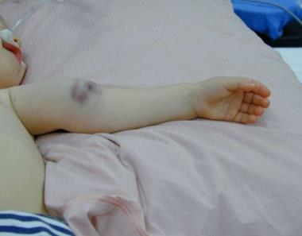
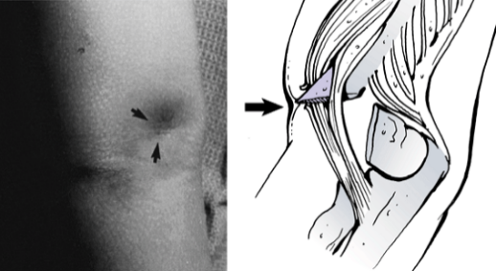
Supracondylar Fractures
Examination
LOOK
  Swelling and Bruising
  Deformity
  Soft tissue compromise
    Pucker/Brachialis sign
    Local Haematoma
  Colour
  Wounds

Slide 10
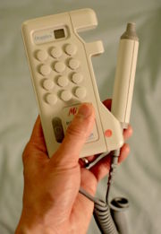
Supracondylar Fractures
Examination
FEEL:
  Tenderness
  Pulses
    Radial pulse compared to opposite side
    Hand held Doppler if not present
  Capillary refill
  Neurological status

Slide 11
Supracondylar Fractures
Examination
Neurological Status:
  Anterior Interosseous Nerve
    Most commonly injured
    Paralysis of the long flexors of thumb and fingers
    Absent ‘OK’ sign
  Median Nerve
    Associated with lateral displacement of the distal fragment and vascular injury
    Complete loss of finger and thumb flexion and thenar eminence musculature
    Sensory loss in index finger

Slide 12
Supracondyalr Fractures
Examination
Neurological Status (cont):
  Radial Nerve
    Associated with medial displacement of the distal fragment
    Wrist drop
    Sensory loss in dorsal first web space
  Ulnar Nerve
    Inability to cross fingers
    Loss of sensation little finger
    Often iatrogenic

Slide 13
Supracondylar Fractures
Examination
MOVE:
  Passive finger flexion and extension
    Significant discomfort could be an early indicator of compartment syndrome
Examine joints above and below
Document all findings in SPECIFIC DETAIL and regularly reassess

Slide 14
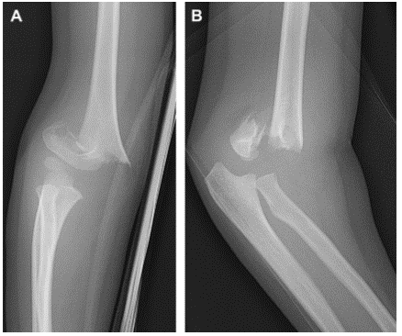
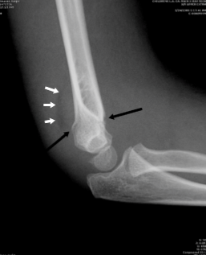
Supracondylar Fractures
Investigations
  AP and lateral Radiographs

Slide 15
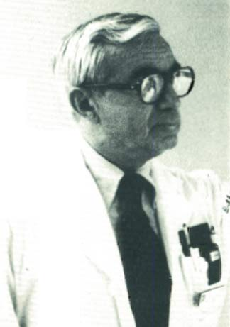
Supracondylar Fractures
Classification
  First described by Felsenreich in 1931 according to degree of radiological displacement
  Gartland Classification
    Gartland JJ. Management of supracondylar fractures of the humerus in children. Surg Gynecol Obstet 1959 109(2):145-154.
  Modified by Wilkins to include rotational deformity
John J Gartland (1918-)
James Edwards Professor Emeritus of Orthopaedic Surgery
Thomas Jefferson University Hospital
Philadelphia

Slide 16
Supracondylar Fractures
Gartland/Wilkins:
Type I
  Nondisplaced: Anterior humeral line intersects capitellum, intact olecranon fossa, no medial or lateral displacement, no medial column collapse, normal Baumann angle.
Type II
  Extended but not completely translated with some cortical contact. Anterior humeral line does not intersect capitellum.
  Type II A: no rotational deformity
  Type II B: rotational deformity
Type III
  Circumferential break in cortex with displacement of fracture fragments

Slide 17
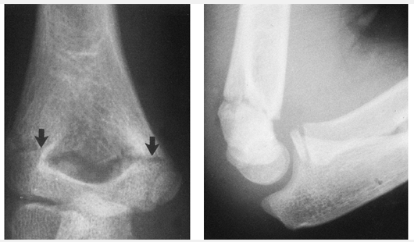
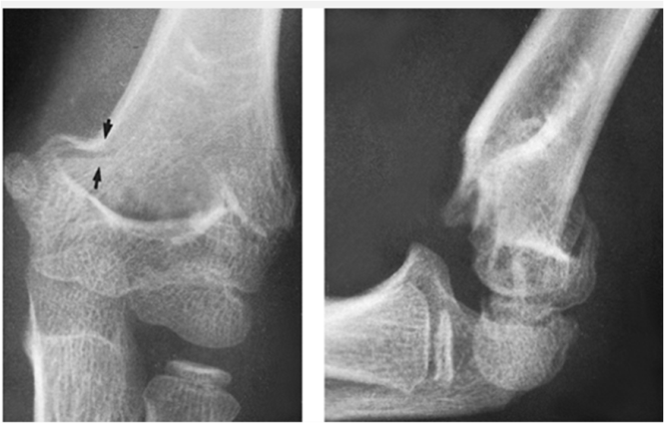
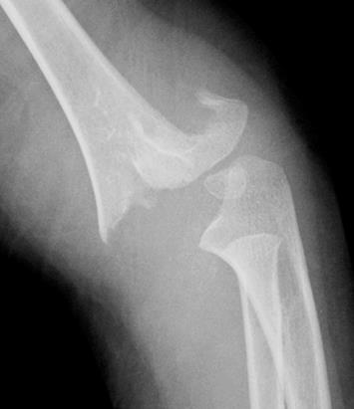
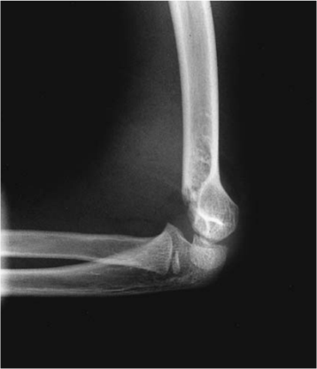
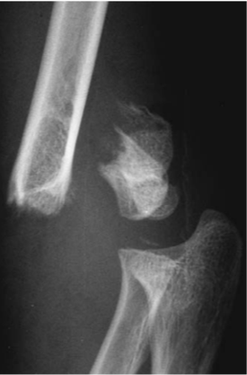
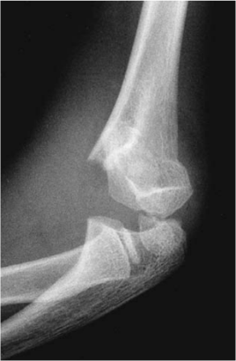
Gartland Classification
Type I
Type II
Type III
Non-displaced
Shaft-Condylar Angle extended
Circumferential break in cortext with displacement of fracture fragments
No medial column collapse
With or without rotational deformity
Without = Type IIA
With = Type IIB
Anterior humeral line intersects capitellum
Anterior humeral line does not intersect capitellum
No medial or lateral displacement
Normal Baumann Angle
Angular displacement
Type IIA
Type IIB

Slide 18
Gartland Classification
Ease of Use
  Simple and well defined
Implications for treatment
  Type I => Cast immobilisation
  Type II & III => Operative Fixation
Reliability/Reproducibility
  Mallo et al. Heal et al.

Slide 19
Supracondylar Fractures
Management
  Analgesia
  Splintage: Backslab 20- 40 degrees of flexion
  Elevation
  Regular re-assessment

Slide 20
Supracondylar Fractures
Type I :
Collar and cuff
Above elbow cast 60-90 degrees in neutral 2-3/52
Type II :
Conservative vs Surgical
  Age
  Extent of displacement
MUA +/- percutaneous K-wire fixation
Type III:
Closed +/- Open reduction + K-wire fixation
Notes:
Distal humerus only supplies 20% of total growth of humerus
8-10 year old child only has 10% of humeral growth left
Perc wires favoured over MUA alone as reduction in swelling post MUA and cast can result in displacement

Slide 21
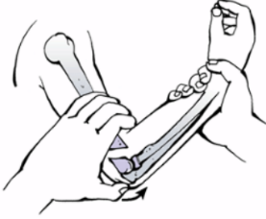
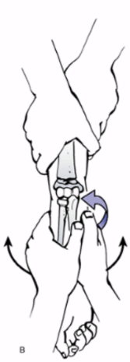
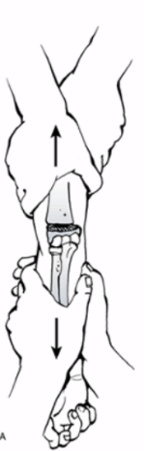
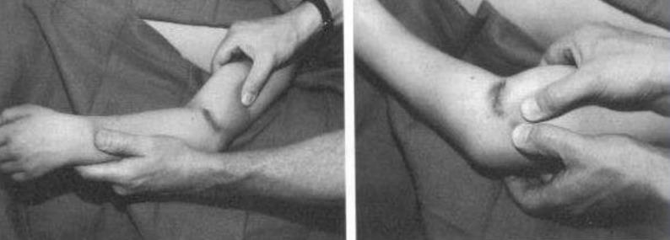
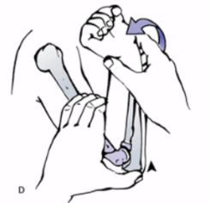
Supracondylar Fractures
REDUCTION TECHNIQUE:
Release soft tissues by milking brachialis off button-holing fragment
Correct AP displacement:
Place thumb over the olecranon and
pronate it while flexing the forearm
Gentle traction and counter-traction for at
least one minute to free the proximal fragment
from the anterior soft tissues
Correct medial/lateral displacement in traction
Medial: pronation + valgus force
Lateral: supination + varus force

Slide 22
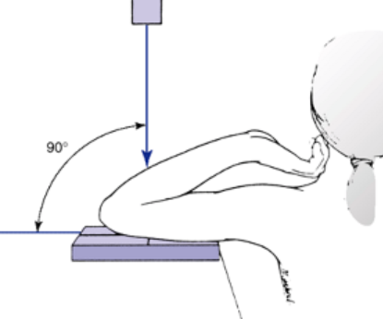
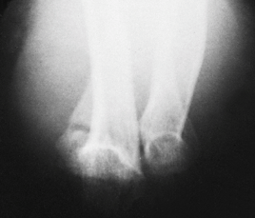
Supracondylar Fractures
Check Reduction and Stability:
  Jones View

Slide 23
Supracondylar Fractures
PERCUTANEOUS PINNING:
  1.6-2mm K-wires
  2 Divergent lateral wires for Type II fractures
  2-3 Divergent lateral wires or crossed medial and lateral wires for unstable or Type III fracture
  Medial wires vs multiple lateral wires remains controversial
    Crossed medial and lateral wires traditionally held to be more stable but risk direct or indirect injury to the ulnar nerve
    With good technique lateral wires alone are just as stable under physiological loads
    Iatrogenic ulnar nerve injury remains rare and vast majority regain full function

Slide 24
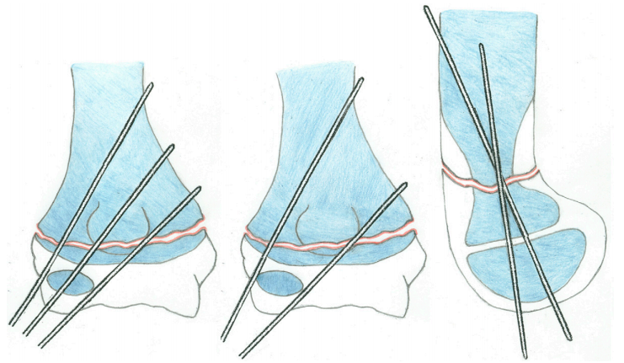
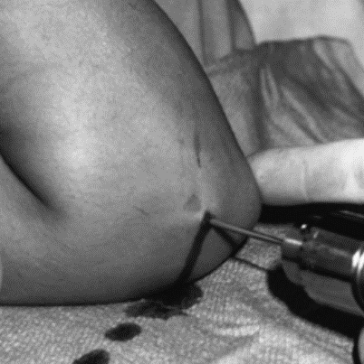
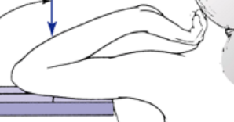
Supracondylar Fractures
2
1
3
>2mm

Slide 25
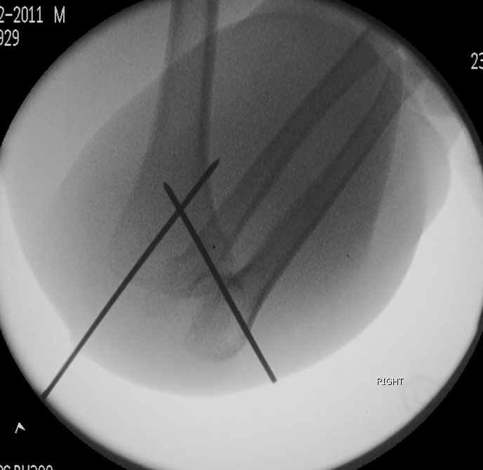
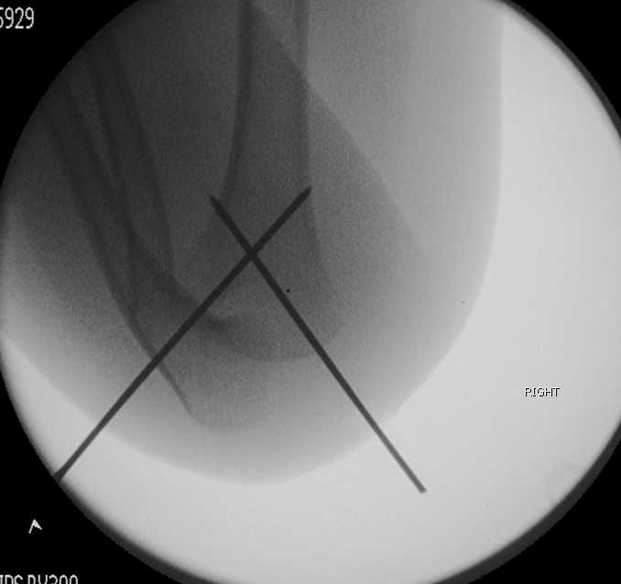
Supracondylar Fractures
Check Reduction and Stability:
  Jones View

Slide 26
Supracondylar Fractures
Follow up
  Fracture clinic review 1 week with XOA
  If no displacement cast reinforced
  Fracture clinic review 4 weeks XOA
    Pins removed in clinic
    If any concern on xrays further 2 weeks in cast followed by mobilisation
  Fracture clinic review 10-12 weeks to ensure ROM returned and assess carrying angle

Slide 27

Supracondylar Fractures
Vascular Deficit
  Associated with 10-20% of Type III fractures
White, non-perfused, pulseless limb should be treated as a vascular emergency
  Splint in 20-40 degrees of flexion
  Do not delay for vascular investigations
  Inform vascular team early
  Reduce and stabilise in theatre then re-assess
  Continued absence of pulse should prompt open exploration
Notes:
Mention loss of pulse and perfusion after reduction

Slide 28
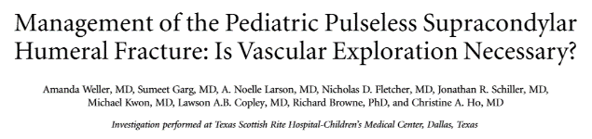
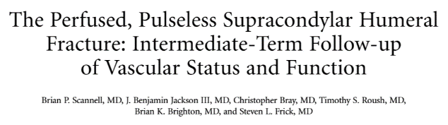
Supracondylar Fractures
Vascular Deficit
Pink, pulseless limb
  More controversial
  Recognised potential for progression to white and pulseless so inform vascular surgeons early
  Urgent but non-emergent reduction and fixation followed by observation for at least 48 hours
  Loss of Doppler signal or clinical deterioration intra-operatively or post-operatively should prompt open vascular exploration
  Absent pulses at discharge with a perfused hand shown to have no adverse effect on long-term functional outcome

Slide 29
Supracondylar Fractures
Other Controversies
  Delay to theatre
    Literature suggests delay of between 8-21 hours results in no deleterious effects on outcome
    Used as justification for referral to tertiary centres and avoidance of surgery at night
      All studies are retrospective – selection bias
      Practical implications of reduction with increased swelling
    What to do with the midnight referral?
  Iatrogenic Nerve Palsy
    Associated with medial pin placement
    Not always direct penetration with the K-wire
    Function shown to return even when K-wire not removed

Slide 30
Supracondylar Fractures
Complications
  Immediate/Delayed:
    Compartment syndrome
    Neurological injury
    Vascular Injury
    Pin site infections
  Late:
    Stiffness
    Malunion

Slide 31
Supracondylar Fractures
Summary
  Relatively common paediatric fracture
  Needs careful history, assessment and documentation
  Emergencies: White and pulseless, compartment syndrome, open fractures
  XR Classification: Gartland Type I-III
  Management depends on grade and
associated injuries

Slide 32
Paediatric Elbow Injuries
Supracondylar
  Gartland
Condylar
  Milch
  Jacob
Apophyseal
Transphyseal

Slide 33
Condylar Fractures
Second most common operative elbow fracture in children
Similar age distribution and mechanism to supracondylar fracture
Unusual for paediatric fracture
  Heals slowly
  Displaces late
  Tendency to non-union

Slide 34
Condylar Fractures
Assessment
  Analgesia
  History
    Mechanism
    Associated Injuries
    NAI
  Examination
    Look, Feel, Move
  Investigations
    Radiograph

Slide 35
Condylar Fractures
First described by Stimson in 1883
Milch
  Treatment of humeral cubitus valgus. Clin Orthop. 1955;6:120-125.
  Fracture of the external humeral condyle. JAMA. 1956;160:641-646.
  Fractures and fracture dislocations of humeral condyles. J Trauma. 1964;4:592-607.
Notes:
Stimson described the fracture as beginning in the lateral metaphysis proximal to the condyle, coursing distally, and exiting through the articular surface through the medial trochlear notch or through the capitellotrochlear groove.

Slide 36
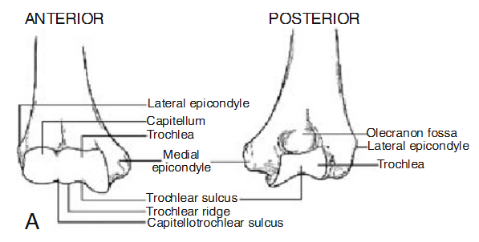
Condylar Fractures

Slide 37
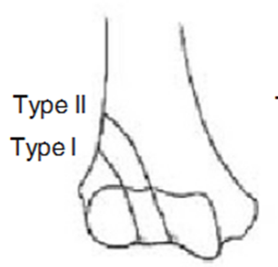
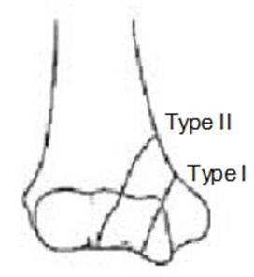
Condylar Fractures
Milch Classification
Lateral Condyle
Medial Condyle
~16% of distal humeral #’s
<1% of distal humeral #’s

Slide 38
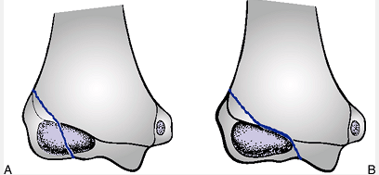
Condylar Fractures
Lateral Condyle
Type I
Type II
Notes:
Type I equivalent to SH Type IV
Type II equivalent to SH type II
Both in effect are treated as SH type IV

Slide 39
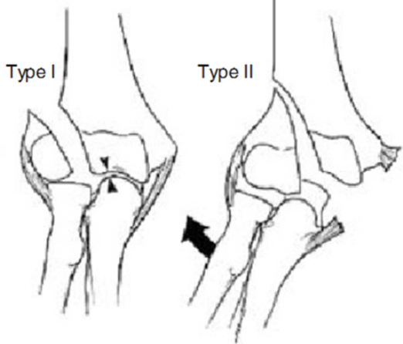
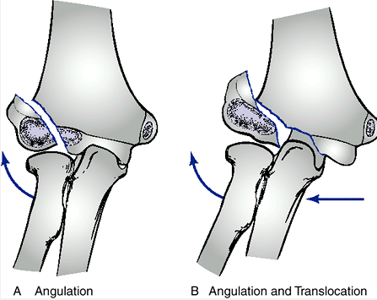
Condylar Fractures
Lateral Condyle
Notes:
Long term follow up suggests that Type I have worse outcome in non-union
Long-Standing Nonunion
of Fractures of the
Lateral Humeral Condyle
TH E JOURNAL OF BONE & JOINT SURGERY · JBJS.ORG
VOLUME 84-A · NUMBER 4 · APRIL 2002

Slide 40
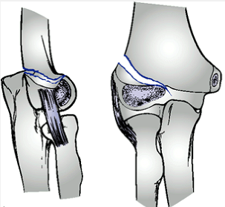
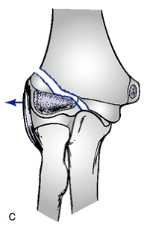
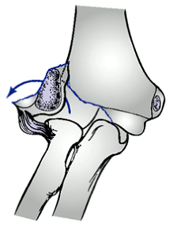
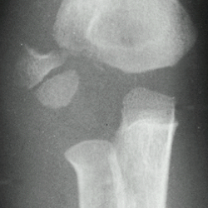
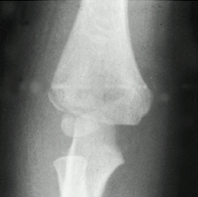
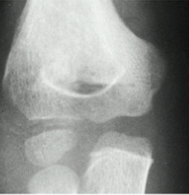
Condylar Fractures
Jakob Classification of displacement
  Stage I: non-displaced (<2mm), articular surface intact
  Stage II: 2-4mm displacement, articular surface disrupted
  Stage III: displaced and rotated

Slide 41

Condylar Fractures
Medial Condyle
Type I
Type II

Slide 42



Condylar Fractures
Kilfoyle Classification of displacement
  Type I: incomplete, undisplaced
  Type II: extension into articular surface of medial condylar physis
  Type III: rotated and displaced

Slide 43






Milch/Jakob/Kilfoyle Classification
Ease of Use
  Radiological classification difficult in preosseous bone
Internal oblique radiographs (Kwang et al.)
Notes:
Unossified lateral condyle. A. AP view. A small ossific nucleus can barely be seen (arrow) in the swollen lateral soft tissues. B. An arthrogram shows the defect left by the displaced lateral condyle (open arrow). The displaced condyle is outlined in the soft tissues (solid arrow).
Kwang Soon Song, MD, Chul Hyung Kang, MD, Byung Woo Min, MD, Ki Chul Bae, MD, and Chul Hyun Cho, MD
Internal Oblique Radiographs
for Diagnosis of Nondisplaced or
Minimally Displaced Lateral Condylar
Fractures of the Humerus in Children
THE JOURNAL OF BONE & JOINT SURGERY · JBJS.ORG
VOLUME 89-A · NUMBER 1 · JANUARY 2007

Slide 44
Condylar Fractures
Jakob Stage I
  Posterior splint with lateral gutter in 90 deg flexion and neutral rotation
  Fracture clinic weekly with AP, lateral and oblique XOA
  Mobilise at 4 weeks if clinically and radiologically united

Slide 45




Condylar Fractures
Jakob Stage II + III
  Open reduction and internal fixation
  Consider intraoperative arthrography
Notes:
Kocher approach to lateral condyle extending proximally to interval between triceps and brachioradialis

Slide 46
Condylar Fractures
Follow up
  Fracture Clinic 1 week XOA + reinforce cast
  Fracture Clinic 4 weeks for XOA + wires out + mobilise
  If any concern regarding osteonecrosis or growth disturbance then follow up for up to 3 years
Notes:
Radial Recurrent
Radial Collateral
Interosseous Recurrent

Slide 47
Paediatric Elbow Injuries
Supracondylar
  Gartland
Condylar
  Milch
  Jakob
Apophyseal
Transphyseal

Slide 48
Apophyseal Injuries
Medial epicondyle fractures 10% of all paediatric elbow fractures
Typical age 9 to 14 years
M>F (80%)
Caused by a valgus stress and avulsion of the medial epicondyle by the flexor-pronator muscle mass
50% associated with elbow dislocation
15-20% incarcerated in joint

Slide 49
Apophyseal Injuries
Marion et al (1962)
Bede et al (1975)
Combined by Beaty and Kasser in Rockwood and Wilkins Fractures in Children
Similar classification by Rang
Notes:
138. Bede WB, Lefebure AR, Rosmon MA. Fractures of the medial humeral epicondyle in children. Can J Surg 1975;18:137â€“142
145. Marion J, Faysse R. Fractures de l'epitrochlea. Rev Chir Orthop 1962;48:447â€“469.

Slide 50




Apophyseal Injuries
Displaced >5mm
Incarcerated
(With elbow dislocation)
Incarcerated
(Without elbow dislocation)
Acute Injuries
  Type I
  Type II
  Type III
  Type IV
Undisplaced or
Minimally Displaced
Notes:
152. Patrick J. Fracture of the medial epicondyle with displacement into the elbow joint. J Bone Joint Surg 1946;28:143â€“147.
Paper describes need to assume fragments at the level of the joint are intra-articular until proven otherwise
Silberstein et al described fractures through the epicondyle with varying degrees of displacement, intra-articular fragment could cause confusion although this is rare

Slide 51

Apophyseal Injuries
Management
  Long tradition of successful non-surgical management and early ROM
  Absolute Indications for surgery
    Incarceration of epicondyle in joint
  Relative indications for surgery
    Associated ulna nerve palsy
    High level sports-person or expected high demand
    Joint instability
    Significant displacement

Slide 52



Apophyseal Injuries
Significant Displacement
  1950s: Smith et al – >2cm displacement
  1980s: Papavasiliou et al – >3mm displacement
  1990s and 2000s: Hennrikus and Wu – >5mm displacemt
How displaced is displaced?
  Edmonds JBJS Dec 2010
Notes:
Edmonds advocates the routine use of internal oblique radiographs to assess displacement
Also seen from condylar fractures that internal obliques give most information
Doesn't help in terms of management as majority of level 3 evidence advocates non-surgical management for minimal displacement on AP radiographs that may be significantly more displaced than initially thought

Slide 53
Paediatric Elbow Injuries
Supracondylar
  Gartland
Condylar
  Milch
  Jakob
Apophyseal
Transphyseal

Slide 54
Transphyseal Fractures
Rare
Most common in infants younger than 2
Can occur up to age 6-7 in girls and 8-9 in boys
Diagnosis challenging before 2 years
Beyond 2 years radiographic diagnosis based upon radiocapitellar line

Slide 55




DeLee Distal Humeral Physis
Group A
  Infants to 12/12
  SH I
Group B
  12/12 to 3yrs
  SH I-II
Group C
  3-7yrs
  SH II

Slide 56
Transphyseal Fractures
Management
  Prompt diagnosis with paediatric review
    NAI confirmed or suspected in up to 50%
  Operative intervention similar to supracondylar fractures
    MUA + K-wires

Slide 57
Elbow Injury Classifications
Supracondylar
  Gartland/Wilkins
Condylar
  Milch
  Jakob
  Kilfoyle
Apophyseal
  Beaty/Kasser
Transphyseal

Slide 58
Recommended Reading/References
Omid, R, Choi PD, Skaggs, DL. Supracondylar Humeral Fractures in Children. J Bone Joint Surg Am. 2008; 90: 1121- 1132.
Weller, A et al. Management of the Pediatric Pulseless Supracondylar Humeral Fracture: Is Vascular Exploration Necessary? J Bone and Joint Surg Am. 2013;95:1906-12
Scannell B et al. The Perfused, Pulseless Supracondylar Humeral Fracture: Intermediate-Term Follow-up of Vascular Status and Function. J Bone Joint Surg Am. 2013;95:1913-9
Scherl S et al. Pediatric Trauma: Getting Through the Night. J Bone Joint Surg Am. 2010;92:756-64
BOAST 6: Management of Arterial Injuries Associated With Fractures and Dislocations. BOA Trauma Group Feb 2014
Beaty J et al. Supracondylar Fractures of the Distal Humerus, in Rockwood and Wilkins Fractures in Children. Lippincott Williams & Wilkins 2006
Kwang et al. Internal Oblique Radiographs for Diagnosis of Nondisplaced or Minimally Displaced Lateral Condylar Fractures of the Humerus in Children. J Bone and Joint Surg Am. 2007;89:A Number 1
Toh et al. Long-Standing Nonunion of Fractures of the Lateral Humeral Condyle. J Bone and Joint Surg Am. 2002;84:A Number 4
E Edmonds. How Displaced Are ‘‘Nondisplaced’’ Fractures of the Medial Humeral Epicondyle in Children? Results of a Three-Dimensional Computed Tomography Analysis. J Bone and Joint Surg Am. 2010;92:2785-91
Mehlman et al. Medial Epicondyle Fractures in Children: Clinical Decision Making in the Face of Uncertainty. J Pediatr Orthop 2012;Vol 32 Number 2 Supplement
W Shrader. Pediatric Supracondylar Fractures and Pediatric Physeal Elbow Fractures. Orthop Clin N Am. 2008;39;163-171

Slide 59
Questions?

Slide 60

Gartland IV
Leitch et al.
9 of 297 supracondylar fractures unstable in both flexion and extension
Notes:
Addition of a type IV fracture has been recently proposed. Leitch and co-workers described a fracture that is unstable in both extension and flexion, present in 9 of 297 displaced supracondylar humeral fractures in children that they reviewed (see Fig. 9-11 ). This fracture is less stable than a Gartland type III extension supracondylar fracture, presumably due to loss of the dorsal periosteal hinge. They described a method of closed reduction and pin fixation that led to good clinical results while avoiding the need to open the fracture.^{[122]} These fractures are generally very unstable and open reduction with internal fixation may be required

Slide 61
Woods/Tullos Medial Epicondyle
Type I
  Undisplaced
Type II
  Minimally displaced (<5mm)
  Displaced (>5mm)
  Elbow not displocated or reduced
Type III
  Epicondyle not in joint
  Epicondyle in joint
  Elbow dislocated
Notes:
Green and Swiontkowski: Skeletal Trauma in Children

Slide 62
Jarvis D’Astous T-condylar
Type I
  Non-displaced
Type II
  Displaced
    Greater than 1mm articular step-off
Type III
  Fracture dislocation
Notes:
Described a series of 16 patients, no type I and only one type III

