Slide 1

Paediatric pes cavus
Assessment and Management Principles
Cesc Malagelada
Paediatric Orthopaedic SpR
Mr Kyle James
Royal London Hospital
October 2014

Slide 2
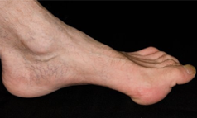
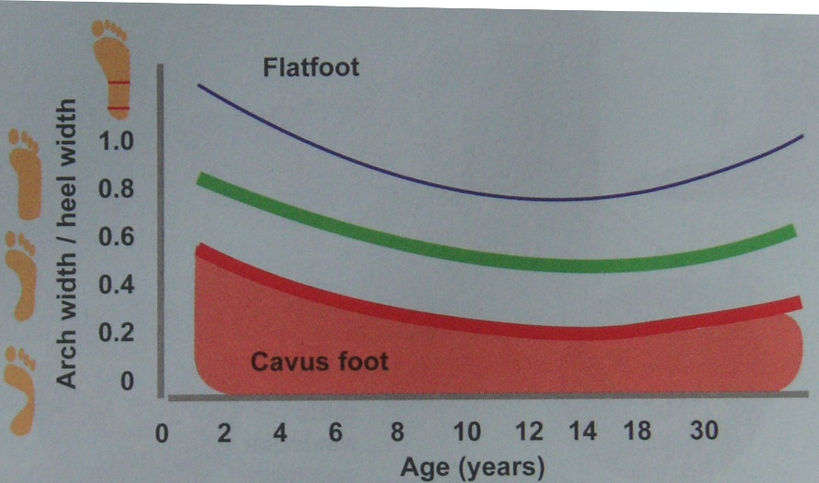
Definition
Abnormal elevation of longitudinal arch on weight-bearing.
Arch width / heel width. Pathological >2 SD
Notes:
Results from a relative equinus of forefoot in relation to hindfoot

Slide 3
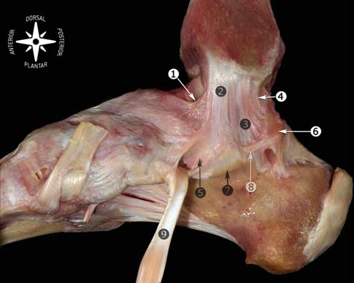
Definition
Arch supported by osseus and ligamentous structures
Windlass effect of plantar fascia – Dynamic support
Spring (calcaneonavicular)
Short plantar (calcaneocuboid)
Long plantar
Superficial Plantar fascia
Golano P et al. Anatomy of the ankle ligaments: a pictorial essay. Knee Surg Sports Traumatol Arthrosc 2010; 18(5):557-69
Lee MC, Sucato DJ. Pediatric issues with cavovarus foot deformities. Foot Ankle Clin 2008; 13: 199-219
Notes:
Results from a relative equinus of forefoot in relation to hindfoot
Windlass is the tightening of a rope or cable. The plantar fascia simulates a rope attached to the calcaneus and MTT joints. Dorsiflexion during propulsive phase of gait winds the plantar fascia around the head of the MTT. This shortens the distance bw calcaneus and MTT and elevates the medial longitudinal arch. The plantar shortening that results from dorsiflexion is the essence of the windlass mechanism principle, is demonstrated when passive dorsiflexion of MTPJ and places plantar fascia under tension and elevates medial arch.

Slide 4
Definition
Arch supported by osseus and ligamentous structures
Windlass effect of plantar fascia – Dynamic support
Spring (calcaneonavicular)
Short plantar (calcaneocuboid)
Long plantar
Superficial Plantar fascia
Golano P et al. Anatomy of the ankle ligaments: a pictorial essay. Knee Surg Sports Traumatol Arthrosc 2010; 18(5):557-69
Lee MC, Sucato DJ. Pediatric issues with cavovarus foot deformities. Foot Ankle Clin 2008; 13: 199-219
Notes:
Results from a relative equinus of forefoot in relation to hindfoot
Windlass is the tightening of a rope or cable. The plantar fascia simulates a rope attached to the calcaneus and MTT joints. Dorsiflexion during propulsive phase of gait winds the plantar fascia around the head of the MTT. This shortens the distance bw calcaneus and MTT and elevates the medial longitudinal arch. The plantar shortening that results from dorsiflexion is the essence of the windlass mechanism principle, is demonstrated when passive dorsiflexion of MTPJ and places plantar fascia under tension and elevates medial arch.

Slide 5
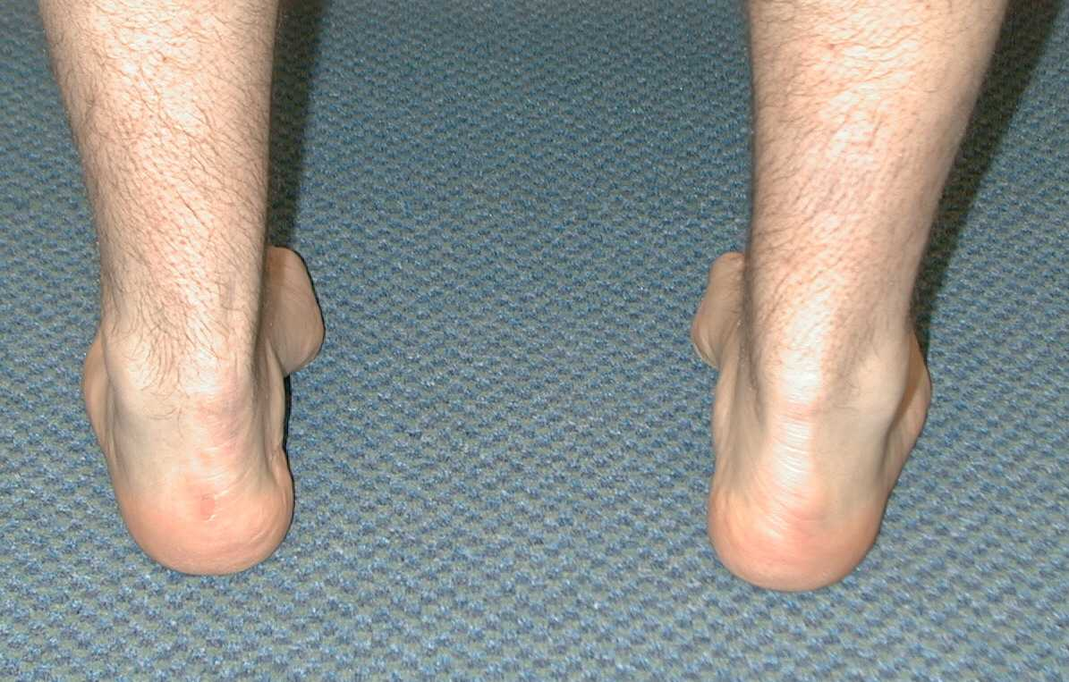
Types
Without hindfoot deformity
  SIMPLE
    Plantarflexed forefoot. Normal hindfoot
With hindfoot deformity
  CAVOVARUS
    Plantarflexed forefoot. Varus Hindfoot
  CALCANEOCAVUS
    Plantarflexed forefoot. Dorsiflexed hindfoot
Notes:
Cavovarus – Most common. Seen in CMT. Weakness intrinsics. → Peroneals, Tib Ant, Tib Post, Triceps Surae???
Calcaneocavus – Polio, CP, Post club foot, Spinal. Weakness triceps

Slide 6
Pathoanatomy
Muscle imbalance
↓
flexible deformity
↓
fixed deformity
↓
bony and joint deformity

Slide 7
Aetiology
Neuromuscular (70%)
  PNS : Charcot Marie Tooth – CMT (Hereditary Sensory Motor Neuropathy - HSMN) – 17 types
  CNS : Friederich Ataxia , CP
  Spinal cord : Myelodisplasia, Polio, syringomielia, tumor
  Muscular dystrophies
Post Club foot (22%)
  Overlengthening of TA, dorsally subluxed navicular
Traumatic
  Compatment syndrome, peroneal nerve injury, burns, talar neck fracture malunion
Idiopathic
Notes:
Mills 1923: The impression left in my mind from reading the list of causes of the cavus foot was one of surprise that anyone managed to escape the disease.
Generalised: CMT, CP, Friedrichs BILATERAL.
Localised: UNILATERAL
If unknown etiology consider Neurology consultation

Slide 8
The cavus foot is the result of an underlying neurological problem until proven otherwise
Remember 70%
  70% of patients with cavus foot have an identifiable associated neurological problem
  70% of patients with bilateral cavus have CMT
  70% of CMT is CMT1A

Slide 9
Hereditary Motor Sensory Neuropathy
Most common HMSN is Charcot-Marie-Tooth
  Complicated group of 50+ peripheral neuropathies
  Type I HMSN classic and most common CMT
    AD, presenting at 2nd decade of life
    Slow nerve conduction velocities. Key for DX
    Most type I are linked to Cr 17 and designated CMT 1A
  Type II similar presentation but later and less severe
NCS/EMG
Hunt KJ, Ryu JH. Neuromuscular problems in foot and ankle: Evaluation and workup. Foot Ankle Clin N Am. 2014;19: 1-16
Notes:
Group of Clinically and genetially distinct conditions. Abnormalities of sensory motor nerves

Slide 10
Charcot-Marie-Tooth (CMT)
Bilateral pes cavovarus + claw toes + leg weakness + loss sensation and proprioception
High Stepping gait
Can also have UE weakness later
Hip dysplasia (late)
Scoliosis
Broad-based gait + late hip dysplasia → EMG
Notes:
In general CMT affects longest nerves to smallest muscles first
Gati shows steppage gait from combinato of DF weakness, fixed equinus and proprioception difficulties.
25% sensory impariment on 2-point discrimination, proprioception and vibration.
Proprioception results in difficulty ambuulating, poor balance, painful calluses (specially when deformity becomes more rigid).

Slide 11
Charcot-Marie-Tooth (CMT)
Bilateral pes cavovarus
  Weakness of Tib Ant and Peroneus Brevis
  Functioning Peroneus Longus, Tib Post
    Plantarflexed 1st ray, cavus foot, compensatory varus
    Cavus exacerbated by Tib Post pull
Claw toes
  Weakness of intrinsic muscles
    EHL and EDL recruited to dorsiflex ankle
    Long toe flexors flex IPJ and long toe extensors extend MPJ
Notes:
In general CMT affects longest nerves to smallest muscles first

Slide 12
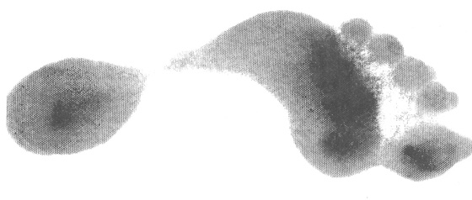
Pes Cavus clinical presentation
Familial incidence
Part of a known disease process – Progressive
Presenting complaints
  Clawtoes
  Metatarsalgia
  Recurrent ankle sprains – “Instability”
  Pain and callosities
Notes:
Underlying NM disorder -> natural history is gradual progression

Slide 13
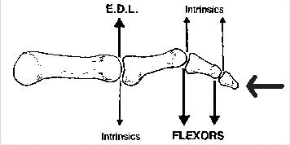

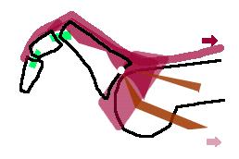
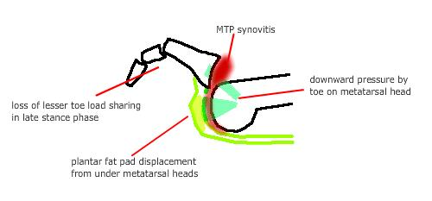
Cavovarus – Toe Clawing
Intrinsic weakness -extensor hood weakness
↓
EHL substitute weak tib ant – MTP hyperextends
↓
Unopposed FDL flex PIP and DIP joint
↓
As MTPJ hyperflexion persist the plantar plate stops reduction leading to a plunger effect and dorsal capsule contracts
Notes:
In CMT , Intrinsecs 1st ms affcted by neuronal degeneration (innervated by longest axons of sciatic nerve) -> loose ability to stabilize MTPJ –> Ext MTP, Flex IP

Slide 14
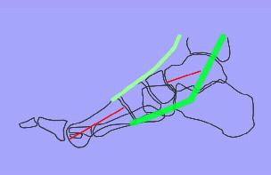
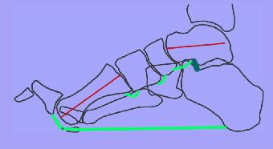
Cavovarus – Plantar flexed 1st Ray
Tib ant is weak, EHL is main dorsiflexor and is easily over come by peroneus longus
↓
Hyperextension of MTP, tighten plantar fascia leads to ‘windlass effect’ creating pes cavus
Notes:
Tib ant weak – Long toe extensors compensate: elevate phalanx

Slide 15
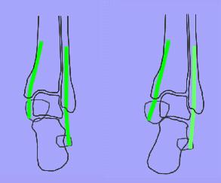
Cavovarus – Hindfoot changes
Weak peroneus brevis and stronger tib post cause hindfoot to be pulled varus
&
Plantar flexed first ray lead to tripod effect with varus of heel
Notes:
Tib Post Strong - Varus

Slide 16
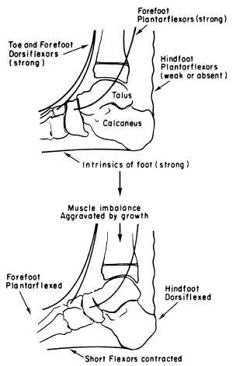

Calcaneocavus
Triceps weakness
↓
Calcaneum vertically orientated
↓
Decreased lever arm leads to mechanical weakness
↓
Intrinsic and Dorsiflexor & contracture in plantar fascia worsen cavus
Normal= 0.5 – 0.8
Bradley GW, Coleman SS. Treatment of the calcaneocavus foot deformity. JBJS Am. 1981;63:1159-1166

Slide 17
Evaluation
Birth History and Family History (CMT)
Spine
  Hairy patch, scoliosis, bowel or bladder.
Hip
  Hip subluxation
Leg
  Thin legs, gastroc-soleus contracture (Silfverskiold)
Gait
  Ataxia, Foot drop, Steppage, Trendelenburg
James HE; McLaurin RL, Watkins WT. Remission of pes cavus in surgically treated spinal dysraphism. Report of a case. JBJS Am 1979;61:1096
Notes:
Cause of spinal dysraphism is corrected early, cavus may resolve spontaneeously
Isolated gastroc contracture (usually in CP): Equinus contracture with knee extended (20 plantar), when knee flexed, ankle dorsiflexion improves (10 dorsi)
Normal: knee extended = 10 DF. With flexion of knee there is an additional 10 DF (= 20 DF)
CMT – Steppage (flexion of hip + knee in swing phase to allow for clearance of foot)

Slide 18
Evaluation
Foot
  Cavus Unilateral or Bilateral
  Deformity forefoot or hindfoot
  Is hindfoot flexible – Coleman block test
  Are toe deformities flexible
  Are the joints flexible
  What is the apex of the deformity
  Neurology
    Grade 4 for tendon transfers (Tib Ant, Tib Post, Gastroc)
Notes:
Examine all components and determine flexibility: 1. Forefoot, Mid-foot. 2. Hindfoot. 3. Toes
Early stages flexible, after years fixed.
3. Toes flexible if passively corrects when DF – Then surgical correction of 1 will correct 3 spontaneously.

Slide 19
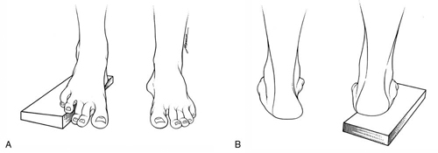
Coleman Block test
Coleman SS, Chesnut WJ. A simple test for hindfoot flexibility in the cavovarus foot. Clin Orthop Relat Res 1977;123:61
Notes:
Evaluates subtalar motion
Heel and lateral obrder of the foot on a block, asked to force the 1st MTT head into bearing weight - > Assess Hindfoot
Assumes initial deformity is in forefoot, and assessess if Hindfoot is flexible or fixed.
If flexible hindfoot – Remains neutral and – Ttx limited to forefoot : OT of 1st Ray
If rigid hindfoot – Still cavus – Ttx both forefoot and hindfoot

Slide 21
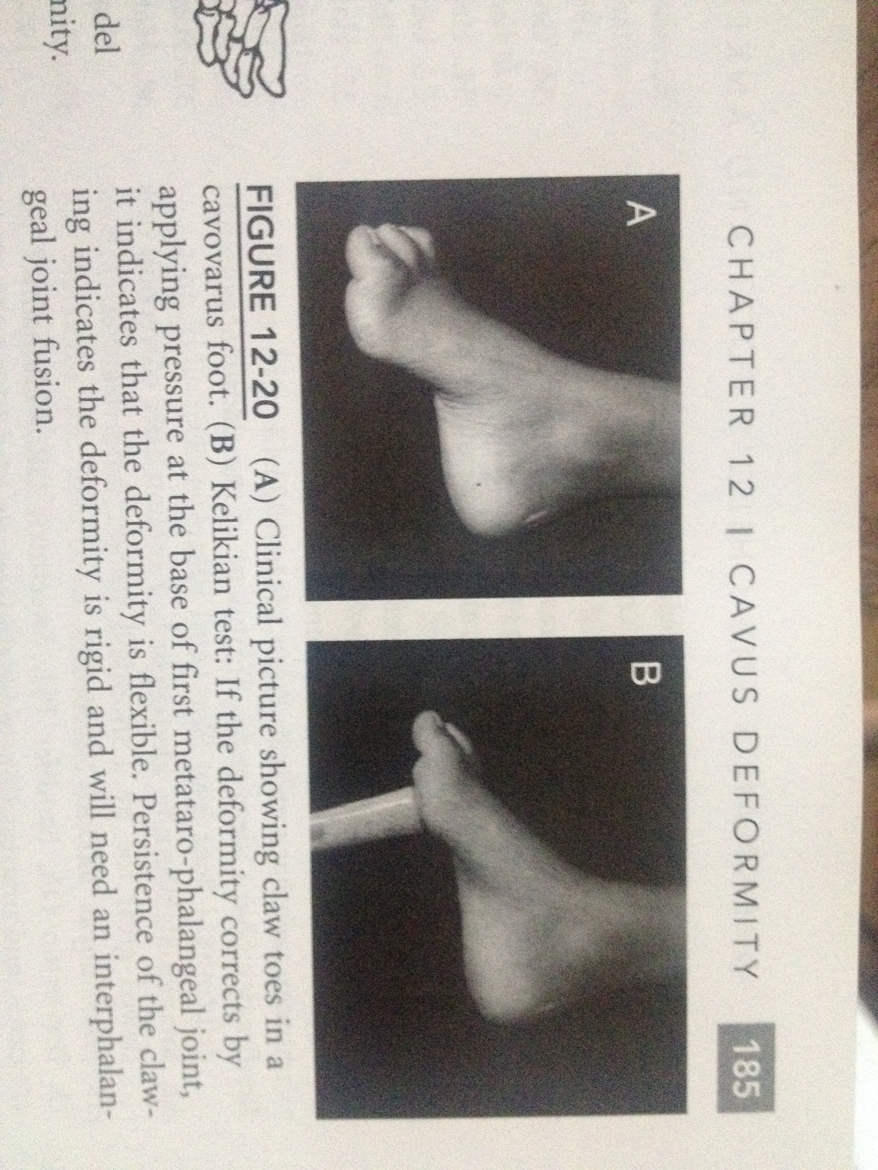
Kelikian test
To assess flexibility of claw toes
Flexible – Will correct spontaneously after forefoot surgery
Rigid – Will need IPJ fusion
Kelikian H. Hallux valgus, allied deformities of the forefoot and metatarsalgia. Philadelphia: WB Saunders. 305. 1965
Notes:
If clawtoes flexible – No IQ on toes. Fixed – Dorsal capsulotomy and Fusion

Slide 22
Evaluation
Unilateral – MRI spine, brain (syringomyelia)
EMG / NCS +- Muscle / Nerve biopsy
  Peripheral nerve – NCS slowed, EMG increased amplitude, muscle biopsy atrophy, nerve bx +- demyelination
  Myopathic – NCS normal, EMG decreased amplitude, muscle biopsy degeneration and regeneration
Notes:
Muscle Bx – if after MRI, EMG still Dx in doubt (DW Neurology, Pahtology)

Slide 23
Evaluation points
Underlying cause?
Evaluation | Significance
Uni or Bilateral | Uni suggests anatomic lesion
Type cavus – hindfoot deformit | Calcaneocavus tx different
Rigidity of deformity – Coleman test | Forefoot + Hindfoot surgery
Apex of cavus | Operative planning
Toes deformity | Operative planning
Sensory and motor examination | Grade 4 strength for transpositions
Notes:
Unilateral: spinal cord tumor
Strong attempt to determine the cause of cavus – IMP bc may affect Prongosis/Outcome

Slide 24
Evaluation
Xray –Weight bearing AP – Lateral
  Normal Angles
    Meary angle : 0-5
    Hibbs angle: 45
    Calcaneal Pitch: 30
    Tibioplantar angle: 90
  In CMT: Pelvis XR
Notes:
Apex of deformity can vary. Usually at Chopart
Hibbs + Meary – Document Severity
Calcaneal pitch – indicates calcaneus os calcis
Meary: 2 lines connecting the long axis of talus with longa xis of 1st MTT . >18. Point of intersection is apex of deformity- Important when considering OT
Calc Pitch: Line parallel to floor and line along plantar surface of calcaneus. =/= Calcaneocavus from a forefoot equinus. If <30 is forefoot equinus rather than CC (>30)
Hibbs: Line through calcaneus and line through axis 1st MTT. 90
Tibioplantar : long axis of tibia nad line form plantar surface of calcaneus to MTT heads. Useful when midfoot OT
CMT: Pelvis to detect asymptomatic DDH

Slide 25
Treatment principles
Tailor according to patient age, level of activity, disease process and prognosis.
As most conditions are progressive – Explain parents that deterioration and further surgery is likely.
Prevent progression in early stages

Slide 26
Treatment principles
Flexible deformities require soft tissue procedures
Fixed deformities require soft tissue release and bony procedures – avoid growth plates

Slide 27
Treatment principles
Flexible deformities require soft tissue procedures
  Muscle power should be MRC grade 4 and above
  Transferred tendons should be routed in as straight a line as possible and secured to bone rather than tendon
  Tendons lose ONE MRC power grade on transfer
Fixed deformities require soft tissue release and bony procedures – avoid growth plates

Slide 28
Treatment principles
Flexible deformities require soft tissue procedures
Fixed deformities require soft tissue release and bony procedures – avoid growth plates
  Bony corrections at the apex of the deformity
  Muscle function can be balanced by changing the lever arm with bony procedure or transfers
  Tendon transfers should be done after fixed deformities are corrected

Slide 29
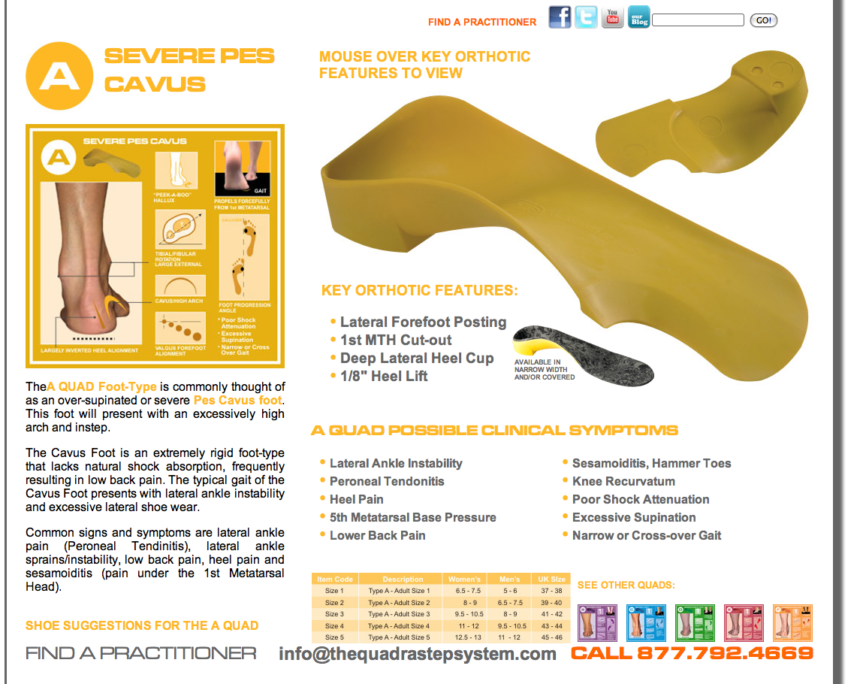
Management
Non-operative
  Orthotics
    Foot orthosis
    AFOs
  Serial casting
Indications
  Mild
  Non progressive disease
  LIMITED
Notes:
Orthotics: unloading pressure areas, control dynamic foot deformities.
AFOS (night) Prevent progress of equinus / For cavus questionable
Serial casting to maintain ankle dorsiflexion
Do not stop or prevent. Role Extremely Limited

Slide 30
Indications for surgery
Ankle instability
Painful callosity
  MT heads
  Base 5th MT
Difficulty with fitting orthoses
Poor balance
Progressive deformity
        Procedure is dependent on deformity

Slide 31
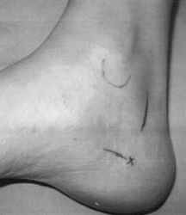
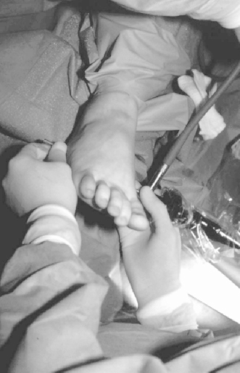
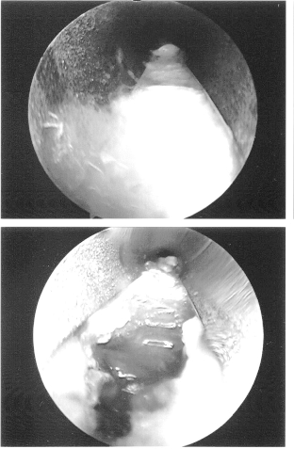
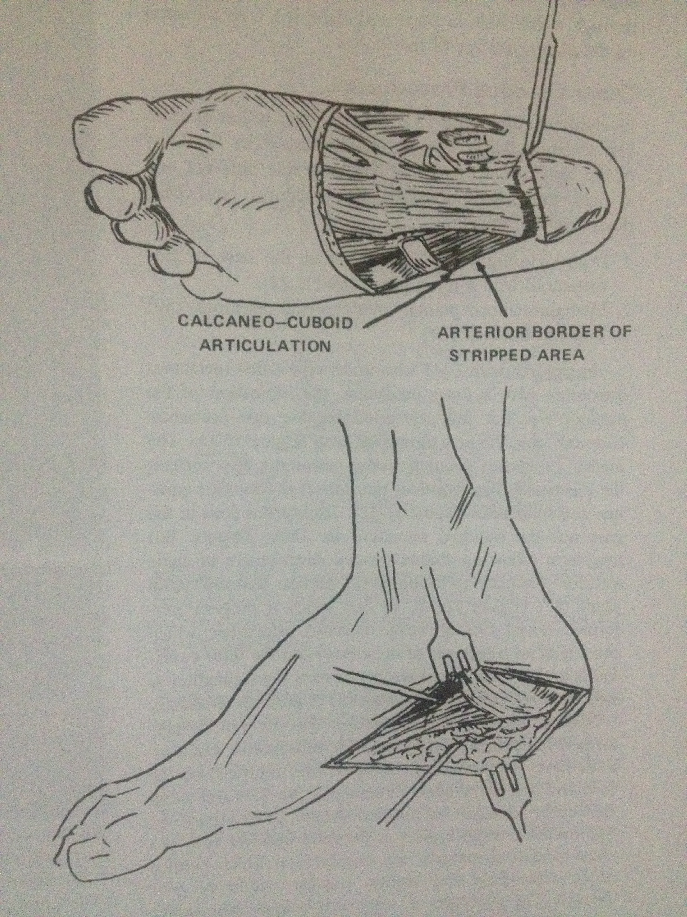
Cavovarus foot - CMT
High arch
<8yo : Alone + serial casting postop
Plantar fasciotomy
Paulos L, Coleman SS, Samuelson KM. Pes Cavovarus. Review of a surgical approach using selective soft-tissue procedures. JBJS Am 1980;62:942-953.
Notes:
Plantar fascia is Always contracted, acts like a bowstring. Essential 1st step: Lengthening
Plantar fasciotomy – seldom performed alone

Slide 32
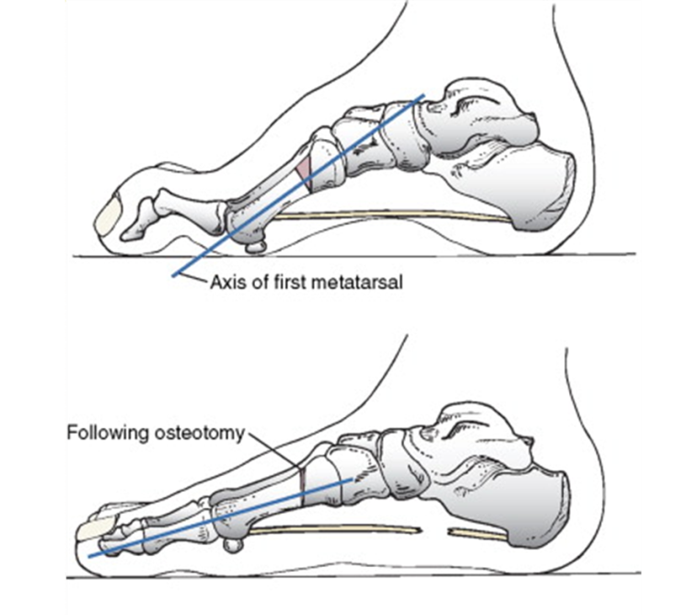
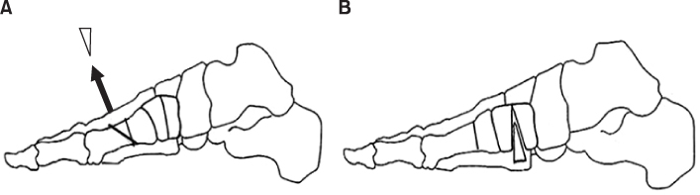
Cavovarus foot - CMT
High arch
Plantarflexed 1st ray
Plantar fasciotomy
Dorsal closing wedge 1st MTO
Plantar opening wedge medial cuneiform OT
Notes:
Plantar fasciotomy – seldom performed alone. Combine with 1st ray OT
Avoid growth plate of 1st MT

Slide 33
Cavovarus foot - CMT
High arch
Plantarflexed 1st ray
Flexible hindfoot on block test
Plantar fasciotomy
Dorsal closing wedge 1st MTO
Plantar opening wedge medial cuneiform OT
PL to PB transfer
Tib Post dorsal transfer to cuneiforms (IOM)
Azmaipairashvili Z, Riddle EC, Kumar SJ, et al. Correction of cavovarus foot deformity in Charcot-Marie-Tooth disease. J Pediatr Orthop 2005;25(3):360-365.
Notes:
Tib Post stays viable long after the otehr ms become weak. Transfer to dorsal aspect to compensate for Tib Ant and help DF. Tib ant ok – To lat cun. Tib ant no – To Mid cun
If <12y and flexible foot (both fore + hindfoot) – ST surgery alone

Slide 34
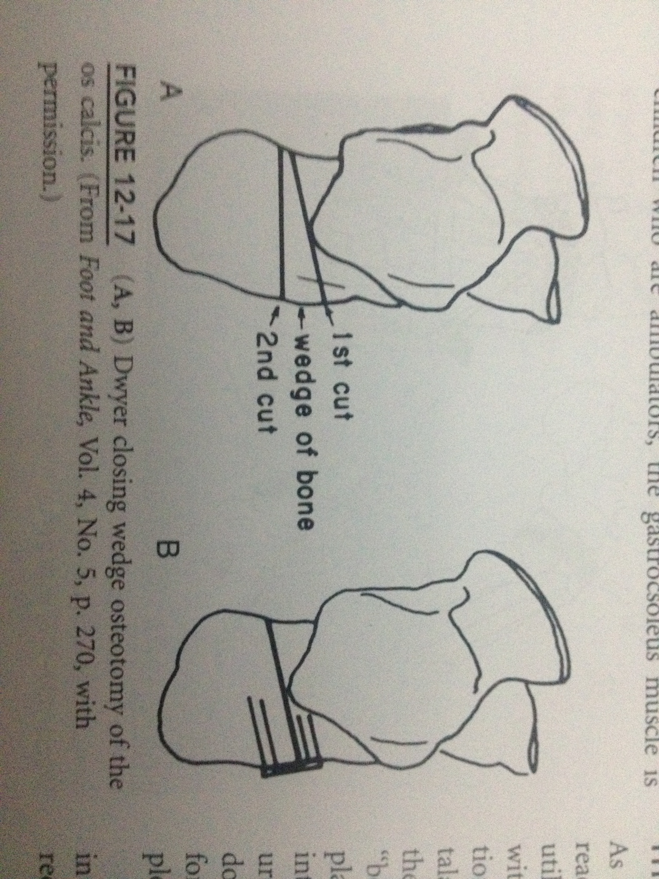
Cavovarus foot - CMT
High arch
Plantarflexed 1st ray
Rigid hindfoot on block test
Plantar fasciotomy
Dorsal closing wedge 1st MTO
Plantar opening wedge medial cuneiform OT
Calcaneal osteotomy
PL to PB transfer
Dwyer FC. The present status of the problem of pes cavus. CORR;106:254-275.
Notes:
Dwyer – Closing wedge OT
Sliding OT – Not shortening the heel

Slide 35
Cavovarus foot - CMT
High arch
Plantarflexed 1st ray
Clawing of great toe
Plantar fasciotomy
Dorsal closing wedge 1st MTO
Plantar opening wedge medial cuneiform OT
Jones procedure
Notes:
Plantar fasciotomy – seldom performed alone

Slide 36
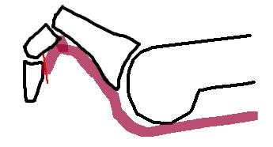
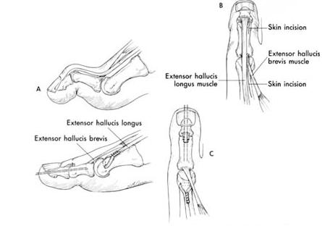
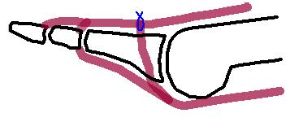
Lesser claw toes
Flexible
Fixed
Corrects spontaneously
MTP release, Fuse IPJ
Flexor – Extensor transfer (Girdlestone)
Extensor digitorum longus to MT base.
Taylor R. An operative note for the treatment of hammer toe and claw toe. JBJS 1940;22:608-609.
Notes:
Girdlestone – Extensive procedure for lesser toes + unpredictive results. Not recommended.
ST procedures (tenotomies, transfers) not worked very well → IPJ fusion better

Slide 37
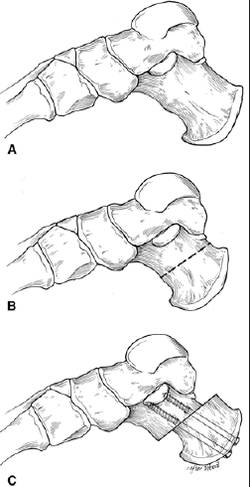
Other cavus feet
Simple cavus
Calcaneocavus
Equinocavovarus
Midtarsal osteotomy
Transfer dorsiflexors to calcaneus
Posterior displacement Calcaneal OT
Tib Post
    Transfer
    Lengthening
Chapman EH. Transfer of the Long Toe Extensors for Imbalance of the Foot following Poliomyelitis. JBJS Am. 1959;41:1077-1093.
Notes:
Calcaneocavus. If Tib Post and toe flexors are working can transfer to calcaneum. Otherwise Tib Ant and FDL to calcaneus or lateral border of foot.

Slide 38
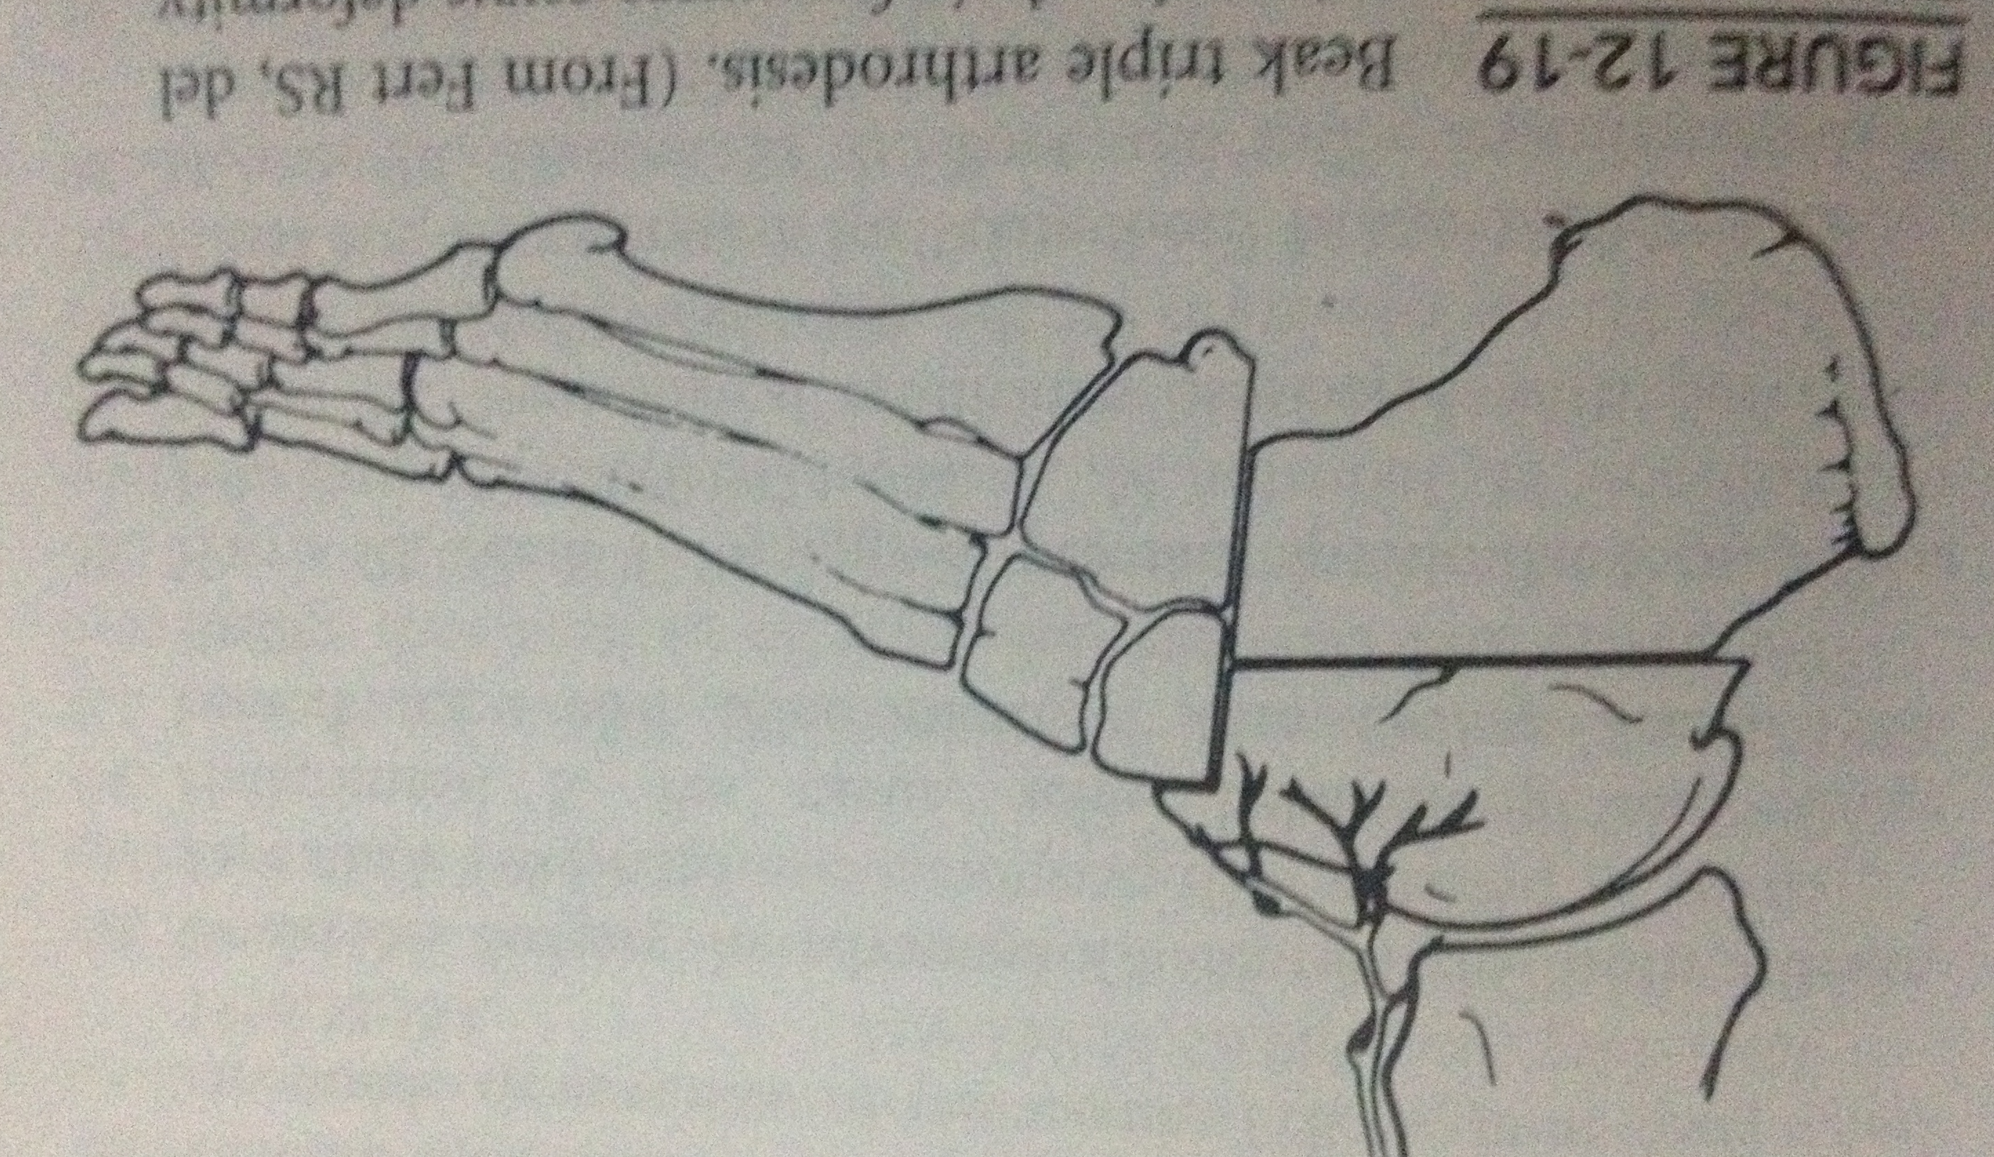
Salvage procedures
Midfoot osteotomies – Severe deformity
  Truncated wedge
  V osteotomy
  “Beak” osteotomy
Triple arthrodesis – Skeletally mature (♀>12, ♂>14)
  Long term outcome is poor in 50%
  Result in degenerate change in adjacent joints (60-70%)
  Caution: In progressive disorders, In sensory neuropathies.
Schwend RM, Drennan JC. Cavus foot deformity in children. J Am Acad Orthop Surg 2003;11:201-211
Siffert RS, del Torto U. “Beak” triple arthrodesis for severe cavus deformity. Clin Orthop Relat Res 1983;181:64-67.
Notes:
These OT can lead to shortening of foot, pseudoarthrosis, or rocker bottom foot if excessive correction attempted
Beak triple arthrodesis. If severe may need to remove a large wedge of talar head-neck -> AVN. To avoid this.
3 A- Unless OA or severity requires + Skel mature

Slide 39
Summary
Pes Cavus is due to Neuromuscular imbalance until proven otherwise
Detailed assessment is needed including spine, NCS/EMG, MRI - Unilateral
Aim of surgery is to prevent progression in children
Flexible deformity – Soft tissue procedures
Fixed deformity – Osteotomies / Soft tissue releases / Tendon transfers
Arthrodesis has poor long term results in progressive deformities and patients with sensory impairment.

