Slide 1
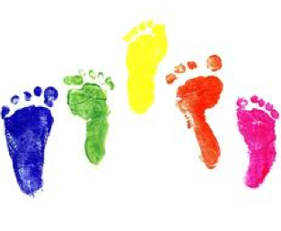
Approaches to assessment and management of normal variants
Sheraz Malik
19 August 2014
Notes:
This talk is about assessment and management of Normal Developmental Variants. In majority of these conditions the natural history usually involves resolution of the perceived deformity. The aim of this talk is to highlight clinical features of normal variants.

Slide 2
Normal Variants
Common cause for parental concern
In one study, 53% of new referrals
Diagnosis usually made on Hx and Ex
Important to exclude pathological conditions
Notes:
In one study, half of new referral to paediatric orthopedic clinic were about normal variants. Therefore, these conditions are commonly encountered in the paediatric orthopaedic clinics. A thorough history and clinical examination are usually all that is required to make the diagnosis of a normal variant. Most cases do not require further investigation. Radiological and other investigations are usually only required to exclude pathological conditions.

Slide 3
Normal Variants
Normal variants of the lower limbs
Plagiocephaly
Torticollis
Pectus carinatum / excavatum
Notes:
The conditions that will covered in this talk are…

Slide 4
Normal variants of the lower limbs
In-toeing/ Out-toeing
Genu varum/ valgum
Flat feet
Curly toes
Growing pains
Traction apophysitis
Notes:
First we will look at the normal variants of the lower limbs.
In-toeing and flat feet are the most common normal variants referrals.

Slide 5
The 5 S’s of normal variants
Symmetrical
Symptom free
Lack of stiffness
Lack of systemic disease
Lack of skeletal dysplasia
Notes:
The properties of these normal variants on clinical assessment can be remembered in terms of 5 S’s.
The following features suggest a pathological condition:
Abnormal facies
Abnormal height
Asymmetry of limb findings
Limitation of joint movements
Leg length discrepancy/hypoplasia

Slide 6
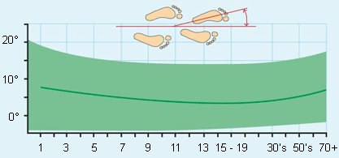
In-toeing
Notes:
Now, we will look at specific conditons:
The typical presentation is a history of in toeing when walking and frequent falls.
Foot progression angle = Angle that the foot makes to the direction in which the child is walking. Normal range = -0 to +15,
Out toeing gait = FPA>15/20 degrees
In toeing gait = FPA <0/-5 degrees.
In toeing or an inward pointing foot is more common than out toeing and occurs in nearly 2 out of 1000 children.
M=F
The typical presentation is a history of in toeing when walking and frequent falls.

Slide 7
In-toeing
Age of presentation | Cause
<1 Year | Metatarsus adductus
1-4 Years | Internal Tibial Torsion
4-7 Years | Persistent Femoral Anteversion
Notes:
(Infant) (Toddler) (School age)
All of these problems may be a result of intrauterine packaging – “moulding”
DIAGNOSIS: Look, Feel, Move

Slide 8
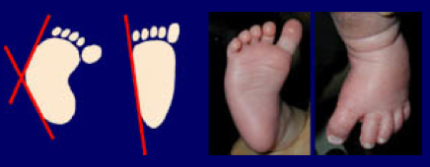
In-Toeing: Metatarsus Adductus
Notes:
The forefoot is adducted at the tarsometatarsal joint. The foot appears C-shaped with a convex lateral border and a concave medial border. The range of motion of the ankle and sub-talar joints is usually normal. This condition can be distinguished from club foot as there are no fixed deformities within the hind foot i.e. hind foot is in neutral. There is no tightness of the tendinoachilles.

Slide 9
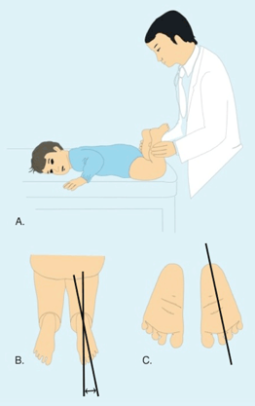
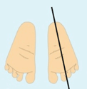
Metatarsus Adductus: Diagnosis
Notes:
The diagnosis is made by assessing the plantar aspect of the feet. The child is turned prone and knees are flexed to 90 degrees. An imaginary line drawn to bisect the heel normally goes through the 2nd toe

Slide 10
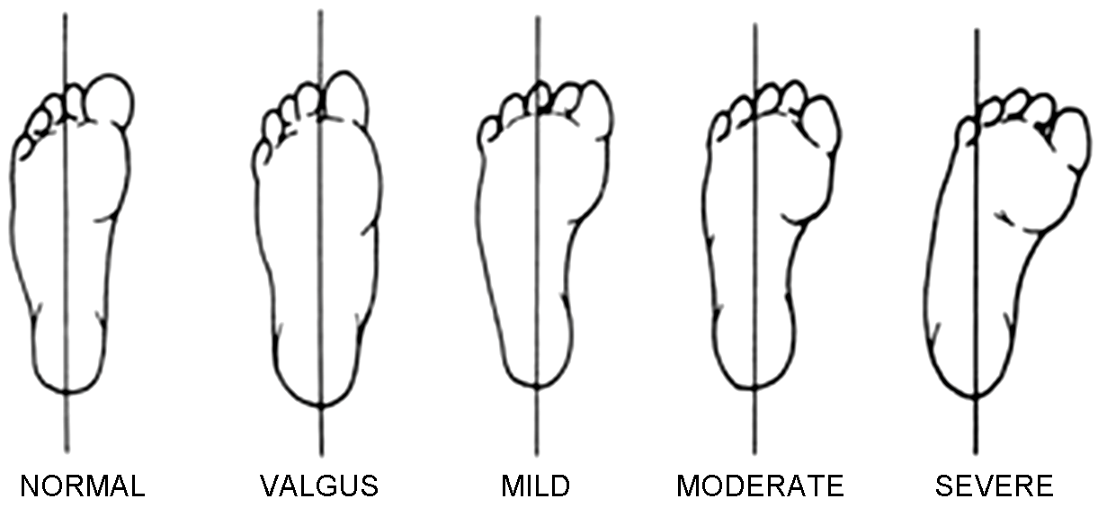
Metatarsus Adductus: Diagnosis
Beck’s Heel Bisector Line
Association with DDH 2%-15%: Also screen hips
Notes:
Bleck has classified this deformity into mild, moderate and severe based on the position of the heel bisector line.

Slide 11
Metatarsus Adductus: Management
85%- 90% resolve by the time child is 1 year old
Actively corrected: Reassure
Passively correctable: Stretching exercises
Severe/ Present >12months = Serial casting
Resistant cases: Surgery
Notes:
Flexible: Reassure
Feet that cannot be passively corrected to neutral: serial casting
Surgery in the form of:
Soft tissue surgery: Release of Abductor Hallucis Tendon; Medial mid-foot/ tarsometatarsal joint capsulotomy
Osteotomies: medial cuneform/ cuboid osteotomies
The best results with osteotomies are seen when the surgery is performed after 5 years of age

Slide 12
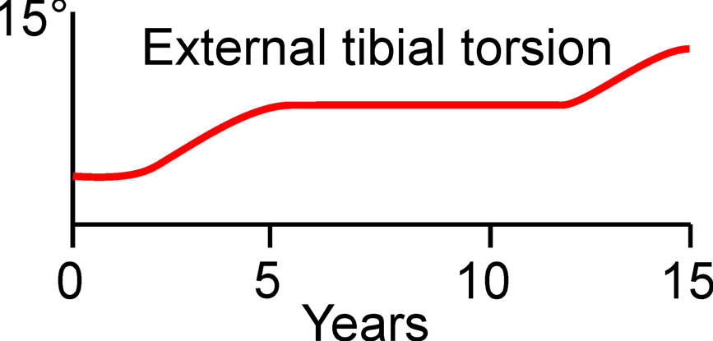
In-Toeing: Internal Tibial Torsion
Notes:
This is the commonest cause of an in toeing gait.
Usually seen in children between the ages of two to four years, but may persist in older children.
Usually bilateral, but on occasions only one side is affected.

Slide 13
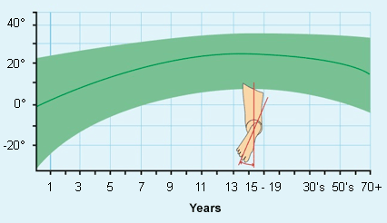

Internal Tibial Torsion: Diagnosis
Thigh-Foot Angle
Transmalleolar Axis
Notes:
Thigh-Foot Angle: Normal = 0-20; <-10 = Internal Tibial Torsion; >30 = External Tibial torsion.
Can also use transmaleolar axis.

Slide 14
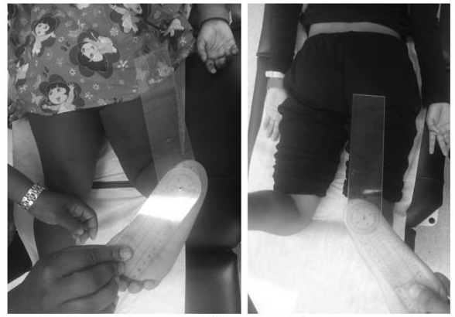
Internal Tibial Torsion: Diagnosis

Slide 15
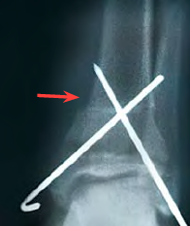
Internal Tibial Torsion: Management
90% resolve by the time child is 8 years old
Surgery for: Child >8 years old
Thigh foot angle <-15º
Severe functional disability
Notes:
A supramalleolar osteotomy is the preferred option.
Braces, shoe modification or orthotic devices do not alter the natural history of internal tibial torsion and are not advisable.
?Image of supramalleolar osteotomy

Slide 16
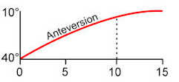
In-toeing: Persistent Femoral Anteversion
Notes:
PFA is usually the cause of in-toeing gait in children 4 – 7 years of age. F>M. Thought to be familial and presentation is usually bilateral.

Slide 17
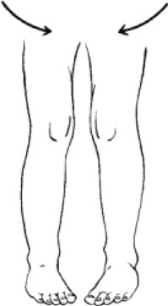
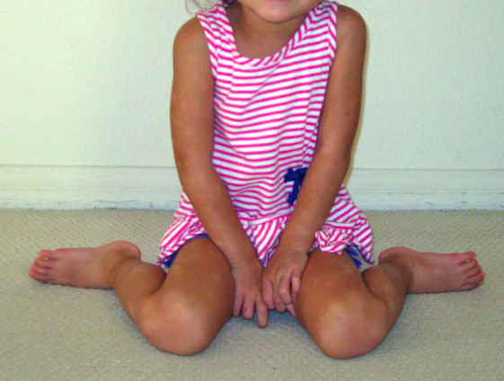
In-toeing: Persistent Femoral Anteversion
Squinting patellae sign
W sitting position
Notes:
Squinting Patellae sign
W sitting position

Slide 18
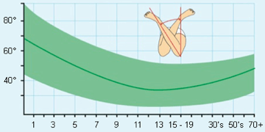
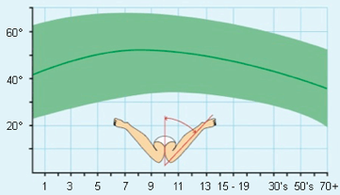
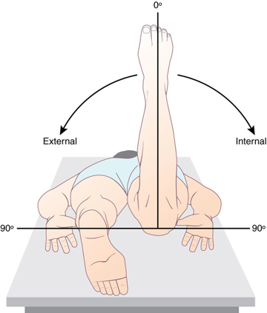
P F A: Diagnosis
Different charts for boys and girls
Notes:
Infants: IR 40; ER 70.
10 years old: IR 50; ER 45.
IR >70 + ER<20 = PFA.

Slide 19
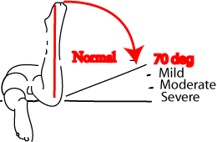
P F A: Diagnosis

Slide 20
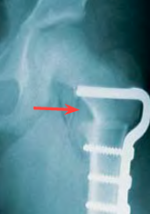
P F A: Management
Most resolve by the time child is 10 years old
Surgery for: Child >10 years old
Deformity not improved
Functional disability
Notes:
Orthotics and shoe modification have been shown to have no beneficial effect and should not be recommended
Surgery involves a femoral derotation osteotomy and is usually undertaken at the level of the lesser trochanter. (?intertrochanteric osteotomy)

Slide 21
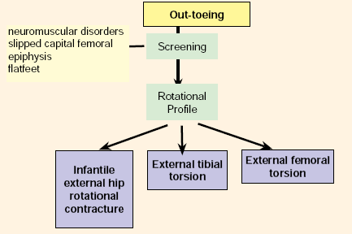


Out-toeing
Toddler
4-7 years old,
Even in adolescents
Notes:
Less common than in-toeing gait
Causes opposite to those of in-toeing:
Clinical finding reversed:
Pre-walking child: Charlie Chaplin Feet (ER>90º)
Reassure and educate parent
Tibial osteotomy for ETT in a child >10 years old

Slide 22
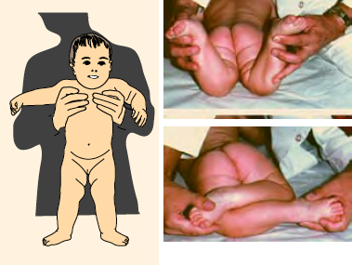
Out-toeing: Infantile ER Hip Contracture
IR 30º, ER80º
Charlie Chaplin Feet (ER>90º)
Notes:
Pre-walking child: Charlie Chaplin Feet (ER>90º).
External rotational hip contracture secondary to intrauterine packaging. Most cases resolve over time, but if persists >2-3 years this could suggest femoral retroversion.
This external hip contracture typically resolves by itself, but the time varies among children.

Slide 23
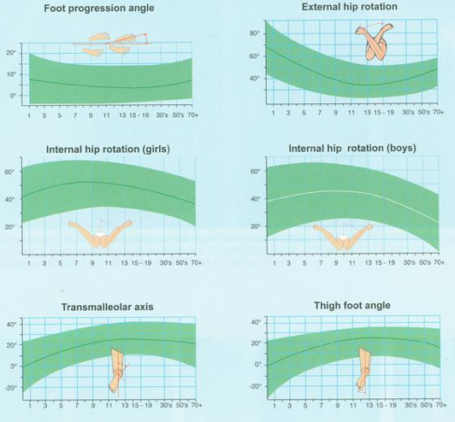
Rotational profile normal values
Staheli et al,
JBJS 67:39, 1985

Slide 24
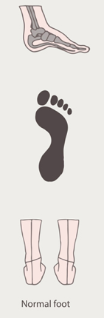
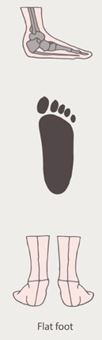
Flat Foot
Notes:
Flat feet aka pes planus
Flat foot is a foot with loss of the medial longitudinal arch and a large contact area on weight bearing.
Run in families; Associated with general ligament laxity.
A pre-walking child normally has a flat foot, the longitudinal arch is usually covered by plantar fat. As the child walks the plantar fat resorbs, muscles develop and joint laxity reduces leading to the formation of the medial arch.

Slide 25
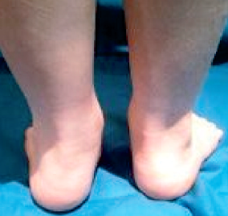
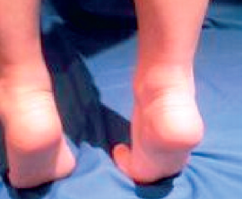
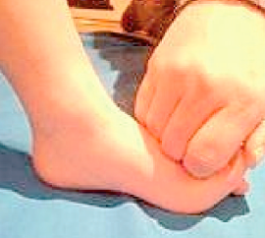
Flat foot: Diagnosis
Hindfoot: Valgus
Forefoot: Abduction
Medial Arch: Collapsed
Standing on tip-toes:
Heel: Varus
Medial Arch: Appears
Younger child:
Medial Arch: Appears in sitting or with Jack’s test
Notes:
Clinical examination reveals loss of the medial arch on weight bearing. On tip-toeing the medial arch is observed to be present. In addition the heel valgus corrects to neu-tral or varus
Flexible flat feet: Movement of the subtalar joint is not affected.

Slide 26
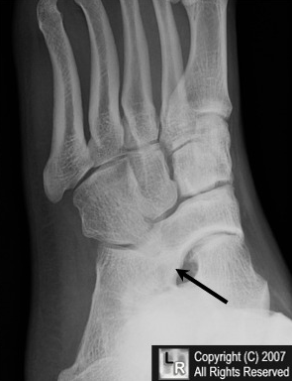
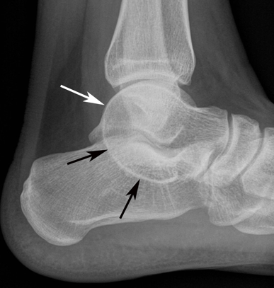
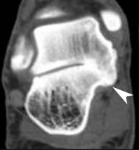
Rigid Flat Foot: Differential Diagnosis
Calcaneonavicular Coalition
Talonacalcaneal Coalition
A coalition may be osseous, cartilagenous or fibrous
Notes:
Rigid flat foot: Differential diagnosis: Tarsal coalition. Most common coalitions are Calcaneonavicular (most common) and talocalcanea. Typical age of presentation: TN: 8-12 Years; TC 12-15 Years.

Slide 27
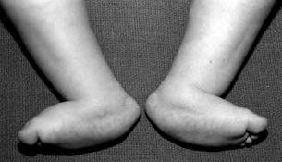
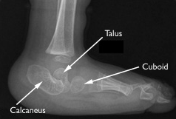
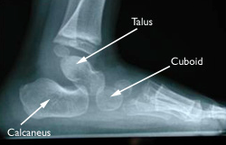
Rigid Flat Foot: Differential Diagnosis
Vertical talus in both feet
Vertical talus
Normal position of talus
Rare!
Notes:
Congenital vertical talus (CVT) is defined by an irreducible and rigid dorsal dislocation of the navicular on the talus. The calcaneus is in fixed equinus, and the Achilles tendon is very tight. The hindfoot is in valgus, while the head of the talus is found medially in the sole, creating the rocker-bottom appearance. The forefoot is abducted and dorsiflexed.The foot is stiff. In ambulatory children, calluses can develop under the head of the talus, which is very prominent along the plantar-medial foot.
Estimated incidence = 1:10, 000. It occurs as an isolated deformity (idiopathic) in approximately half of all cases and is associated with neuromuscular and genetic disorders in the remaining cases.

Slide 28
Flexible Flat Foot: Management
Most children will develop a medial arch
20% will never develop an arch
Orthotics and insoles not recommended
Notes:
Reassurance of the parent and child of the benign nature of the condition

Slide 29
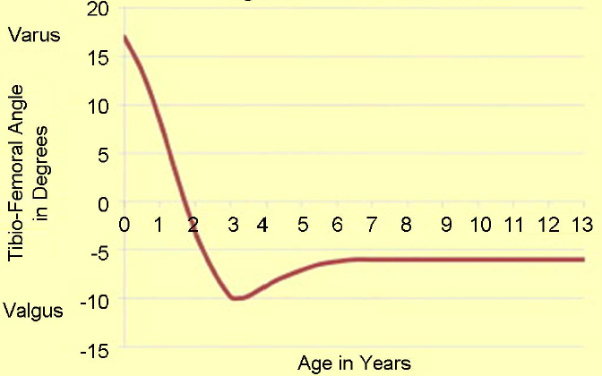



Genu Varum/ Valgum
Salinius Graph
Notes:
This graph shows how the tibiofemoral alignment changes with the age of the child.

Slide 30
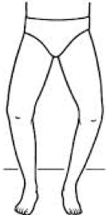
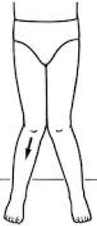
Genu Varum/ Valgum: Diagnosis
Genu Varum:
Intercodylar Distance <6cm
Genu Valgus:
Intermalleolar Distance <8cm
Notes:
On clinical examination abnormal height, abnormal body proportions, asymmetrical deformity, leg length discrepancy, limitation of joint movement are all findings suggestive of a pathological process.

Slide 31
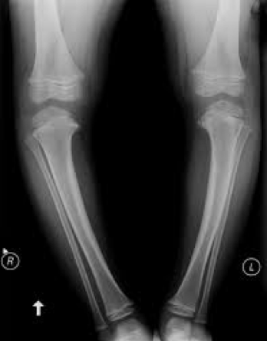
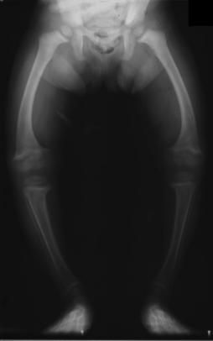
Genu Varum/ Valgum: Differential Diagnosis
Blount’s Disease:
Fragmentation of medial
tibial epiphysis
Rickets:
Decreased bone opacity, suggesting poor bone mineralisation
Notes:
Failure of the deformity to correct as expected sug- gests it is pathological thus necessitating further investi- gations in the form of radiographs and blood tests i.e. serum calcium, alkaline phosphatase and phosphate.
Blount’s Disease: Fragmentation of medial tibial ephiphysis, leading to irregular medial physeal line.
Rickets: Genu Varum in toddlers and Genu Valgus in older children. Check calcium, phosphate and ALP.
Differential Diagnosis for Genu Valgus: Following trauma; Associated with skeletal deformity/ abnormality.

Slide 32
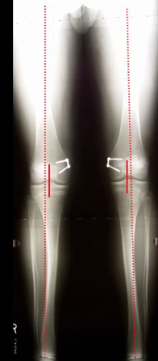
Genu Valgum: Surgical Management
Hemiepiphysodesis with 8 plates
Another option: Corrective osteotomy

Slide 33
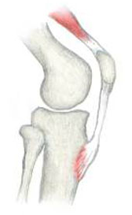
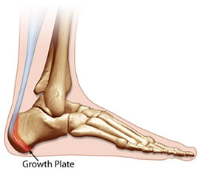
Traction Apophysitis
Sindig- Larsen- Johannsen Disease
Osgood Schlatter’s Disease
Sever’s Disease
Notes:
I am sure everyone here is familiar with this condition. So I will go through this briefly.
An apophysis is a secondary ossification centre that acts as an insertion site for a tendon. Apophysitis refers to irritation and inflammation of an apophysis. Apophysitis of calcaneum is known as Sever’s Disease; of the Tibial Tubercle is known as Osgood Schlatter’s Disease and inferior pole of patella is Sindig- Larsen- Johannsen Disease.

Slide 34
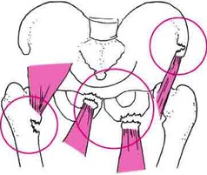
Traction Apophysitis
Notes:
The pelvis also has a number of apophyses, and is also a common place for apophysitis.
Apophysitis is considered to be an overuse injury that occurs in young athletes; especially those who take part in jumping and sprinting activities. In a growing child the apophysis is susceptible to injury because of repetitive stress or an acute avulsion injury. An avulsion fracture usually occurs with sudden muscle contractions where a small piece of bone is torn away from its origin. During rapid growth period, the ability of the muscle tendon unit to stretch decreases compared to bone growth resulting in increased tension at the attachment site. In the young athlete, because of training and participation in multiple sports a traction force at the apophysis is exaggerated.

Slide 35
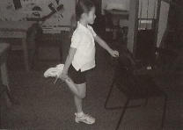
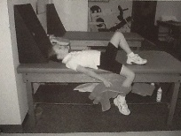
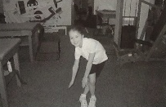
Traction Apophysitis: Management
Usually self limiting
Resolves after skeletal maturity
Improves with:
Modification of activities
Anti-inflammatories
Stretches/ Physio
Surgery is rarely necessary:
To remove ossciles after skeletal maturity
Quads and IT band stretches

Slide 36
Growing Pains
Affects up to 1/3 Children
Typical age group: 4-14 years; F>M
Unknown aetiology
Not due to “growing”
AKA:
“Benign idiopathic nocturnal limb pains of childhood”
“Non-inflammatory pain syndrome of early childhood’’

Slide 37
Growing Pains: Diagnosis
Diagnosis of exclusion
Pain at night time
Relieved by rubbing
Insidious onset, long history
No day time symptoms
Normal clinical examination
RED FLAGS: Unilateral – Osteoid Osteoma
Abnormal FBC/ESR & Bilateral- Leukaemia
Notes:
No day time symptoms: No limping/ Affect on activities.
Given that there is no specific test to confirm the diagnosis positively, it is important to be aware of the ‘rules’ of growing pains (Table 2), and to know that presentations outside these parameters warrant concern.
The diagnosis can be safely established without unnecessary laboratory investigations or imaging; however, identification of one or more clinical cautionary signs, such as
unilateral pain, morning stiffn
ess, joint swelling and systemic symptoms (e.g. fever, weight loss and malaise), should trigger an extended evaluation to exclude other more serious conditions that might also present with limb pain.
Occasionally, it is accompanied by sensations of restlessness but never by tenderness, redness, or local swelling. Similarly, pain in the legs is not provoked by walking and the gait is always normal.
The pains typically occur at night with full resolution by morning, are bilateral in nature, and occur in the absence of systemic signs or symptoms of disease, such as fevers, weight loss, easy bruising or bleeding, or night sweats.

Slide 38
Growing pains: Management
In most cases it is a self-limiting condition
Reassure and educate the parents
Symptomatic treatment
Mild painkillers at night
Stretches/ Physiotherapy

Slide 39
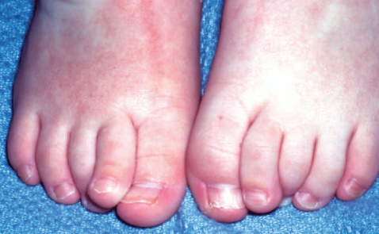
Congenital Curly toes
Usually the lateral three toes; Usually bilateral
Familial: AD mode of transmission
Conservative measures:
Well-fitting shoes
Spacers
Taping does NOT work
Flexor tenotomy after 2/3 years of age if complications
Notes:
No one has straight toes. Toddlers curl toes for balance.
Parents concerned about the shape of child’s toes, especially if one is not as straight as the other.
Usually due to imbalance in activity between flexor and extensor tendons.
The toes can usually be straightened if necessary, so ignore the problem until 2 years. Flexor tenotomy after 2 years if severe and/or pain, broken skin/ pressure areas not relieved by spacers. Rarely, if all of the toes of one or both feet are clawed as if gripping an object and the in-step is particularly high, there may be an underlying neurological cause that requires further investigation, usually in the form of an MRI scan. Treatment for these feet varies significantly from that of curly toes, and is tailored depending on the underlying diagnosis.

Slide 40
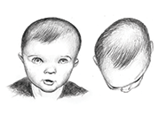
Plagiocephaly
Forehead protrudes to one side
Back of the head flattened on one side
Eyes and ears may be misaligned
These features can be mild or extreme
85% have Congenital Muscular Torticollis
Notes:
Plagiocephaly = Oblique Head
Prolonged external pressure on one area of the head can cause it to become misshapen over time e.g. premature babies in PCCU.
Often times, plagiocephaly is linked to congenital muscular torticollis. In fact, 85% of children treated for plagiocephaly also have torticollis. Torticollis affects 1 in 250 babies and is the result of the tightness of the neck muscles on one side of a baby’s head. Torticollis causes the baby’s head to be tilted to one side, while his/her chin is turned to the opposite side. This consistent head tilt and rotation can cause his/her head to regularly rest against a support surface in the same position, resulting in a flat spot on the infant’s soft skull.
If plagiocephaly is present and is non-responsive to repositioning efforts, early orthotic treatment can correct the situation in a relatively short time.

Slide 41
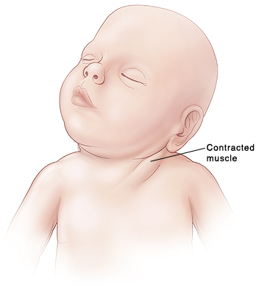
Congenital Muscular Torticollis
Contracture of SCM
?Compartment syndrome of SCM
Non-SCM causes:
Ophthalmologic
Vestibular
Traumatic/ Tumour
Notes:
The head is tilted towards and rotated away from the affected side.
Physical examination shows reduced rotation and bending to the side opposite to the affected muscle.
Congenital Torticollis: ?Compartment syndrome of sternocleidomastoid secondary to obstruction to venous outflow.

Slide 42
Torticollis: Diagnosis
Reduced rotation + bending to the opposite side
A mass may be papable in the first 4 weeks
Radiographs/ USS: To assess osseous and soft tissue structures for other conditions
Screen for DDH (5-20% association)
Notes:
Sometimes a mass, such as a sternocleidomastoid tumor, is noted in the affected muscle at the age of two to four weeks. Gradually it disappears, usually by the age of eight months, but the muscle is left fibrotic

Slide 43
Torticollis: Management
90% respond to stretching exercises by one year
Z Plasty lengthening/ Distal bipolar release:
Condition present for >12 months
Limitation >30 degrees
Notes:
Z plasty lengthening or distal bipolar release of SCM
Indications: Condition present for greater than 1 year/ limitation greater than 30°

Slide 44
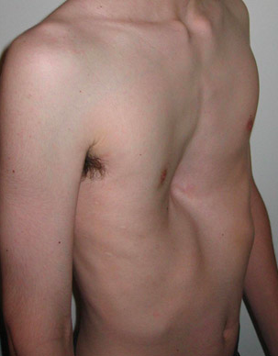
Pectus Excavatum
Incidence 1:400-1000 children
M>>F 3-5:1
Runs in families
Presents early
Associated with scoliosis, kyphosis
and Marfans
Deformity usually gets worse
Thoracic surgeons
Notes:
The most common congenital chest wall problem
Unknown aetiology

Slide 45
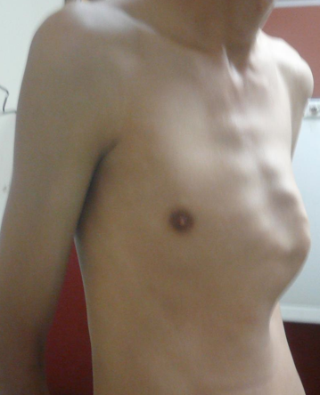
Pectus Excarinatum
Incidence 1:1, 500 children
M>>F 4:1
Runs in families
Presents at puberty
15% develop scoliosis
Deformity usually gets worse

Slide 46
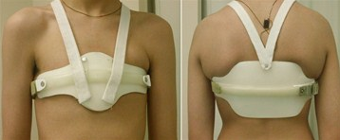
Pectus Excarinatum: Management

