Slide 1
National Joint Registry - THR
Dennis Kosuge
Orthopaedic Specialist Registrar
The Royal London Hospital

Slide 2
History
Data on hip and knee replacements collected from 1st April 2003
Data on ankle replacements from 1st April 2010
Data on shoulder and elbow replacements – 1st April 2012
Four parts
  Part 1 – Annual Progress
  Part 2 – Clinical Activity
  Part 3 – Outcomes after joint replacements from 2003 onwards
  Part 4 – Trust, Health Board- and unit-level activity and outcomes

Slide 3
NJR – 9th Annual Report
Published 2012
Data up to December 2011
Total activity since 2003 – 1.2 million
Four-parts
  Part 1 – Annual Progress
  Part 2 – Clinical activity 2011
  Part 3 – Outcomes after joint replacement 2003 to 2011
  Part 4 - Trust, Health Board- and unit-level activity and outcomes 2011

Slide 4
Part 1 – Annual Progress
Total activity since 2003 – 1.2 million
Patient consent 2011/12
  90.4% compared to 88.9% in 2010/11
Linkability 2011/12
  95.5% compared to 91.7% in 2007/08

Slide 5
Part 2 – Clinical Activity
Total Hip Replacements – 80 314
  Primary – 71 672 (increase in 5% over 2010)
  Revision – 8 641 (similar at 11%)
Demographics
  Age – 67.2 years; Females – 60%
  ASA I – 15% ; BMI – 28.5
Primary Total Hip Replacements
  Cemented – 35%
  Uncemented – 44%
  Hybrid/revervse hybrid – 18%
  Resurfacing – 2%
Notes:
Higher ASA in NHS hospitals vs independent hospitals
ASA III – 20% v 7%

Slide 6
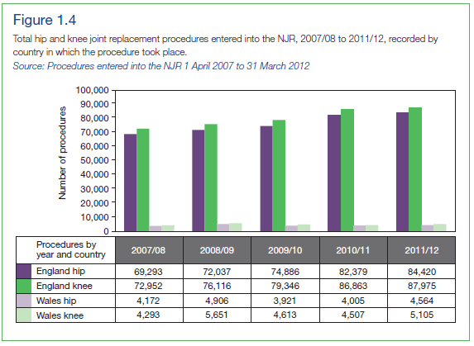
Part 1 – Annual Progress
Total Hip Replacements
  Wales – 4564 (5.4%); England – 84 420

Slide 7
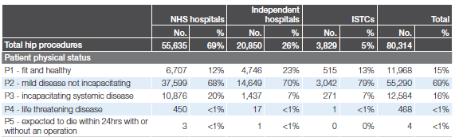
Part 2 – Clinical Activity
ASA

Slide 8
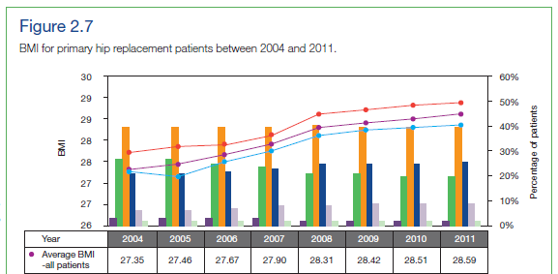
Part 2 – Clinical Activity
BMI

Slide 9
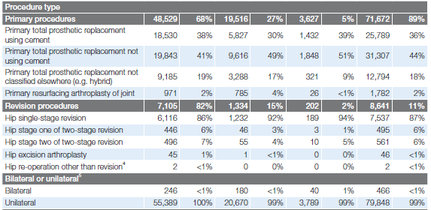
Part 2 – Clinical Activity
Primary and Revision

Slide 10
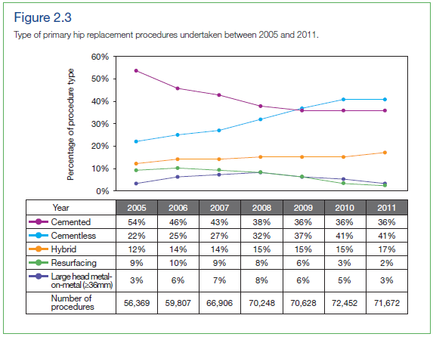
Part 2 – Clinical Activity

Slide 11
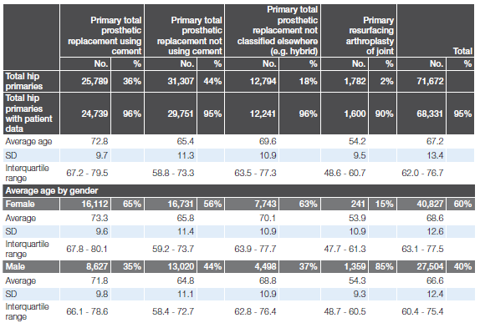
Part 2 – Clinical Activity

Slide 12

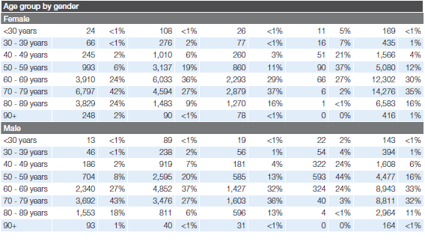
Part 2 – Clinical Activity

Slide 13
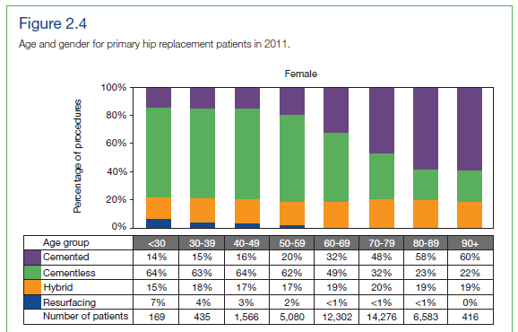
Part 2 – Clinical Activity

Slide 14
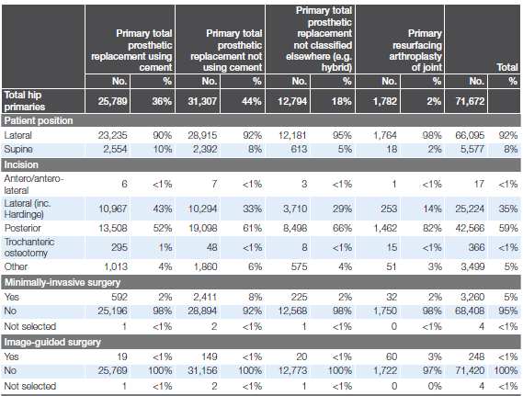
Part 2 – Clinical Activity
Surgical Technique

Slide 15
Part 2 – Clinical Activity
Brand of implants
  Femoral stem – 142
  Acetabular cup – 119
  Resurfacing cups – 10
ODEP compliance (10A rating)
  Cemented stems – 85%
  Uncemented stems – 72%
  Cemented cups – 40%
  Uncemented cups – 3%

Slide 16
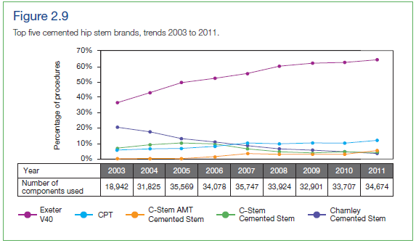
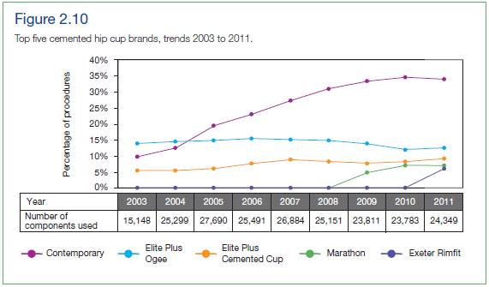
Part 2 – Clinical Activity

Slide 17
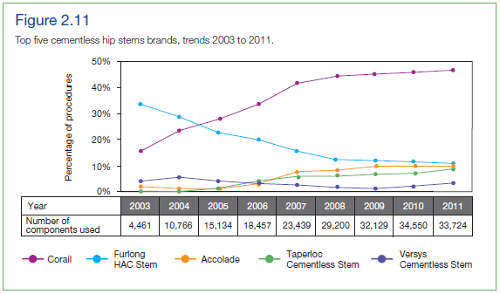
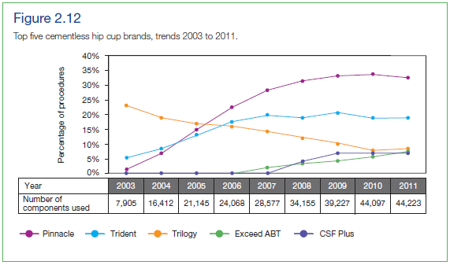
Part 2 – Clinical Activity

Slide 18
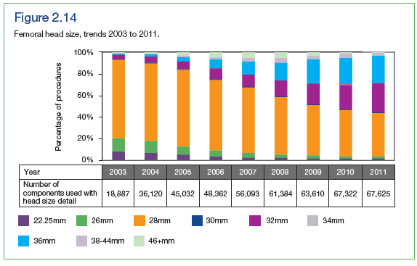
Part 2 – Clinical Activity

Slide 19
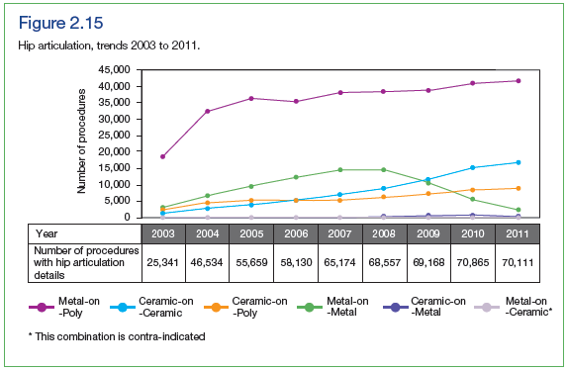
Part 2 – Clinical Activity

Slide 20
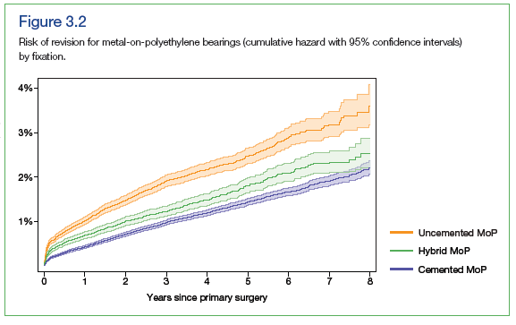
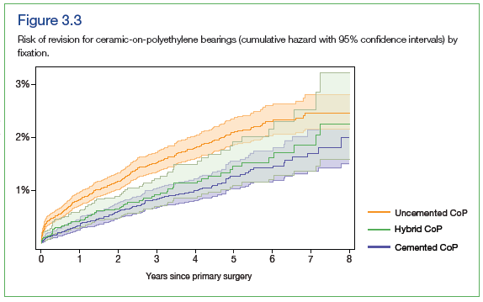
Part 3 - Outcomes

Slide 21
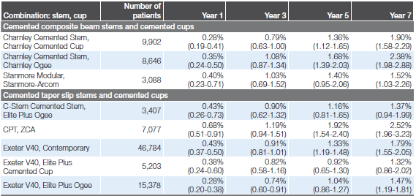
Part 3 - Outcomes

Slide 22
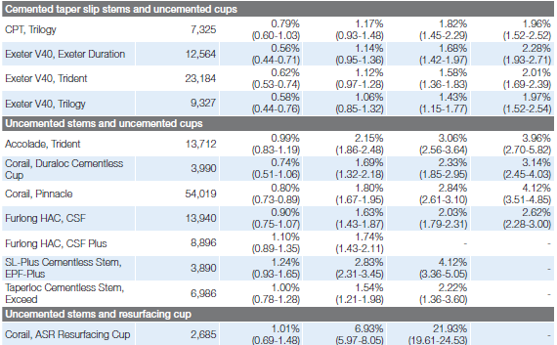
Part 3 - Outcomes

Slide 23
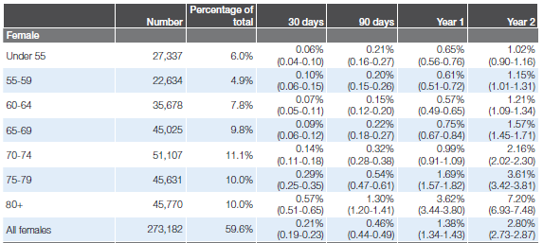
Part 3 - Outcomes

Slide 24

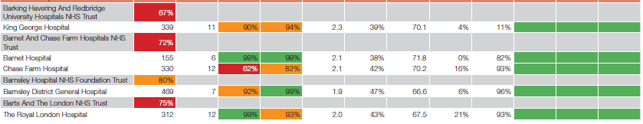
Part 3 - Outcomes

Slide 25

NJR – Public & Patient Guide

Slide 26

BOA/BHS/BASK
Individual surgeon data to be published by end June 2013

Slide 27
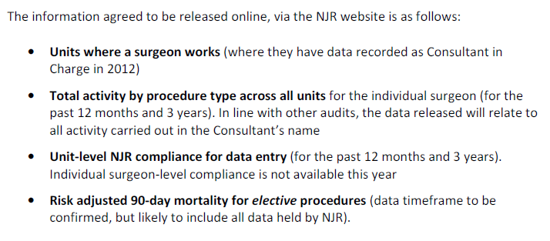
BOA/BHS/BASK

Slide 28
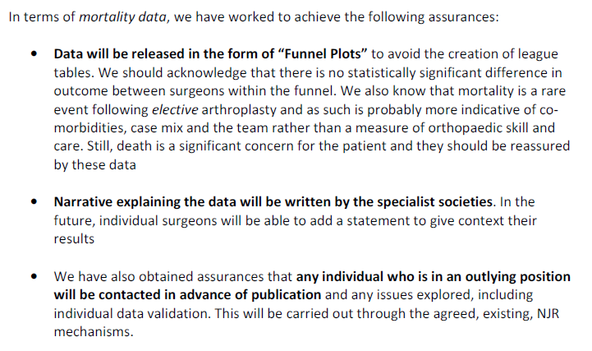
BOA/BHS/BASK

Slide 29
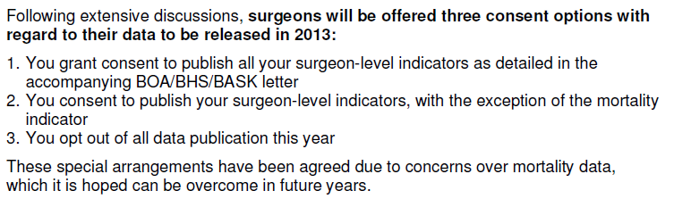
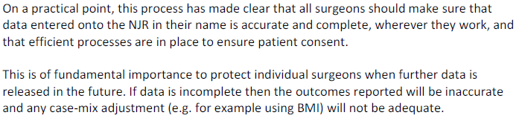
NJR

