Slide 1
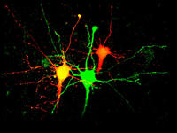
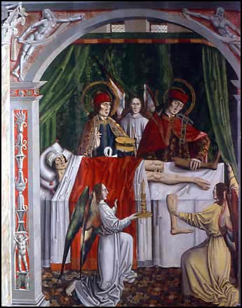

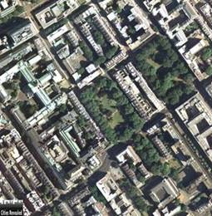
Mechanisms of pain
Tony Dickenson
University College London

Slide 2
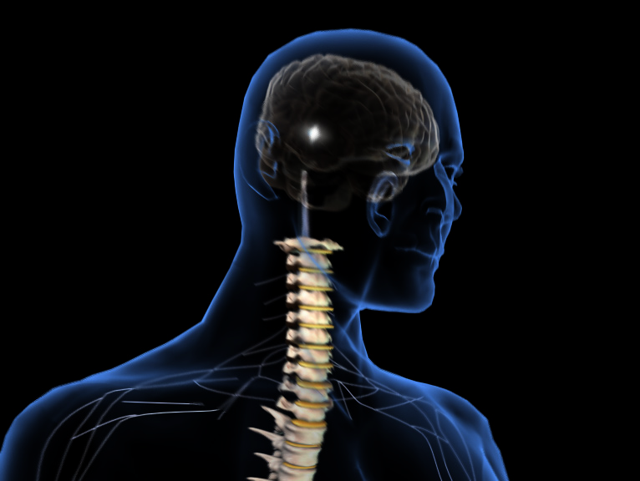
Activity generated within CNS pain circuits
Higher centres
Brain stem mechanisms and descending controls
Spinal events
Peripheral events

Slide 3
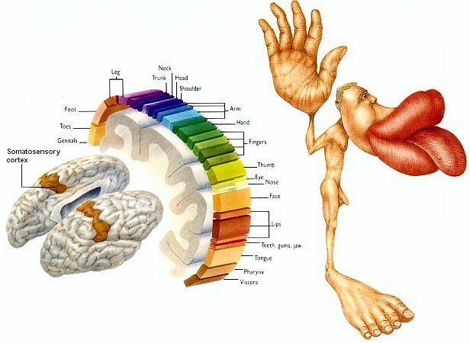
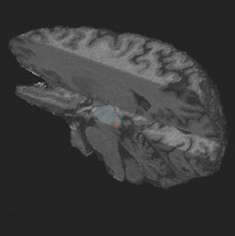
Limbic brain
Affective aspects
of pain
Fear, anxiety,
sleep
Cortex
Location and
intensity
Descending controls
Allow top-down processes
to enhance pain - link mood, sleep and pain
Spinal cord
Integrates, amplifies and modifies
incoming messages
Output to brain
Incoming peripheral nerves
Convey touch, temperature
Convey painful messages - heat, mechanical, chemical
Are altered by tissue and nerve damage

Slide 4
Co-morbidity associated
with pain
Difficulty sleeping
60
Lack of energy
55
Drowsiness
39
Concentration difficulties
36
Depression
33
Anxiety
27
Poor appetite
18
0
10
20
30
40
50
60
70
% patients with moderate to very severe
discomfort due to symptoms (n=126)
Meyer-Rosberg K et al. Eur J Pain 2001; 5: 379–89.

Slide 5
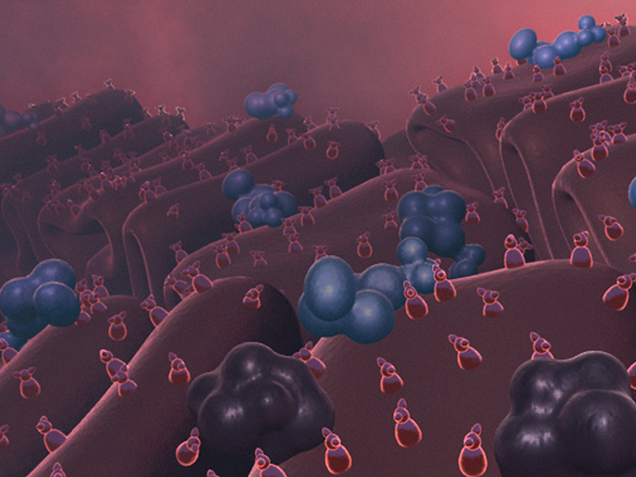
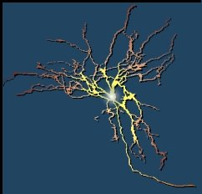

Slide 6
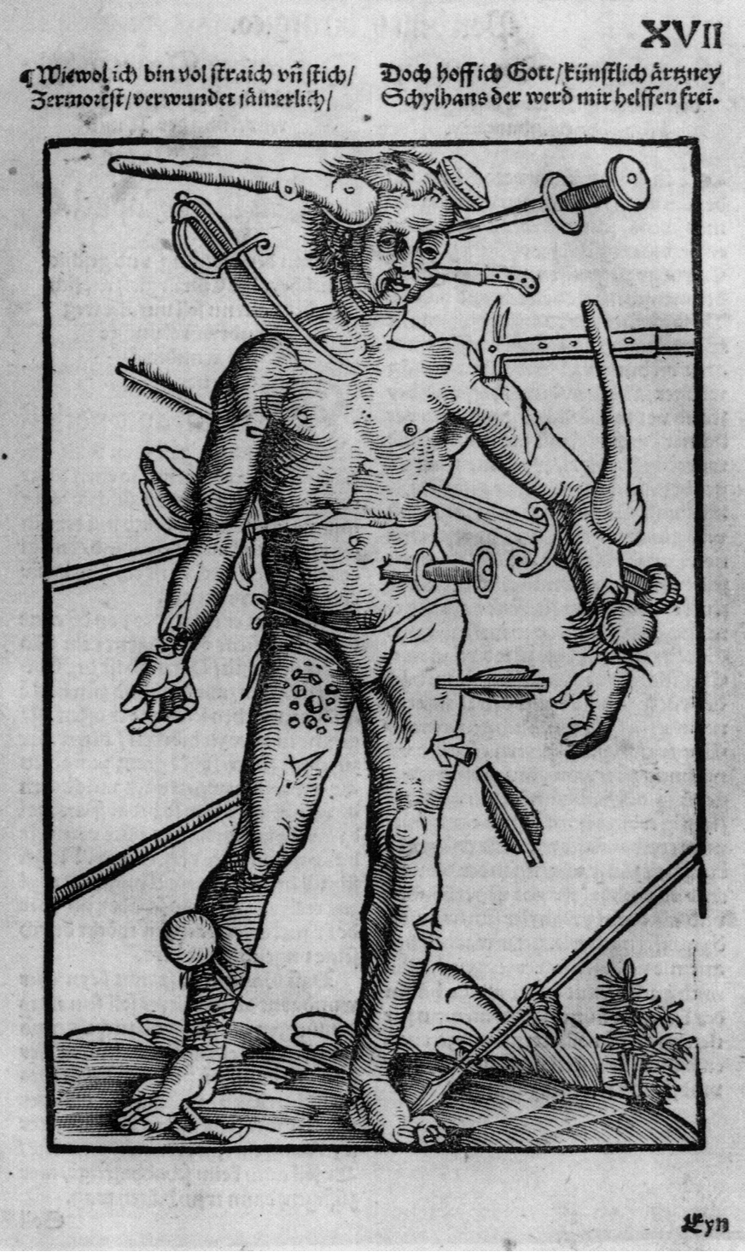


Key types of pain
Nociceptive pain
Pain caused by
an inflammatory or
non-inflammatory
response to a
noxious stimulus
Tissue damage
Neuropathic pain
Pain initiated or caused
by a primary lesion or disease in the
peripheral or central
nervous system
Nerve damage
Both types of
pain can co- exist
Low back pain, cancer pain etc
Mild
Moderate
Severe

Slide 7
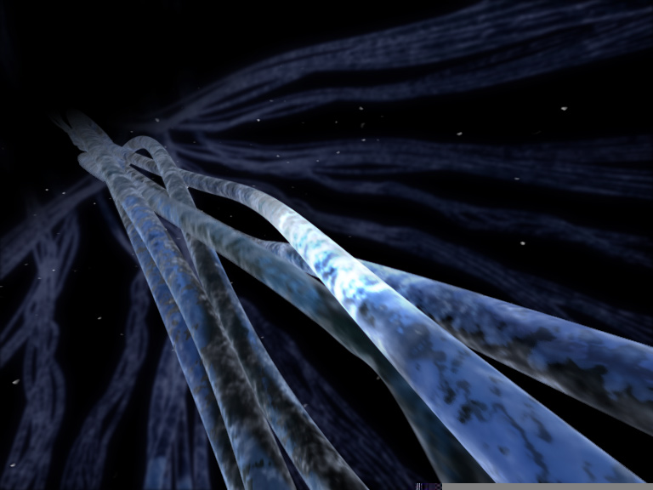
C and A-delta fibres - nociceptors - heat, mechanical and chemicals

Slide 8
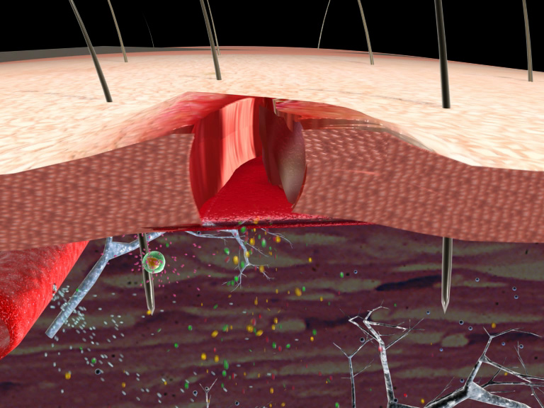
Inflammation – ongoing activation
of pain sensors
capsaicin
heat
NGF
COX 1/2
ATP
H+
PGs
Na⁺, K⁺,
Ca²⁺
channels
5HT
C-fibre
cytokines
sensitize, activate

Slide 9
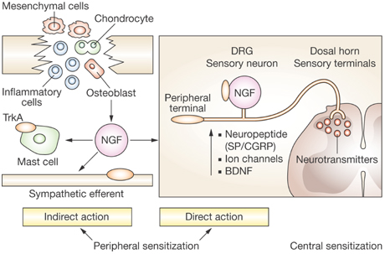

Nerve Growth Factor -Direct peripheral, direct gene effects and indirect…
Xian CJ and Zhou X-F et al. (2009) Treating skeletal pain: limitations of conventional anti-inflammatory drugs, and anti-neurotrophic factor as a possible alternative
Nat Clin Pract Rheumatol doi:10.1038/ncprheum0982

Slide 10
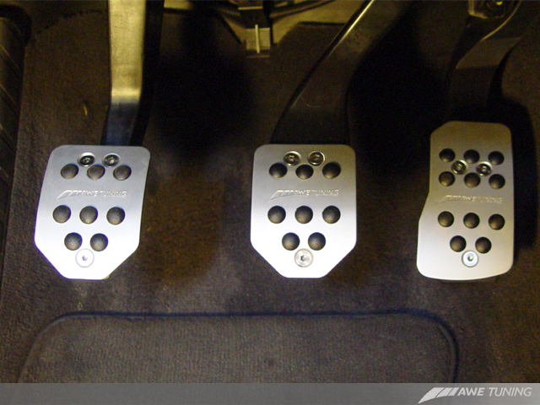
Calcium channels Potassium channels Sodium channels
Release of transmitter Brakes Accelerator - action potentials
Problem of driving without brakes or transmission

Slide 11
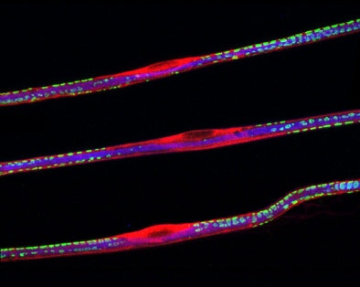
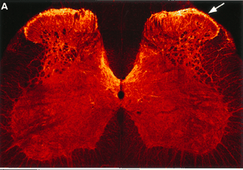
Neuropathy - nerves tend not to heal…
Diabetes
Trauma
HIV
Shingles
Treatments..
Alcohol
Changes and accumulations
of channels
Damage
Calcium Potassium Sodium

Slide 12
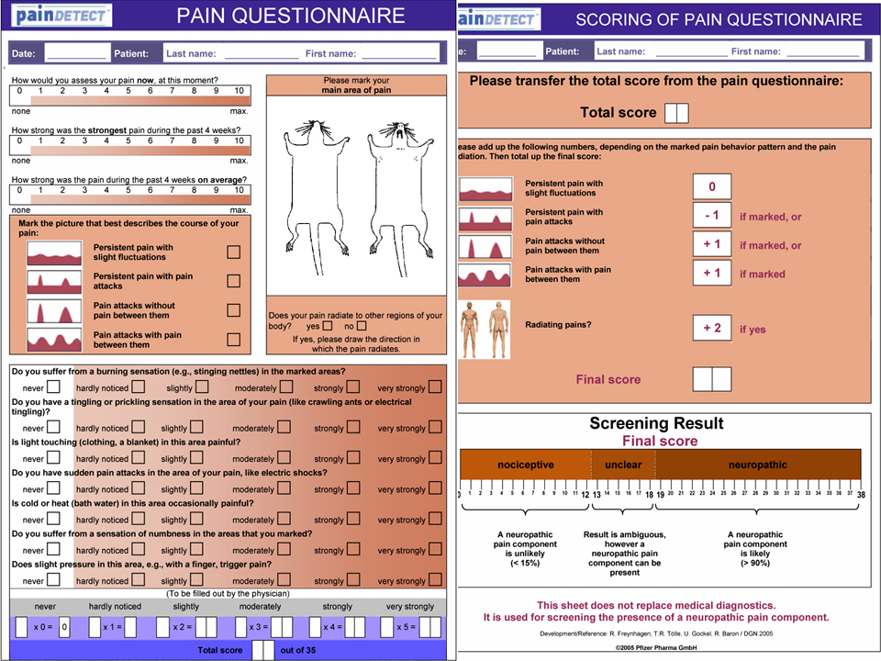
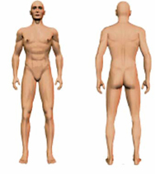

Slide 13
Channelopathic pain syndromes
Inherited erythromyalgia | Nav 1.7 | Lower threshold, enhanced responses | Attacks of burning pain and redness in extremities
Paroxysmal extreme pain disorder | Nav 1.7 | Impaired inactivation Enhanced response | Episodic lower body ocular, jaw pain
Channelopathy associated insensitivity to pain | Nav 1.7 | Loss of function | Inability to sense pain
Familial episodic pain syndrome | TRPA1 | Enhanced response | Episodic upper body pain, triggered by fasting, cold, fatigue

Slide 14
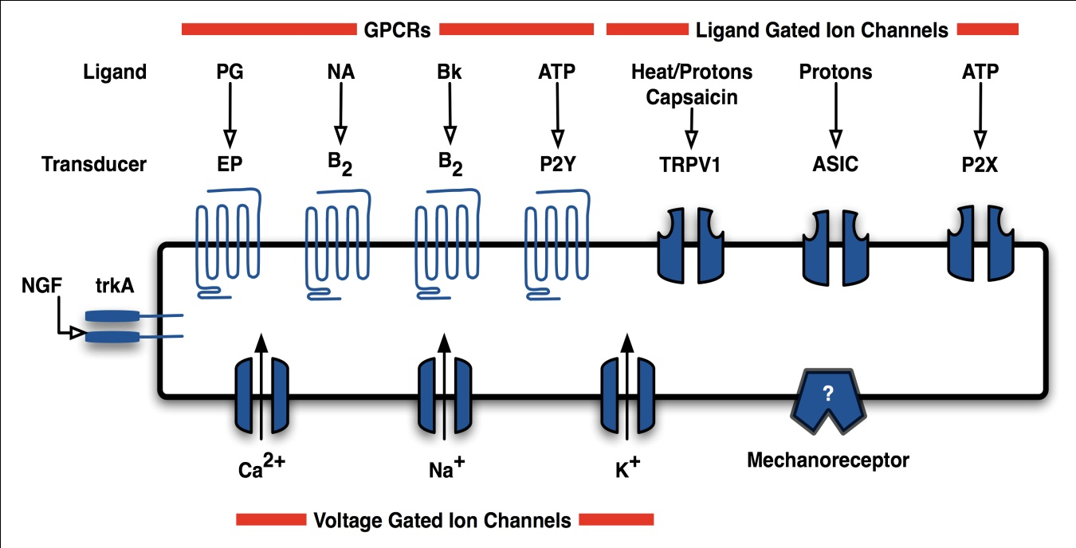
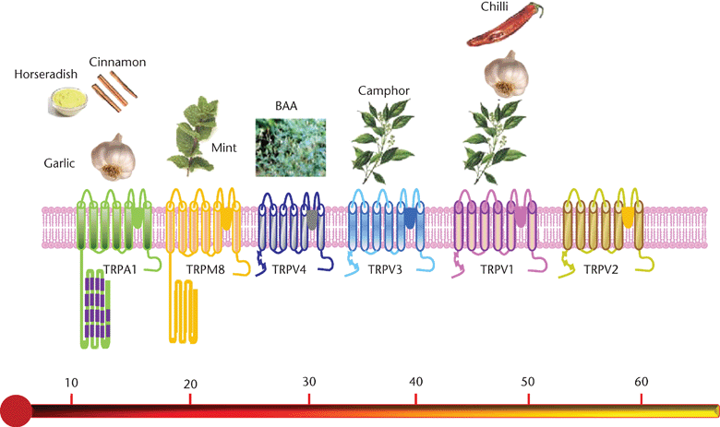
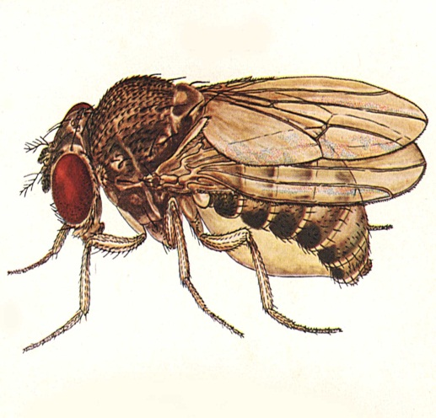
Inflammation - chemical
activation in the periphery
Neuropathy – abnormal
nerve activity

Slide 15
A gain-of-function mutation in TRPA1 causes familial episodic pain syndrome
Irritant sensor
Upper body pain
Triggered by
  cold
  hunger
  fatigue
  exertion
Prodermal……pain 1.5 hrs…..sleep
Kremeyer B et al.
Neuron 2010;66(5):671-80
Normal acute pain

Slide 16
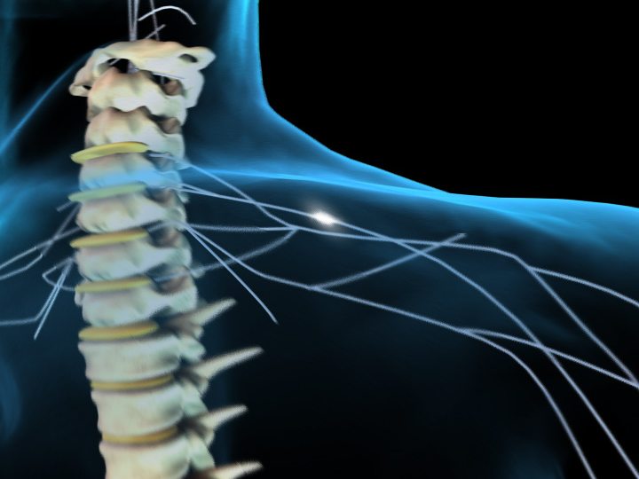
Channels are key to neuropathic pain
Major spinal increases in excitability
α₂δ ligands
Damaged Zone
Electrical activity
s
α2
s
α1
δ
i
β
Carbamazepine
Lidocaine
Release of
transmitters

Slide 17
Peripheral activity causes central hyperexcitability …
Spinal cord
Aδ
I
Dorsal root
C
II
Aα/β
III
Peripheral nerve
IV
Aδ
V
V
I
X
V
I
I
I
X
V
I
I
I

Slide 18
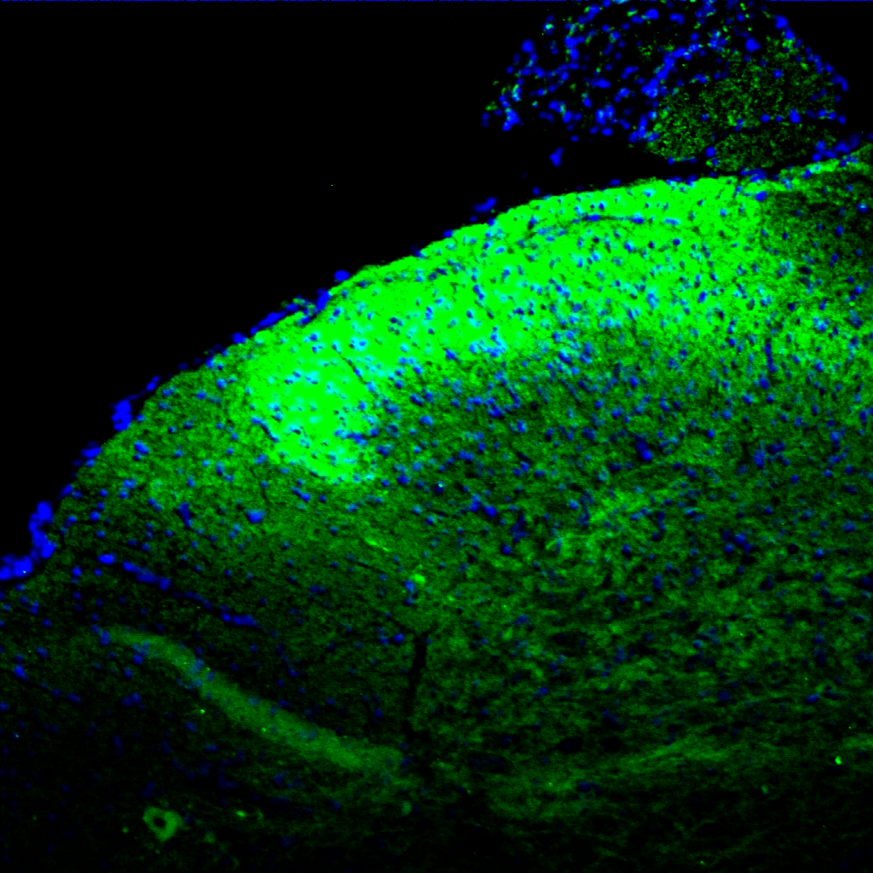
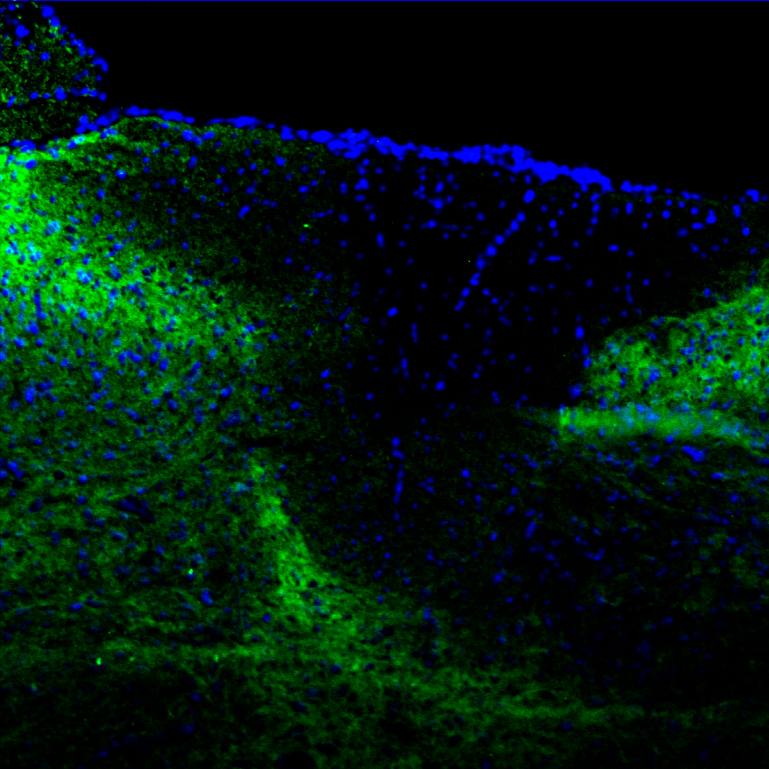
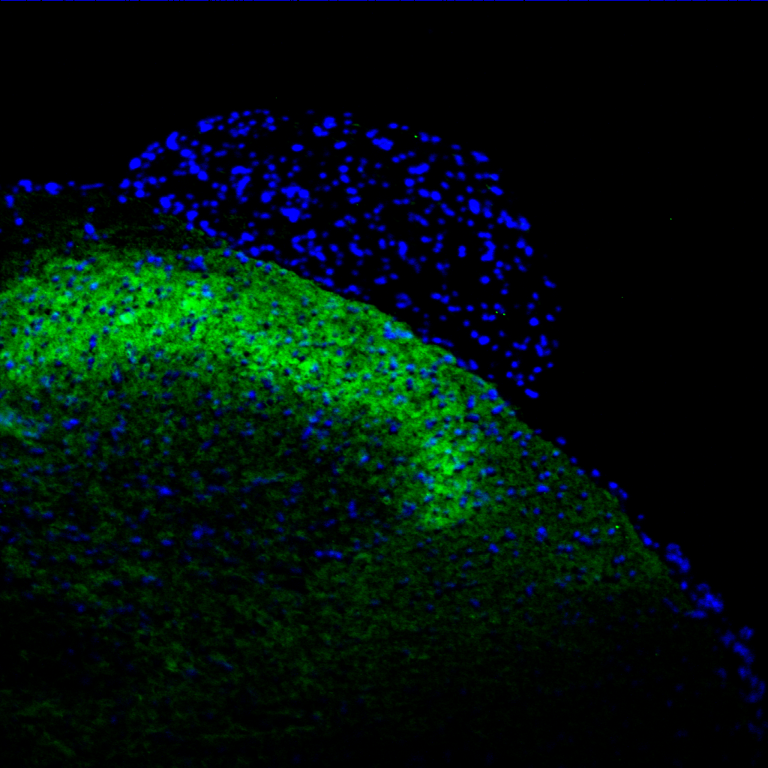
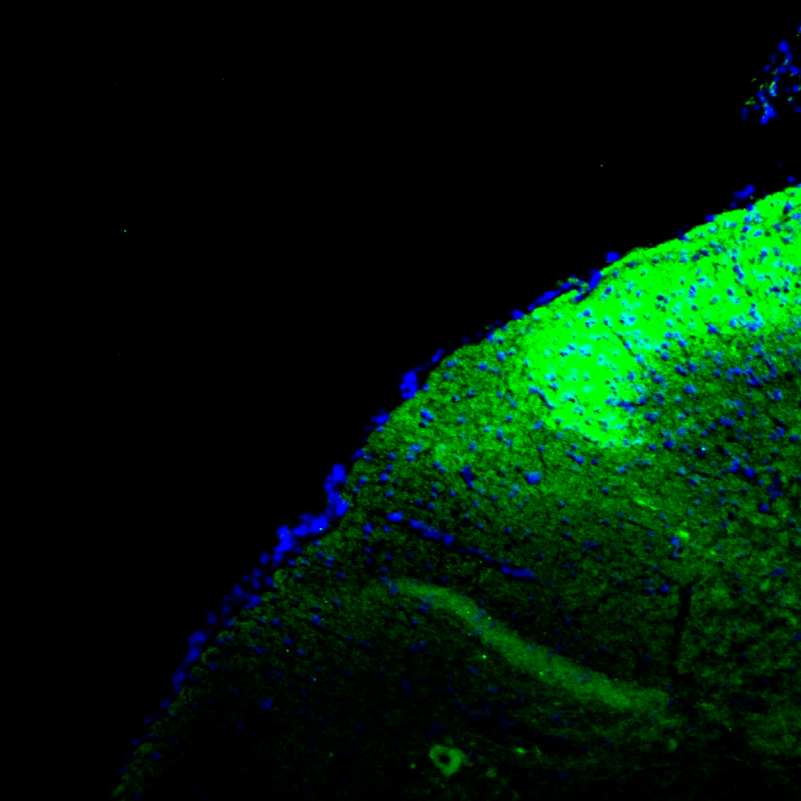
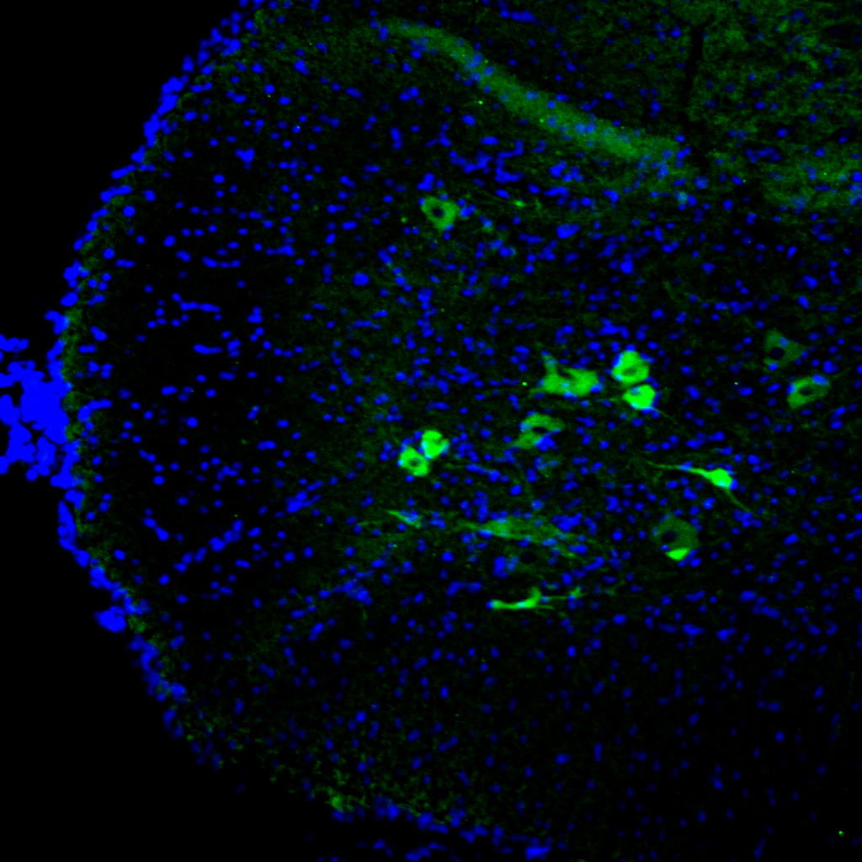
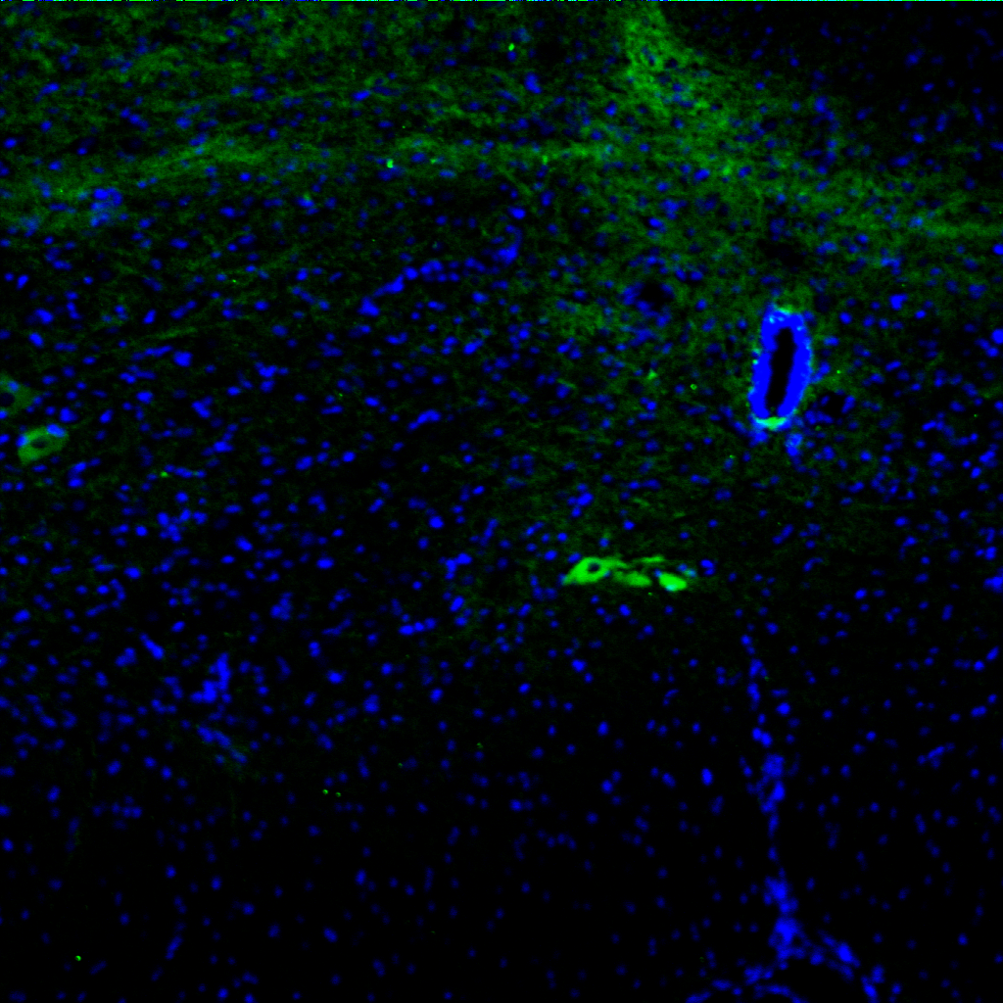
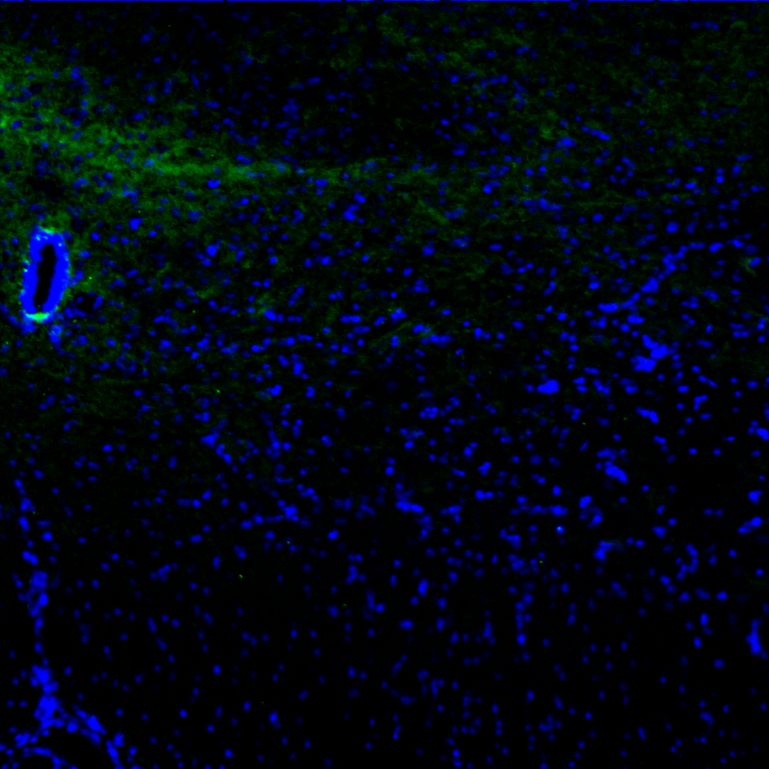
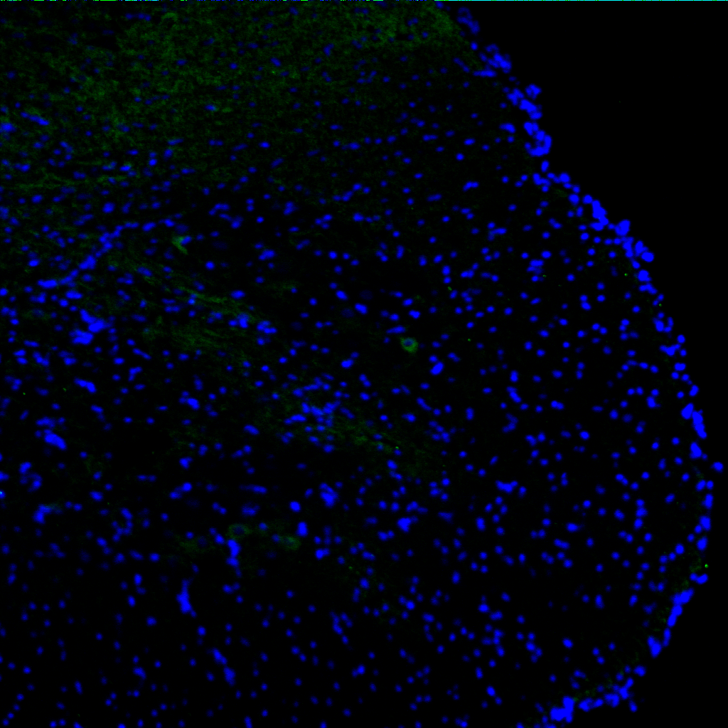
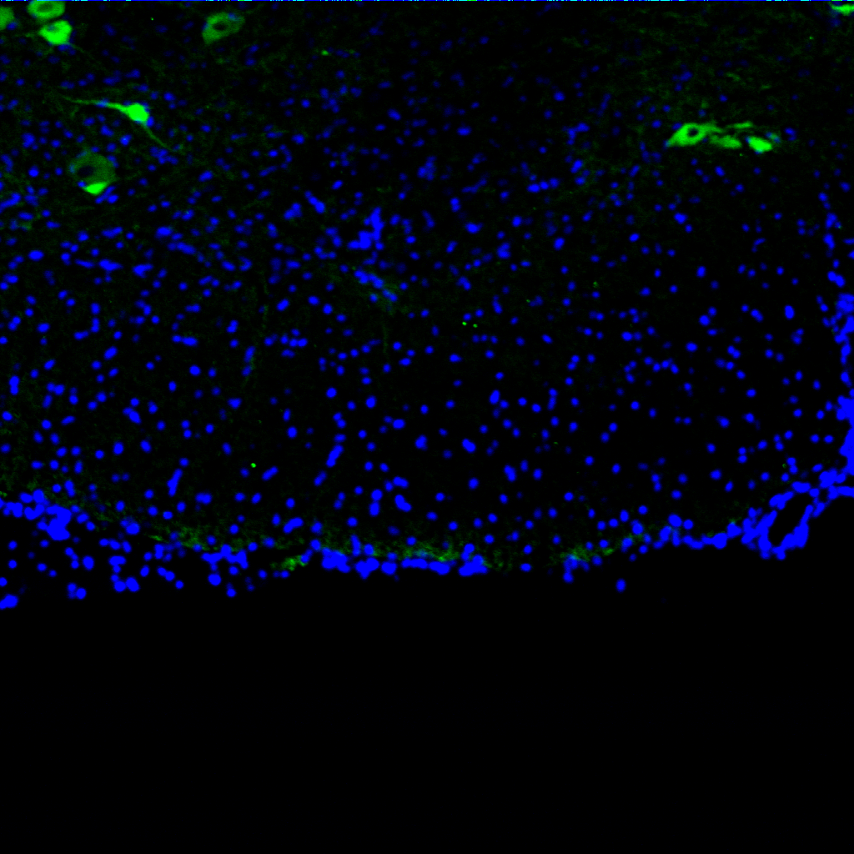
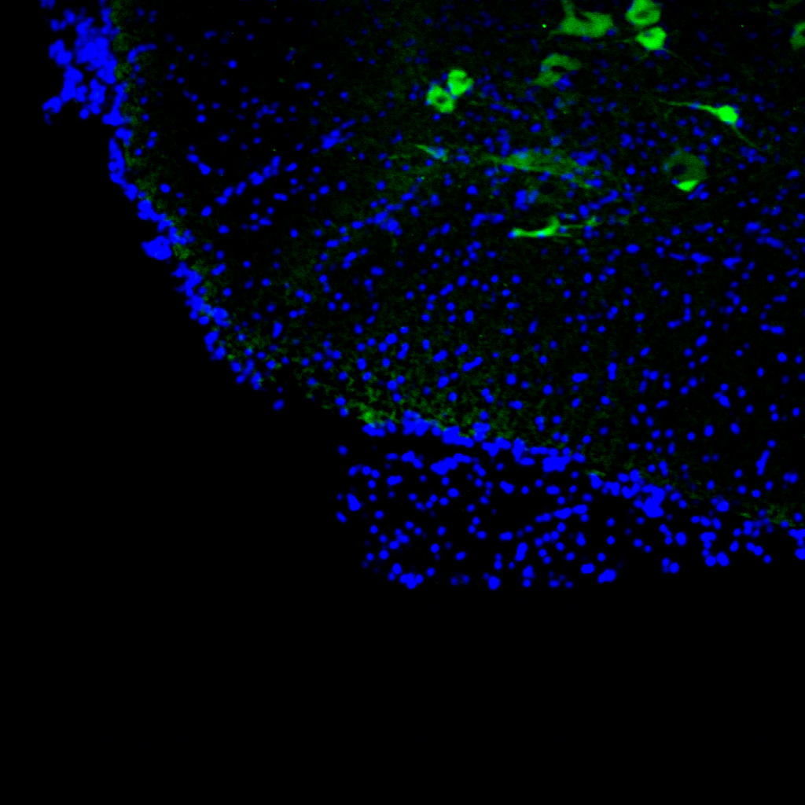
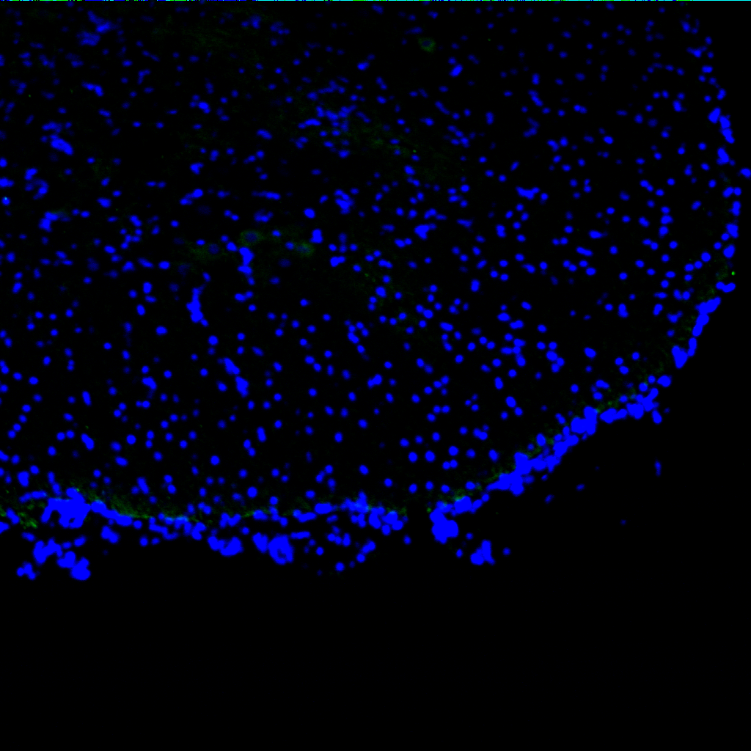
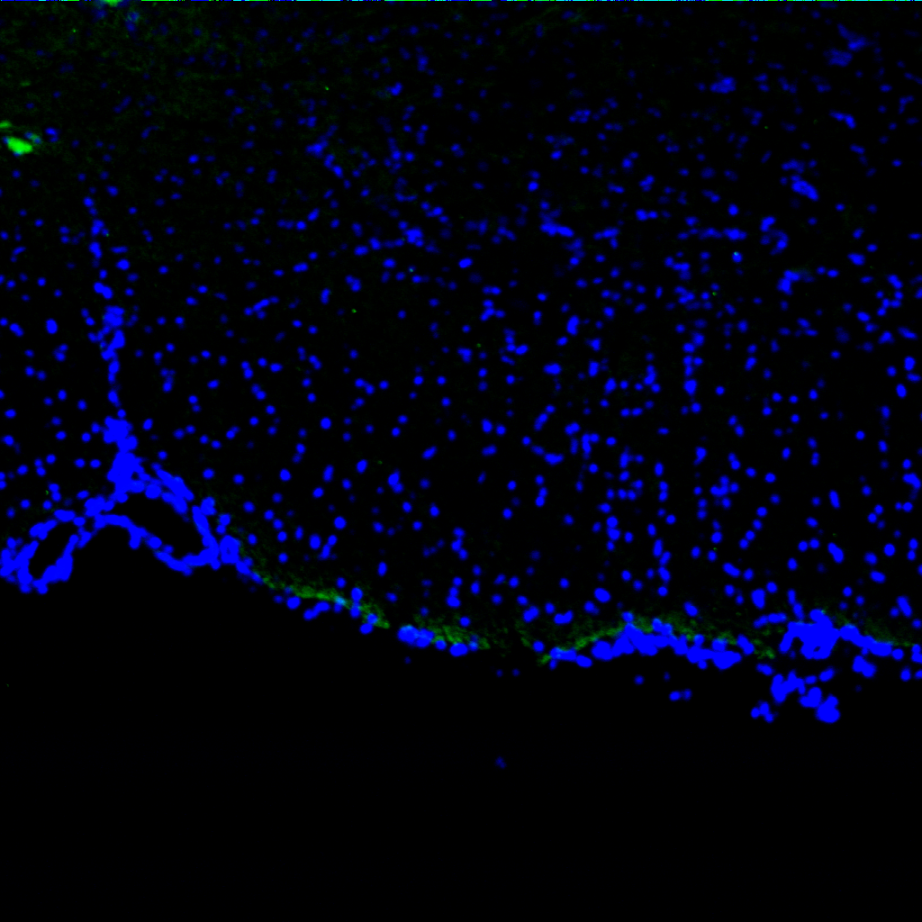
Binding site - Ca channels - massive changes after neuropathy
a
SNL L5
*
*
ipsi

Slide 19
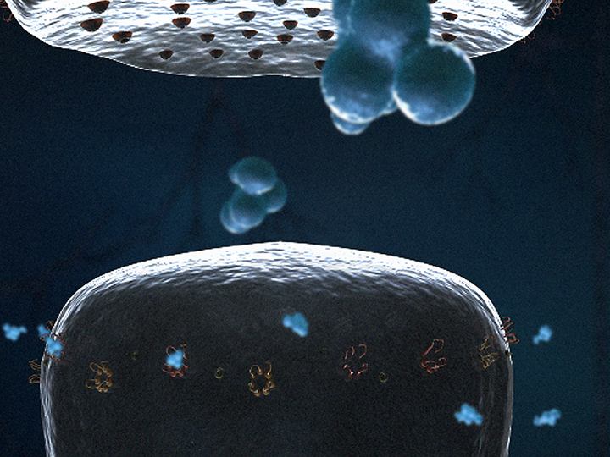

Slide 20
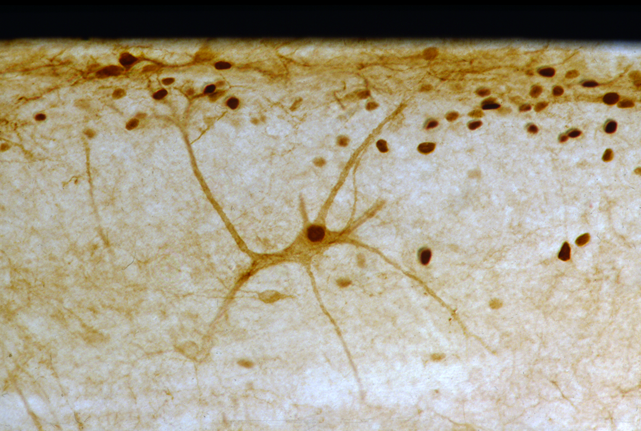
Spinal mechanisms
Wind-up
Long term potentiation
Different pain states now converge on common pathways

Slide 21
NMDA receptors and wind-up
40
NMDA-R mediated amplification & prolongation of response
30
Decay dependent on peripheral input
ketamine
Neuronal response
20
Stimulus no.
1
6
12
16
10
secs - hours -weeks
(intensity and frequency of stimulus)
Increased excitability
0
Stimulus number
D’Mello RD, Dickenson AH. Br J Anaesthesia 2008;101:8-16

Slide 22
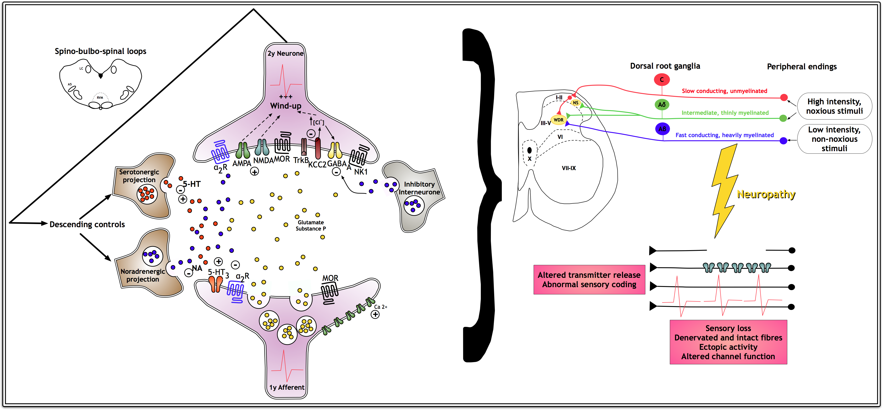
Altered pain states
Subsequent inputs
++++++
Early C-fibre inputs

Slide 23
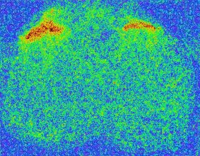
Spontaneous
pain
Tissue
damage
Hyperalgesia
Allodynia
PERIPHERAL
ACTIVITY
CENTRAL
SENSITIZATION
Decreased
threshold to
peripheral
stimuli
Increased
spontaneous
activity
Nerve
damage
Expansion of
receptive field

Slide 24
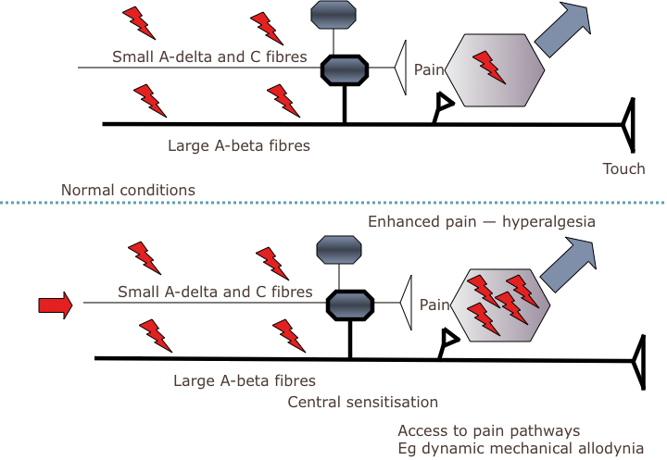
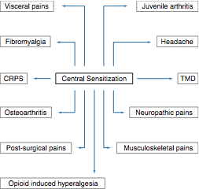
Notes:
Clin p6

Slide 25

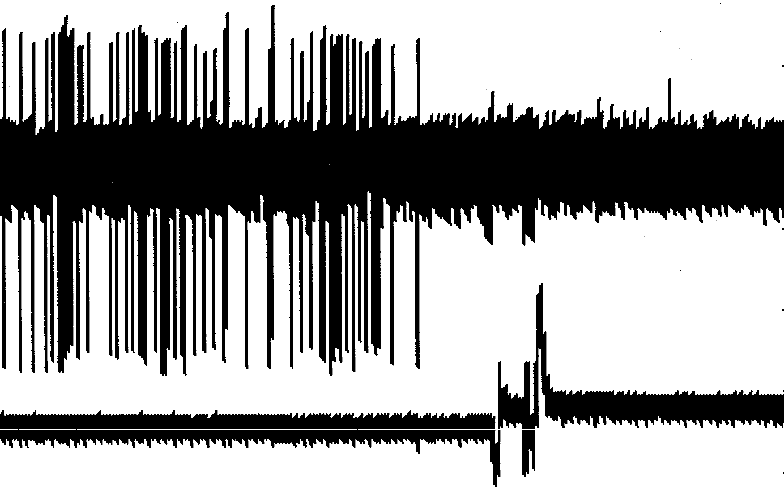
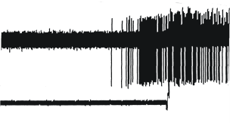
Noradrenaline and 5HT
PAIN
Limbic System
Amygdala
Hypothalamus
Mood, fear, anxiety,
rage, panic, sleep-wake….
Periaqueductal grey
Neutral Cell
Locus coeruleus
Off-Cell
Rostroventral medial medulla
On-Cell
Noradrenaline and 5HT
Inhibitory and excitatory controls

Slide 26
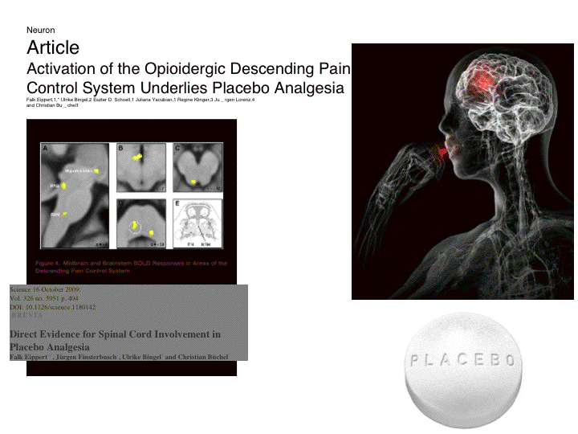
DESCENDING INHIBITIONS IN HUMANS
Notes:
28 for NL

Slide 27
DESCENDING EXCITATIONS IN PATIENTS
Psychophysical and Functional Imaging Evidence Supporting Presence of Central Sensitisation in a Cohort of Osteoarthritis Patients
PAG activation
Patients > Controls
2.0
1.5
1.0
0.5
0.0
% change of BOLD signal
(vmax) within PAG mask
High PainDETECT > Low PainDETECT
0
5
10
15
20
25
Pain DETECT score
Gwilym SE et al. Arthritis Rheum 2009; 61(9):1226-34

Slide 28
Cortex
Location and intensity
Pain sensitivity in fibromyalgia is associated
with catechol-O-methyltransferase (COMT) gene.
Limbic brain
Affective
aspects of pain
Fear, anxiety, sleep, hunger
temperature…
Serotonin transporter gene (SLC6A4) polymorphism
in patients with irritable bowel syndrome and healthy controls.
Descending controls
Allow top-down processes to alter pain - link mood, sleep and pain
Spinal cord
Integrates, amplifies and modifies
incoming messages
Output to brain
Incoming peripheral nerves
Convey touch, temperature
Convey painful messages - heat, mechanical, chemical
Are altered by tissue and nerve damage

Slide 29
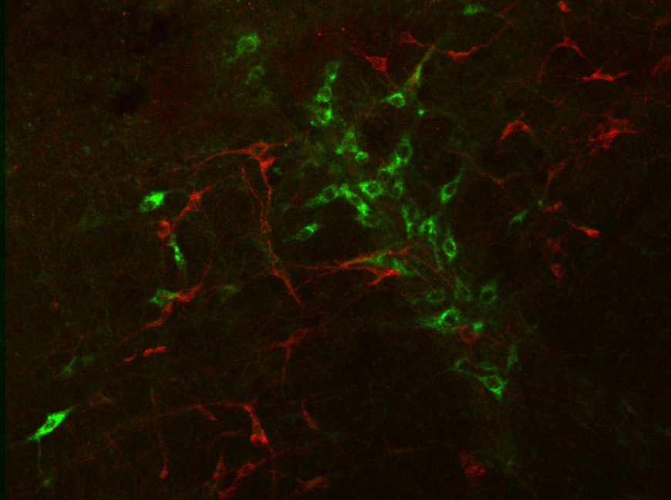

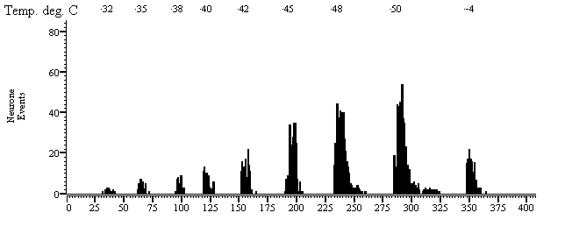
Excitations up – Inhibitions down
Excitations up – Inhibitions down
Reduced NA function - mood and sleep change
Increased 5HT function - anxiety, fear, sleep change
Higher centres

Slide 30
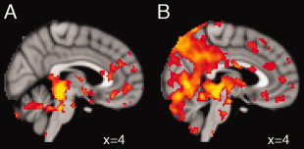
Altered functional magnetic resonance imaging resting-state
connectivity in periaqueductal
gray networks in migraine.Caterina Mainero MD, PhD¹,
Jasmine Boshyan BS¹, Nouchine Hadjikhani MD, PhD^{1,2,*}

Slide 31
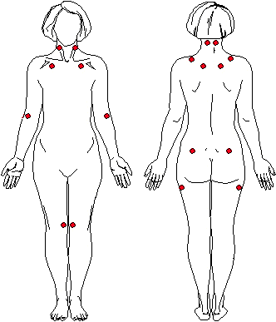
Differential development of central hypersensitivity and a measure of spinal cord hyperexcitability following whiplash injury
Mild
Reflex threshold
Recovered
Moderate/severe
3 weeks 3 months 12 months
Sterling M. J Pain 2011

Slide 32
Time ….. The pain moves….
100
vF 8g
75
Maintained hypersensitivity
after peripheral neuropathy
and abnormal cold…
Response Frequency (%)
50
Ablation of RVM descending facilitations
25
Control values
0
0
5
10
15
Post-operative Day
Could there be time-related events in neuropathic pain?
Bee LA, Dickenson AH. Pain 2008;140:209-23

Slide 33
Descending facilitations cause NeP
Descending inhibitions protect….
Partly NA controls
Nerve injury
Nerve injury
Strain 1
85% mechanical
hypersensitvity
Normal
Strain 2
50% mechanical
hypersensitvity
.
De Felice M, et al .Pain. 2011 Jul 9.

Slide 34
Diffuse Noxious Inhibitory Controls (DNIC)
Extra-segmental inhibitions - via brain
Slowed in chronic fatigue disorder
Relate to chronic post-op pain
Reduced in fibromyalgia
Altered by gender, age….
Reduced in opioid hyperalgesia

Slide 35
A struggle between the
outer and inner worlds
Pain intensity
Abnormal
cold touch etc
Internal processes
Mood, Anxiety
Sensory inputs
Life

Slide 36
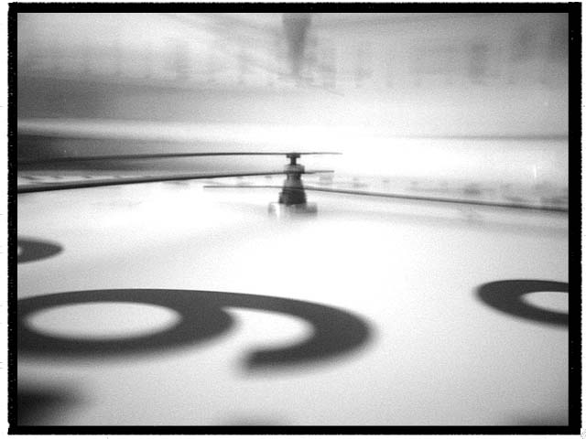
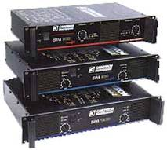
Multi
drug
TCA duloxetine
NMDA
blockers
Lidocaine
Lacosamide
Tanezumab
Capsaicin
CBZ
GBP PGB
CNS level
Brain facilitations up
Inhibitions down
Wind-up and long-term
potentiation are induced
Calcium
channel
function
increases
Peripheral level
OPIOIDS
Tapentadol
Altered nerve
function

Slide 37
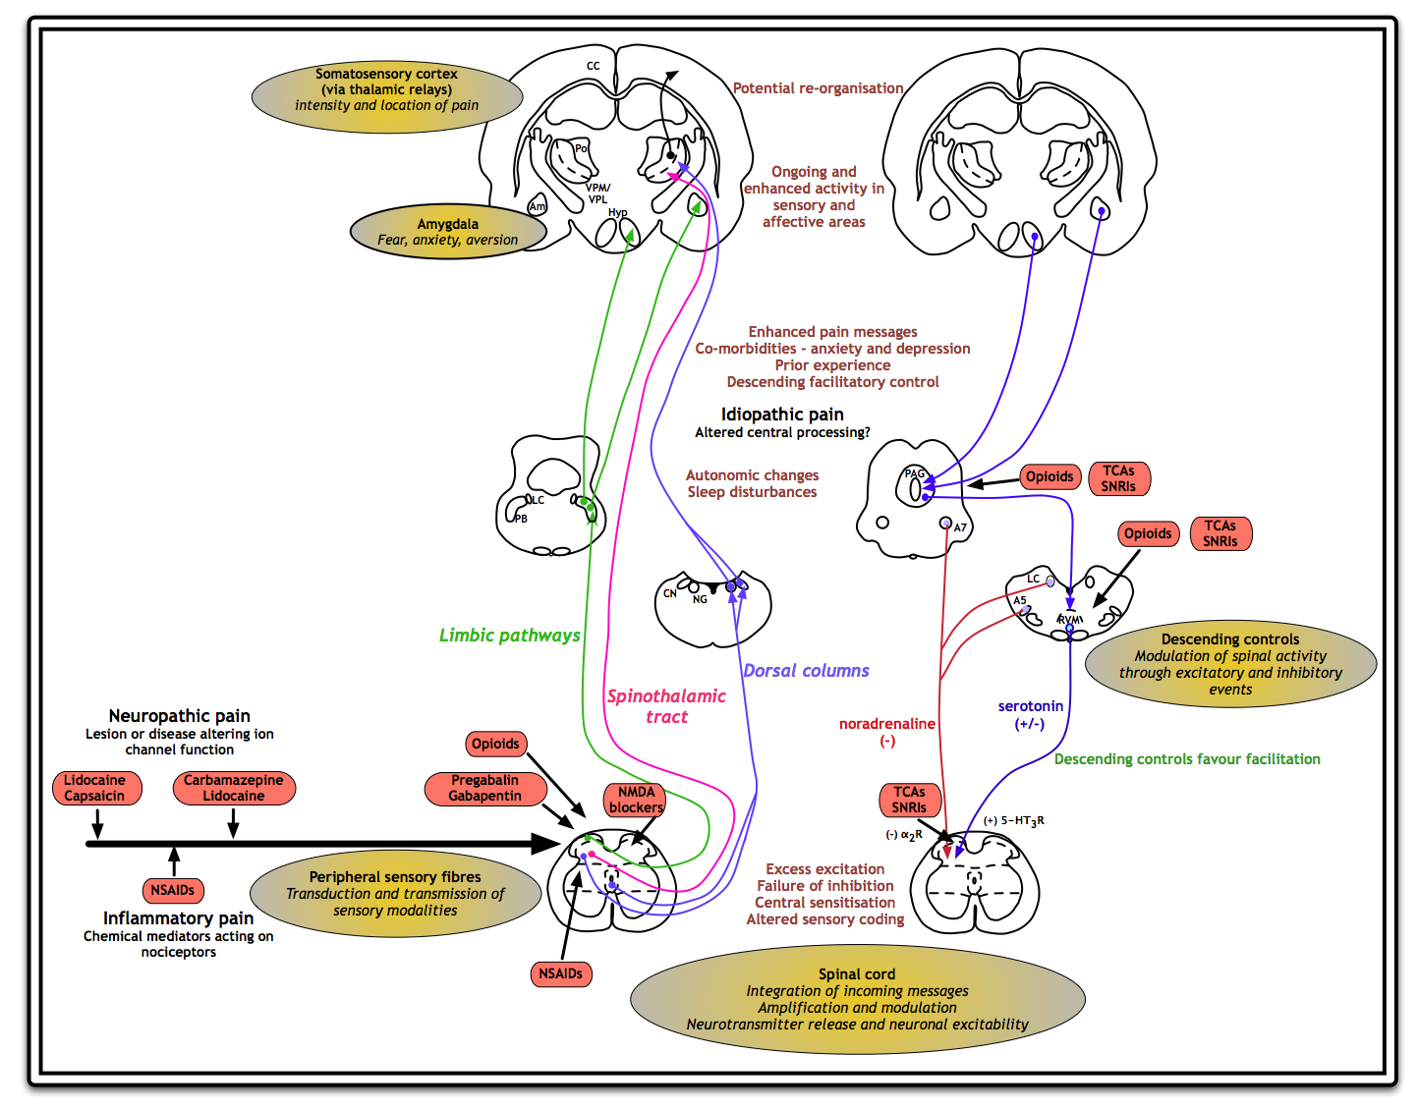

Slide 38
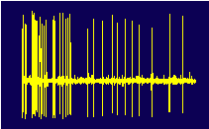
Mechanism
Mechanism
Symptom/sign
Mechanism
ongoing

Slide 39

Back and forward translation…
Higher centres
Brain stem mechanisms and descending controls
Spinal events
Peripheral events
Notes:
39
Introduction 2

Slide 40

John Wood, Steve McMahan, Giandom Iannetti, Dave Bennett, Irene Tracey
Frank Porreca, Daniela Salvemini

