Slide 1
Biomechanics of the hip
Sam Heaton

Slide 2
Summary
Basic terms.
Assumptions.
How to draw a hip FBD.
Some examples.

Slide 3
Why do we need to know this?
Exam!
Which side should they hold a walking stick?
THR offset?
Weight loss?

Slide 4
Basic terms
What is force?
The action of one body on another.
Has a direction, a point of application and a magnitude.

Slide 5
Basic terms
What is a moment?
The effect of the force at a perpendicular distance from a pivot
M = Fd
Magnitude of a moment is the ….
Torque

Slide 6
Basic terms
What is a free body diagram?
A method of determining the forces around a stationary structure.
What are the components of a free body diagram?
Muscles/actions
Gravity
Supports (e.g. the ground)

Slide 7
FBD assumptions
The body is in equilibrium so moments add up to zero.
The line of action of a muscle is along the centre of its cross-sectional area.
Joints are rigid frictionless hinges
No antagonistic muscle action
Weight of body is concentrated at the exact centre of body mass
Internal forces cancel each other out
Muscles only act in tension
Joint reaction forces are assumed to be only compressive.
Bones are rigid rods

Slide 8
Basics
What is the joint reaction force?
Force generated within a joint in response to forces acting on the joint
In the hip, it is the balance of the moment arms of the body weight and abductor tension

Slide 9
How to draw a hip FBD

Slide 10
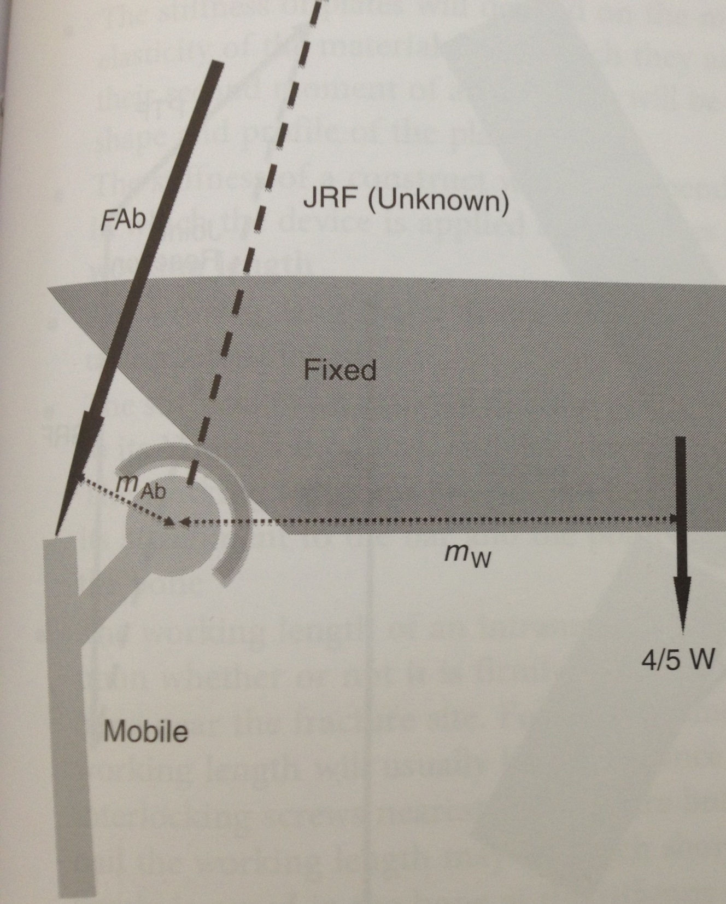

Slide 11
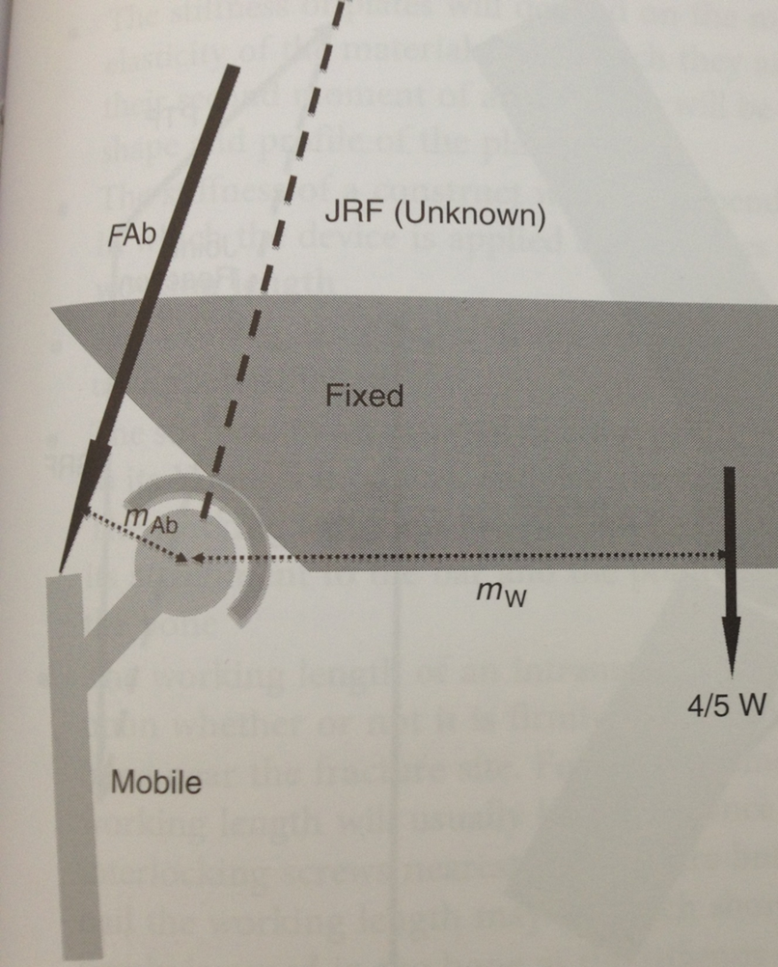
How to I work out Abductor force?
Fab X mAb = Fw X mW
JRF acts through the pivot point so has no moment arm so therefore not considered when moments balanced.

Slide 12

Abductor force
W = 820 N
Weight of leg 120N
mAb = 0.05m
Mw = 0.1m
Line of application of abductor muscle 70⁰

Slide 13
Abductor force
M = (820 -120) x 0.1
= 70Nm
FAb x 0.05 = 70 Nm
FAb = 1400 N

Slide 14
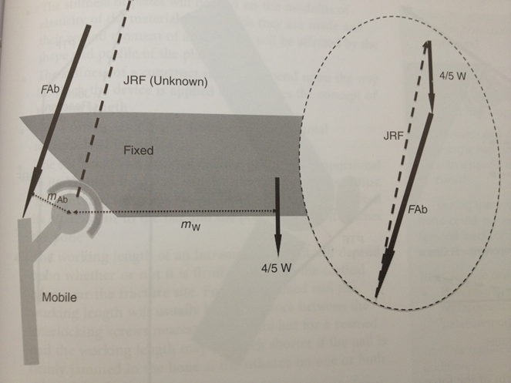
2 ways to calculate the JRF?
1 = Force vector triangle
2 = Maths!!!
Resolve forces in X and Y directions.

Slide 15
What would happen if:
The patient used a walking stick?
The patient carried a weight in the ipsilateral hand?
A larger offset hip replacement was used?
The abductor mechanism was weak?

Slide 16

Walking stick
0.4M
50N

Slide 17
To reduce JRF
Help the abductors
  Provide additional moments
    Walking stick in opposite hand
    Suitcase in ipsilateral hand
  Increase abductor lever arm
    Increase offset
    Lateral transfer of GT
    Varus stem of THR
Reduce body weight, trendelenburg gait.

Slide 18
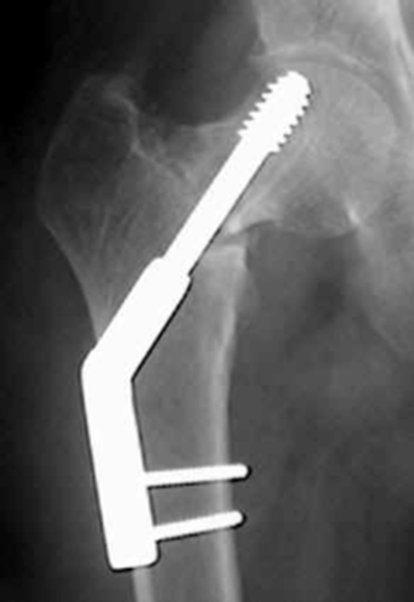
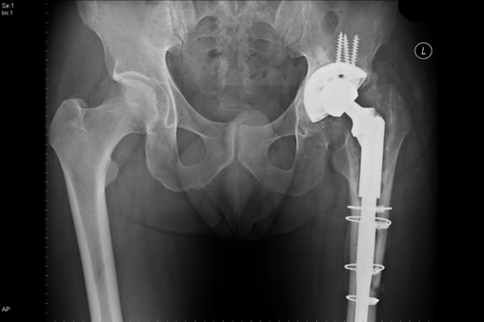
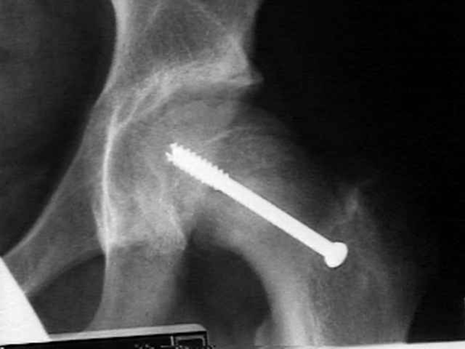
Weight bearing status
NWB gives bigger JRF
JRF at its least when TWB. (1.8 x BW)

Slide 19
Summary
Basic terms
Principle of balancing of moments
Learn to draw the simple diagram
Realise the practical implications.

