Slide 1
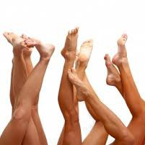
Hallux Rigidus
Maureen K Monda

Slide 2
Background
Davis-Colley 1887: ‘Hallux flexus’
Cotterill 1888: ‘Hallux rigidus’
Hiss 1931: ‘Hallux limitus’
Laird 1972: ‘Functional Hallux limitus’
Stiff great toe
A condition characterized by loss of motion of first MTP joint in adults due to degenerative arthritis
  osteophyte formation leads to dorsal impingement

Slide 3
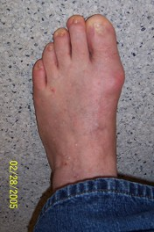
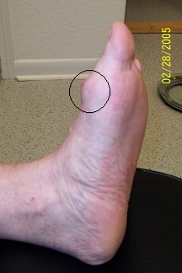
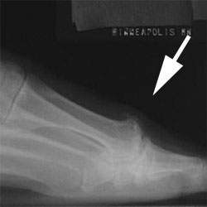
Background

Slide 4
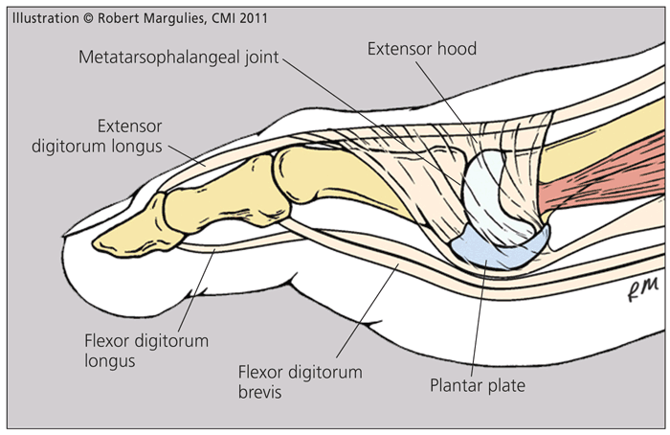
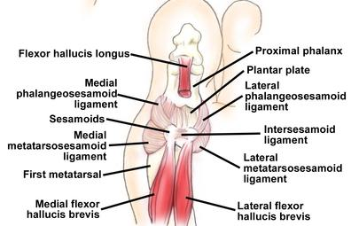
Anatomy
Tibial and fibula sesamoids
FHL and FHB
Plantar Plate
Articular surface:
-MTP
-MT-Sesamoid

Slide 5
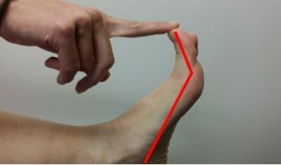
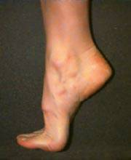
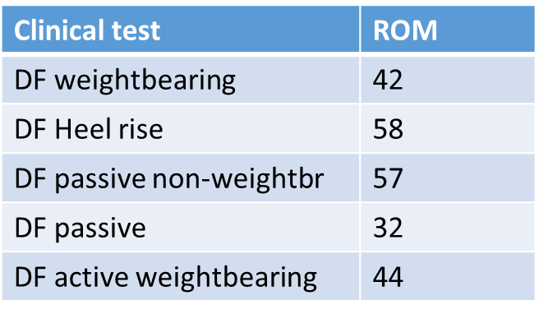
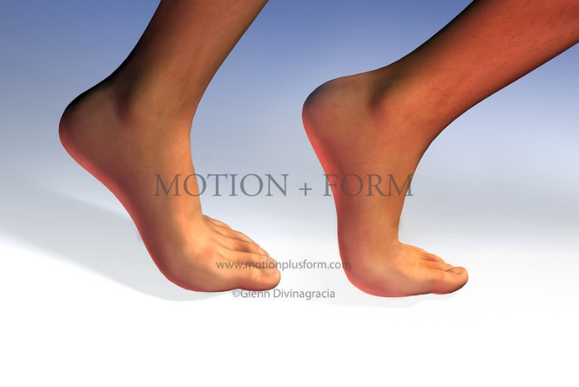
MTPJ ROM
Nawoczenski et al 1999
EM tracking to look at 3-D motion of 1st MTPJ
33 subjects
4 Clinical Tests for ROM of 1st MPJ compared to actual ROM of 1st MPJ during gait

Slide 6

Biomechanics
5,000 – 8,000 steps a day.
Importance in push off phase of gait (MTP rocker)
In sport: sprinting, jumping, ballet, dancing

Slide 7
Biomechanics
Normal gait: up to 50% body weight transmitted through great toe complex
Jogging, running: 2-3 times body weight
Jumping: 8 times body weight.

Slide 8
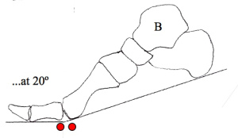
Biomechanics
Roll
-first 20º dorsiflexion
-great toe fixed to ground
-metatarsal rolls over PP
-FHL, FHB, Abd H, Add H
-Plantar fascia windlass

Slide 9
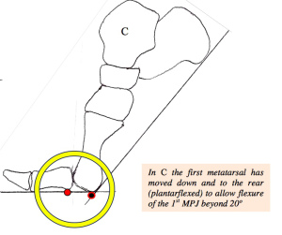
Biomechanics
Slide
->20º dorsiflexion
-1st MT plantarflexion
-peroneous longus
Compression
terminal dorsiflexion provides stability for transfer of forces and balance

Slide 10
Epidemiology
2nd most common disorder after hallux valgus
Coughlin and Shurnas 2003
-110 pts
-80% bilateral
-98% family history
-68% female

Slide 11
Etiologies
Multiple:
-Traumatic (overuse/OCD injury sequelae, iatrogenic)
-Degenerative (systemtic arthrosis, Inflammatory disorders)
-Dorsal bunion (paralytic/neuro-muscular)
-Metatarsus primus elevates (congenital)
The prevailing thinking is that abnormality in dynamic foot function is the primary etiology of hallux rigidus. However, the true mechanism of dysfunction of the great toe joint during gait remains poorly understood.

Slide 12
Etiology
Two distinct groups:
Adolescents:
-rigid swollen joint
-painfull dorsiflexion
-chondral lesion (traumatic) or OCD (atraumatic)
Adults:
-degenerative, overuse, traumatic etiology

Slide 13
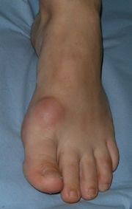
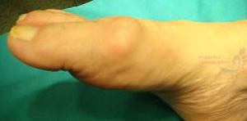
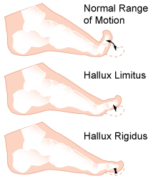
Presentation
Dorsal prominence
Foot wear irritation
Paraethesiae secondary to dorsal cutaneous nerve compression
Painful ROM (DF and PF with pushoff)
Pain less severe with disease progression

Slide 14
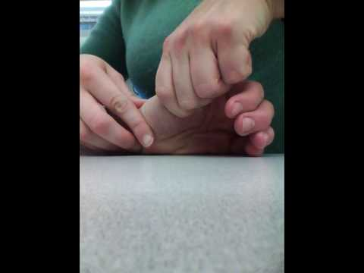
Physical examination
Limited dorsiflexion
-pain at extremes
-at mid range poor prognosis
Pain with grind test
Tenderness on palpation
-over sesamoids poor prognosis

Slide 15
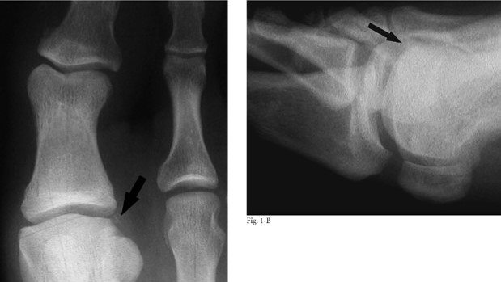
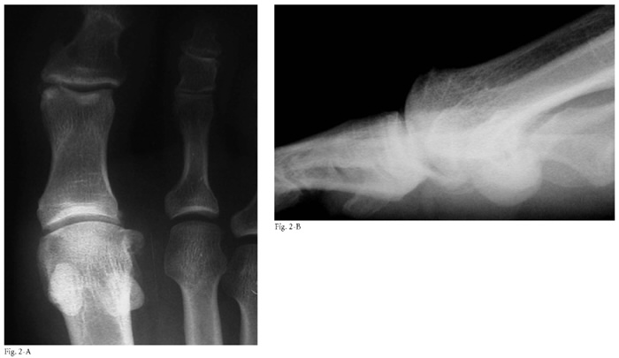
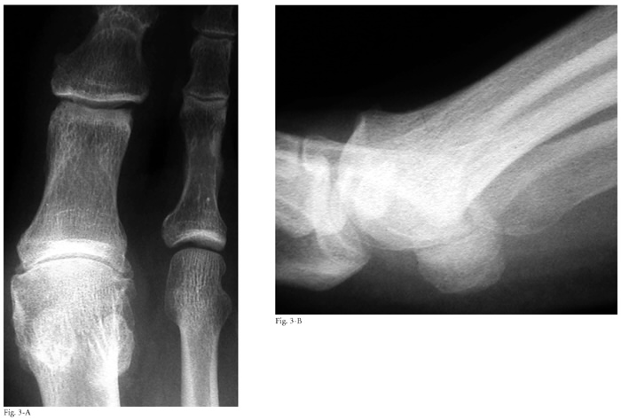
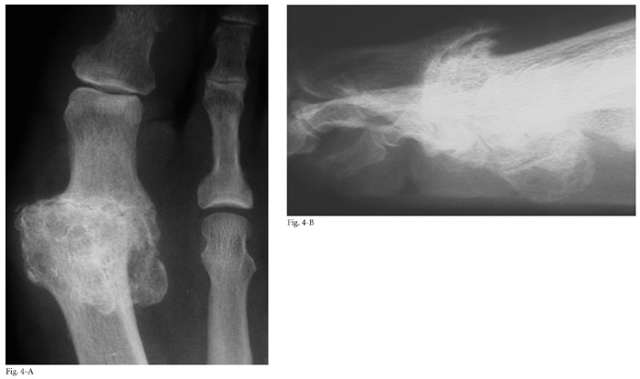
Imaging

Slide 16
Coughlin and Shurnas classification
Grade | Examination findings | Xray findings
0 | Stiffness | normal
1 | Mild pain at extremes of motion | mild dorsal osteophyte, normal joint space
2 | Moderate pain with range of motion increasingly more constant | moderate dorsal osteophyte, <50% joint space narrowing
3 | Significant stiffness, pain at extreme ROM, no pain at mid-range | severe dorsal osteophyte, >50% joint space narrowing
4 | Significant stiffness, pain at extreme ROM, pain at mid-range of motion | severe dorsal osteophyte, >50% joint space narrowing

Slide 17
Treatment
Lengthy discussion
Is pain the issue
Is Range of motion the issue
Is push off strength important to them

Slide 18
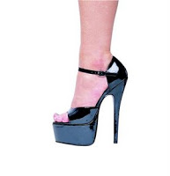
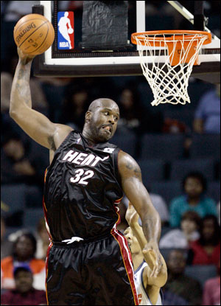
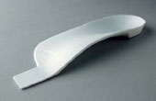
Non-operative treatment
Grade 0 and 1 disease
Foot wear modification
Activity modification
Orthotics
↓pressure on ostephytes
↓MTPJ movement
NSAIDs
Steroid Inj selective→ Increased degeneration

Slide 19
Injections
Injection
Pons et al 2007
RCT Hyaluronate vs Triamcinolone
37 pts
Improvement both groups
No pain at rest
Hyaluronate grp better
-gait pain and passive ROM
-AOFAS MTP score
MUA+Injection
Solan 2001
31pts MUA+ depomedrone/bupivacaine
Blinded x-ray grading
1 yr follow up
Grade | Survival | surgery
1 | 6 months | 4/12
2 | 3 months | 12/18
3 | 2 months | 5/5

Slide 20
Operative treatment
Procedure | Indication | Notes
Joint debridement and synovectomy | acute osteochondral or chondral defects
Dorsal cheilectomy | Pain with dorsiflexion Shoe wear irritation Pain in mid ROM contraindicated | Obtain 70-90% DF intraop.
Dorsal closing wedge osteotomy of the proximal phalanx | Runners with reduced dorsiflexion Failure of cheilectomy | Decreases plantarflexion arc of motion
Keller Procedure (resection arthroplasty) | Elderly, low demand Significant joint degeneration | Risk of hyperextension Weakness with pushoff Transfer metatarsalgia
MTP arthroplasty | Controversial Poor long term results with silicone implants | Osteolysis and synovitis lead to joint destruction and pain Failed arthroplasty, transfer metatarsalgia
MTP joint arthrodesis | Significant joint arthritis (3 and 4) | High fusion rate (70-100%) 15% IPJ degeneration

Slide 21
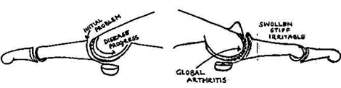
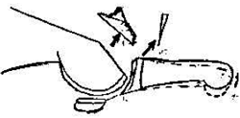
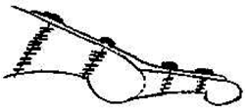
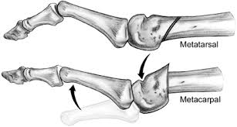
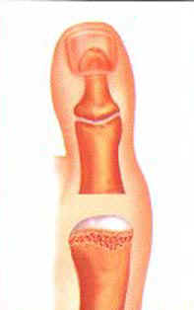


Slide 22
MTP joint arthrodesis
  dorsal plate with compression screw is biomechanically strongest construct
  preferred surgical alignment
    10 to 15 degrees of valgus in relation to the metatarsal shaft
    15 degrees of dorsiflexion in relation to the floor
  fusion in excessive dorsiflexion causes pain at tip of the toe, over the IP joint, and under the 1st metatarsal with excessive dorsiflexion
  fusion in excessive plantar flexion causes increased pressure at the tip of the toe
  fusion in excessive valgus increases the risk of IP joint degeneration

Slide 23
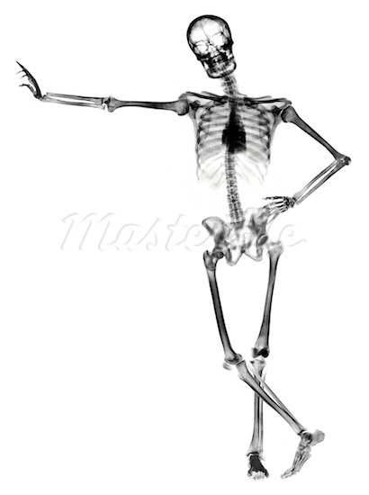
Thank you

