Slide 1
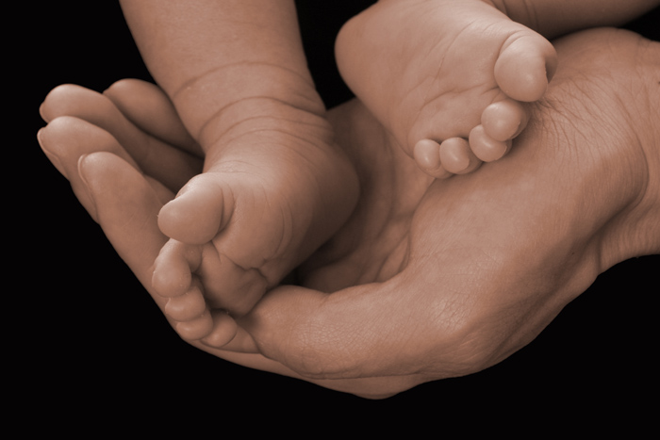
Forefoot Pathologies
Royal London SpR teaching
16th June 2015
Iris Kwok

Slide 2
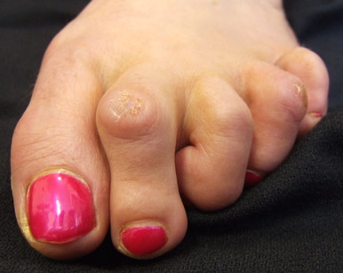
Outline
Lesser toe deformities
Hammer toe
Mallet toe
Claw toe
5th toe deformities
Metatarsalgia
Morton’s neuroma
Freiberg’s disease

Slide 3
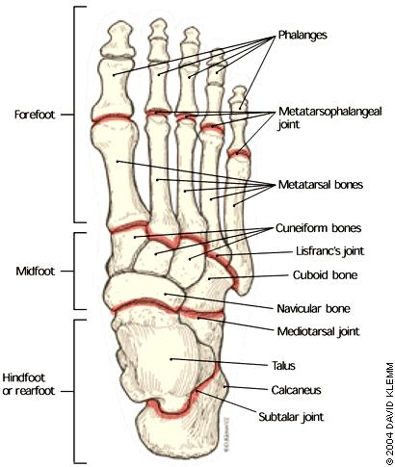
Foot problems – 10% of general population
Elderly: prevalence 50-95%
90% of foot disorders
(DuVries et al 1965)

Slide 4
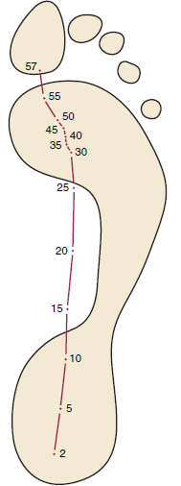
Gait cycle
62% stance phase
38% swing phase
Stance phase
heel strike
mid stance
late stance
toe off
1st MT carries 50% of body weight
Progression of centre of pressure during walking cycle
(Hutton et al 1982, Clark TE 1980 )

Slide 5
The lesser toes
Takes 70-80% pressure during late stance phase in walking
Stability and coordination with rest of the foot relies on plantar fascia
Muscle imbalance
+
loss of plantar fascial control
=> toe deformity
 | Total toe pressure
Great toe | 30%
2nd toe | 25%
3rd toe | 20%
4th toe | 15%
5th toe | 10%
(Hughes et al 1990)
Notes:
Does not take much pressure in standing
The great toe takes the highest pressure when walking (Hughes et al 1990)

Slide 6
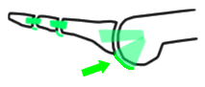
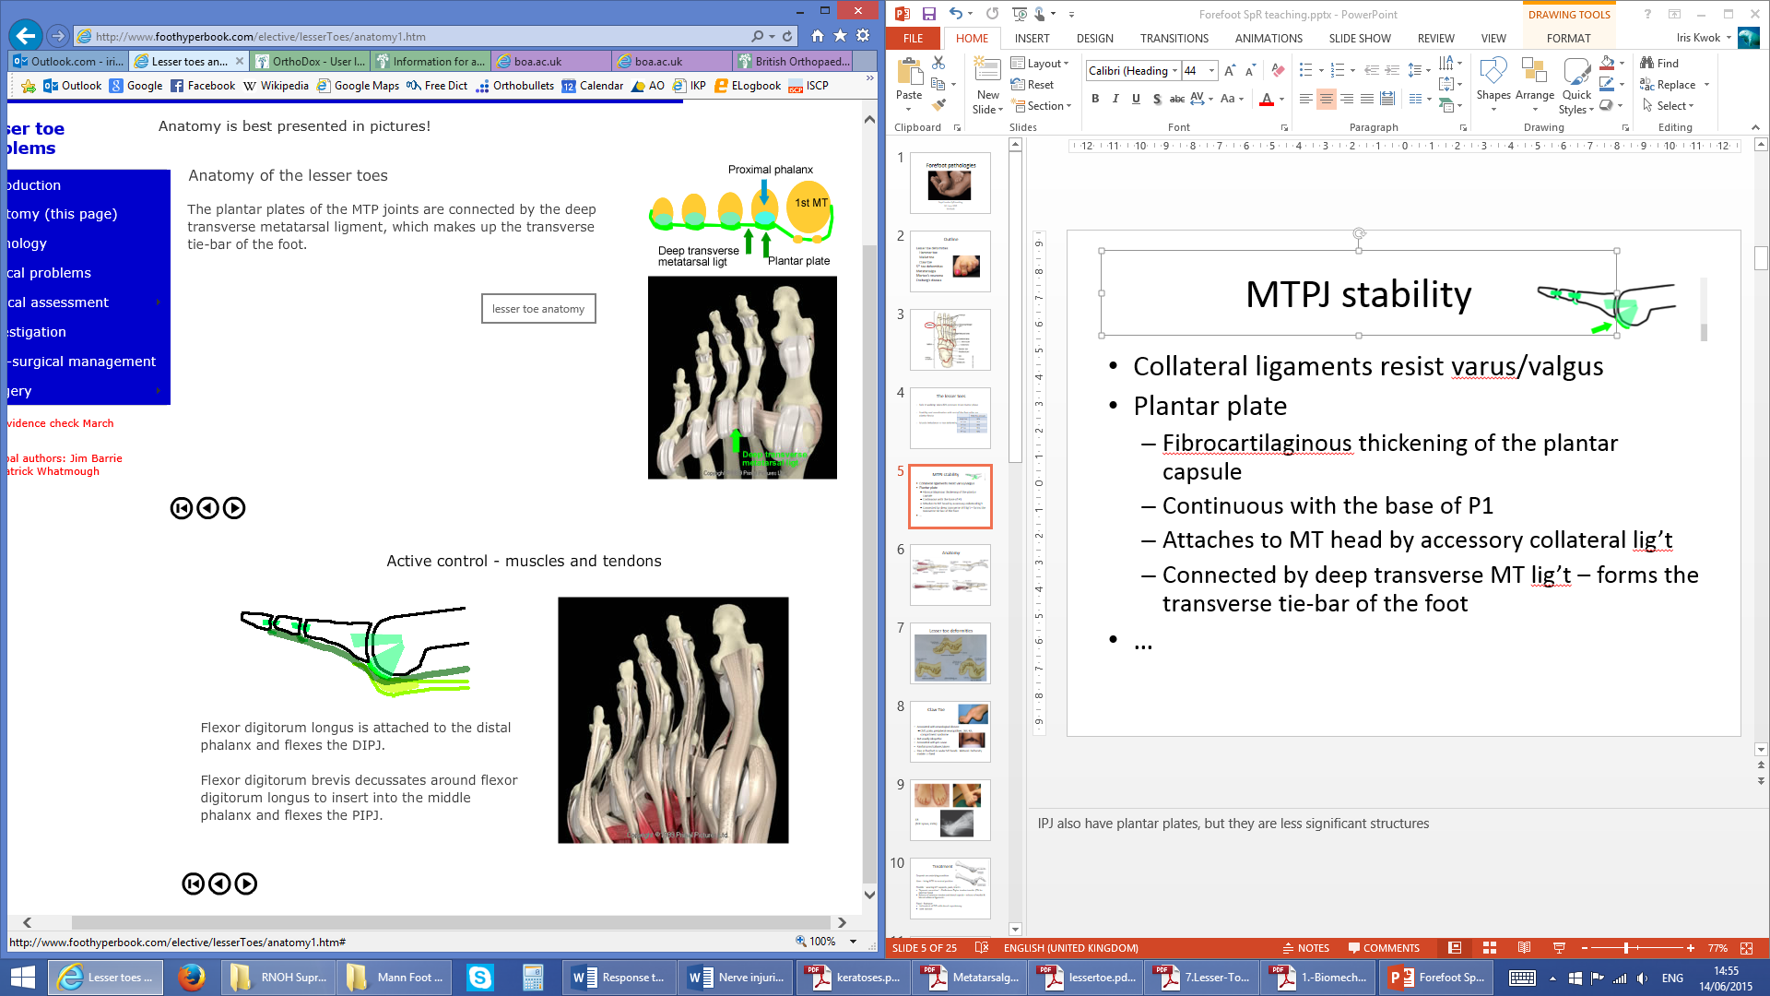
MTPJ stability
ROM: 90° dorsiflexion, 30°/50°plantarflexion
1) Collateral ligaments resist varus/valgus
2) Plantar plate and fascia resist dorsal displacement
  Fibrocartilaginous thickening of the plantar capsule
  Continuous with periosteum of P1 base
  Attaches to MT head by accessory collateral lig’t
  Connected by deep transverse MT lig’t

Slide 7
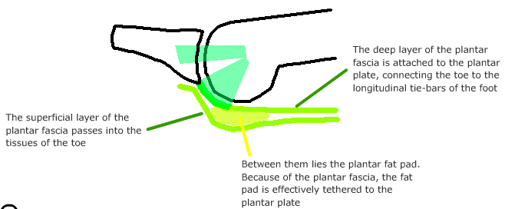
Deep layer of plantar fascia
Superficial layer of plantar fascia
Plantar fat pad
Attachment of plantar fascia to P1 forms the main plantar flexor of the toe in normal gait.

Slide 8
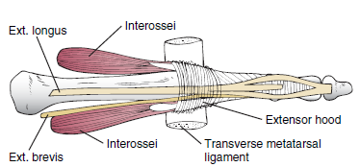
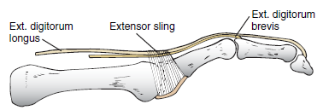
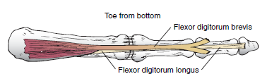
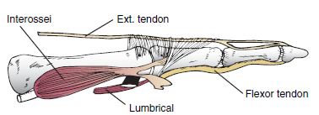

Slide 9
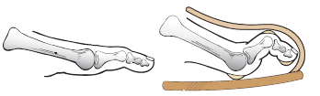
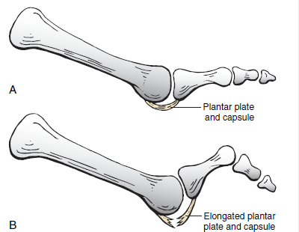
Toe failure
Shoewear – abnormal force on toes
High heels – MTPJ in constant dorsiflexion = plantar plate failure
Causes:
Chronic pressure, degeneration
Trauma
Inflammatory arthritis
Neuromuscular disorders
Associated with hallux valgus

Slide 10
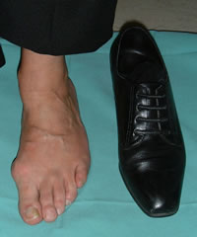
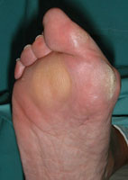
Examination
Gait (high stepping, antalgic)
Posture
Hyperkeratotic lesions, ulcers
ROM: hyperextension/flexion of MTPJ
Fixed vs flexible deformity
Axial rotational deformity
Associated hallus valgus
Skin contractures
Shoe wear (sizing, wear pattern)
Neurological (Neurofilament testing)
Vascular symptoms (pulses, Doppler, ABPI)
Infection

Slide 11
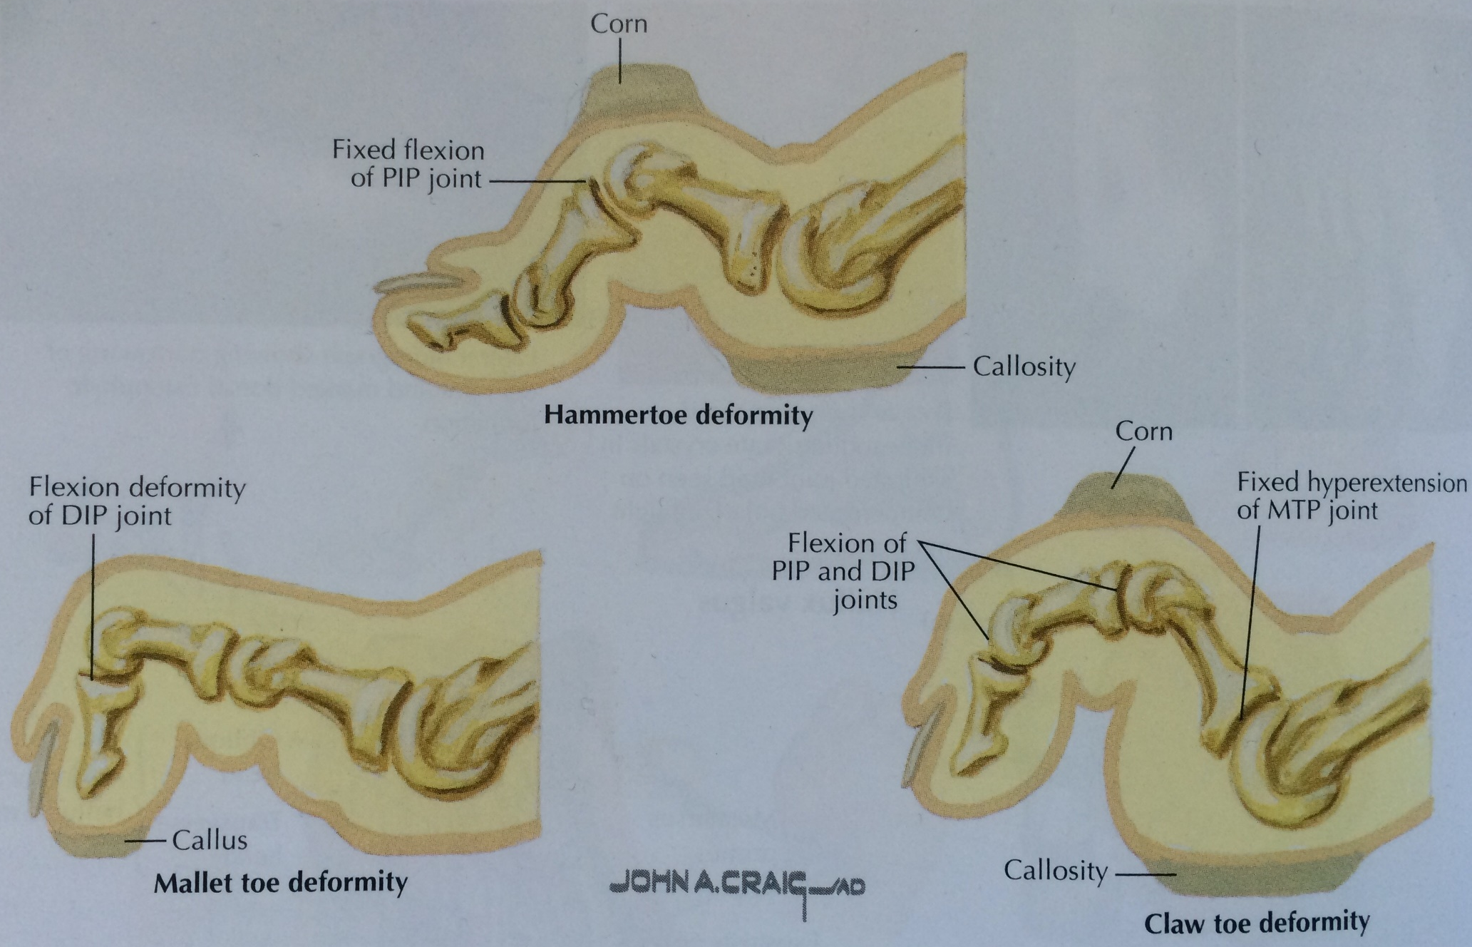
Lesser toe deformities
Increases with age
Peaks at 6th-7th decades
F:M = 4-5:1

Slide 12
Claw Toe
Associated with neurological disease
  CMT, polio, peripheral neuropathies, DM, RA, compartment syndrome
But usually idiopathic
Associated with pes cavus
Painful corns/calluses/ulcers
Pain in forefoot or under MT heads.
Bilateral, multiple toes.
Deformity mobile => fixed
Notes:
Initially joints are mobile and the deformity can be passively corrected. With time this deformities become fixed and the MTP joints can sublux even be dislocated
Hairy patch on lumbrosacral spine – ass with diastematomyelia

Slide 13
XR – AP & lat WB views
(MRI spine, EMG/NCS)

Slide 14
Treatment
Depends on underlying condition
Aim: bring MTPJ to neutral position
Flexible
MT supports/pads – reduces MT head pressure by 12-60%
‘Dynamic correction’ – Girdlestone-Taylor tendon transfer (FDL to extensor hood)
Release of extensor tendon and dorsal capsule + release of medial & lateral collateral ligaments
Fixed
Footwear
Arthrodesis of PIPJ with dorsal capsulotomy
Joint excision
(Holmes GB et al 1990)

Slide 15
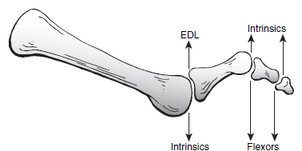
Hammer Toe
2nd toe most commonly affected
May be bilateral
Callus on dorsal PIPJ
MTPJ hyperextension may progress to dislocation
Causes
  ? similar to boutonniere deformity in finger
  Extensor dysfunction. (Associated with dropped MT
  head, flat anterior arch and hallus valgus.)
  Toe too long/shoe too short
  Also seen in neuromuscular diseases
  XR – look for joint subluxation, long MT

Slide 16
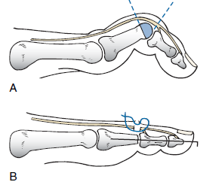
Treatment
Pads, shoe inserts
Indications for surgery – pain, difficulty with shoewear
Flexible: FDL release at PIPJ or
Girdlestone-Taylor tendon transfer
Fixed: Duvries arthroplasty (PIPJ excision and fusion) – fibrous union
If MTPJ dislocated – dorsal capsulotomy and extensor lengthening
Arthrodesis (N.B. non-union)

Slide 17
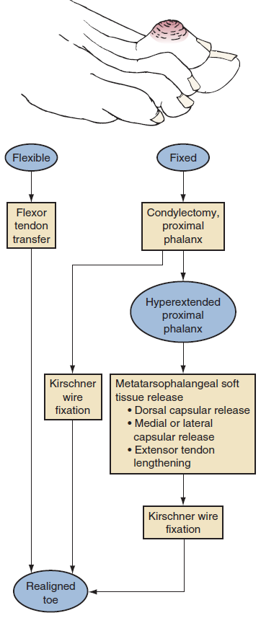

Slide 18
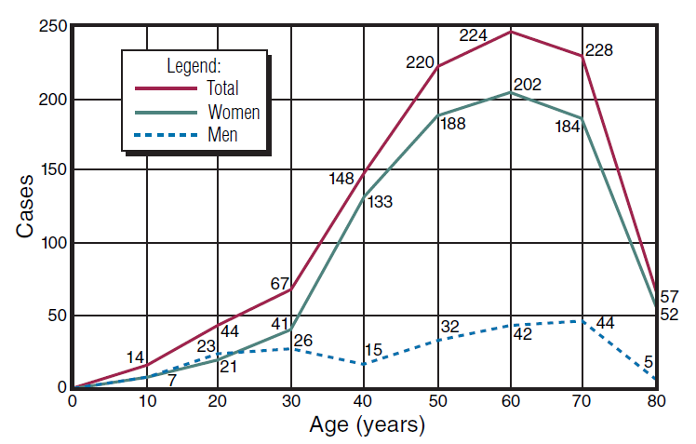
Mallet Toe
Tip of toe presses into shoe => painful callus
Females 84%
Associated with long ray in tight shoes
Usually fixed
XR – DIPJ flexion deformity

Slide 19
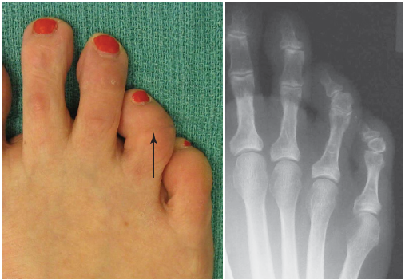
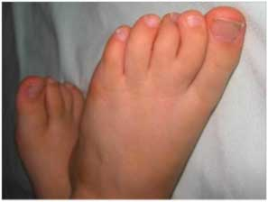
Paediatric population ‘Curly toe’

Slide 20
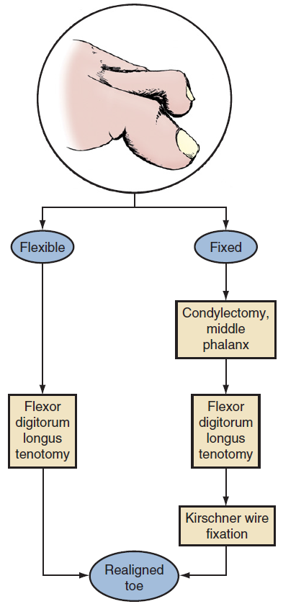
Treatment
Padding, chiropody

Slide 21
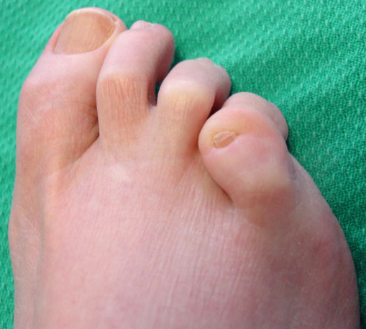
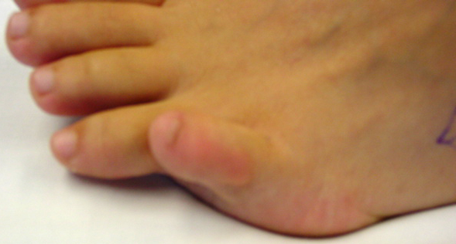
Fifth toe deformities
Overlapping 5th toe – commonest
Congenital abnormality
Externally rotated, compressed in AP plane
Dorsal and medial contracture to the capsule, EDL tendon and dorsal skin
Treatment:
Conservative
Release of extensor tendon, capsule, skin contracture

Slide 22
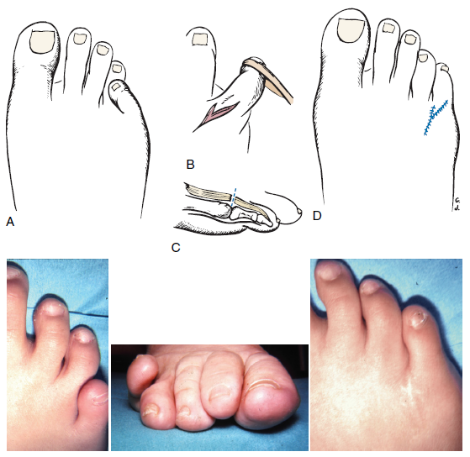
Wilson’s V-Y plasty

Slide 23
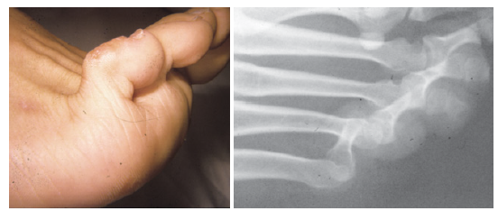
Cock-up deformity

Slide 24
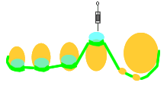

Metatarsalgia
Pain in the region of MT and MPTJ
Commonest cause of foot pain in middle-aged females
‘The plunger effect’

Slide 25
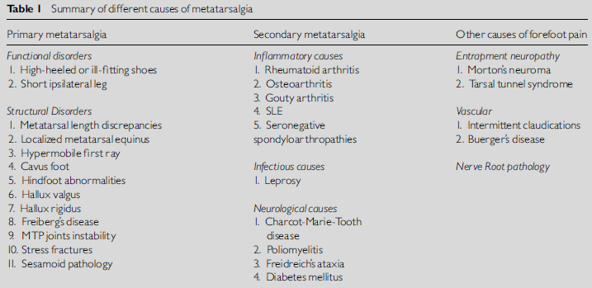
3 categories:
1. Primary – chronic imbalance in WB distribution across forefoot
2. Secondary – cause of MT weight imbalance originates from other factors/conditions
3. Others – not associated with WB imbalance
XR – AP & lat WB views
(MRI spine, EMG, bone scan)
Bloods (if DM or inflammatory conditions suspected)

Slide 26
Morton’s neuroma
Common nerve entrapment syndrome
F:M = 9:1, 5th decade
Interdigital neuralgia (usually 2nd/3rd interspace)
Perineural fibrosis and thickening
Radiation of pain into digits, numbness, ‘pebble in the shoe’
Mulder’s click (+ve in 41%)
US (87.3% accuracy) +/- MRI
Treatment:
Offloading, shoe wear
Steroid injections (50% relief)
Surgical excision (80-90% success)
– dorsal approach lower wound complication rate
30% prevalence in asymptomatic feet. >5mm most likely symptomatic
(Fadel GA et al 2002, Mann RA et al 1983)

Slide 27
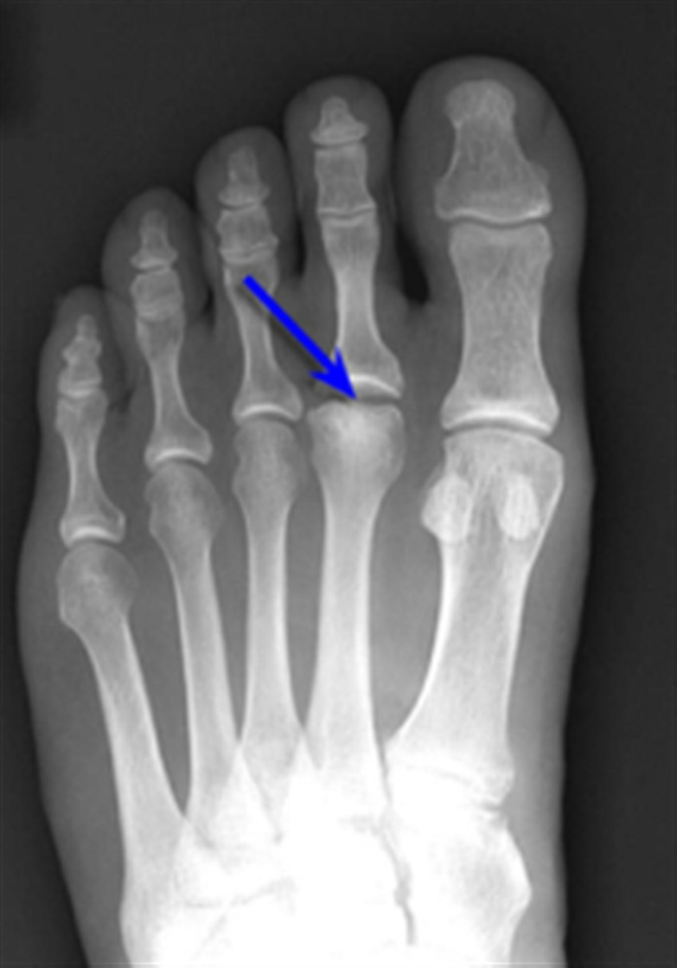
Freiberg’s disease
Osteonecrosis of the MT head (2nd)
F:M = 5:1, peak age 10-18
Bilateral in 10%
Pain worse with activity, limited ROM, swelling, plantar callosity
XR; MRI – bone oedema
Smillie’s classification (5 stages)
XR – flattening of MT head, sclerosis, joint destruction
(Freiberg 1926)

Slide 28
Treatment
Treatment:
Rest from high impact activities
Below knee cast 4/52, stiff soled shoe, MT pad
- Symptomatic relief in 50% of patients
Severe: partial MT head resection, removal of loose bodies
(Fadel GA and Rowley DI 2002)

Slide 29
What I have not covered…
Tarsal tunnel syndrome
Sesamoidits
Bunionette deformity
Stress fractures
Hyperkeratotic pathologies

Slide 30
Resources
Mann's Surgery of the Foot and Ankle 9th Ed, Coughlin MJ et al.
http://www.foothyperbook.com/elective/lesserToes/lesserToesIntro.htm
Metatarsalgia. Fadel GE, Rowley DI, Current Orthopaedics 2002, 16:193-204
Lesser toe abnormalities. Coughlin MJ, JBJS 2002, 84A(8):1446-69
Keratotic disorders of the plantar skin. Mann RA, JBJS 2003, 85A(5): 938-5
Netter’s Concise Orthopaedic Anatomy 2nd Ed, Thompson et al.
Mallet toes, hammer toes, claw toes, and corns. Causes and treatment of lesser-toe deformities. Couglin MJ, Postgrad Med 1984 75(5):191-198, 1984.
Operative repair of the mallet toe deformity. Coughlin MJ, Foot Ankle Int 1995 16(3):109-116, 1995.

