Slide 1
Elbow disorders
Niel Kang
Cambridge University Hospitals
NHS Foundation Trust
RLH/Pott HST teaching
10/06/2014

Slide 2
overview
Anatomy
Tendinopathy
Nerve entrapment syndromes
Arthroscopy
Arthroplasty
Approaches

Slide 3
Elbow stabilisers
Static
  Primary
    Ulnohumeral joint (coronoid)
    MCL/LCL
  Secondary
    radiocapitellar joint
Dynamic
  brachialis
  anconeus
  triceps

Slide 4
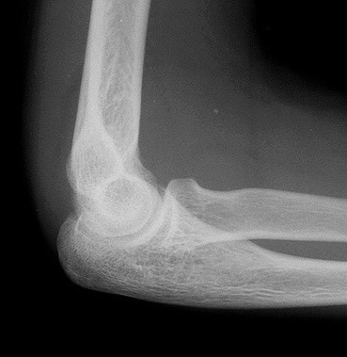
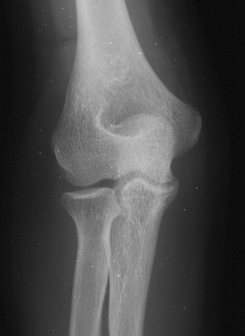
Osseous anatomy
Hinge joint - Ulnotrochlear
Rotation - Radiocapitellar
PRUJ

Slide 5
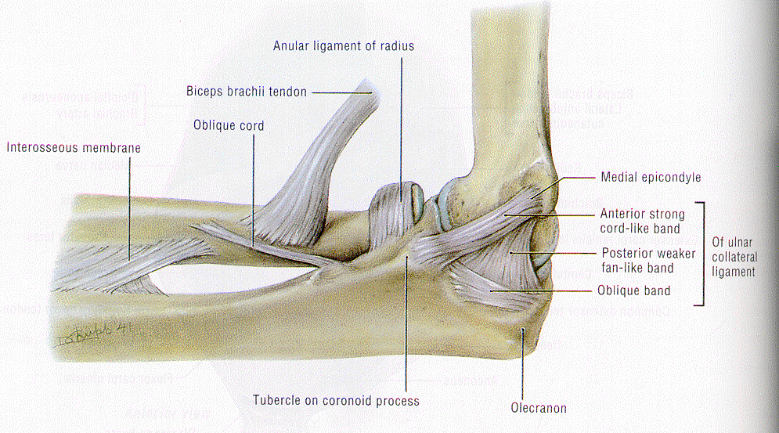
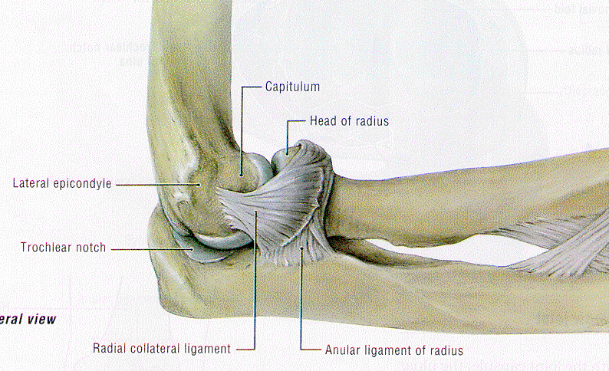
Ligaments

Slide 6
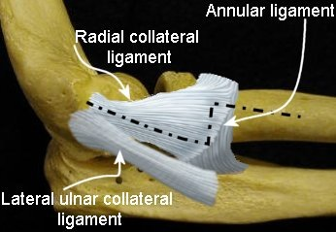

Slide 7
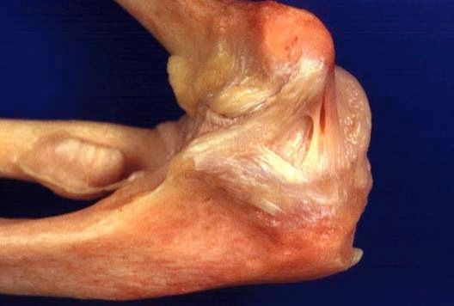
medial

Slide 8
Coronoid

Slide 9
PUDA & Varus angles

Slide 10
Hook angle

Slide 11
tendinopathy
Epicondylitis
  lateral
  medial
Distal biceps
Triceps

Slide 12
clinical exam
Look
Feel
Move
Special tests

Slide 13
special tests
Mill’s
Maudsley’s
Pronator teres provocation
O’ Driscoll’s Hook test
Triceps provocation

Slide 14
differential diagnosis lateral sided pain
Radial tunnel syndrome
Radiocapitellar lesion
  OCD
  OA
PLRI

Slide 15
differential diagnosis medial sided pain
Cubital tunnel
MCL tear

Slide 16
management
Correct technique
Activity modification
Eccentric exercises

Slide 17
counterforce bracing

Slide 18
injections
Steroids
Dry needling
Hyaluronic acid
PRP

Slide 19
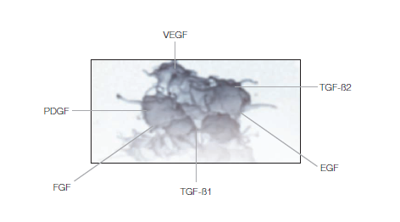
PRP

Slide 20
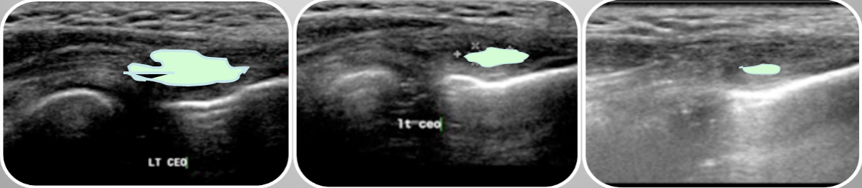
radiological results

Slide 21
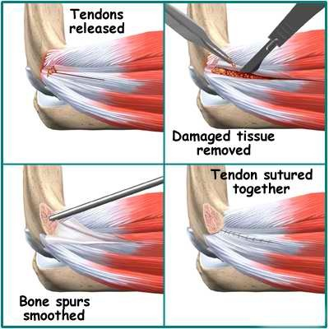
surgery

Slide 22
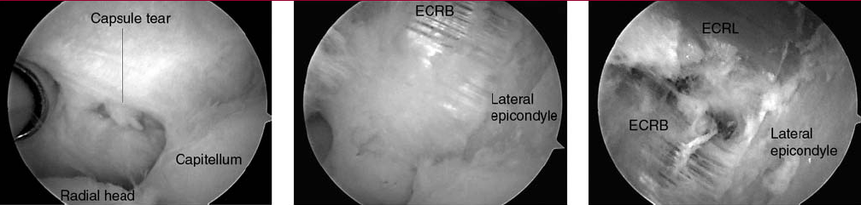
arthroscopy

Slide 23
Cubital tunnel syndrome
History
  Numbness, weakness, clumsiness
Examination
  Sensory
  Motor
  Tenderness, Tinel sign positive, wasting
Treatment
  non-operative
    night splints
  Surgical release

Slide 24
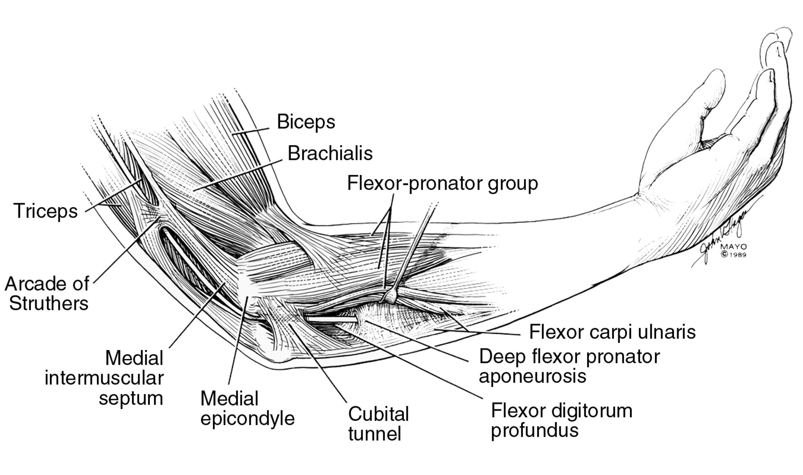
Cubital tunnel syndrome

Slide 25
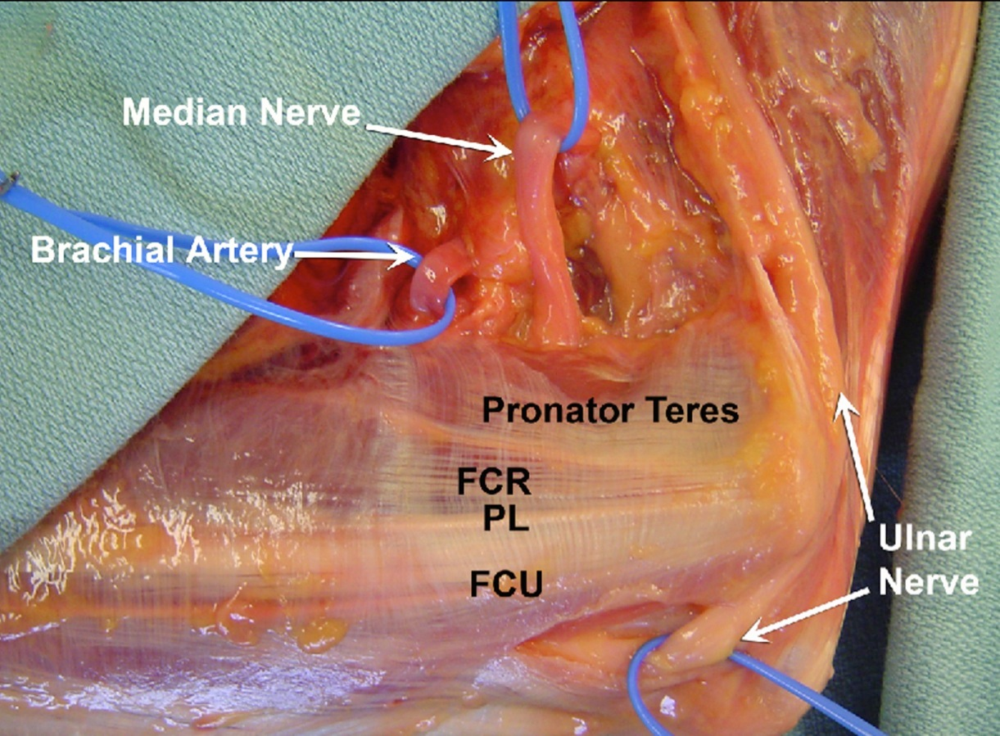
anatomy

Slide 26
surgical options
Decompression
Medial epicondylectomy
Anterior transposition
    Subcutaneous
    Intramuscular
    Submuscular
Endoscopic decompression

Slide 27
Radial tunnel syndrome
Radial nerve C6,7,8
Tenderness 3 - 4 cm distal and anterior
Middle finger
EMG’s non diagnostic

Slide 28
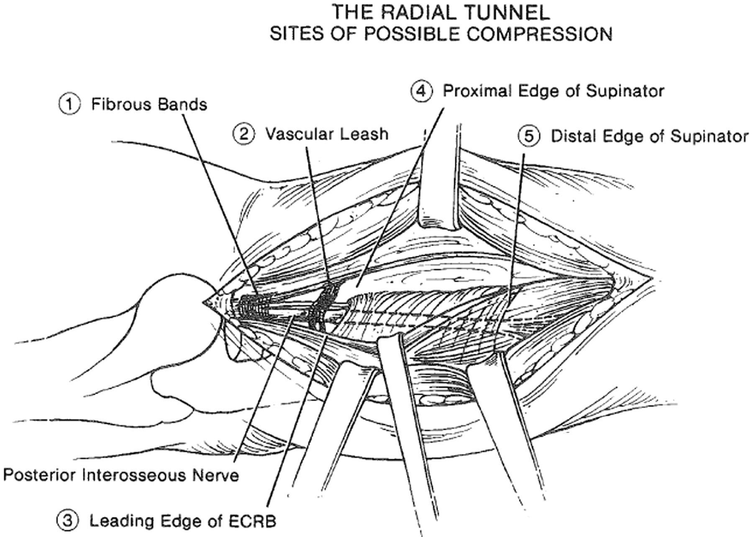
Radial tunnel syndrome

Slide 30
Distal Biceps rupture
• “pop”
• Pain
• Physical exam
▪ “reverse” popeye deformity
▪ palpable defect
▪ hook test
▪ With a partial tear or no tear (strain) the examiner will be able to get their finger under the tendon near the insertion.
▪ tenderness at biceps insertion
◦ Strength
▪ loss of supination/flexion strength
▪ lose more supination than flexion, up to 50%
◦ Distinguish between complete tear and partial tear.
▪ biceps tendon is absent in complete rupture and palpable in partial rupture (otherwise they have a very similar clinical picture)

Slide 31
natural history
• 70% flexion strength around 3 months (JSES 2009)
• 85% flexion strength after 1 year (JBJS 2009)
•
• 50% Supination strength around 3 months (JSES 2009)
• 75% supination strength after 1 year (JBJS 2009)

Slide 32
single incision
• Galatz 2002 - suture anchor
• Bain 2002 - endobutton
• Mazocca 2005 - endobutton and interference screw

Slide 33
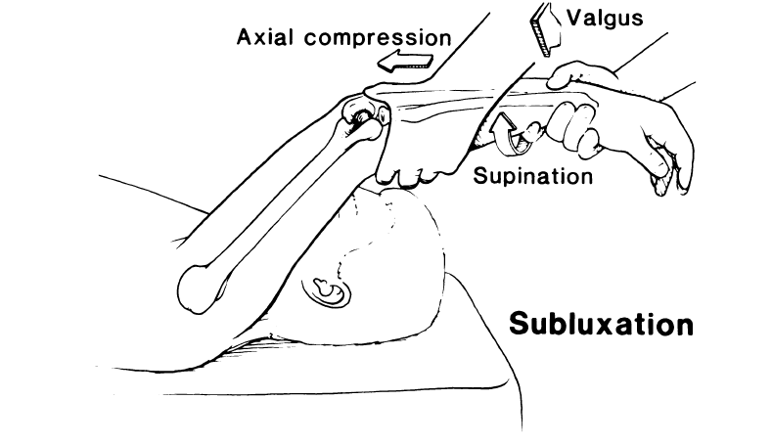
POsterolateral instability
Lateral Pivot Shift

Slide 35
Reconstruction of LUCL complex
▪ Graft types
▪ autograft, allograft or synthetic
▪ palmaris longus most common
▪ Graft configuration
▪ tendon graft tied to itself over lateral column, through tunnel in supinator crest & then weaving through "Y" tunnel configuration in humerus
▪ graft covers posterior 25% of the radial head to create a sling
▪ graft secured with arm in neutral rotation and 45 degrees of flexion
▪ Graft fixation
▪ graft may be "docked" on humerus with sutures exiting "Y" tunnels or on both humeral and ulnar sides with interference screws (or sutures tied over bone)

Slide 36
elbow arthroscopy
Diagnostic
Removal of loose bodies
Radial head excision
Debridement osteophytes OK procedure
Capsular release

Slide 37
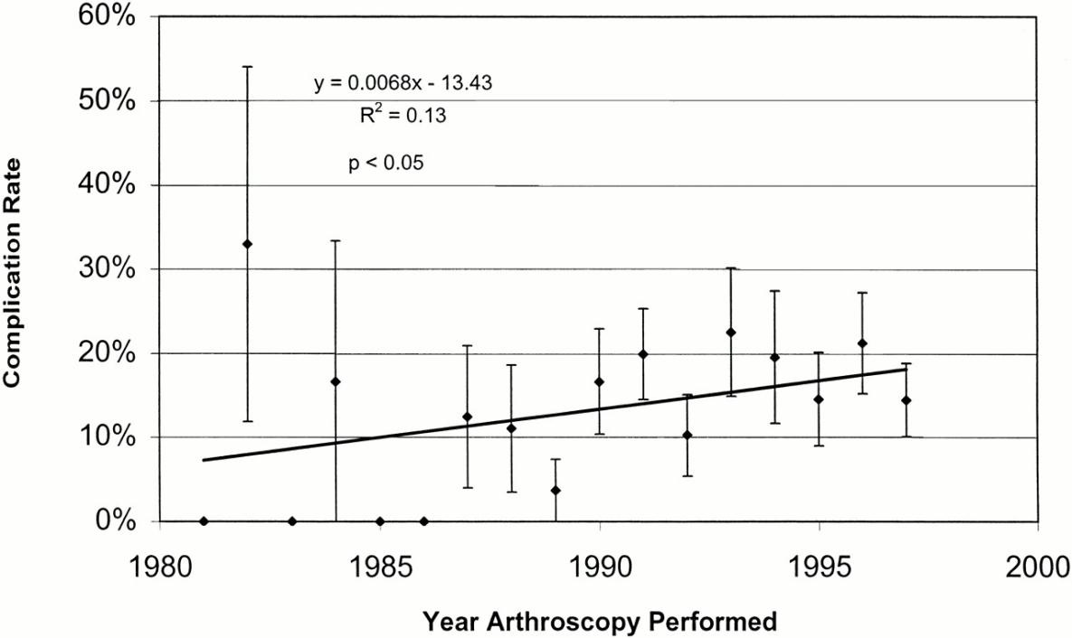
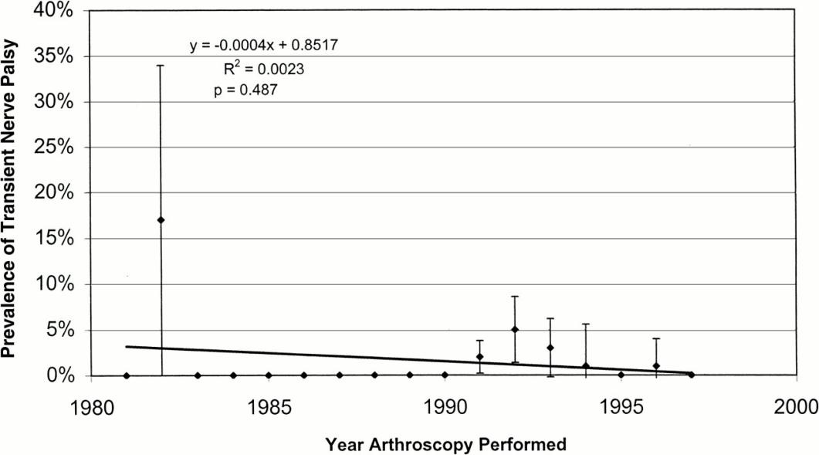
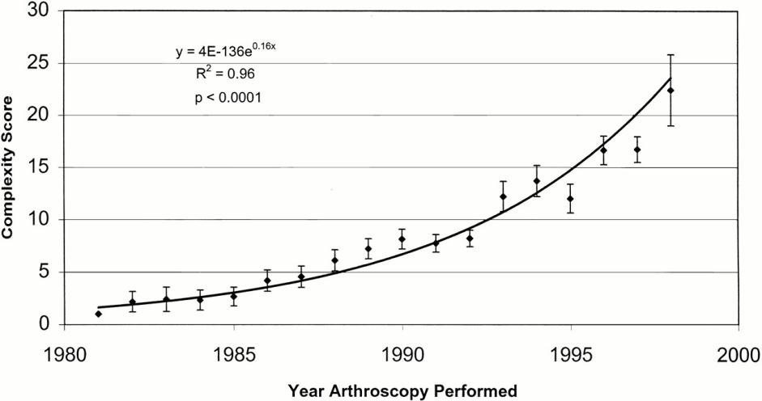

Slide 38
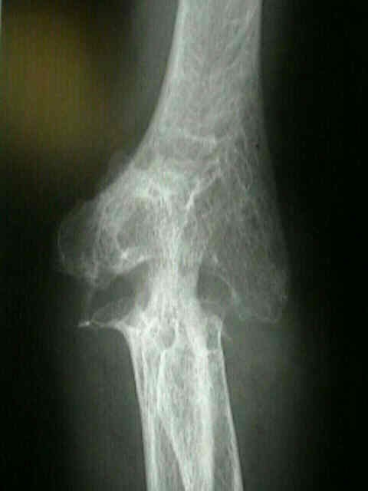
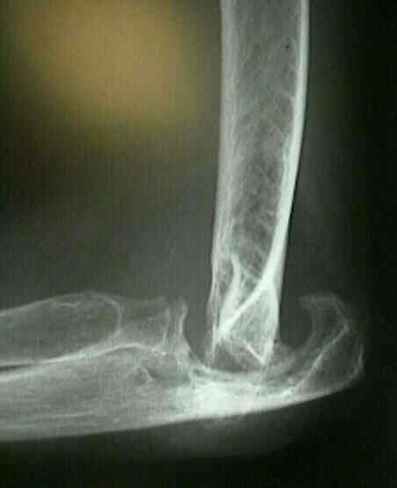
Indications for TEA
Rheumatoid arthritis
Trauma sequelae
Acute trauma

Slide 39
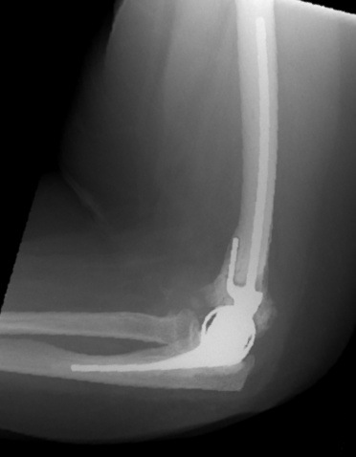
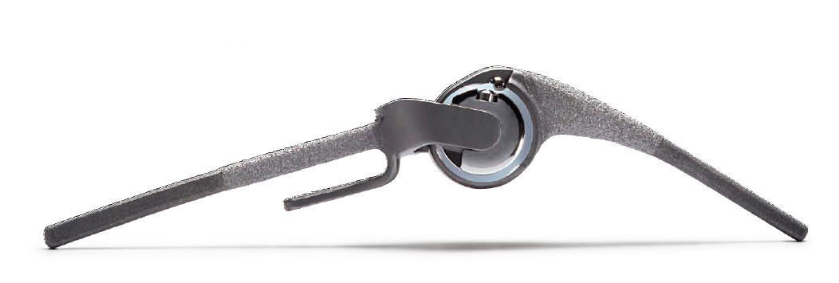
types of tea

Slide 40
Types of TEA
Constrained / Linked
Semi-constrained / “Sloppy”
Unconstrained
Special
  radial head
  lateral compartment
  hemiarthroplasty

Slide 41
complications of tea
Overall 30%
  Infection 5%
  Wound healing 10%
  Triceps detachment 3%
  Ulna nerve palsy 5% (permanent)
  Disassembly (linked) 1-6%
  Dislocation (unlinked) 5%, instability 14%
  Loosening 9%

Slide 42
5 yr performance
Revision ROM improvement Good/ Excellent
Overall 13% 26° 78%
RA 10% 26° 83%
PTA 10% 49° 81%
* Acute # 3% NA 99%
*<3yr fu
Little et al JBJS 2005

Slide 43
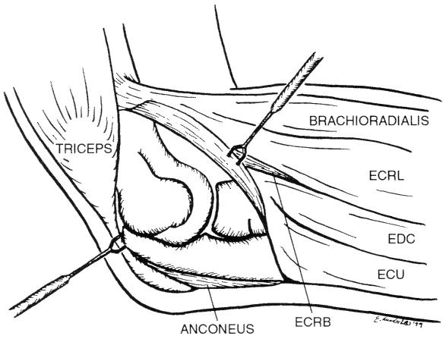
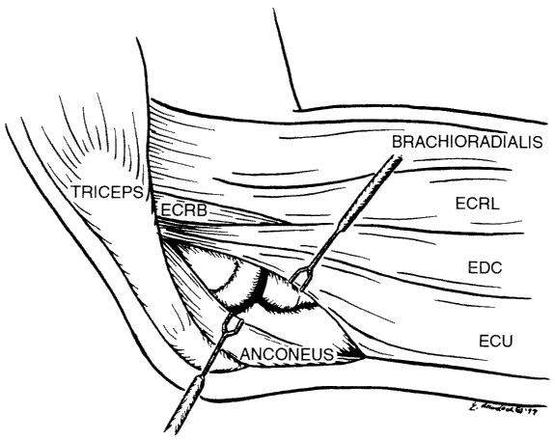
lateral approaches

Slide 44
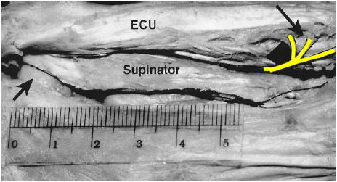
PIN protection
Mekhail et al
    Safe to expose about 6 cm of the proximal radius
Witt et al
    Safe to expose to distal extent of bicipital tuberosity
Safer if:
    Fully pronate forearm
    Use posterior interval between ECU and anconeus
    Release supinator muscle close to the ulna

Slide 45
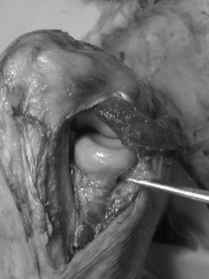
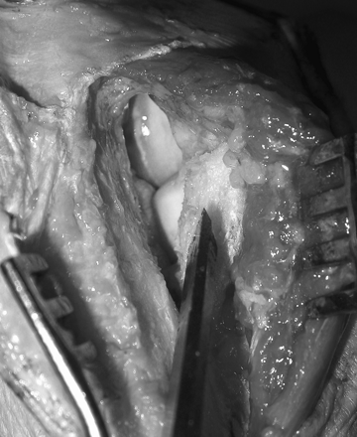
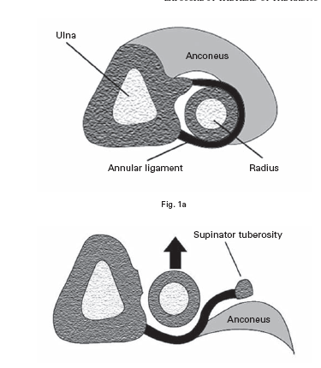
Wrightington Approach

Slide 46
Questions?
Acknowledgements:
Mr Lee Van Rensburg
(providing a shoulder to lean on and an elbow in the ribs!)

Slide 47
