Slide 1
The Elbow: Approaches
Mr Zacharia Silk – Percivall Pott Rotation
BSc MBBS MRCS

Slide 2
General Comments
Know a variety of approaches
Obtain adequate exposure
Preserve normal anatomy
Prevent disability
Two conceptual incision types:
  Extensile posterior / posterolateral approach = universal approach
  Limited, specific for-purpose exposures

Slide 3
The Approaches
Specific approaches to be discusses…
  Lateral Approach to the Distal Humerus
  Posterolateral Approach to the Radial Head (*Kocher)
  Anterolateral Approach to the Elbow
Posterior Approach
  Olecranon Osteotomy
  Triceps Split
  Triceps Turndown
  Triceps Preserving

Slide 4
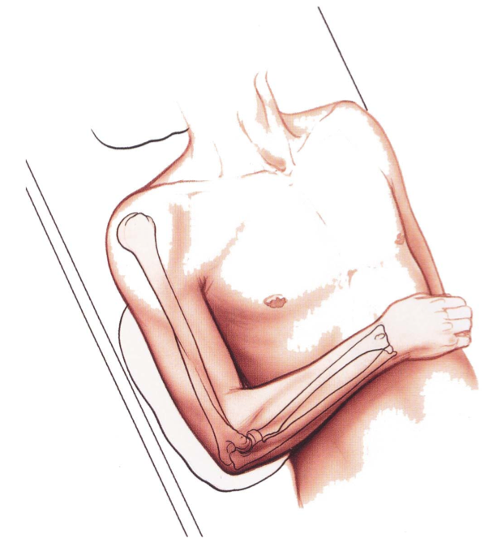
1) Lateral Approach to Distal Humerus
Exposes lateral epicondyl and common extensor origin
Indications:
  ORIF lateral condyl
  Surgical treatment of tennis elbow
Position:
  Supine / arm across chest
  Tourniquet / Exanguinate
Landmarks:
  Lateral epicondyle
  Lateral supracondylar ridge – can be followed up as far as deltoid tuberosity

Slide 5
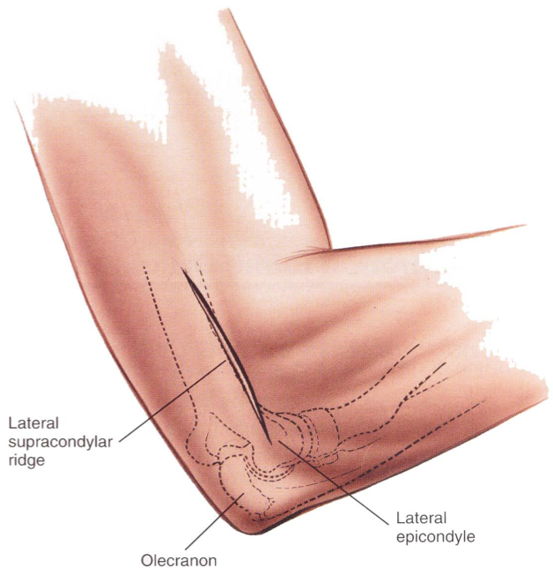
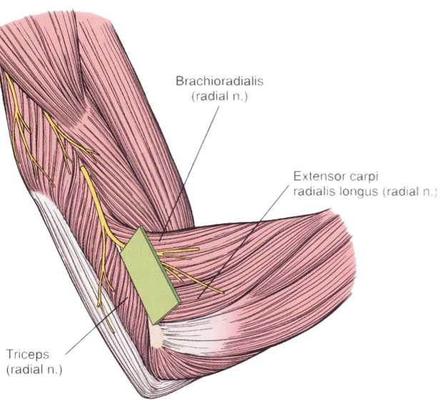
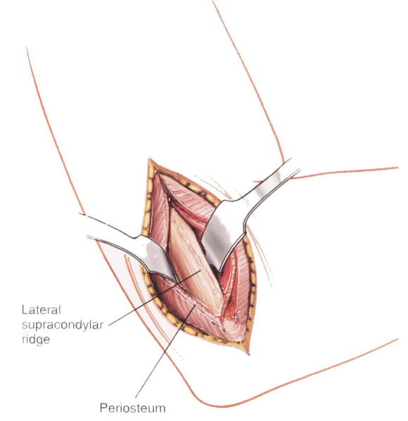
Incision:
  4-6cm curved / straight incision over lateral supracondylar ridge
Internervous Plane:
  No true internervous plane.
  Dissection between triceps / brachioradialis – supplied by radial nerve proximally
Superficial surgical dissection
  Incise deep fascia in line with skin
  Define plane between brachioradialis and triceps – cut down to bone

Slide 6
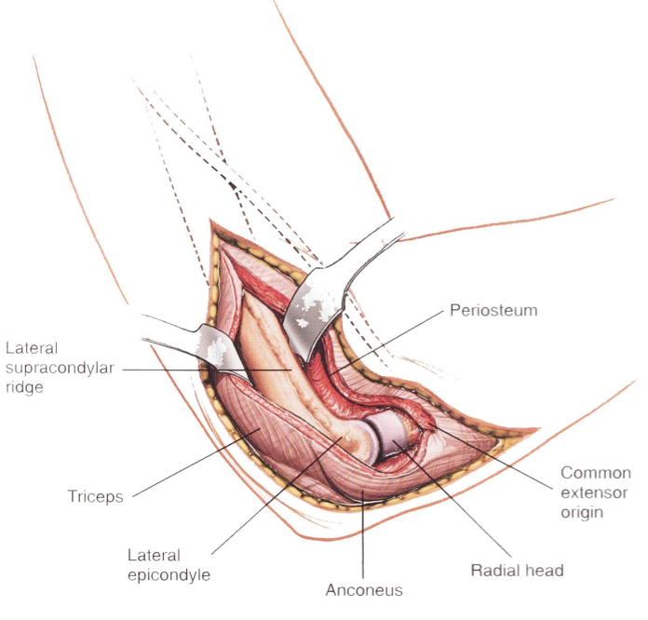
Deep surgical dissection:
  Identify the common extensor origin – this can be released if required
  If further exposure is required, reflect triceps off back of the humerus
Structures at risk:
  Nerves: Radial nerve pierces lateral intermuscular septum
Extensile measures:
  Proximally: not possible
  Distally: Can extend to radial head – internervous dissection between anconeus / ECU

Slide 7
2) Anterolateral Approach to the Elbow
Extension of the anterolateral approach to the humerus and proximal extension of the anterior approach to the radius
Indications:
  ORIF Capitelum
  Excision of tumours of proximal radius
  Treatment of aseptic necrosis
  Drainage of infection of the elbow
  Decompression of PIN (proximal) – access to arcade of Frohse
  Treatment of radial head fractures
  Treatment of biceps avulsion
  Total elbow arthroplasty

Slide 8
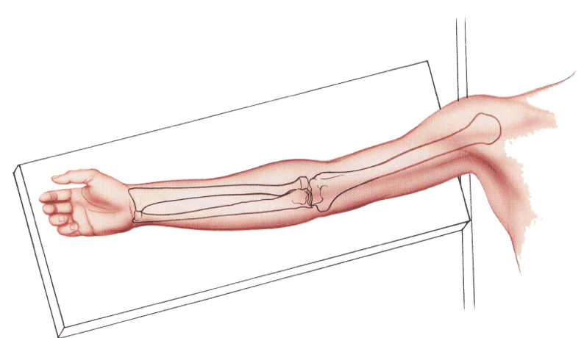
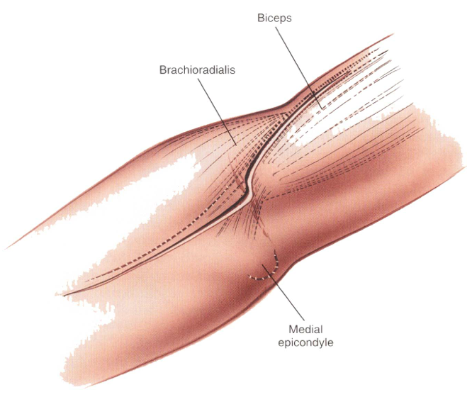
Patient Position:
  Supine on operating table / arm board / tourniquet
Landmarks:
  Lateral aspect of biceps tendon
  Brachioradialis as part of mobile wad
Incision:
  Curved incision along anterior aspect of elbow joint

Slide 9
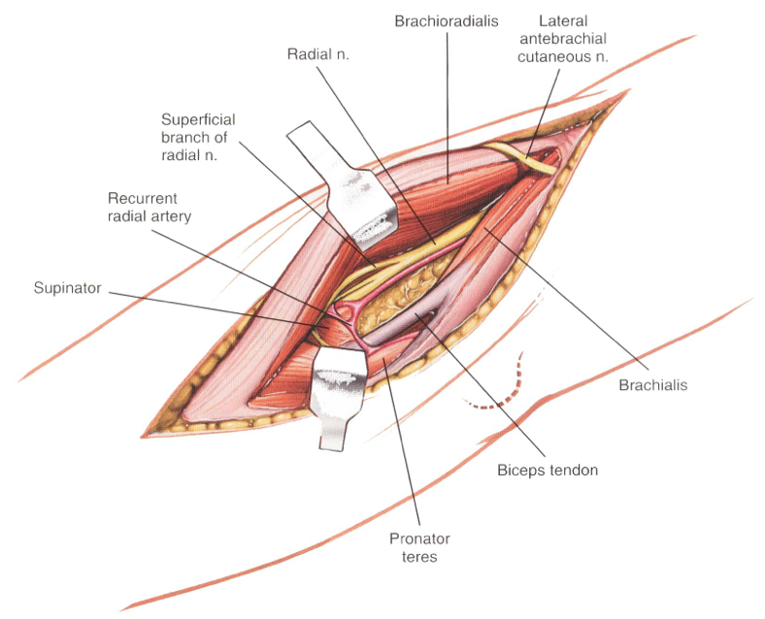
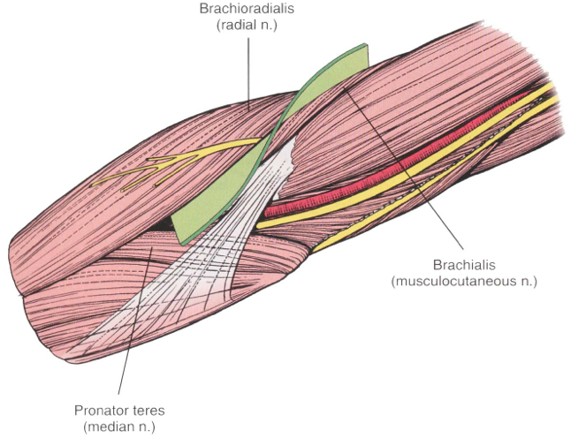
Internervous plane:
  Proximally between brachioradialis (RN) / Brachialis (MCN)
  Distally between brachioradialis (RN) / Pronator teres (MN)
Superficial surgical dissection:
  Isolate and protect the lateral cutaneous nerve of forearm lateral to biceps
Deep surgical dissection:
  Separate interval between brachioradialis and brachialis to identify the radial nerve proximally
  Separate interval between pronator teres and brachioradialis distally
  Fully supinate the forearm to expose the origin of supinator and protect the PIN

Slide 10
Structures at risk:
  The radial nerve: found in interval between Brachioradialis (within its fascial compartment) / Brachialis
  Posterior interosseous nerve: winds around neck of radius within supinator. Detach supinator from radius with forearm fully SUPINATED
  Lateral cutaneous nerve of forearm: between biceps / brachialis laterally
  Recurrent branches of the radial artery: must be ligated to mobilise brachialis
Extensile measures:
  Proximal: anterolateral approach to distal humerus
  Distal: anterior approach to radius

Slide 11
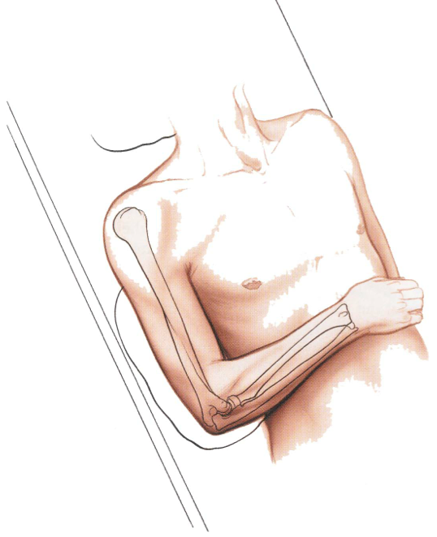
3) Posterolateral Approach to the Radial Head
Indications:
  ORIF / Excision / Replacement of radial head
  Cannot be extended beyond annular ligament due to risk to PIN – avoid in proximal radial fractures
Patient positioning:
  Supine / arm pronated across chest / Tourniquet
Landmarks:
  Lateral epicondyle
  Radial head – 2.5cm distal to lateral epicondyl
  (can be palpated with forearm rotation)

Slide 12
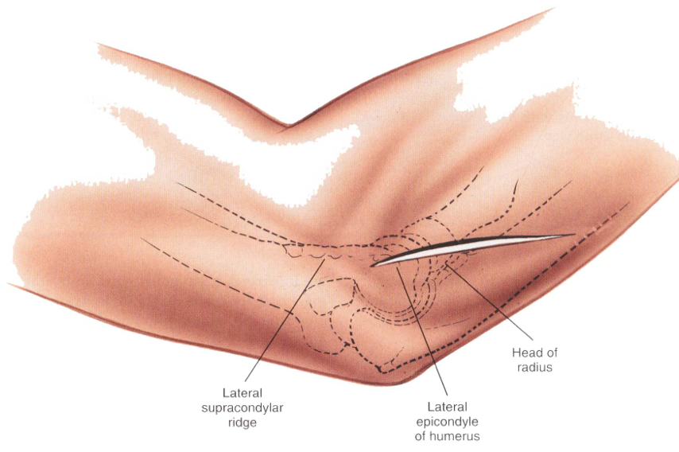
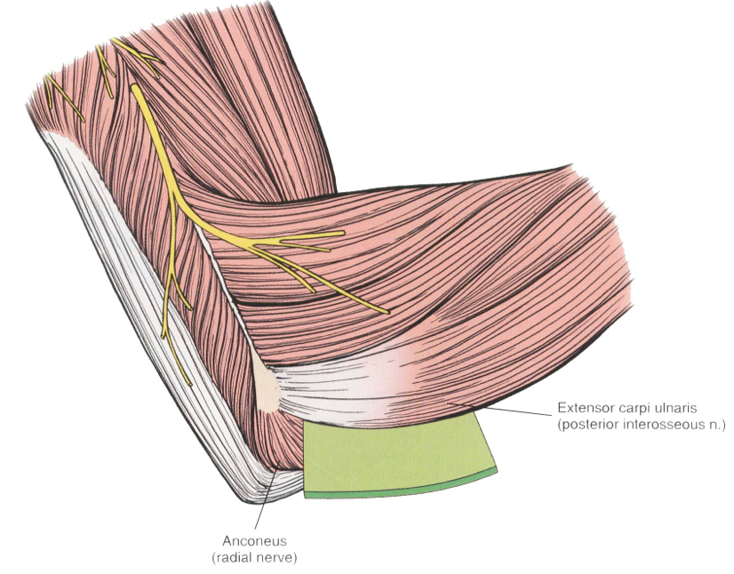
Incision:
  Longitudinal incision based proximally on lateral epicondyle
Internervous Plane:
  Between anconeus (radial) / Extensor carpi ulnaris (PIN)
Superficial surgical dissection:
  Incise deep fascia in line with skin
  Identify interval between ECU and anconeus – start distally as the two muscles share a common aponeurosis proximally
  Detach part of the superior origin of anconeus

Slide 13
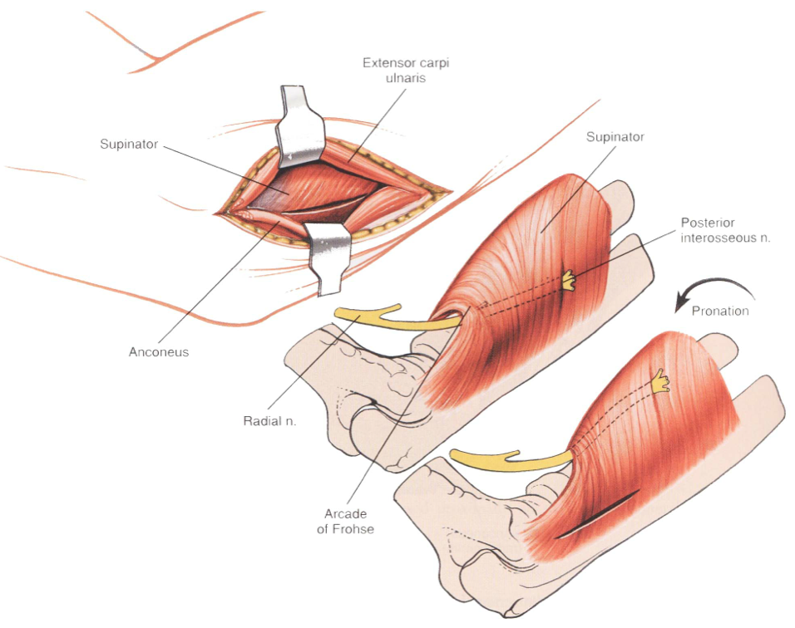
Deep Surgical Dissection:
  Fully pronate the forearm to displace the PIN medially and to expose the ulnar origin of the supinator
  Incise the capsule longitudinally to expose the capitellum / radial head / annular ligament
  DO NOT EXTEND INCISION BEYOND ANNULAR LIGAMENT
Structures at Risk:
  Posterior interosseous nerve - Keep proximal to annular ligament
  Radial Nerve – keep lateral
Extensile Measures:
  Proximally: Lateral approach to distal humerus
  Distally: Not possible

Slide 14
4) The Posterior Approach
Indications:
  ORIF distal humerus
  Removal of loose bodies within the elbow
  Triceps tendon lengthening
Key = know how to manage the triceps
  “Triceps-On” / Triceps splitting approaches
    Supracondylar / non-comminuted intra-articular fracture
  Olecranon Osteotomy / Triceps reflecting approaches
    If visualisation of articular surface required
  (note: extent of articular involvement dictates approach)

Slide 15
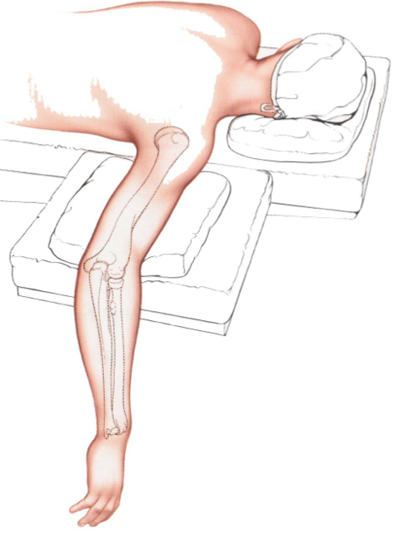
Initial Steps
  Posterior incision
  Medial / Lateral subcutaneous flaps
  Subcutaneous unlar nerve transposition
  Develop medial column
Patient Positioning:
  Prone: Arm abducted and elbow flexed over an arm table
  Lateral: Arm hanging over an L-bar / in a gutter support
  Supine: Arm across chest. Sand bag behind ipsilateral scapula

Slide 16
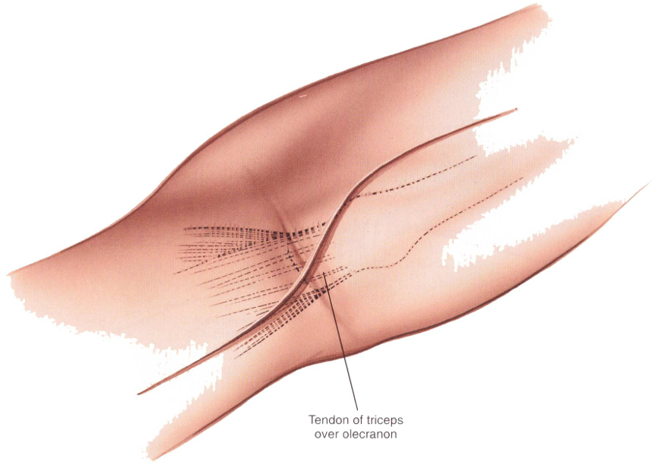
Landmarks:
  Olecranon process
  Shaft of humerus proximally
  Shaft of ulna distally
Incision:
  Longitudinal incision curved laterally across weight-bearing part of the olecranon
Internervous Plane:
  No true internervous plane
  Radial nerve supply to triceps is proximal

Slide 17
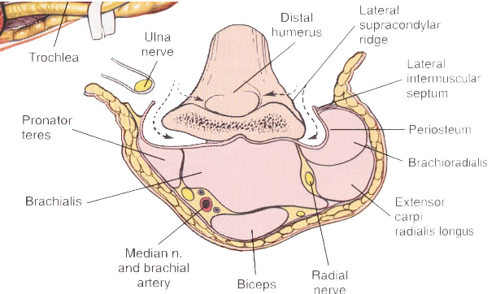
Structures at risk:
  Ulnar nerve – identify early and do not place excessive traction
  Median nerve – anterior to distal humerus. If exposing the anterior structures using this approach, ensure they are elevated off sub-periosteally
  Radial nerve – proximal dissection should be done with care making sure to identify the radial nerve as it exits the spiral groove and passes through the medial inter-muscular septum
  Brachial artery – lies with the median nerve anteriorly

Slide 18
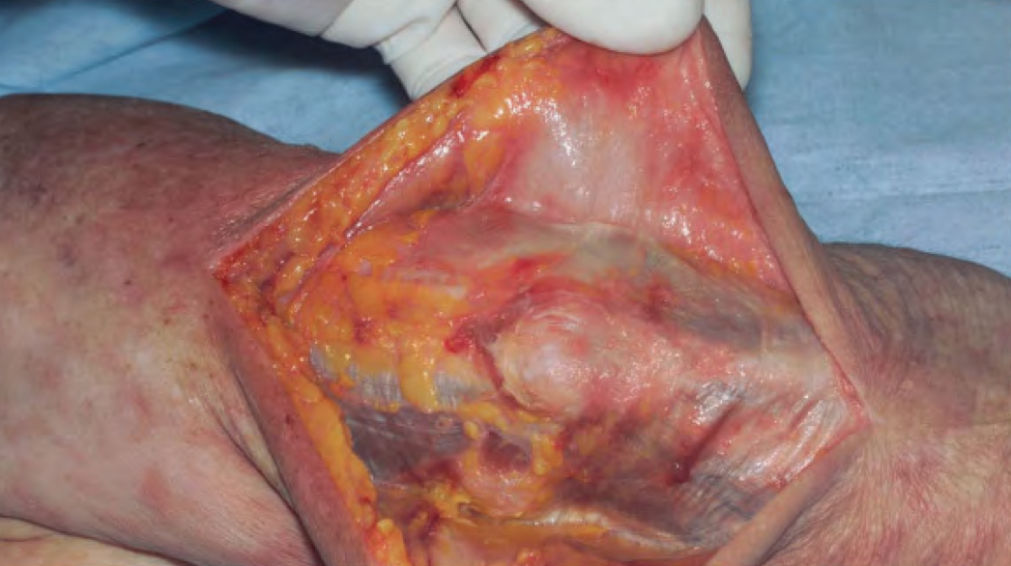
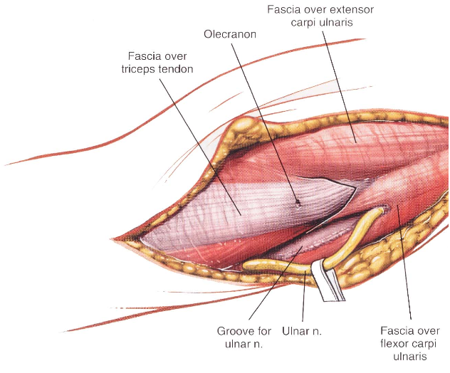
Superficial surgical dissection:
  Incise the deep fascia in the midline
  Sharp subfascial dissection to raise full thickness flaps medially, then laterally – suture skin edges away from surgical field to aid exposure
  Palpate and protect the ulnar nerve behind the medial epicondyle – incise the fascia overlying it and identify the nerve proximally / distally
  https://www.vumedi.com/video/surgical-exposures-for-distal-humerus-fractures
Notes:
53s

Slide 19
“Triceps On” Approach
Deep Surgical Dissection:
  Release the ulnar nerve at the level of the medial intermuscular septum
  Subperiosteally elevate the triceps from medial to lateral to expose the distal humerus
  Pass a blunt dissector beneath triceps from medial to lateral to identify the lateral intermuscular septum
  Release lateral triceps
  Careful dissection proximally to avoid injury to the radial nerve.

Slide 20
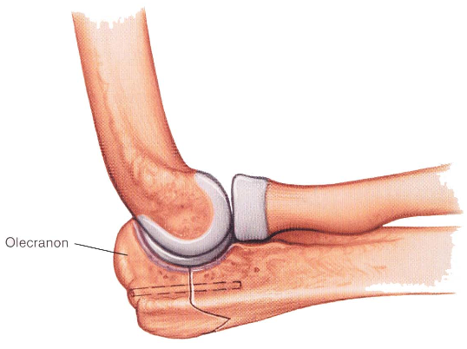
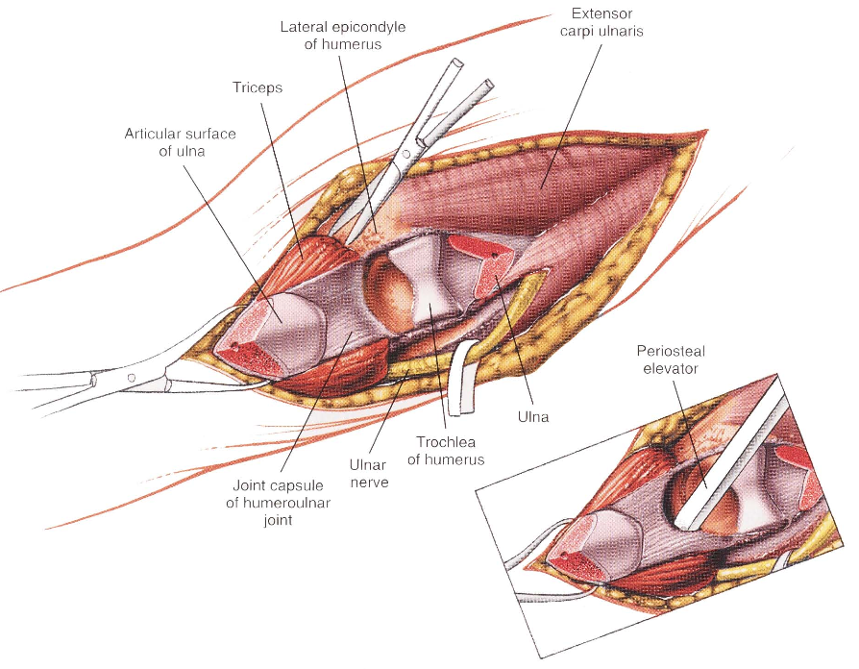
Extensile Measure = Olecranon osteotomy
  Pre-dill and tap the olecranon before the osteotomy is performed
  Score the bone longitudinally with an osteotome to allow for correct alignment when replacing
  A v-shaped osteotomy is more stable than a transverse one

Slide 21
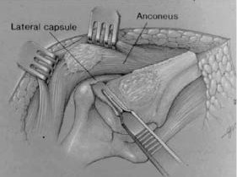
Triceps Reflecting Approach
Bryan-Morrey Approach
  Medial to Lateral triceps subperiosteal reflection off olecranon
  Continuous flap with anconeus and ECU
  Disadvantage
    Residual weakness
    Exposure to lateral column is an issue in 180 degree plating
Triceps-Reflecting Anconeus Pedicle (TRAP) - Shaun O’Driscoll
  Kocher’s interval developed (between anconeus and ECU)
  Extend proximally to develop lateral triceps
  Olecranon tip is left attached
  Anconeus pedical maintained

Slide 22
Decision making tool…

Slide 23
Summary
Common approaches to elbow discussed
  Anterolateral to elbow
  Posterolateral to radial head
  Lateral approach to distal humerus
Focus on posterior (universal) approach
  Start by exposing medial column
  Then decide on next step…
    Triceps on +/- olecranon osteotom
    Triceps reflection
We’ve not discussed…
  Anterior approach to the elbow
    Neurovascular exposure of the antecubital fossa
  Medial approach to the elbow
    Access medial epicondyle / Coronoid. Osteotomy may be required

Slide 24
References
www.vumedi.com (Matthew Ramsey – Surgical Exposures for Distal Humerus Fractures)
Basic Orthopaedic Sciences: The Stanmore Guide (Manoj Ramachandran)

