Slide 1
The Elbow: Anatomy
Mr Zacharia Silk – Percivall Pott Rotation
BSc MBBS MRCS

Slide 2
Outline
Basic Kinematics
Anatomy of the elbow joint:
  Ulno-Humeral Articulation
  Radio-Humeral Articulation
  Proximal Radio-Ulnar Joint
  Neurovascular anatomy
Elbow stabilisers
  Static – Osseous / Capsuloligamentous
  Dynamic - Muscular

Slide 3
Importance of The Elbow

Slide 4
Basic Kinematics
Together with the shoulder, acts to position the hand in space
Motion is relatively constrained
Flexion / Extension:
  Normal ROM = 0⁰ – 140⁰
  Functional ROM = 30⁰ – 130⁰
Pro / Supination:
  Normal ROM = 180⁰ (Pronation 80⁰ – 90⁰ / Supination 90⁰)
  Functional ROM = 100⁰ (Pronation 50⁰ / Supination 50⁰)
  Loss of pronation can be compensated for by shoulder abduction
  No effective mechanisms to compensate for loss of supination
Notes:
was shown that the axis of rotation shifts slightly ulnar and volar during supination and shifts radial and dorsal during pronation [26]. The radius also moves proximally with pronation of the forearm and distally with supination [27].

Slide 5
*Elbow is described as a Trochoginglymoid Joint
Notes:
The elbow has been called the trochleogingylomoid joint for the hinged (ginglymoid) motion in flexion and extension at the ulnohumeral and radiocapitellar articulations and radial (trochoid) motion in pronation and supination at the proxi- mal radioulnar joint

Slide 6
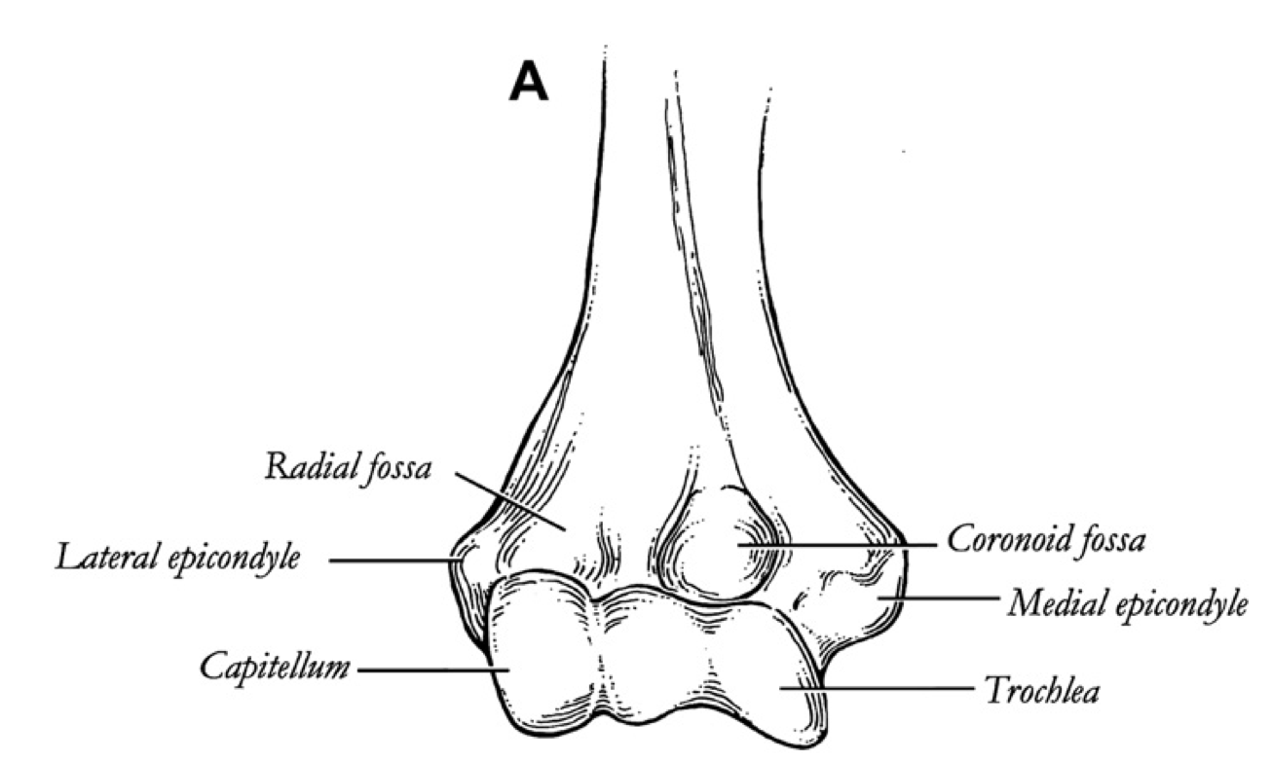
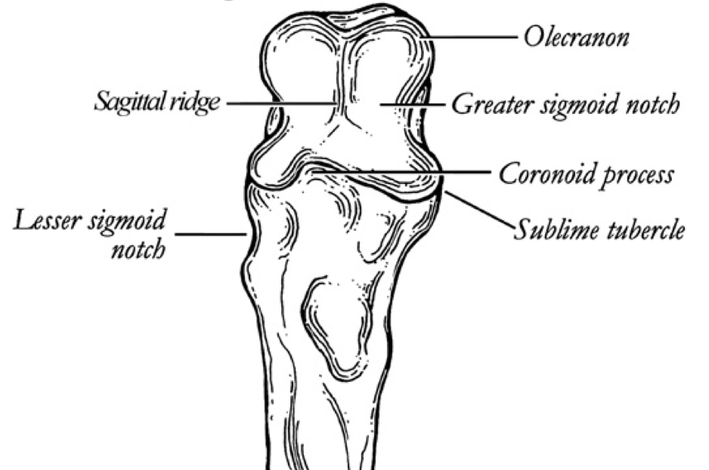
Ulno-Humeral Articulation
Highly congruent – *primary constraint of the elbow
The Trochlea
  In line with long axis of humeral shaft
  Prominence of the medial ridge contributes to the Trochlear axis
  (i.e. this creates 6–8º of valgus tilt)
The Olecranon
  Greater sigmoid notch provides articulation with trochlea
  Medial / lateral facets separated by sagital ridge
  Sublime tubercle receives attachment of AOL (MCL)
Range of movement maximised by…
  Anterior angulation of distal humerus by 40⁰
  Hollowed out olecranon / coranoid / radial fossae
  (provides greater osseous stability in flexion and extension)
Notes:
Highly stable / congruent joint
ROM 140 degrees of flexion / extension
Trochlear axis involved in carrying angle of arm in extension.

Slide 7
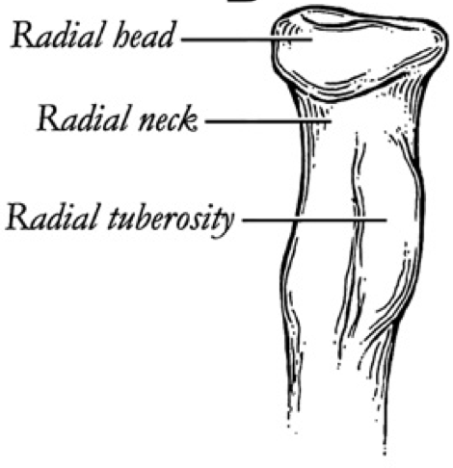
Radio-Humeral Articulation
Radial Head
  Concave articular surface
  Important secondary stabiliser of the elbow
Capitellum
  Hemispherical in shape
  Smaller radius than the radial head
Less congruent articulation. Rotational movement permitted at any degree of elbow flexion

Slide 8
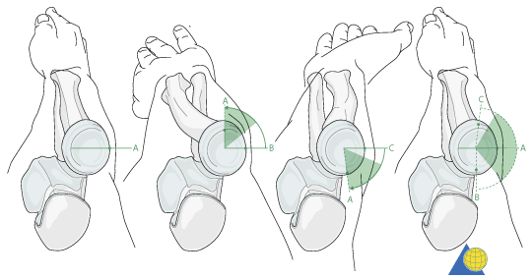
Proximal Radio-Ulnar Joint
Rim articulation of radial head with lesser sigmoid notch on ulna
  Articular cartilage covers an arc of 280⁰ of the rim
  Screw fixation of the radial head permitted within the non-articular 80⁰
Relatively constant axis of rotation - runs through centre of radial head to centre of distal ulna
  Axis shifts volar / ulnar in supination. Radius migrates proximally.
  Axis shifts dorsal / radial in pronation. Radius migrates distally.
  Note: the radial head is not perfectly circular – variable offset from anatomical neck
Stabilised by the annular ligament

Slide 9
Neurovascular Structures
Nerves:
  Superficial:
    Lateral Cutaneous Nerve of Forearm
    Medial Cutaneous Nerve of Forearm
  Deep:
    Ulnar Nerve
    Radial Nerve
    Median Nerve
Vessels:
  Veins: Cephalic / Basilic / Median Cubital
  Arteries: Brachial artery / Recurrent branches of radial artery

Slide 10
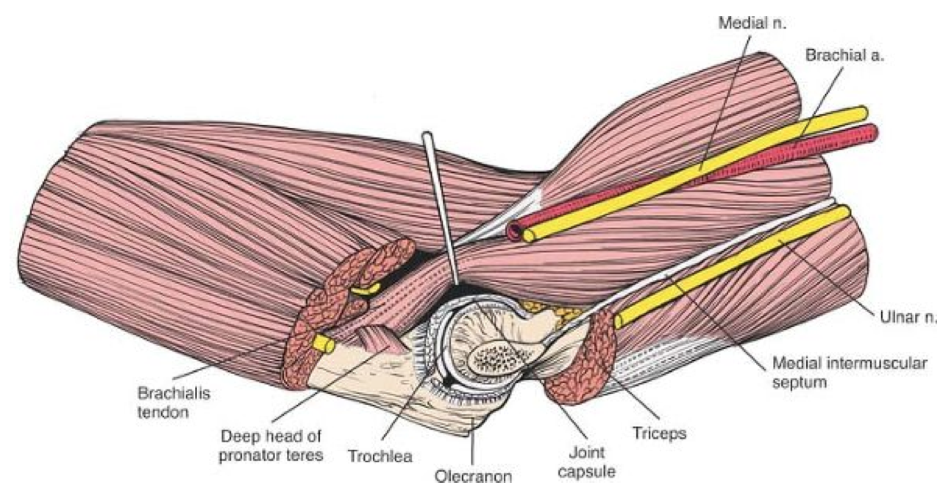
Medial side…
Median Nerve – passes between two heads of pronator teres
Ulnar Nerve - passes between two heads of FCU

Slide 11
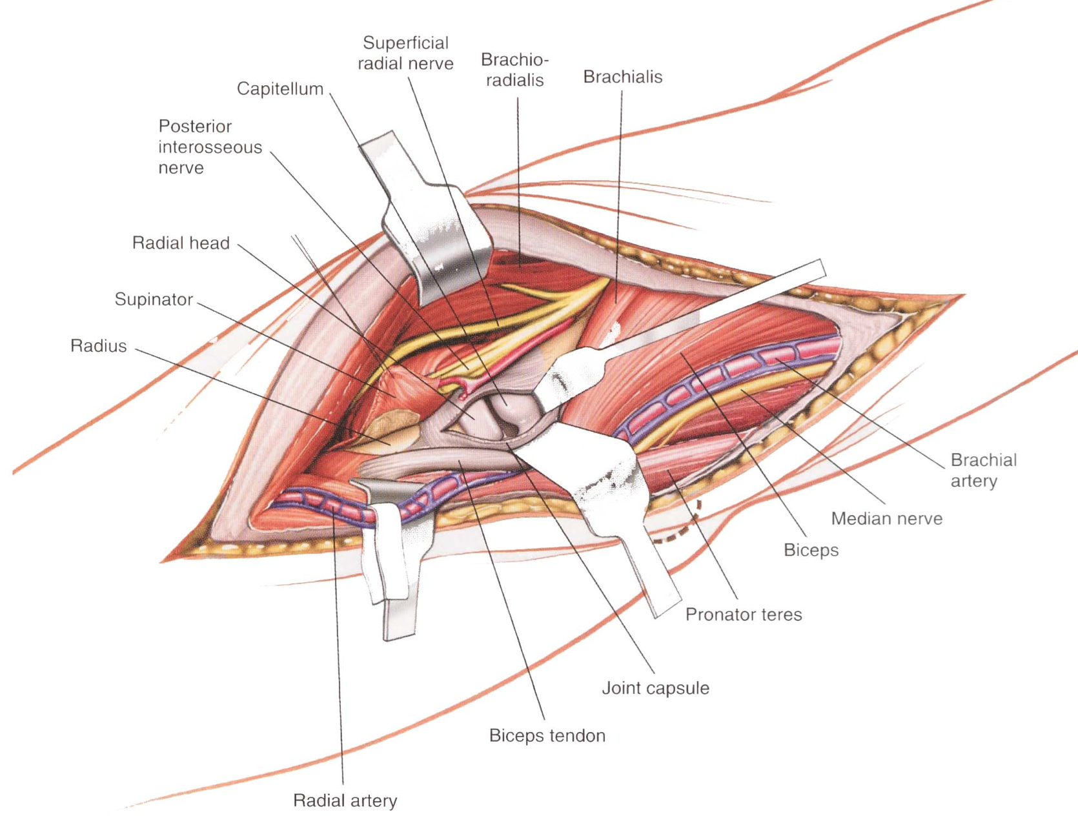
From the front…
Radial Nerve
  PIN – between two heads of supinator
  Superficial radial nerve
Note vascular structures
  Brachial artery medial to biceps tendon
  Radial artery passes from medial
  to lateral under cover of BR
  giving branches to it

Slide 14
Ulno-Humeral Articulation
The largest joint reaction forces are directly posteriorly
Therefore, the coranoid is essential to resist posterior displacement.
  At least 50% is required to maintain stability in flexion.
  This is less in extension
Overall, however, the ulno-humeral articulation has limited role in joint stability
  (i.e. significant bone loss can occur before stability is affected)

Slide 15
Radio-Humeral Articulation
Injuries to the MCL / LCL or DRUJ depend on an intact radial head to maintain stability
  Radial head is a secondary restraint to valgus stress in the presence of an intact MCL
  An intact radial head resists posterior displacement with a deficient coranoid
Radial head excision should be done with careful thought!
  Even with an intact MCL, proximal migration of the radius may occur leading to DRUJ pain / instability
Forearm rotation helps to stabilise the elbow when moved passively:
  Supination stabilises the MCL-deficient elbow / Coronoid fractures > 50%
    Passive tension of forearm pronators
  LCL-deficient elbow more stable in pronation
    Proximal radial head migration increases the JRF at the radio-capetellar articulartion

Slide 17
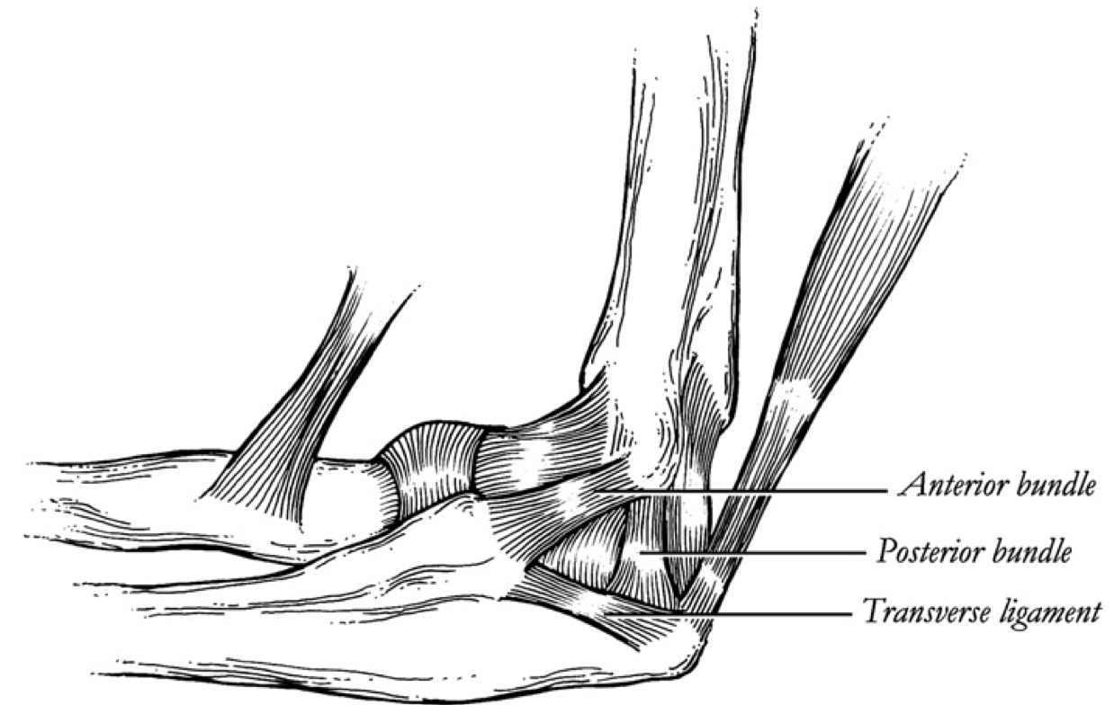
Medial Collateral Ligament
Origin = anteroinferior surface of the medial epicondyle
3 components
  Anterior Oblique Ligament
    *Primary restraint to valgus strain
    Tight in extension / Lax in flexion
    Inserts into the sublime tubercle
  Posterior Oblique Ligament
    Tight in flexion / Lax in extension
  Transverse (Cooper’s) Ligament
    Connects coronoid to tip of olecranon
    Insignificant contribution to joint stability
If MCL is ruptured, do not excise a fractured radial head!

Slide 18
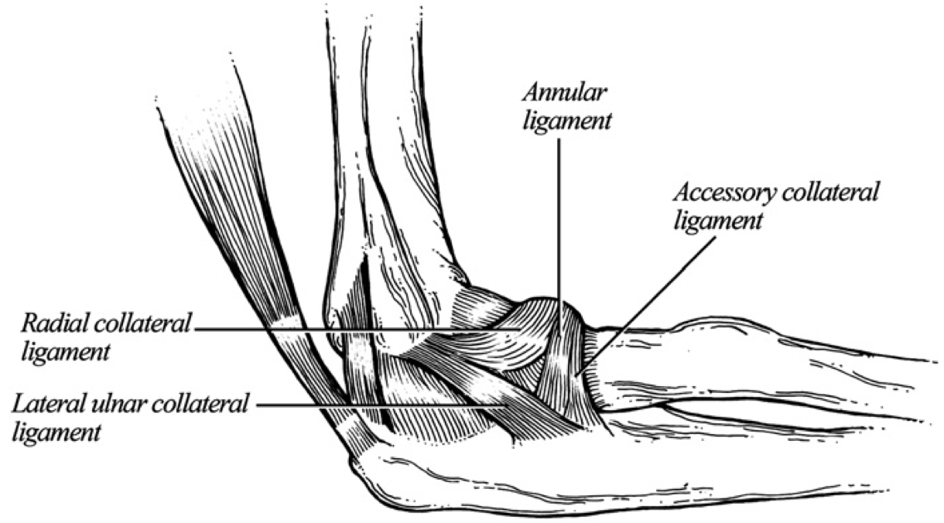
Lateral Collateral Ligament
Origin = inferior surface of the lateral epicondyle
4 components
  Radial Collateral Ligament
    Inserts into the annular ligament
    Stabilises the radial head
  Annular Ligament
    Attached to the anterior & posterior margins of the lesser sigmoid notch
  Lateral Unlar Collateral Ligament
    *Primary elbow restraint to varus and posterolateral strain
    Insertion is distal to the posterior attachment of the annular ligament into the crista supinatoris
    MORE IMPORTANT THAN MCL FOR STABILITY
  Accessory Lateral Collateral Ligament
    Attached between the annular ligament and crista supinatoris

Slide 19
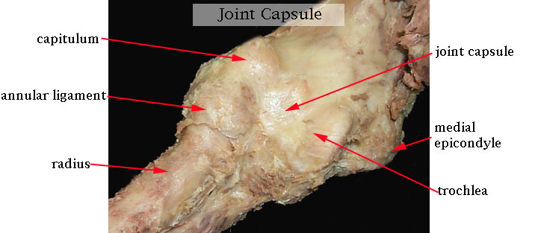
Joint Capsule
Attachment along articular margin
  Anterior capsule – taut in extension
    Proximal extension above coronoid and radial fossae
    Distal extension to edge of coronoid process
    Lateral extension to cover the annular ligament
    Provides stability against valgus stress, during distraction and in hyperextension
  Posterior capsule – taut in flexion
    Proximal extension above olecranon fossa
    Distal extension along medial and lateral articular margins of the greater sigmoid notch
    Laterally, it becomes continuous with the annular ligament
Intra-articular pressure is lowest between 70 – 80 degrees of flexion – capacity is 25 – 30mls

Slide 21
Muscular Stabilisers
Provide dynamic stability and protect the static stabilisers
  Compressive load applied to the joint when muscle contracts
Actual effect dependent on joint position
4 distinct groups
  Flexors = Biceps / Brachialis / Brachioradialis
  Extensors = Triceps / Anconeus (dynamic constraint to PLRI / varus)
  Pronation = Pronator teres & quadratus
  Supination = Biceps / Supinator
  Note: Musculature have an antagonistic stabilisation action

Slide 22
Elbow Stabilisers
Instability | Primary Stabiliser | Secondary Stabiliser
Valgus stress | Anterior oblique ligament (MCL) | Radiocapitellar joint Ulno-humeral joint
Varus stress | Ulno-humeral joint | Extension: Anterior capsule Flexion: Lateral collateral ligament
Posterolateral rotatory instability | Lateral ulnar collateral ligament
Notes:
3 primary static constraints – if all three are intact, the joint is stable

Slide 23
Clinical Application
Elbow Dislocation:
  Simple Vs Complex
  Stable Vs Unstable
Simple elbow dislocation (no fractures)
    MCL / LCL ruptured in nearly all cases
    Most are stable when reduced
    Ulnohumeral joint is responsible for > 50% of elbow joint stability
    On going instability uncommon
    Early active mobilisation encouraged
Notes:
Brachialis inserts into a roghened area of the antero-inferior part of coronoid process and the ulnar tuberosity at junction of antero-inferior part of coronoid process and the body

Slide 24
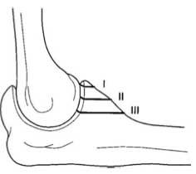
Coronoid Fractures
Rarely occur in isolation
  Pathognomonic for an episode of elbow instability and associated with collateral ligament injuries
Associated conditions
  Posteromedial rotatory instability: coronoid anteromedial facet fracture with LCL disruption (varus injury)
  Posterolateral rotatory instability: coronoid tip fracture, radial head fracture, and LCL injury
  Olecranon fracture-dislocation usually associated with a large coronoid fracture
  Terrible triad of elbow: coronoid fracture , radial head fracture, and elbow dislocation
Regan & Morrey Classification (O’Driscol Modification)
  Type 1 = tip. A = < 2mm, B = > 2mm (a/w terrible triad)
  Type 2 < 50%. A = Anteromedial facet, B = plus anterior tip, C = plus sublime tubercle
  Type 3 > 50%. A = Coronoid only, B = Associated olecranon fracture
Isolated coronoid tip fractures do not require ORIF if stable…
  …remember, these aren’t simple avulsion fractures! The tip has no soft tissue attachment

Slide 25
Summary
Effect of joint stabilisers dependent on source of instability
Three primary stabilisers – LCL more important than MCL
Active motion provides inherent stability to the joint due to antagonistic muscle function
Even small coronoid fractures can lead to instability – sign of a significant injury

Slide 28
Exam Questions
Discuss the management of a comminuted fracture of the radial head with respect to maintaining elbow stability.
Draw a free-body diagram of an arm held in 90 degrees of flexion and carrying a mass in the hand. Resolve the forces through the elbow and calculate the joint reaction force.

Slide 29
Free-Body Diagram
Forces across the elbow are variable.
At 90 degrees, the elbow must maintain an equilibrium
  Clockwise (extension) moment = anticlockwise (flexion) moment

Slide 30
Free Body Diagram
  (25 N x 0.3) + 10 N x 0.15) = B x 0.5
  7.5 N + 1.5 N= 0.05B
  9 N / 0.05 = B
  180 N = B
  JRF + 25 + 10 = 180
  JRF = 180 – 35
  JRF = 145 N

