Slide 1
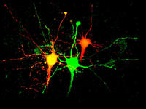

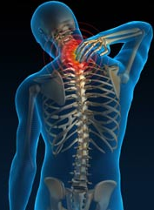
Deep tissue sensory processing
Shafaq Sikandar
University College London
7 May 2013
Notes:
Muscle pains and reduced muscle strength are frequently observed in patients with OA in the knee and hips
Muscles can be overexerted to support the affected joints, so as the patient experiences more pain they minimize use of the supporting deep tissue structures resulting in loss of muscle strength.
This cycle can become exacerbated so pain is amplified and persistent
But understanding the sensory processing of deep tissue inputs is not only important for OA, there are a number of pain syndromes that are characterised by deep pains like fibromyalgia, myofascial pain and other widespread musculoskeletal pain states.s

Slide 2
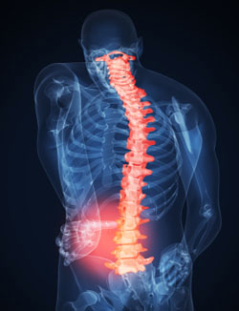
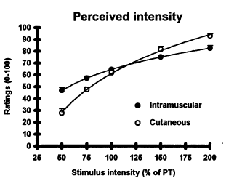
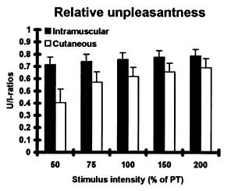
Muscle nociception
Poorly understood compared to sensory processing of cutaneous input
An adequate stimulus for deep somatic tissue
May involve sensitisation of other somatic structures
Quality of sensation – implications for sensory processing pathways?
Svensson et al. Exp Brain Res 1997
Notes:
Studies of deep tissue nociception has been largely ignored compared to cutaneous sensory processing, Both preclinical and clinical studies have been largely focussed on cutaneous measures of pain. There are few outcome measures in most pain studies that relate to changes in muscle sensitivity.
So the basic sensory mechanisms of muscle pain are poorly understood, as well the factors underlying chronicity of muscle pain states, like plasticity of spinal cord and higher centres.
One of the most likely reasons that people have shied away form study muscle pain is probably the easier access to test cutaneous structures and the lack of an adequate muscle stimulus – in practical terms it’s difficult to stimulate deep somatic tissue selectively without also stimulating part of the overlying skin.
What we do know about muscle pain is that it can be accompanied by a heightened senstivity of cutaneous tissue overlying the pain of origin, but pains from deep origin can evoke different types of sensations compared to pain arising in cutenaous structures.
For example:
Electrical stimulation of mechanosensitive afferents in muscle can evoke a diffuse cramping pain
But electrical stimulation of the same afferent types in cutaneous apparatus evoked sharp, pricking or burning pain
Pain originating in tendons and fascia have been shown to be more well localised, whereas muscle is diffuse and referred
A fairly old study, but quite nicely shows that intensity discrimination of cutaneous stimuli is better than muscle stimuli and that noxious muscle stimulation ay a range of intensities is always perceived as more unpleasant
So if the final peception of cutaneous and muscle pain is different, it’s possible there are important differences in the transmission and integration of deep and cutaneous inputs, as well as their central processing descending modulation

Slide 3
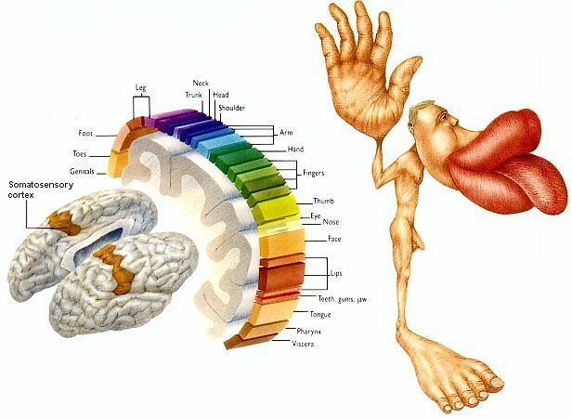
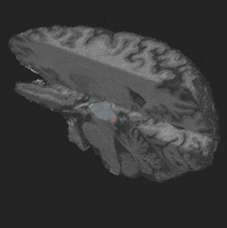
Limbic brain
Affective aspects
of pain
Fear, anxiety, sleep
Cortex
Location and
intensity
Descending controls
Allow top-down processes to enhance or inhibit pain - link mood, sleep and pain
Spinal cord
Integrates, amplifies and modifies incoming messages
Output to brain
Incoming peripheral nerves
Convey touch, temperature
Convey painful messages - heat, mechanical, chemical
Are altered by tissue and nerve damage
Notes:
In terms of sensory processing of deep somatic inputs, there are gaps in our knowledge at all these levels of pain processing in the peripheral and central nervous systems
…………………
Here we can see these events in a bit more detail
Sensory input is transmitted along peripheral nerves, so these convey information about touch, temperature, pressure, pain and normal daily events that your nerve endings are exposed to. These primary afferent fibres terminate in the dorsla horn of the spinal cord, which itself is is important for integrating the incoming peripheral input
Sensory signals processed in the spinal cord projects to the brain to limbic areas that process the affective components of pain – including the processing of fear, anxiety and sleep that are associated with pain. And spinal neurones also project along spinothalamic routes for sensory discrimination in thalamocortical areas. Here the quality, location timing and intensity of the stimulus is discerned.
Importantly, the brain can also feedback to the spinal cord through descending controls, allowing for modulation of spinal activity, and through loops between brain and spinal cord, the central processing of pain and central excitability can be modulated.

Slide 4
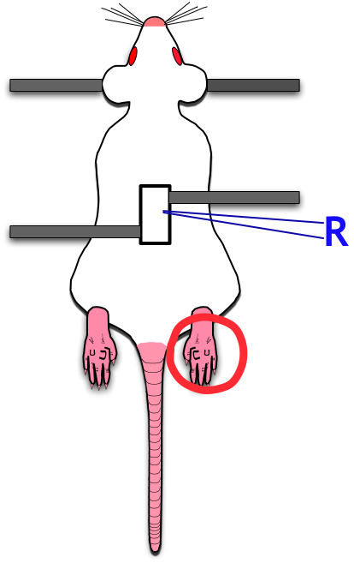
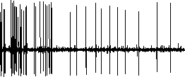
In vivo electrophysiology
In vivo electrophysiology
Isoflourane N₂0 & O₂
Stimuli applied to receptive fields of spinal neurones
Evoked neuronal firing

Slide 5
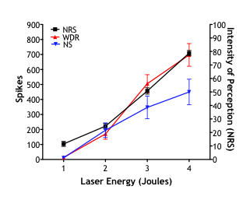
Neurones to perception
Cortical activity
(EEG)
Painful
Spinal neurones
Sikandar et al. Pain 2013
Notes:
So you might be thinking, why bother modelling pain in rodents? Of course, our ultimate aim is to improve our understanding of pain processing in humans. And we have recorded neuronal activity in human subjects using cortical recordings and psyhophysical measures. What we’ve found is that we can nicely correlate the activity of spinal neurones in our rats and the perceptual outcomes in humans.
The activity of spinal neurones in rats can predict perceptual outcomes in humans

Slide 6
Lateral spinal nucleus
Electrophysiological characterisation
Sensitisation to noxious deep tissue stimulation
Notes:
Receives convergent deep afferent input
In contrast to the rich knowledge available on physiology of cutaneous pain at the primary afferent level, little is known about the neural mechanisms encoding and transmitting muscle pain under normal conditions. The pathophysiological mechanisms underlying clinical pains also remain to be documented.

Slide 7
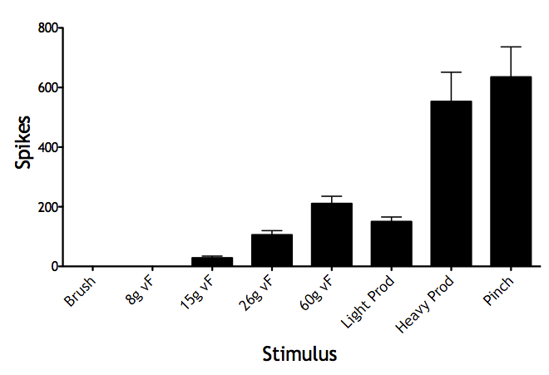
Electrophysiological characterisation
Threshold
dynamic
punctate
N=45
- Graded evoked activity to high threshold mechanical stimulation
- No response to low threshold stimuliç

Slide 8
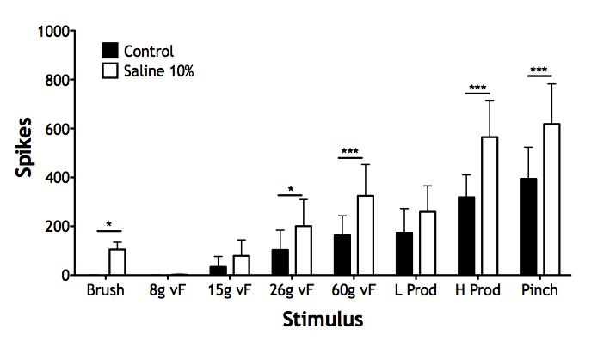
Hypertonic saline
N=10
- HS sensitises LSN neurones and potentiates evoked responses
LSN neurones develop a brush response (referred cutaneous
hypersensitivity)
This HS-induced sensitisation can be prevented with systemic
opioids

Slide 9
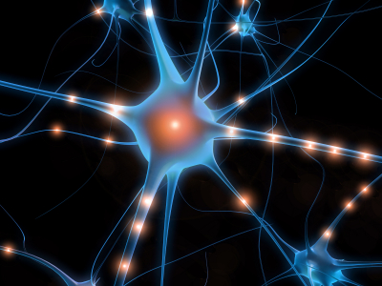
Next steps
Explore role of fascia in muscle pain
Develop chronic model of muscle pain
Supraspinal processing of deep tissue inputs
Collaborations!

