Slide 1
Congenital Talipes EquinoVarus
CTEV

Slide 2
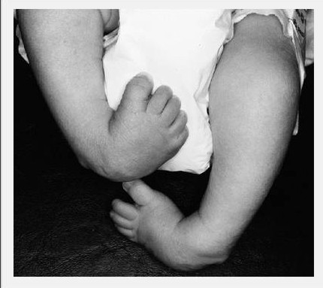
CTEV
Idiopathic deformity
Hindfoot Equinus - Varus
Midfoot Varus - Supination
Midfoot - Forefoot Cavus
Forefoot Adduction – Pronation
CAVE mnemonic
Notes:
Forefoot pronation commonly misunderstood

Slide 3
Epidemiology
most common birth defect
1/1000 in general population
highest prevalence in Hawaiians and Maoris 7:1000), lowest in Chinese (0.4/1000)
more common in males (2.5/1)
Up to 50% bilateral

Slide 4
Genetic predisposition – no proven pathways
Etiology : theories
Histological findings in soft tissues
Notes:
No actual proven pathway
normal parents + affected child, risk of next child w/ clubfoot is 2-5% etc
Infection, intrauterine positiion, mechanical factors, bone developement

Slide 5
Secondary clubfoot (DDx)
Myotonic muscular dystrophy
Myelomeningocele
Poliomyelitis
Infantile CP
Peroneal type of progressive muscle atrophy
Charcot-Marie-Tooth
CPN injury
Notes:
neuro

Slide 6
Associated anomaly in systemic disorders (DDx)
Arthrogryposis (generalized mobility restriction)
Larsen syndrome (generalized laxity - dislocations)
Diastrophic dwarphism
Freeman-Sheldon syndrome
Möbius syndrome
Prune belly syndrome

Slide 7
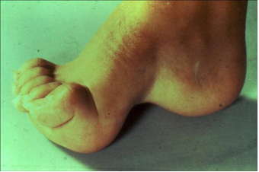
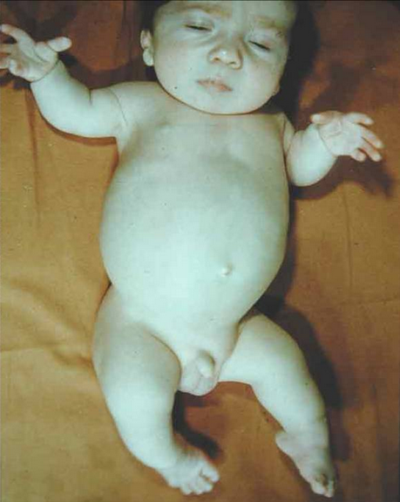
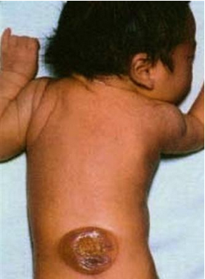
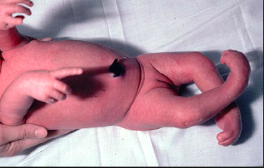
Associated anomaly in systemic disorders

Slide 8
Classification (etiology)
Congenital clubfoot
Clubfoot posture
Congenital pes adductus
Neuromuscular clubfoot (myelomeningocele, polio, CP palsy)
Clubfoot in systemic disorders (e.g. arthrogryposis).
Notes:
theoretical

Slide 9
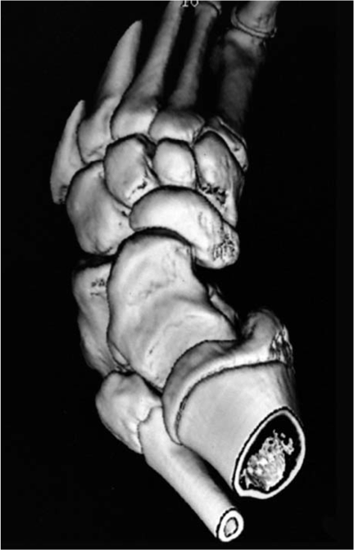
Anatomy - talus
Talus shortened / medial-plantar neck and ant. art. surface rotation
Smaller size, delayed ossification
Hypoplastic calcaneus/sust. Tali/midfoot/forefoot bones
Notes:
9 year old

Slide 10
Anatomy
Fibula: displaced posteriorly
Ankle joint: talus pushed forward
Subtalar joint: calcaneus rotated medially and tilted caudally
Talonavicular joint: navicular displaced in medial and plantar direction
Calcaneocuboid joint: medial subluxation
Forefoot: adduction/cavus
Notes:
Tibia: same torsion in healthy limb. False impression of external rotation
Ankle: 1/3 of talar joint surface does not articulate in a case of clubfoot
Talonavicular: . In severe cases, lateral section of the anterior talar surface does not articulate with the navicular

Slide 11
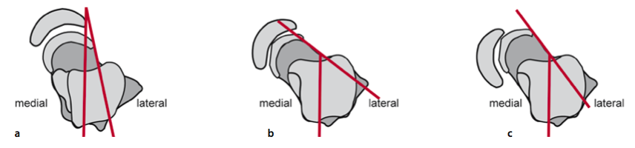
Anatomy - talus
Notes:
Normal foot
Medial deviation of talus
b+subluxation of navicular

Slide 12
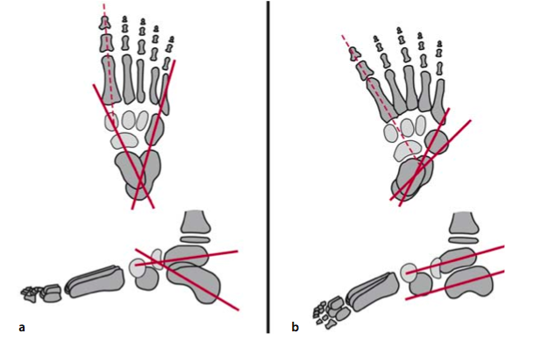
Foot configuration
Notes:
Normal foot. 30-50
CC. bones tend to be parallel in both planes. Calcaneus loses upward slope, anterior portion of the calcaneus lies beneath the head of the talus

Slide 13
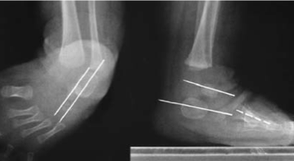
Foot configuration – x rays
Notes:
Talocalcaneal angles normal 30-50
Navicular oss nucleus appears at 4th month. Talus line lateral to 1st MTT (and navicular).

Slide 14
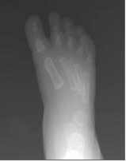
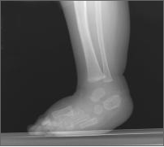
Foot configuration – x rays
Convergence of MTT bases
Ladderlike configuration of MTT

Slide 15
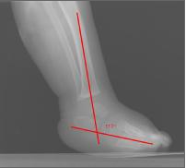
Tibia - foot configuration – x rays
Notes:
Normal 60-90s

Slide 16
Soft tissues
All tissue types (skin, ligaments, tendons, muscles, blood vessels, nerves) are contracted to the same extent
Atrophy of calf muscles!
Notes:
Clubfeet: rigid soft tissues – soft bones!!

Slide 17
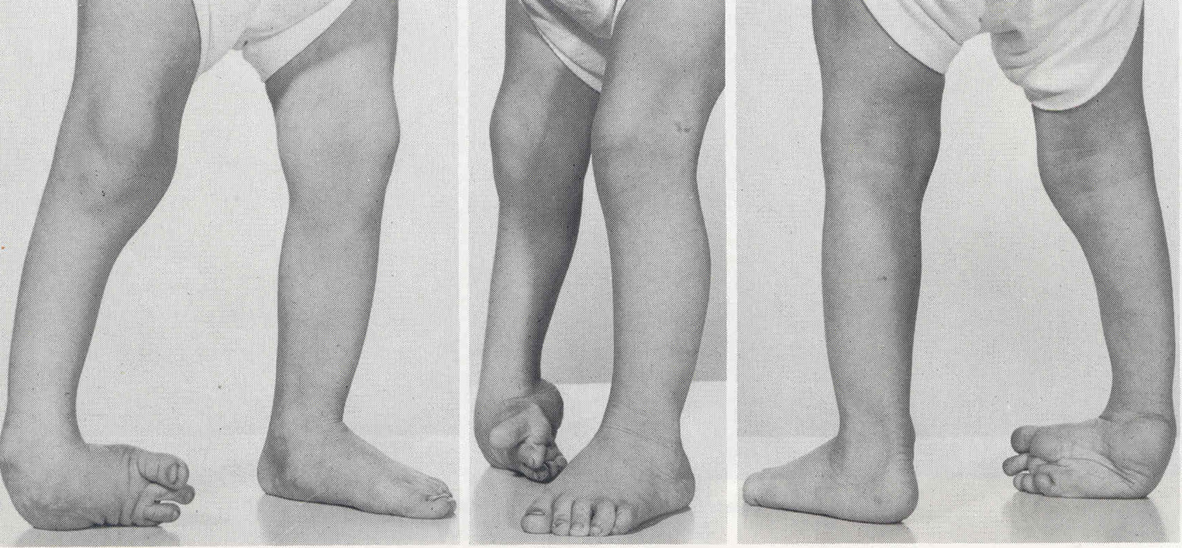
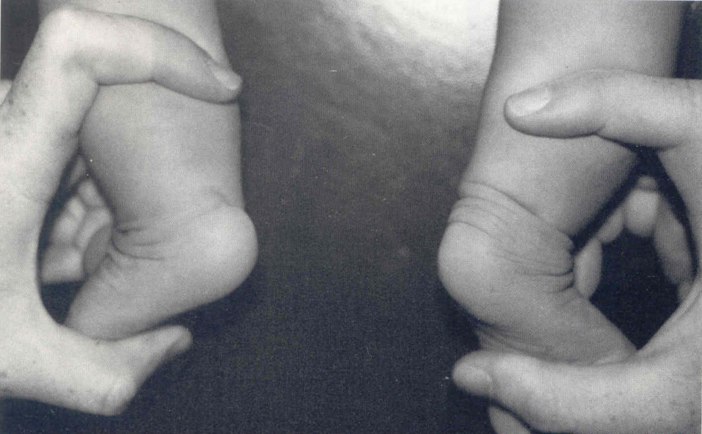
Clinical examination
Rear- foot is in an equinus and varus
Forefoot in adduction and eversion (pronation)
Anterior talus palpated laterally
Thin skin
Shortened Achilles tendon - palpated as a tough cord
Heel is small and raised
Lateral malleolus displaced posteriorly
Calf atrophy (prognostic criterion)
! The forefoot in clubfoot is pronated, and not supinated, in relation to the hindfoot.

Slide 18
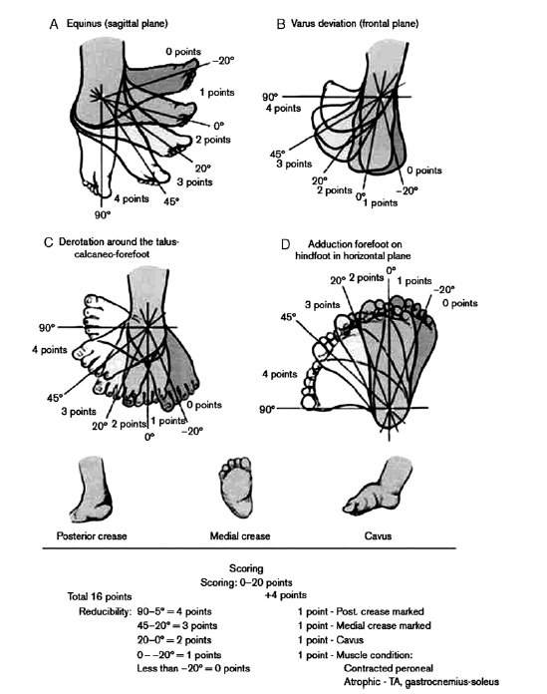
Dimeglio scoring system

Slide 19
Dimeglio scoring system
Grade I (1-5) : benign, so-called “soft” clubfoot, readily reducible without significant resistance, similar to clubfoot posture)
Grade II (6-10): moderate clubfoot (reducible with a certain degree of resistance)
Grade III (11-15): severe clubfoot (only reducible against strong resistance)
Grade IV (16-20): very severe clubfoot (not reducible, as in arthrogryposis).
Notes:
a comparative investigation of 4 classification systems found the Dimeglio system to be the most reliable
Jbjs 2002 Wainwright et al, Systems: Dimeglio, Caterall, Ponseti-Smoley, Harrold-Walker

Slide 20
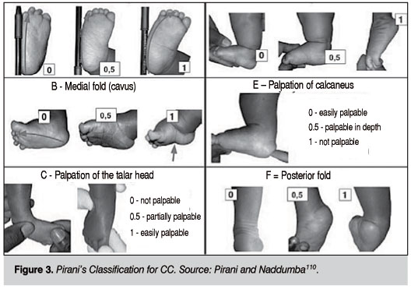
Pirani scoring system
Look (3), feel (2), move (1)
A - Lateral border D - Equinus
Notes:
Scores 0-6
Weekly monitoring - Assessment of treatment - ? Change of treatment

Slide 21
Treatment
Conservative
Surgical
Combination

Slide 22
Treatment goals
Plantigrade foot
No residual stiffness
Normal function (ROM-muscle balance)
Painless foot
Avoid permanent need for orthotics
Notes:
Even pressure in sole of foot
Scarring -> stiffness / sometimes treat. Begins w/ stiffness (arthrogryposis)
Impossible in neurogenic conditions
Better leave some painless resid. deformity
NO data to support protracted use of orthotics reduces recurrence / necessary in neurologic clubfeet

Slide 23
History
1932: Kite proposes gentler manipulation and serial correction of deformities. Kite’s error
1940’s: Ponseti’s first functional anatomy – pathology studies
1970’s: Turco’s posteromedial release gains popularity. Cincinatti (circumferential) and Carroll (2 incision) procedures follow. Surgical treatment prevails until 90’s. French functional non-op method introduced
1992: Ponseti’s results (only 5% need surgery) set current standards.
[Ponseti IV. Treatment of congenital clubfoot. J Bone Joint Surg. 1992]
Notes:
Kite’s error attempt to correct varus with pronation, as there is, respectively, blocking of the adduced calcaneus below the talar head (which prevents lateral rotation of the calcaneus and maintains the varus deformity

Slide 24
Ponseti method
Begins the first days of life
Serial manipulation- above knee casting 6-12/52
Staged CAVE correction
Bone remodeling throughout correction
Notes:
!!!! Manipulations before each cast

Slide 25
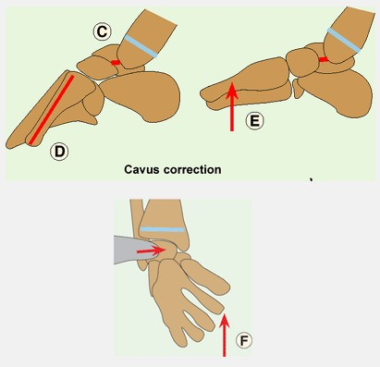
Cavus correction
Notes:
Counterpressure to talar head
Plantar fascia stretch – talonavicular reduction

Slide 26
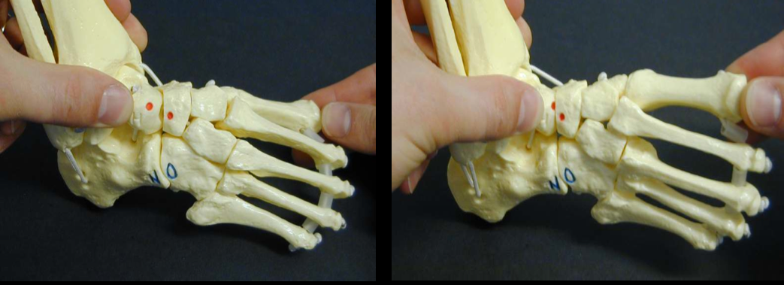
Cavus correction
Notes:
Correction of forefoot adduction and heel varus

Slide 27
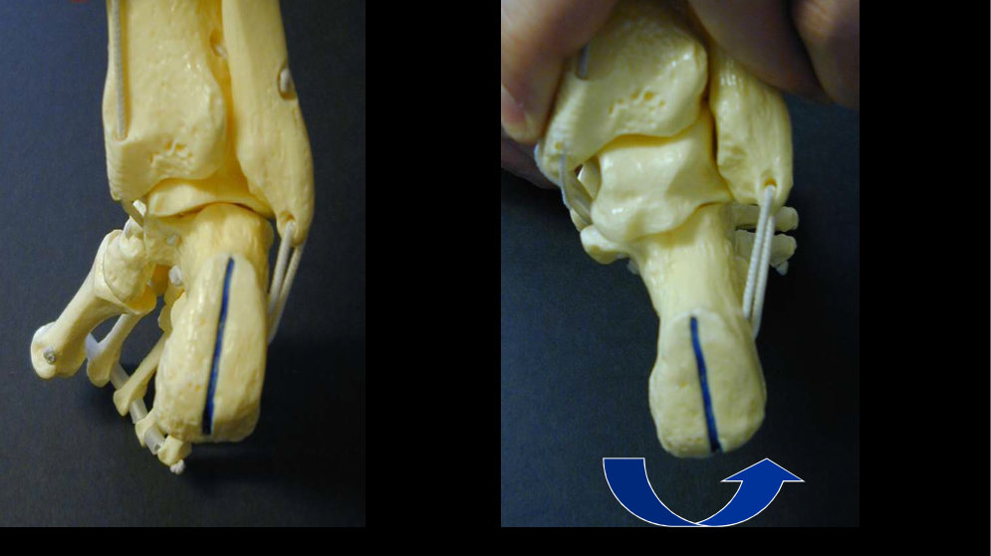
Adduction-varus correction
Notes:
Kinematic coupling of subtalar joint

Slide 28
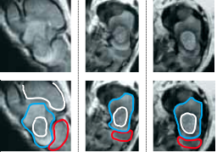
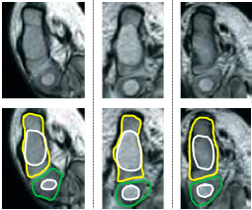
Hindfoot - midfoot reduction
Notes:
Demonstrated by Pirani

Slide 29
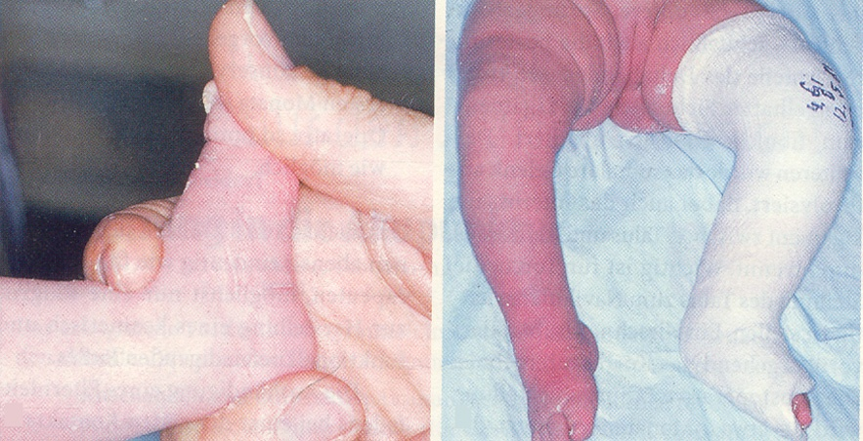
Equinus correction
Notes:
Pull heel downward NOT forefoot dorsally

Slide 30
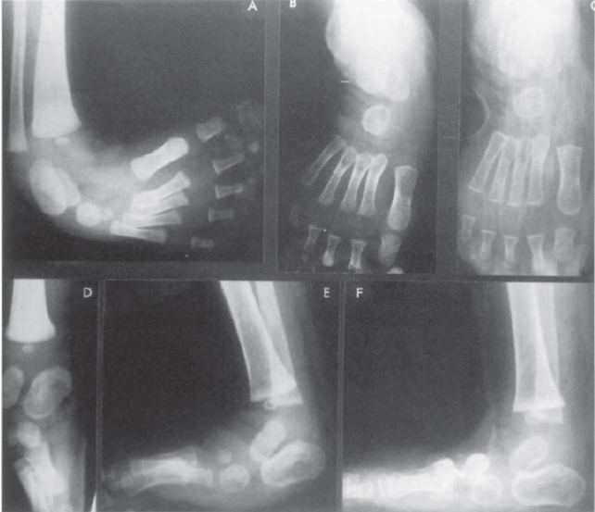
Rocker bottom deformity

Slide 31
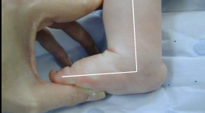
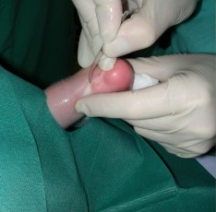
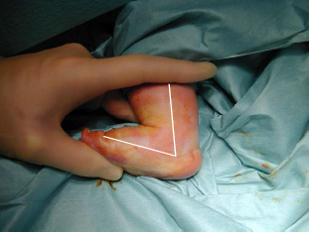
Equinus correction +/_ TA tenotomy
➔

Notes:
TA percutaneous section if not 15 deg of dorsiflexion achieved (90% of cases)
Last cast for 3 weeks to allow TA to heal

Slide 32
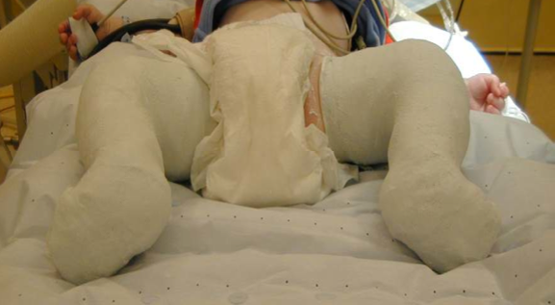
Final cast - 3 weeks - overcorrection
Notes:
70 degrees of abduction, 15 deg of dorsiflexion in cast

Slide 33
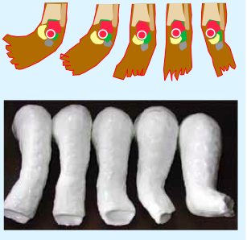
Notes:
1st cast in supination
Equinus corrected last

Slide 34
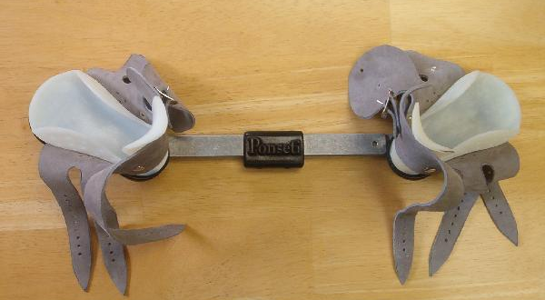
Boots and bar
3 months initially, nights-naps until 4 years

Slide 35
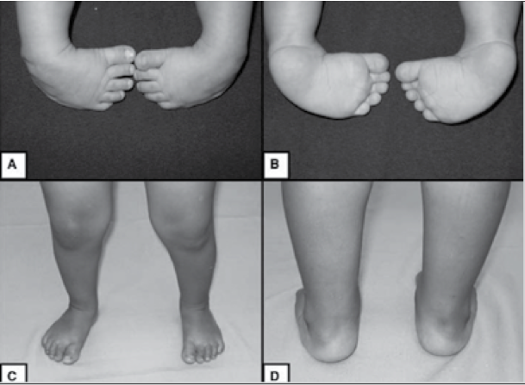

Slide 36
Results
78% excellent or good results
The outcome could not be predicted from the radiographic result!
Cooper, D. M., & Dietz, F. R. (1995). Treatment of idiopathic clubfoot. A thirty-year follow-up note. The Journal of Bone and Joint Surgery. American volume, 77(10), 1477-89.

Slide 37
Errors
Forefoot eversion instead of supination-abduction
Abduction centered in CC instead of TN
Everting calcaneus before reducing it under talus
Correction of equinus with forefoot dorsiflexion

Slide 38
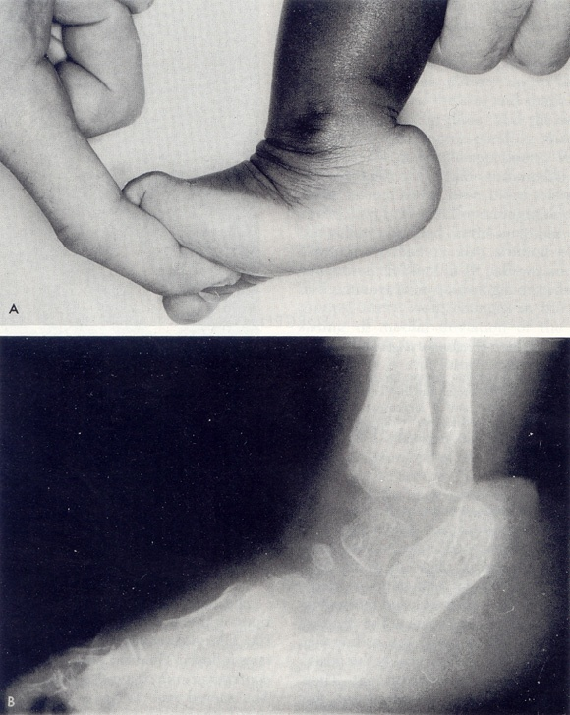
Complications
Recurrence - undercorrection
Residual stiffness
Rocker bottom deformity
Residual deformities:
Forefoot adduction
Equinus
Notes:
Non compliance with bracing protocol

Slide 39
Recurrence
8-22% rate of relapse
Terrazas-Lafargue G, Morcuende JA. Effect of cast removal timing in the correction of idiopathic clubfoot by Ponseti method. Iowa Orthop J. 2007
Abdelgawad AA, Lehman WB, van Bosse HJP, et al. Treatment of idiopathic clubfoot using Ponseti method: minimum 2-year follow-up. J Pediatr Orthop B. 2007
Ponseti IV, Zhikov M, Davis N, et al. Treatment of the complex
idiopathic clubfoot. Clin Orthop Relat Res. 2006
up to 80% in non-compliant families!
Morcuende JA, Egbert M, Ponseti IV. The effect of the internet in the treatment of congenital idiopathic clubfoot. Iowa Orthop J. 2003
Haft GF, Walker CG, Crawford HA. Early clubfoot recurrance after use of the Ponseti method in a New Zealand population. J Bone Joint Surg. 2007
Notes:
Ponsetti 50%frecurrence in his first outcome assessment 1963
What changed was last cast in overcorrection - prolonged bracing

Slide 40
Recurrence
Usually not after the age of 5 years
Ponseti IV. Congenital clubfoot: fundamentals of treatment. Oxford: Oxford University Press; 1996.
After the age of 7 years full neurologic work-up is encouraged!
Lovell ME, Morcuende JA. Neuromuscular diseases the cause of late clubfoot relapses: report of 4 cases. Iowa Orthop J. 2007
Notes:
321 clubfeet – 12 relapses after 7 – 6 neurological disorders
CMT, myotonic dystrophy, myasthenia gravis

Slide 41
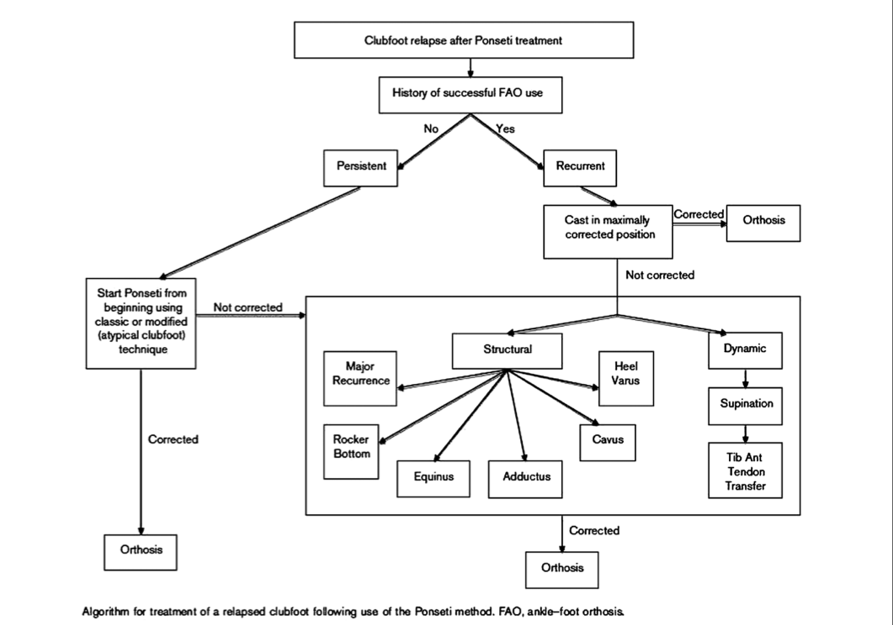
Recurrence
Chu A, Lehman WB. Persistent clubfoot deformity following treatment by the Ponseti method. J Pediatr Orthop B. 2012
Notes:
Literature review
Distinguiush recurrent from persistent clubfoot
Always 2nd attempt with serial casting!
Modified technique: different manipulations – various soft tissue interventions

Slide 42
Operative treatment
2 failed serial casting treatments
Scores deteriorating
Correct as much as possible conservatively before operating
Carroll NC, Gross RH. Operative management of clubfoot. Orthopedics 1990; 13: 1285–96.

Slide 43
Operative treatment
Tendon transfers
Soft tissue releases
Osteotomies
Gradual distraction
Bone resection
Fusions

Slide 44
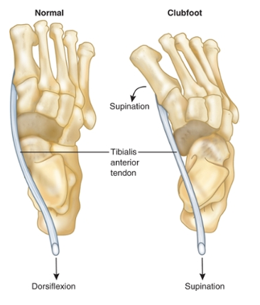
Dynamic supination
26,6 – 51% after initial treatment
Laaveg SJ, Ponseti IV. Long-term results of treatment of congenital club foot. J Bone Joint Surg. 1980
Chu A, Lehman WB. Persistent clubfoot deformity following treatment by the Ponseti method. J Pediatr Orthop B. 2012
Notes:
Especially in swing phase
Everting vs dorsiflexing force of TA – overpowers peroneals

Slide 45
Tibialis anterior transfer
Passively correctable (elastic) deformity
Mandatory for muscle balance restoration in neurogenic clubfeet

Slide 46
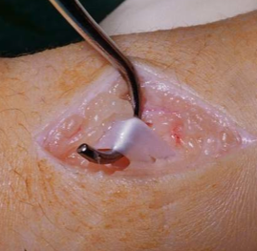
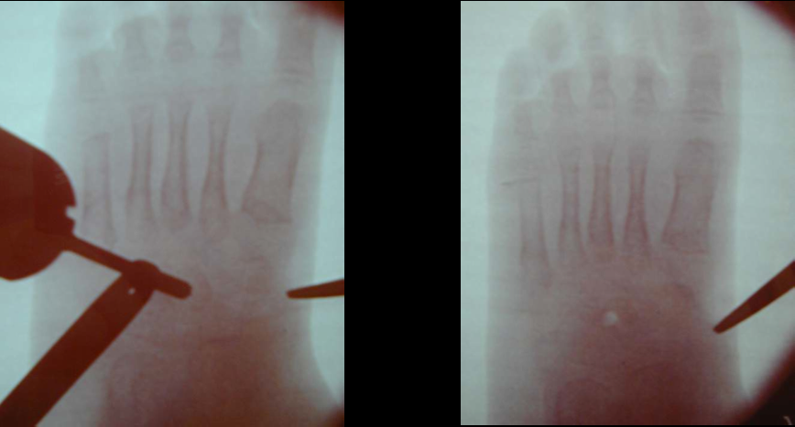
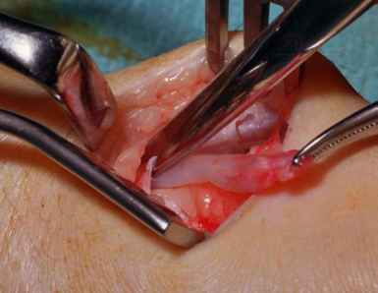
Tibialis anterior transfer
Complete tibialis anterior
Transfer to lateral cuneiform
Notes:
Around 3 Y.O.
Lateral cuneiform ossific nucleus appears in xrays (later in late walkers)
TA can act as a strong dorsiflexor

Slide 47
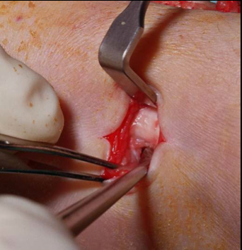
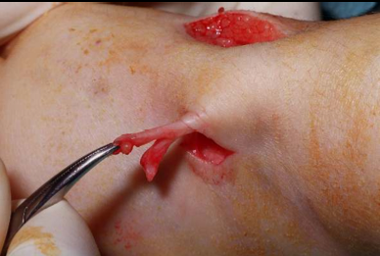
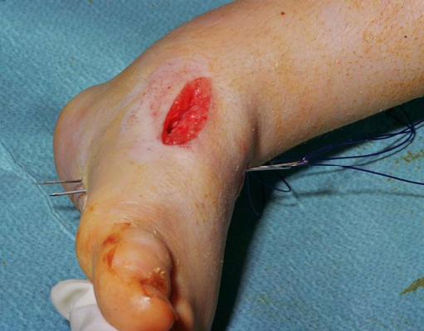
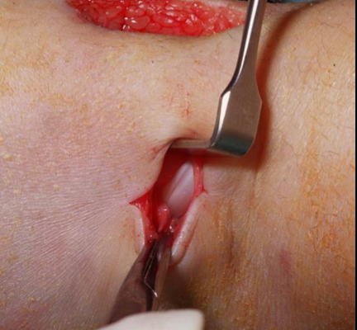
Tibialis anterior transfer
Complete tibialis anterior
Transfer to lateral cuneiform
Notes:
Around 3 Y.O.
Lateral cuneiform ossific nucleus appears in xrays (later in late walkers)
TA is can act as a strong dorsiflexor

Slide 48
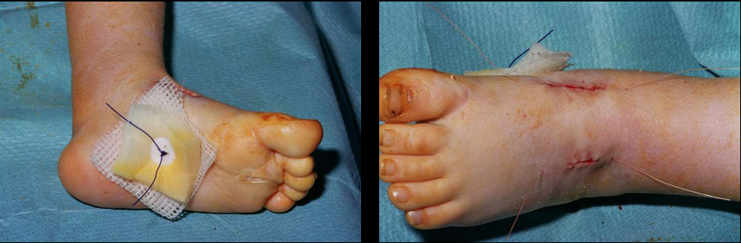
Tibialis anterior transfer
Complete tibialis anterior
Transfer to lateral cuneiform
Notes:
Around 3 Y.O.
Lateral cuneiform ossific nucleus appears in xrays (later in late walkers)
TA is can act as a strong dorsiflexor

Slide 49
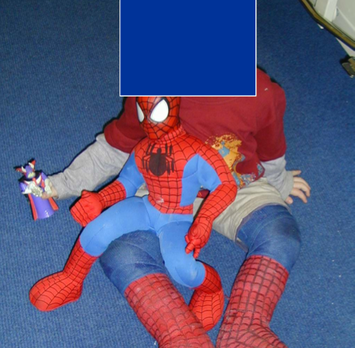
Tibialis anterior transfer
Complete tibialis anterior
Transfer to lateral cuneiform
Above knee cast for 5 weeks
Notes:
Around 3 Y.O.
Lateral cuneiform ossific nucleus appears in xrays (later in late walkers)
TA is can act as a strong dorsiflexor

Slide 50
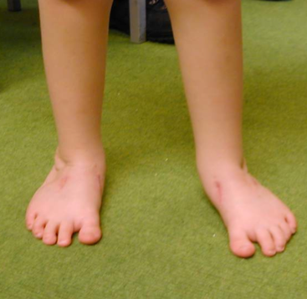
Tibialis anterior transfer
Complete tibialis anterior
Transfer to lateral cuneiform
Physiotherapy occasionaly
No special shoes - splints
Notes:
Around 3 Y.O.
Lateral cuneiform ossific nucleus appears in xrays (later in late walkers)
TA is can act as a strong dorsiflexor

Slide 51
Tibialis anterior transfer
Early results (3 months-1 year): up to 100% success
Gray K, Burns J, Little D, Bellemore M, Gibbons P Is tibialis anterior tendon transfer effective for recurrent clubfoot? Clin Orthop Relat Res. 2014 Feb

Slide 52
Tibialis anterior transfer
2nd recurrence 15,2%
80% in non compiant families
Correlated to early 1st transfer
Masrouha KZ, Morcuende JA. Relapse after tibialis anterior tendon transfer in idiopathic clubfoot treated by the Ponseti method. J Pediatr Orthop. 2010

Slide 53
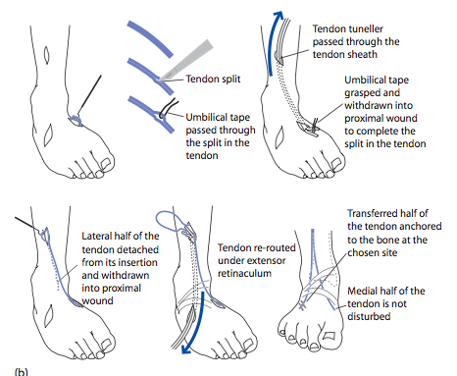
Tendon transfers
Split tibialis anterior
Transfer to cuboid or attach
to peroneus brevis tendon
Botte MJ1, Bruffey JD, Copp SN, Colwell CW. Surgical reconstruction of acquired spastic foot and ankle deformity Foot Ankle Clin. 2000 Jun;5(2):381-416.
.
Notes:
Spasticity – neurologic disorders when tib ant overpowers peroneals

Slide 54
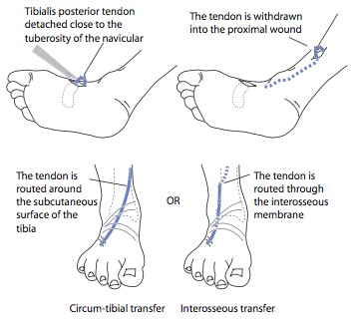
Tendon transfers
Tibialis posterior
Deforming to corrective force
Usually fibrotic and difficult to transfer (esp. post soft tissue release)
Notes:
Charcot Marie Tooth

Slide 55
Soft tissue releases
After 9 months of age (technically easier – child begins to walk after treatment)
Neglected - older
Recurrent
Undercorrected
Usually bilateral
Up to 15% recurrence

Slide 56
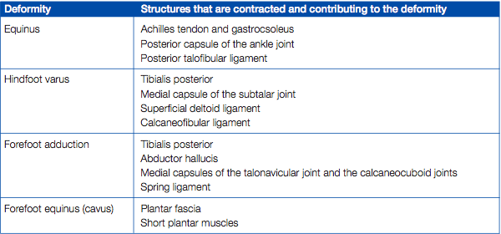
Soft tissue releases
Degree-location of residual deformity

Slide 57
Soft tissue releases
Posteromedial hockey stick (Turco)
2 incisions medial- lateral
Circumferential (Cincinatti)

Slide 58
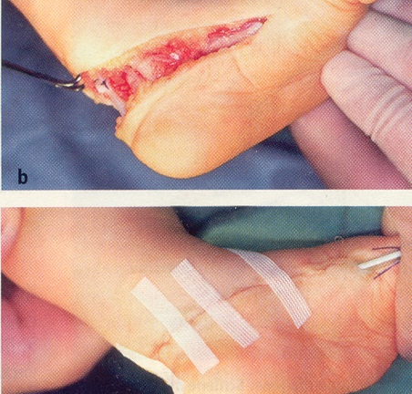
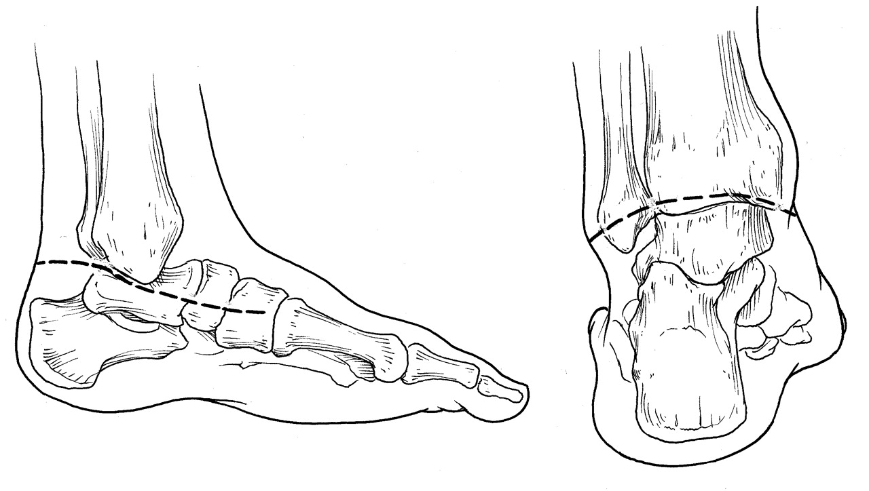
Soft tissue releases - Cincinatti
Crawford AH, Marxen JL, Osterfeld DL. The Cincinnati incision: a comprehensive approach for
surgical procedures of the foot and ankle in childhood. J Bone Joint Surg Am 1982; 64:
1355–8.

Slide 59
Post correction splinting
Individualised
3 months generally accepted

Slide 60
Osteotomies
Failure of previous extensive release
Medial-lateral columns need adjustment
Stiff adducted forefoot
Residual heel varus
4-7 y.o.

Slide 61
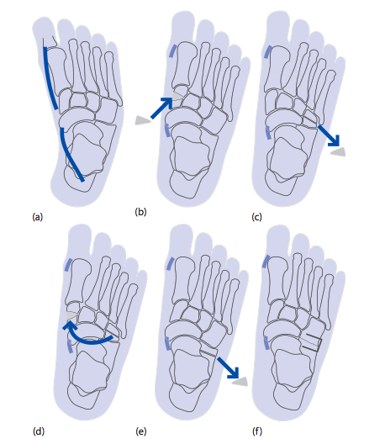
Osteotomies (forefoot adduction)
Notes:
CC Fusion (Evans)
Z lenghthening of post tib tendon
CC and TN capsule release
Closed wedge or decancellation of cuboid

Slide 62
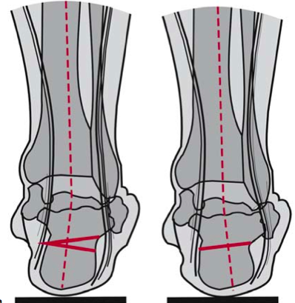

Osteotomies (heel varus)
Notes:
Address hindfoot varus
Closing wedge preferred (skin)
Dwyer (pes cavus) – Mitchell (not shortening a short calcaneus)

Slide 63
Bone resection
Talectomy (arthrogryposis)
No other way to restore plantigrade foot
Largely replaced by Ilizarov techniques
33% good, 42% fair, 25% bad results
Legaspi J, Li YH, Chow W, Leong JC. Talectomy in patients with recurrent deformity in club foot. A long-term follow-up study. J Bone Joint Surg Br. 2001 Apr;83(3):384-7.
Notes:
Mainly equinus contracture
Good: no residual deformity, no pain during walking
Fair: residual deformity requiring correction, no pain
Bad: residual deformity requiring correction + pain

Slide 64

Gradual correction
Notes:
Alternative to Ponseti (rare)
With osteotomies

Slide 65
Gradual correction
Neglected cases
Stiff, recurrent deformities
Adolescents
Alternative to triple fusion

Slide 66


Gradual correction
Notes:
U osteotomy for equinus
V for equinovarus

Slide 67
Gradual correction
Neglected cases
38 feet, 19 (5-39) y.o, FU 56 months
16/52 in frame, 6/52 walking cast, AFO 6/12
78,9% good, 7,9% fair, 13,2% poor
Ferreira RC, Costo MT, Frizzo GG, da Fonseca Filho FF. Correction of neglected clubfoot using the Ilizarov external fixator. Foot Ankle Int 2006 Apr;27(4):266-73.
Notes:
Achilles tenotomy + plantar fasciotomy
Residual deformity, plantigrade foot, pain

Slide 68
Gradual correction
Recurrent cases
35 feet, 14 y.o, FU 58 months
77% good, 14% fair, 9% poor
Ferreira RC, Costo MT, Frizzo GG, Santin RA. Correction of severe recurrent clubfoot using a simplified setting of the Ilizarov device. Foot Ankle Int. 2007 May;28(5):557-68.
Notes:
Achilles tenotomy + plantar fasciotomy
Residual deformity, plantigrade foot, pain
1/29 required required midfoot osteotomy

Slide 69
Gradual correction
Complications
Residual deformity/pain/stiffness
Distal tibia epiphysis injury
Toe contractures
Vascular compromise

Slide 70
Triple fusion
Salvage procedure
After 12 y.o.
Stiff pain-free plantigrade foot

Slide 71
Complications
Skin-wound problems, neurovascular injury
Growth disturbance
Osteonecrosis (talus-navicular)
Residual deformity / Overcorrection

Slide 72

Treatment algorithm - infant and young child
Notes:
Ponseti is the gold standard
Only soft tissue releases – no bone procedures – no tib ant transfer

Slide 73

Treatment algorithm 4-7 years old
Notes:
Depending on deformity, soft tissue releases/tend transf/lateral column shortening

Slide 74

Treatment algorithm in adolescents
Notes:
Gradual distr soft tissues/+bones, arthrodesis

Slide 75
Natural history
More than 90-95% of CTEV cases can be treated with the Ponseti method
(+ Achilles tenotomy + Tib Ant transfer)
Functional but not radiologically perfect, painless, slightly shorter foot
Late osteoarthritis more common in surgically treated feet

Slide 76
Thank you

