Slide 1
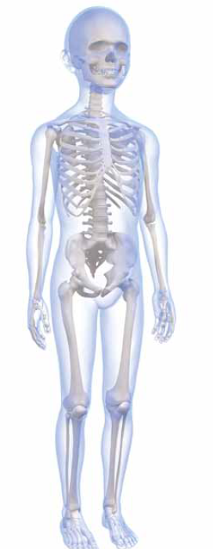
BONE & JOINT
INFECTION in
CHILDREN
Viva
Mr Kyle James
Consultant Paediatric Orthopaedic Surgeon

Slide 2
Case 1
3 year old
Not using arm
After pulling away from Mother in supermarket
What is your diagnosis & management?

Slide 3
Pulled Elbow
Age under 7
50% Hx of Pull
PAIN – RULE OUT FRACTURE incl clavicle
Hyperpronation > Supination
Click on reduction in 70%
Recurrence rate 15%
Not using arm
Held in ext and pronation
Mild / moderate pain on palpation
Block to rotation (painful)
Krul, Marjolein, et al. "Manipulative interventions for reducing pulled elbow in young children." Cochrane Database Syst Rev 1 (2012).
Irie, Takashi, et al. "Investigation on 2331 cases of pulled elbow over the last 10 years." Pediatric Reports 6.2 (2014).
HYPER-PRONATION
SUPINATION FLEXION

Slide 4
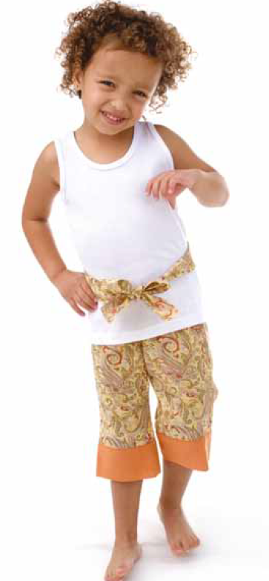
Case 2
5 yo boy
Limp
Painful restricted Left hip movement
Recent sore throat
Differential Diagnosis
Transient Synovitis
Bone /Joint infection
Perthes / DDH
Inflammatory arthropathy
Differential Diagnosis?
Management?

Slide 5
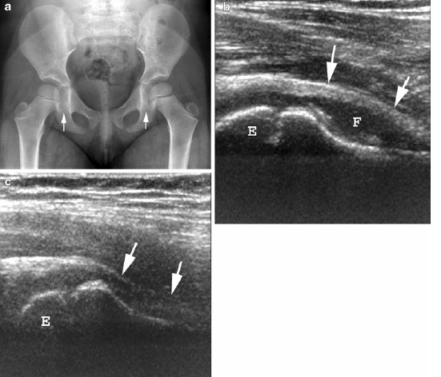
Case 2
Temp = 38ºC
WCC = 10.7
CRP = 5
ESR = ‘insufficient sample’
Xray
USS - effusion
Diagnosis & Management?

Slide 6
Transient Synovitis of the Hip
Age 5.4 (95% CI 5-5.8y)
25 -75 per 100,000
No seasonal variation ? viral
No socioeconomic variation unlike Perthes
Resolves 3- 10 days
NSAIDs shortens duration
Transient Synovitis
Painful hip/ normal bloods/ effusion USS
Treat NSAIDS
Review in One week – still problem needs further investigation
Harrison, W. D., Vooght, A. K., Singhal, R., Bruce, C. E., & Perry, D. C. (2014). The epidemiology of transient synovitis in Liverpool, UK. Journal of children's orthopaedics, 8(1), 23-28.

Slide 7
Bone Joint Infection vs TRANSIENT SYNOVITIS
KOCHER’s CRITERIA
History of fever 38.5ºC
ESR >40 (mm/hour)
WCC >12.0 (x 10⁹ cells/l)
Non Weight-bearing
CRP > 20
No. of predictors | Predicted probability of septic arthritis (%)
 | Kocher et al 1999 N=168 ESR | Kocher et al 2004 N=154 ESR | Luhmann et al 2004 N= 165 ESR | Caird et al 2006 N= 48 ESR/CRP | Sultan & Hughes 2010 N= 96 ESR/CRP | Singhal et al 2011 N=311 CRP
0 | 0.2 | 2 |  | 16.9 | 2.3 | 1
1 | 3 | 9.5 |  | 36.7 | 5
2 | 40 | 35 |  | 62.4 | 11
3 | 93.1 | 72.8 |  | 82.6 | 22
4 | 98 | 93 | 58 | 93.1 | 39 | 87
5 |  |  |  | 97.5 | 60
BUT
Currently Insufficient Sample Size or Cases of Septic Arthritis (End Point) in all studies for predictive Logistic Regression analysis.
Uzoigwe, C. E. Another look: is there a flaw to current hip septic arthritis diagnostic algorithms?. Clinical Orthopaedics and Related Research(2014) 472:1645–1651

Slide 8
SEPTIC ARTHRITIS vs TRANSIENT SYNOVITIS
ROLE OF USS
Normal bloods with joint effusion then likely transient synovitis
Abnormal Bloods / NO EFFUSION
? OSTEOMYELITIS
Raised Bloods and EFFUSION
LIKELY SEPTIC ARTHRITIS

Slide 9
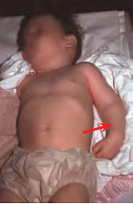
Case 3
8 month old, SVD
Brought in by mum
Not moving arm for 2 days
Fever
Differential Diagnosis
Fracture
pulled elbow
NAI
Plexus injury missed
Bone /Joint infection
Differential Diagnosis?
Management?
Notes:
NAI /

Slide 10
Case 3
Hx of viral illness
Clinically won’t move arm, ?localising to elbow – pain swelling warm
Temp 38.2ºC
CRP 92 / ESR 60 / WCC 13
No Fracture on Xray
USS Joint effusion ? Periosteal collection proximal radius
Diagnosis & Management?
Notes:
NAI /

Slide 11
Septic Arthritis – Exam answer
Blood Culture
Theatre
Aspirate send for
  m,c&s (in culture bottle)
  cell count
  PCR in normal specimen container
Pus aspirated = open washout
Start iv antibiotics broad spectrum change to oral once better
Treat for 3 weeks minimum as likely contiguous osteomyelitis
Monitor CRP
CULTURE Negative Bone & Joint Infection (1/3 cases) is Cell Count important
Cell Count >50 x10⁹/L WCC = infection??
Culture negative with WCC > 50 x10⁹/L only has a 25% probability of septic arthritis as this is seen with many types of inflammatory arthropathy.
Notes:
NAI /

Slide 12
Finnish Approach – Paakkonen & Peltola
Pediatr Clin N Am 60 (2013) 425–436
INDICATIONS
MONITORING
Key CRP improving
Surgery = delay normalisation CRP/ESR
> 3months of age
No comorbidities
Early presentation <5 days
Culture positive and Sensitive bacteria

Slide 13
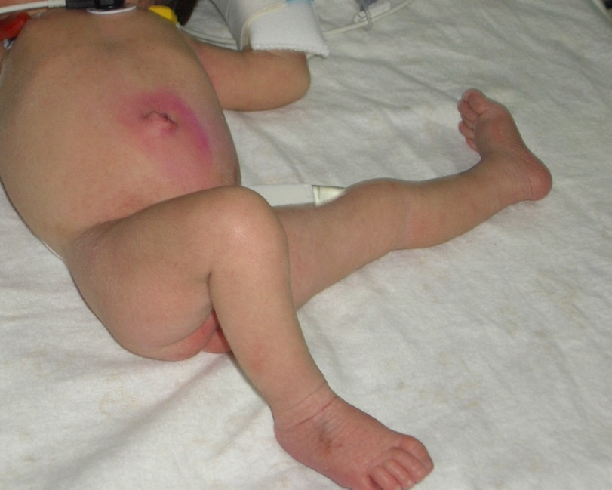
Case 4
3 month old
Not feeding
Unwell last week
Not using left leg
Management?

Slide 14
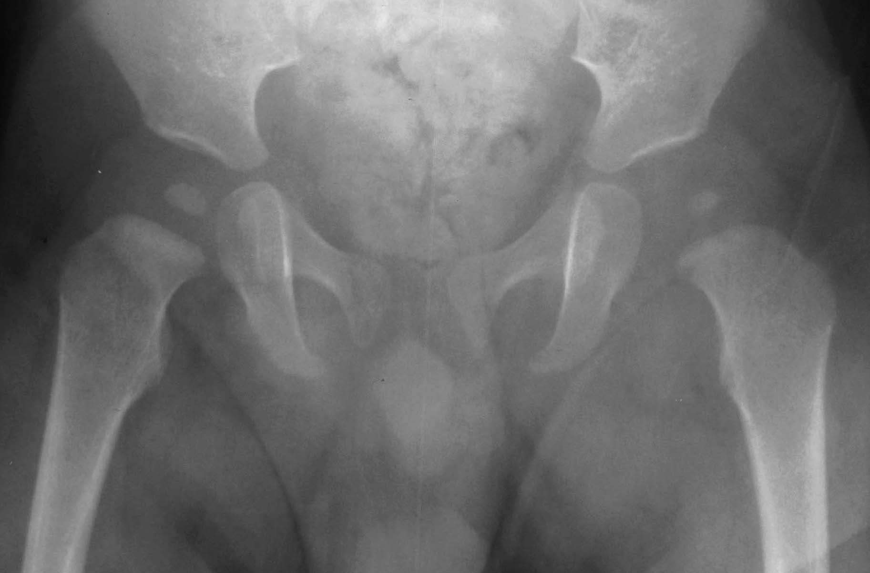
Case 4
WCC 13
CRP 19
ESR insufficient
Tachycardia
Dehydrated
Xray

Slide 15
Neonatal Bone & Joint Infection
<3months of age
May not mount a septic response
Pseudo paralysis
Multi- focal
Septic arthritis and Soft tissue infection (physis is not a barrier <2yr)
Late sequalae more common
TREATMENT: RESUSCITATE
BROAD SPECTRUM ANTIBIOTICS
SURGICAL DRAINAGE
IV THERAPY FOR 4 weeks – poor absorption oral
Failing to improve - ?multifocal – Bone Scan or MRI

Slide 16
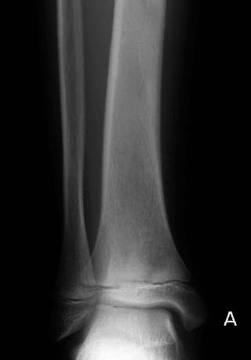
Case 4
10 yo boy
Right ankle pain
Limp and progressive loss of weight bearing in the last 2 weeks
Tender distal tibia, moving ankle
Fever – Temp 38
WCC 17/ CRP 90 / ESR 70
Diagnosis & Management?

Slide 17
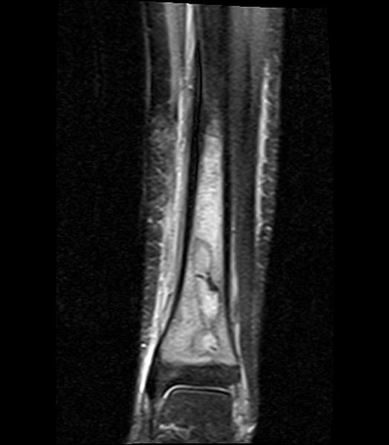
Case 4
10 yo boy
Right ankle pain
Limp and progressive loss of weight bearing in the last 2 weeks
Tender distal tibia, moving ankle
Fever – Temp 38
WCC 17/ CRP 50 / ESR 70
Management?

Slide 18
Acute / Sub acute osteomyelitis
SURGERY INDICATED
Failure to Improve on antibiotics (Day 3-4)
Subperiosteal collection > 3mm long bones >2cm intrapelvic
Intra-osseous abscess
Adjacent septic arthritis
MRSA isolated
Drill – if intraosseous abscess – increase fracture risk
Preserve periosteum and soft tissue
Drain – surgeon choice
Blood culture
Aspiration
  SOFT TISSUE NEONATES
  SUBPERIOSTEAL INFANTS
  INTRA-OSSEOUS CHILDREN / ADOLESCENT
Iv antibiotics - monitor clinical response and CRP
Nsaids for Bone Pain

Slide 19
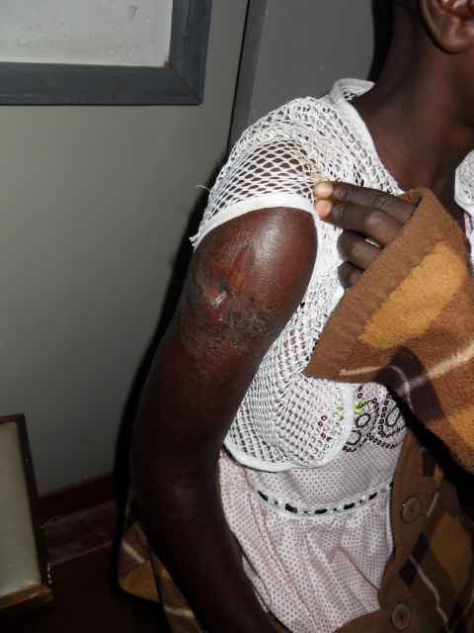
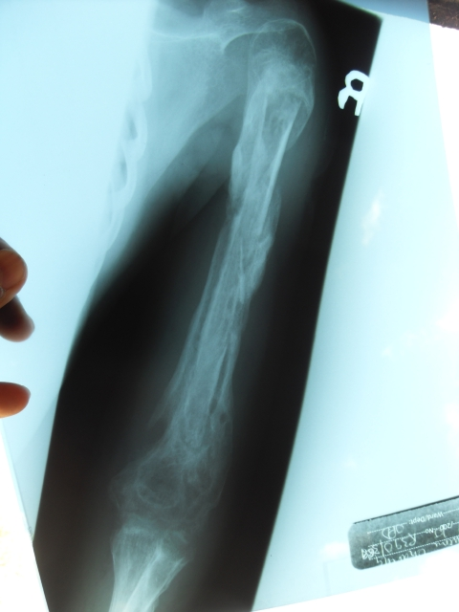
Case 5
12 yo female
Chronic discharging sinus 3 months
Right arm ache
Well
CRP 7 / ESR 13/ WCC 13/ Hb 7
No Sickle Cell
Arm pain and fever 1 yr ago
Diagnosis & Management?

Slide 20
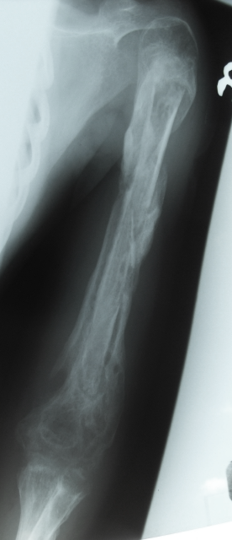
Chronic Osteomyelitis
Involucrum
Rare in western countries
MEDICAL
Assess and Treat immunocompromise
  Malnourished (albumin)
  Anaemia
  HIV
No role of antibiotics pre-op (resistance)
Sinus swab inaccurate (<50% correct)
TREATMENT IS SURGICAL
Sequestrum

Slide 21
Chronic Osteomyelitis
Surgical Principles
Involucrum
WAITING GAME
  involucrum b4 sequestrectomy
removal dead bone (preserve periosteum KEY)
  Sequestrectomy/ Curettage
Soft tissue / dead space management
  Dressing – VAC - Muscle flap
Splint limb whilst new bone forms
Role of antibiotics
  Oral rather than iv depending (4-6 weeks)
Reconstruction if required
Sequestrum

Slide 22
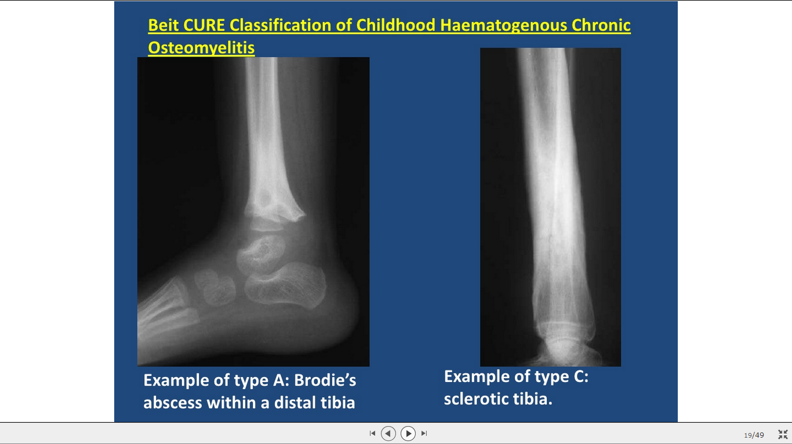
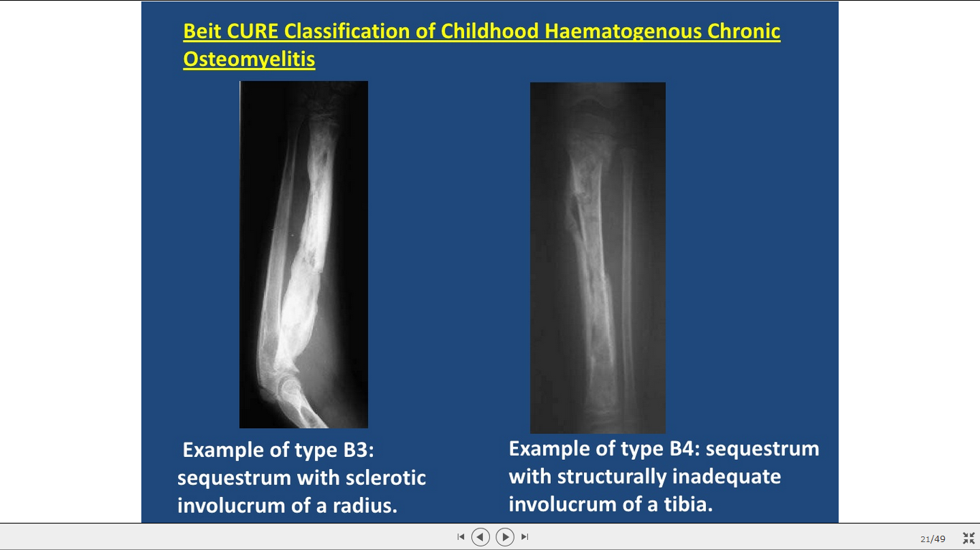
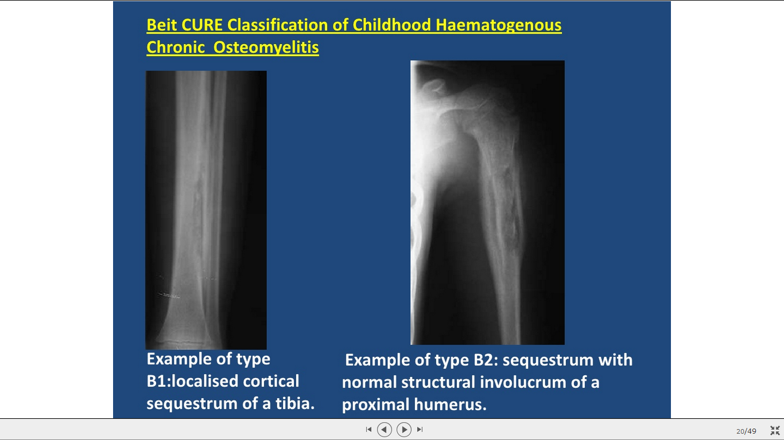
Beit Cure Classification
SEQUESTRUM-INVOLUCRUM TYPE B
Localised Cortical Sequestrum | Sequestrum with Structural Involucrum | Sequestrum with Sclerotic Involucrum | Sequestrum without structural involucrum
B1 | B2 | B3 | B4
SURGERY & Antibiotics
SURGERY & Antibiotics
+/- reconstruction
Surgery
Alone
Surgery
Alone
SURGERY & Antibiotics
Delay Surgery until more involucrum

Slide 23
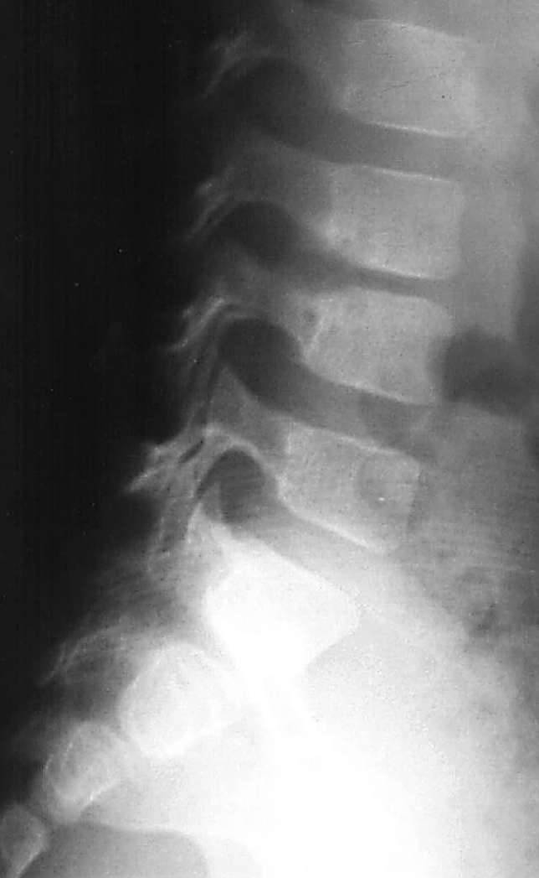
Case 6
4 yo girl
2 week history of intermittent back pain
Refusal to walk
Well
No specific area of pain
Afebrile
Hb 12/ WCC 10/ CRP 10 / ESR 18
Diagnosis & Management?

Slide 24
Discitis vs Vertebral Osteomyelitis
DISCITIS | vs | Vertebral OSTEOMYELITIS
2.8 yr (most <5) | Av Age at presentation | 7.8 yr
22 days | Duration of symptoms | 33 days
28% | Fever | 79%
Two Thirds | Abnormal Xray | Less than half
Pediatrics 2000;105;1299
Marisol Fernandez, Clark L. Carrol and Carol J. Baker
Discitis and Vertebral Osteomyelitis in Children: An 18-Year Review
Xray / MRI – key to diagnosis
FBC/ Blood film – rule out Haematological cause
Blood Cultures / ?Biopsy / Mantoux /CXR
Most Treated with Antibiotics (4 – 6 weeks)
Discitis ? Role of antibiotics

Slide 25
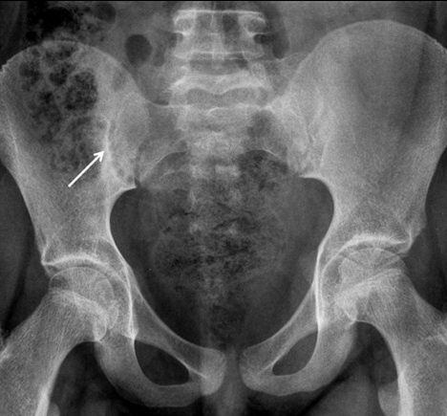
Case 7
13 yo girl
2 month history of intermittent back pain and right sided limp
Overweight
Normal Blood Tests
?low grade temp in morning
Hip examination – slight loss of ROM on Right compared to Left
Differential Diagnosis
Inflammatory Arthropathy
SUFE
Perthes
Overuse Injuries
Differential Diagnosis?
Management?

Slide 26
MALIGNANCY vs INFLAMMATORY ARTHROPATHY
Bone Pain
Night pain
Low WCC
Low Platelets
Marked Raised ESR
Organomegaly
Intermittent bone / joint pain
Duration months
Swelling
Intermittent fever
Skin rash / eye symptoms
No good blood test
Sacroiliac most common

Slide 27
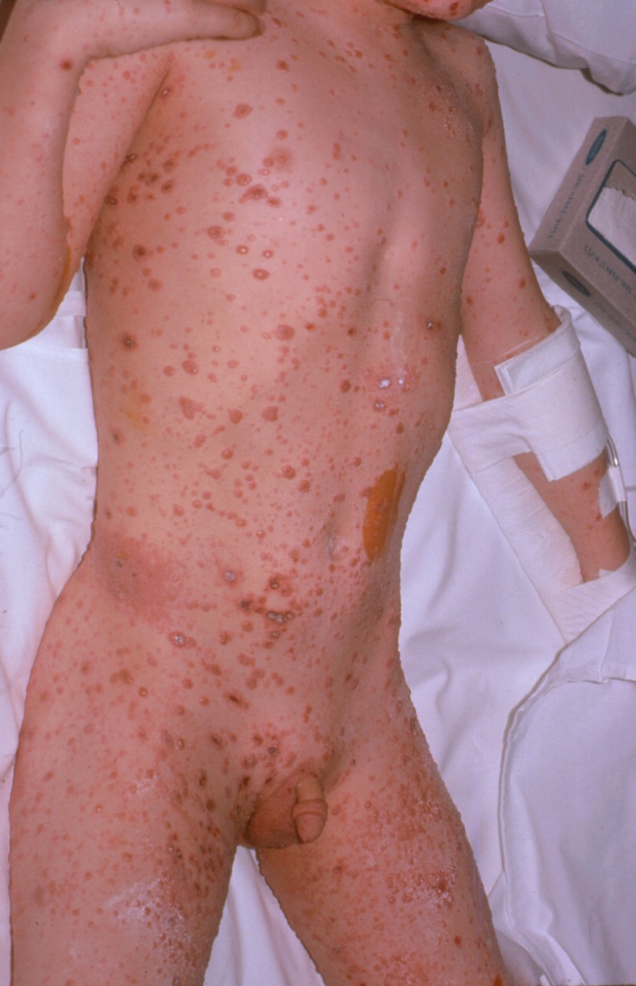
Case 8
5 yo boy
4 day post chicken pox
Febrile 39.8
Not using right leg
Pain / Swelling /tender
CRP 180, WCC 26, HR 180
Unwell
Diagnosis?
Management?

Slide 28
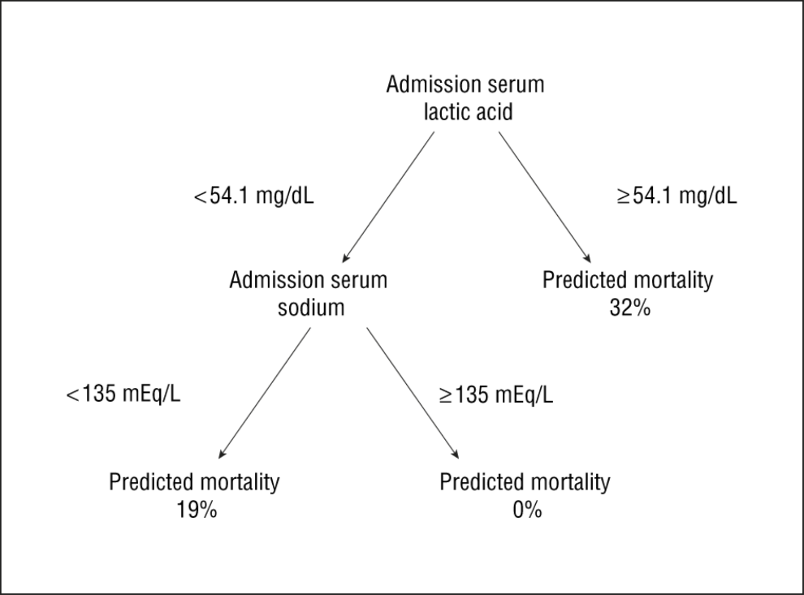
POST VARICELLA SOFT TISSUE INFECTION
<2% invasive STI necrotizing fasciitis
Group A Beta Haem Strep
Emergency Treatment
Resuscitate / PICU – treat coagulopathy / inotropes
High Dose BenzylPenicillin / Clindamycin
Consider iv Ig G (200-2000mg/kg/day 1-5 days)
Repeated Surgical Debridement – “Dishwater pus”/ grey necrotic tissue / lack of resistance to blunt dissection – Pulse Lavage useful as dissection
Vac initially then Soft tissue coverage
Use of Admission Serum Lactate and Sodium Levels to Predict Mortality in Necrotizing Soft-Tissue Infections. Arch Surg. 2007;142(9):840-846.
Diagnostic Key
Septic Shock– Coagulopathy
Soft tissue gas – CT better than Xray
Lactate predicts mortality

Slide 29
Case 9
6 yo known sickle cell
Present with right tibia pain, fever and raised inflammatory markers
How do you differentiate infarction from infection?
How do you manage infection in sickle cell?

Slide 30
Sickle Cell Osteomyelitis vs Infarction
Fever/Bloods/ Xray Findings similar
Majority crisis prophylactic antibiotic treatment
Failure to improve more likely with infection
MRI – Fat suppressed +/- Contrast
Treatment – Prolonged antibiotics 4-6 weeks
Ceftriaxone – Staph / Salmonella
Surgery in abscess formation

Slide 31
Case 10
MRI – suggestive of multiple sites of infection
Biopsy peformed – Inflammatory cells in keeping with infection
Culture no growth
10 yo boy
6m hx of recurrent pain Left ankle / both clavicles
Hx of acne
Sclerotic lesion on xray
Normal Bloods / Rheumatology screen
What is the diagnosis?

Slide 32
Chronic Recurrent Multifocal Osteomyelitis
CRMO or CNO or SAPHO
Inflammatory Bone Condition affecting children (rare) – multiple site
Associated with inflammatory skin / bowel disease or FHx of these (50%)
Mild raised inflammatory marker / radiological and histological features of infection but no organism is found
IL mediated – Majeed Syndrome infantile CRMO gene identified
Full work up (Rheumatology / Orthopaedic)
Treatment: Tertiary Rheumatology
1st Line: NSAIDs with short course Prednisolone / Sulphasalazine
2nd Line: Bisphosphonates / TNF inhibitor (Infliximab)

Slide 33
Which antibiotics?
Kingella Kingae
Septic Arthritis in young (6month – 3yrs)
Less symptoms
Lower markers of infection (Temp/CRP/WCC)
Local prevalence important (France, Spain, Israel)
PCR to detect – rtxA toxin gene of K Kingae
Microbiologist Key
  Local pattern / prevalence esp atypical
  Resistance
Age
  Neonates – add Gram neg cover
  (Gentamicin)
  No Hib Vaccine - add amoxicillin
  Sickle Cell-Incl salmonella cover (Ceftriaxone)
  Kingella – flucloxacillin / co-amoxiclav

Slide 34
Summary Bone & Joint Infection Children
CRP – Best marker diagnosis & monitoring
Need to know Bug – PCR / Culture
Uncomplicated SA / OM
  High dose regular antibiotics= iv for 3-4 days, then oral (2 wks SA; 3 wks OM)
  Surgery if not improving
  Surgery increases CRP /ESR and delays return to normality (10+7; 24+10 days)
Chronic Osteomyelitis – Tx Surgery, involucrum key
Special Cases to remember – Neonates / Sickle Cell / K Kingae/ Post Varicella

