Slide 1
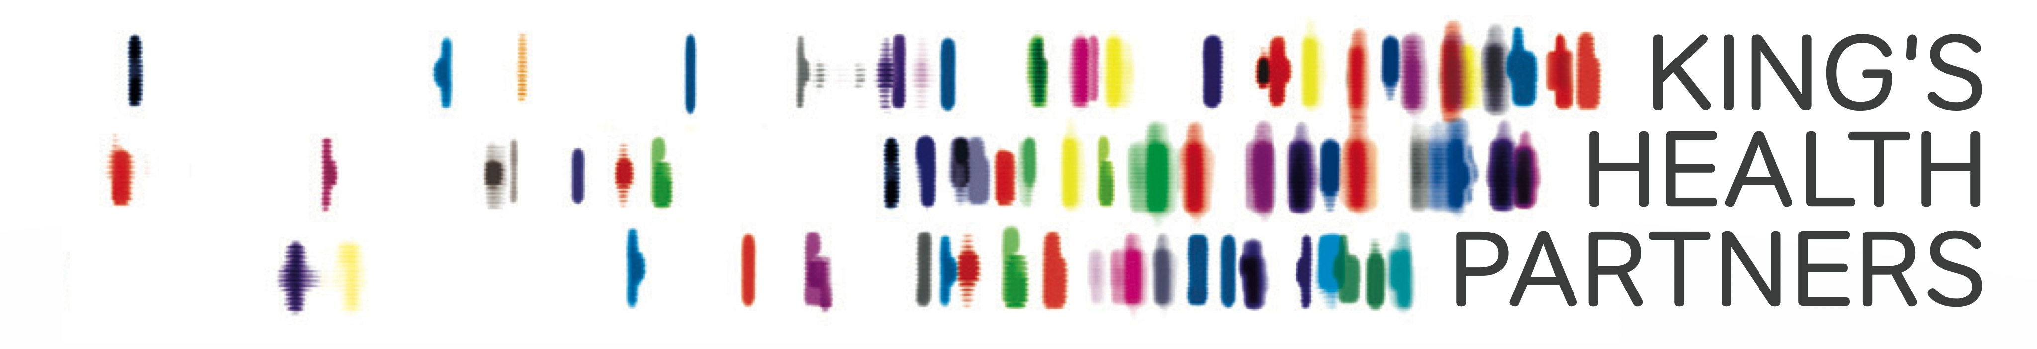

Assessment Lower Limb Deformity and Leg Length Discrepancy
Om Lahoti
Consultant Orthopaedic Surgeon
King’s College Hospital

Slide 2
Introduction
To define normal alignment
To assess deformity
Plan correction of common deformities
Methods of correction
  Paediatric and Adult
Assessment of leg length discrepancy
Principles of leg length equalization

Slide 3
Normal Alignment
Normal Limb
  Mechanically aligned, mobile joints, good muscle power, pain free
Normal Alignment (Mechanical)
  Frontal and Sagittal Alignment of Limb
  Normal Joint Orientation
Notes:
Normal alignment doesn’t always mean normal limb – which constitutes a mechanically aligned limb, mobile joints, good muscle power and co-ordination and pain free
Normal alignment has several components – coronal or frontal plane alignment and sagittal alignment, normal orientation of joints

Slide 4
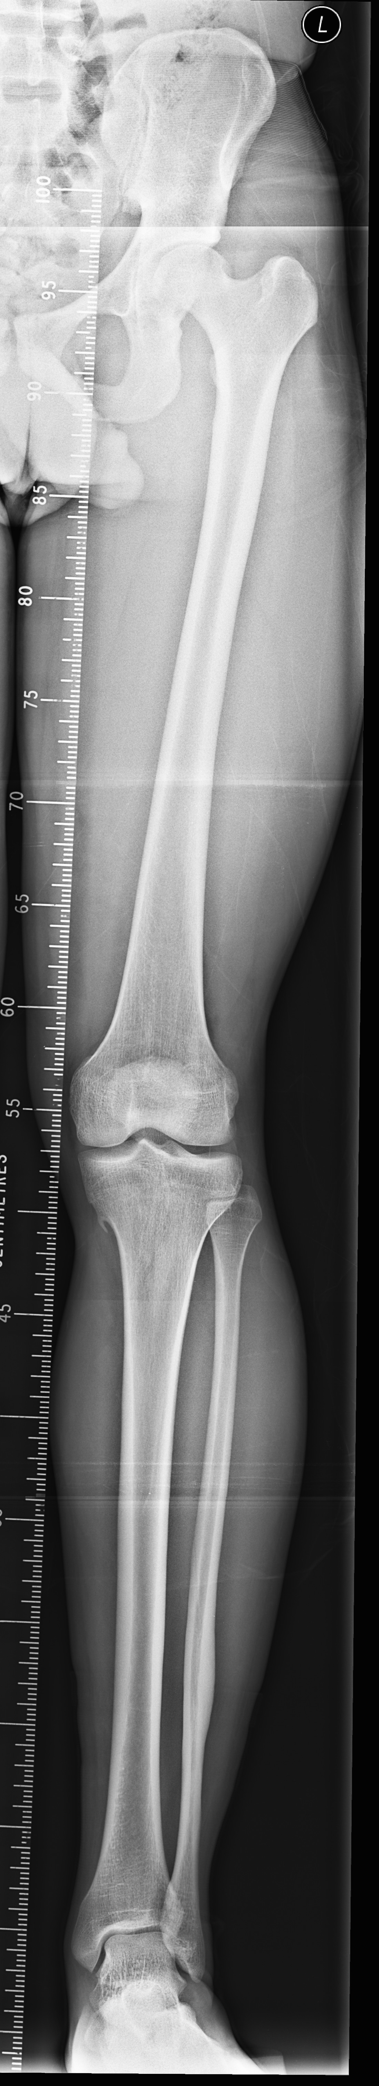
Normal Alignment
1. Weight bearing line – Mechanical Axis
Notes:
This x-ray shows a normally aligned lower limb – to be able to say that it has normal alignment we need to define its mechanical axis – this is achieved by joining the centre of hip to centre of ankle – so called mechanical axis – it should pass through centre of the knee joint just medial to tibial spine – it means that weight bearing line is colinear to the centre of the hip, knee and ankle joints. Any deviation of this line has major impact on knee and to some extent on ankle and hip.

Slide 5
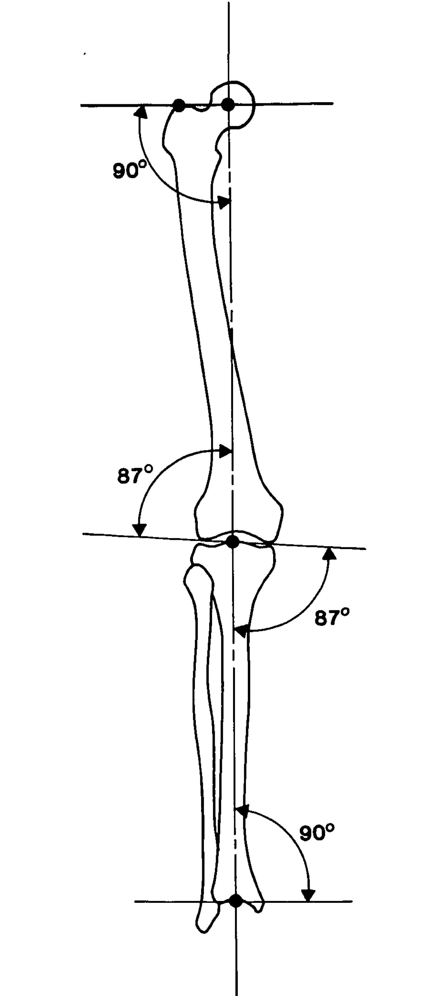
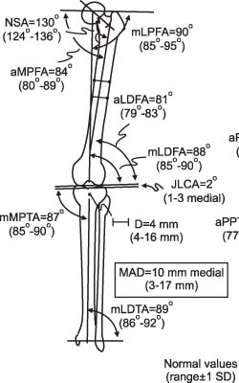
Normal Alignment
2. Joint Orientation
Notes:
Each joint has a normal mechanical inclination to the mechanical axis - - knee joint is 3 degrees off the perpendicular so that the distal femur is in slight valgus and tibia in varus. Ankle is perpendicular to the axis. Hip joint orientation is tricky – we have a mental image of normal hip joint represented by a normal neck shaft angle – which can vary from 125-131 degrees and can change with rotation of the limb. For the mechanical axis assessment a line joining tip of trochanter to the centre of the femoral head is taken as hip joint orientation line and it is more or less 90 degrees +/- 6 degrees. This date is essential to define the normal lower limb thus assessing the deformity if any

Slide 6
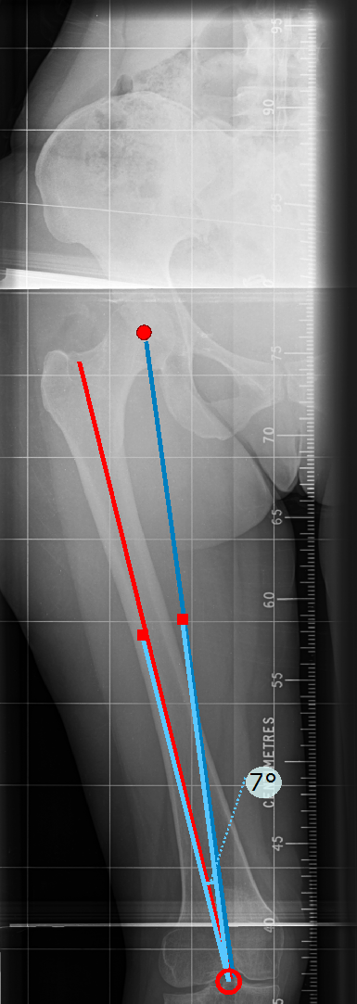
Mechanical vs. Anatomical Axis
Notes:
At this stage it is important to differentiate between mechanical and anatomical axis. Mechanical axis is an imaginary line running through the centre of the hip and ankle joint – all joints centres are co linear to this axis but bones are not. Femur anatomical axis subtends 5-7 degree valgus angle to the mechanical axis of the femur. In tibia it is easy as both anatomical and mechanical axis are the same

Slide 7
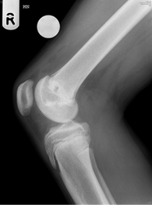
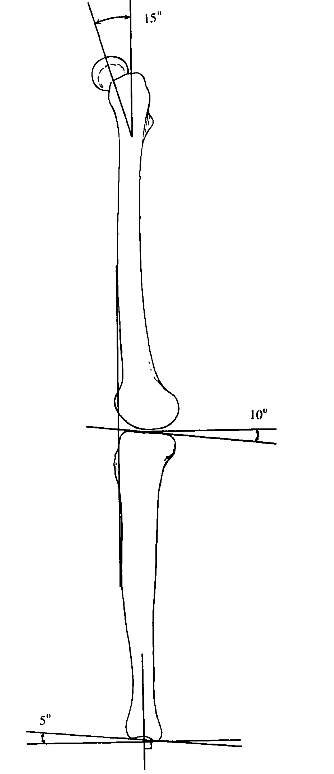
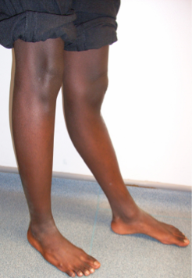
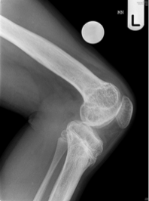
Sagittal Plane Alignment

Slide 8
Mechanical Axis Deviation
(MAD)
Frontal plane deformities lead to MAD
Medial MAD – Varus
Lateral MAD – Valgus
Mainly affect Knee >Ankle> Hip
Deformities of lower femur and proximal tibia influence MAD more than other deformities
Notes:
Mechanical axis is mainly influenced by deformities around the knee

Slide 9
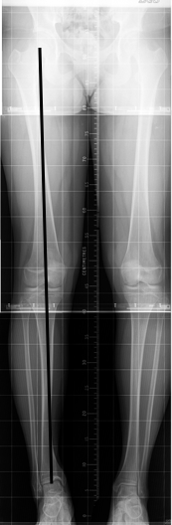
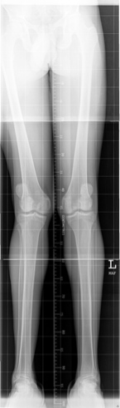
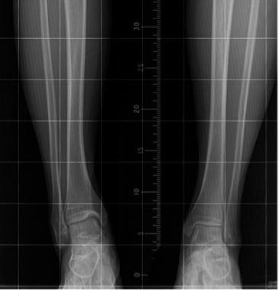
Notes:
Influence of level of deformity - Deformity of proximal tibia and distal femur has direct effect on MAD than similar degree of deformity away from the knee joint. This x-ray can not be passed on as normal alignment – remember there are two components to normal alignment – MA and joint orientation line

Slide 10
Radiology
Long leg weight bearing films
Align lower limbs properly – patella facing forward
Correct leg length discrepancy by blocks
Make a note of fixed deformities (clinical assessment) while assessing the films

Slide 11
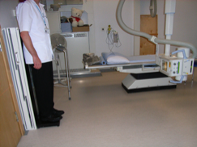
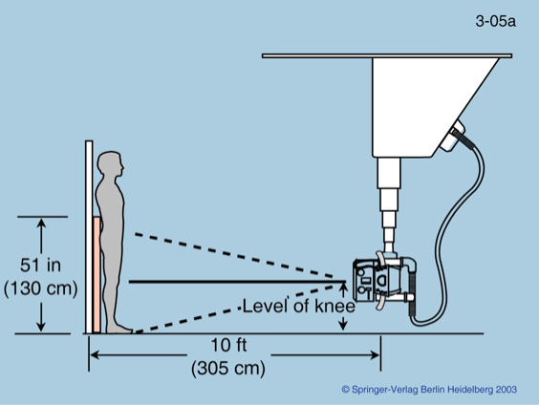
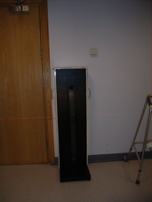

Slide 12
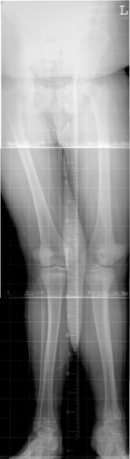
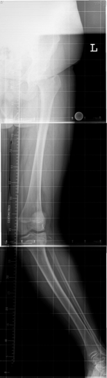
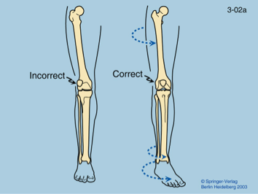
Notes:
Effect of rotation of limb

Slide 13
Notes:
If patella are subluxed and high riding as in this case, point tibial tuberosities to the front – not foot

Slide 14
Level of Deformity (in a limb segment)
Diaphyseal – post traumatic
Metaphyseal – developmental, post infective, trauma (growth disturbance)
Juxtaarticular – developmental
  Between physeal scar and joint surface

Slide 15
Assessment of Deformity
Draw a mechanical axis – MAD (Mechanical Axis Deviation) – Frontal Malalignment
Causes of MAD
  1. FEMORAL
  2. TIBIAL
  3. KNEE JOINT LAXITY

Slide 16
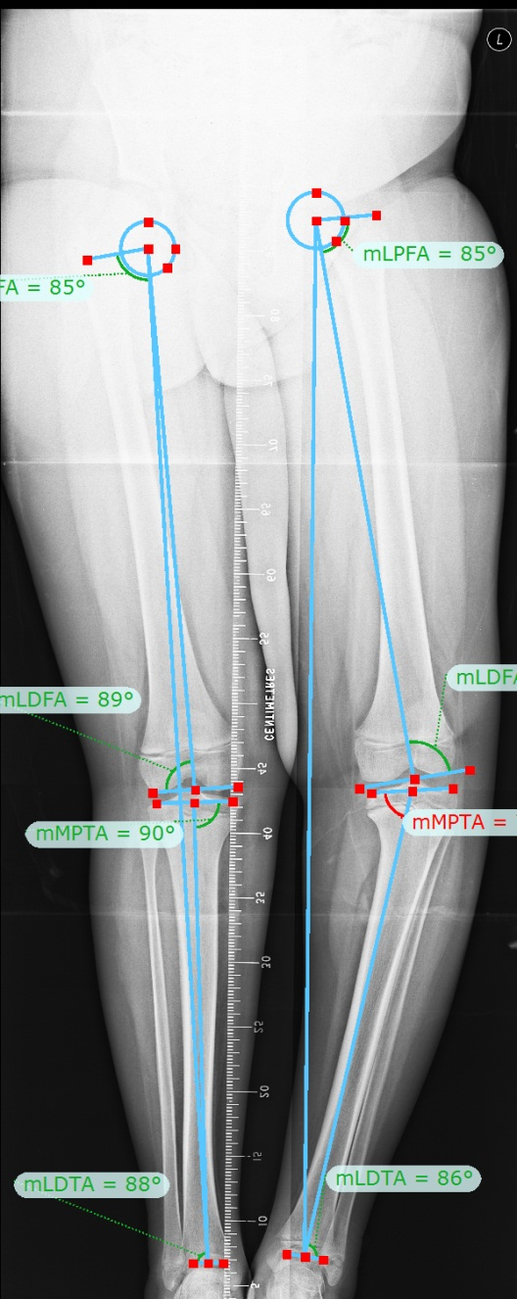
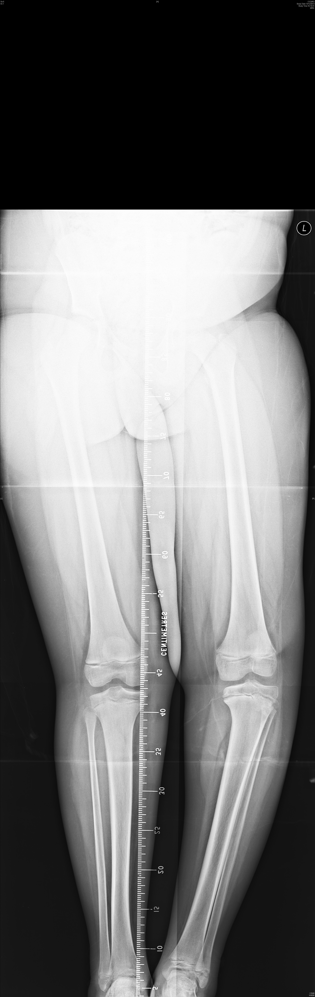
LDFA 88°
MPTA 73°
Notes:
Stepwise assessment of MAD – tibia vara deformity

Slide 17
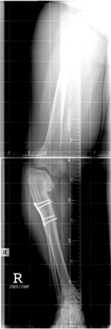
Notes:
Tibia vara plus joint obliquity

Slide 18
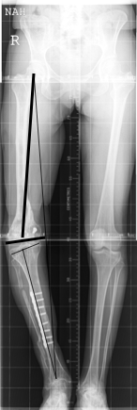
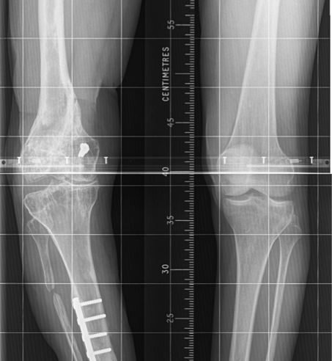
Notes:
Varus deformity due to joint laxity

Slide 19
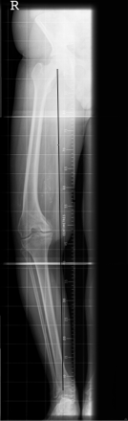

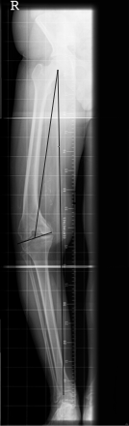

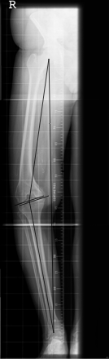
Notes:
MAD varus due to distal femoral varus

Slide 20
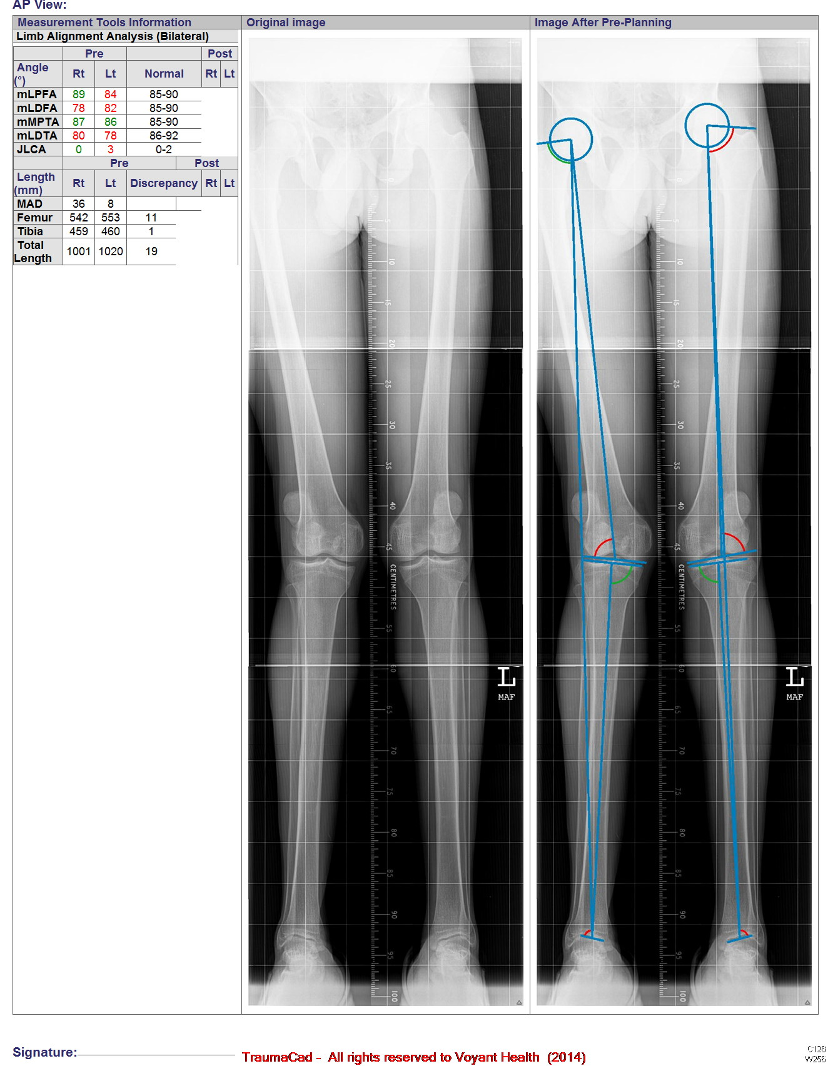
Notes:
Examples of juxta-artricular deformities – valtus due to distal femoral

Slide 21
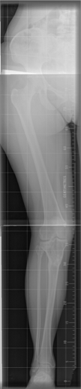
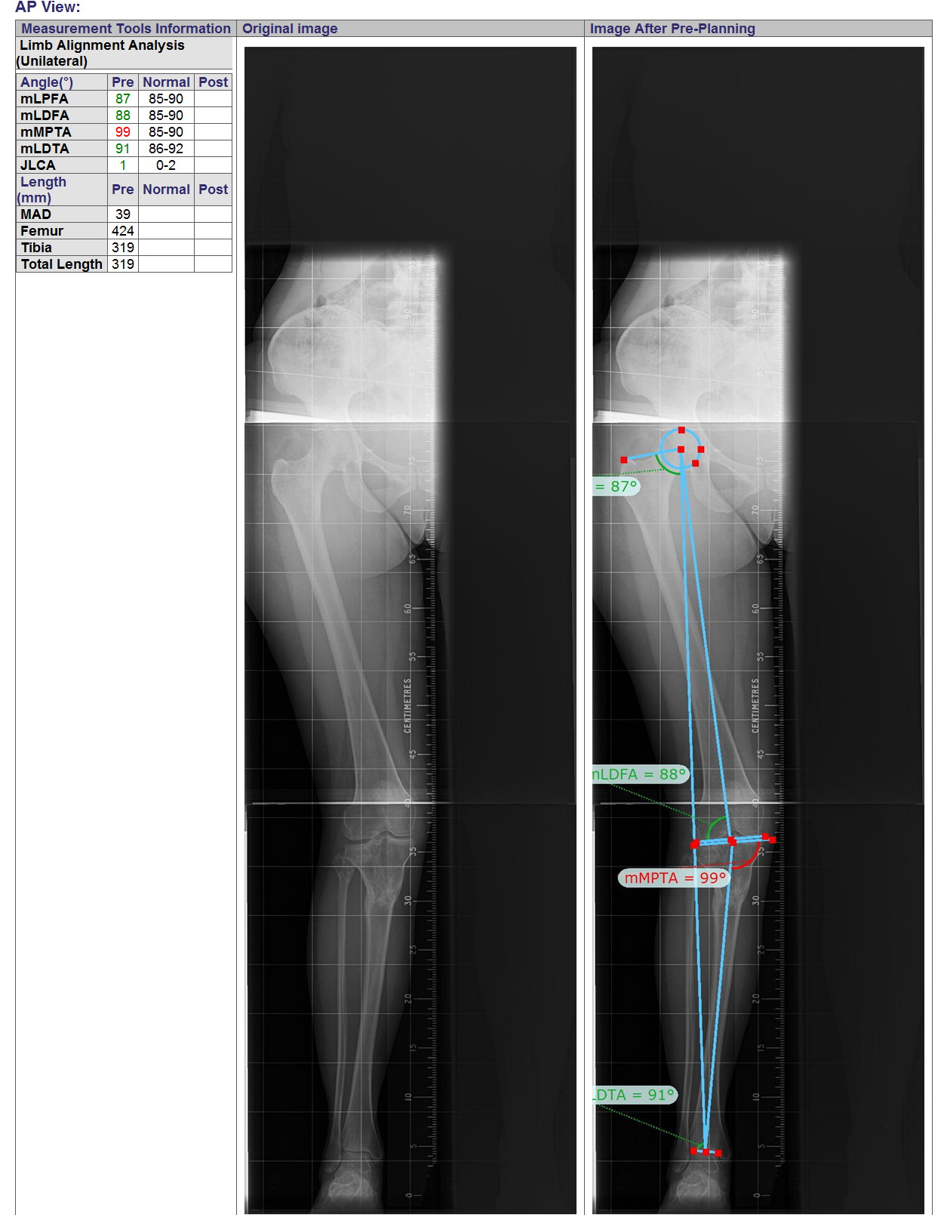
Notes:
Examples of diaphyseal deformities

Slide 22
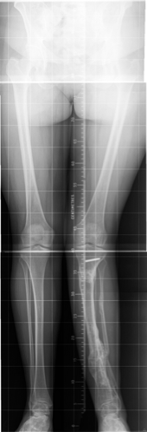
Notes:
Example of a multi apical deformity

Slide 23
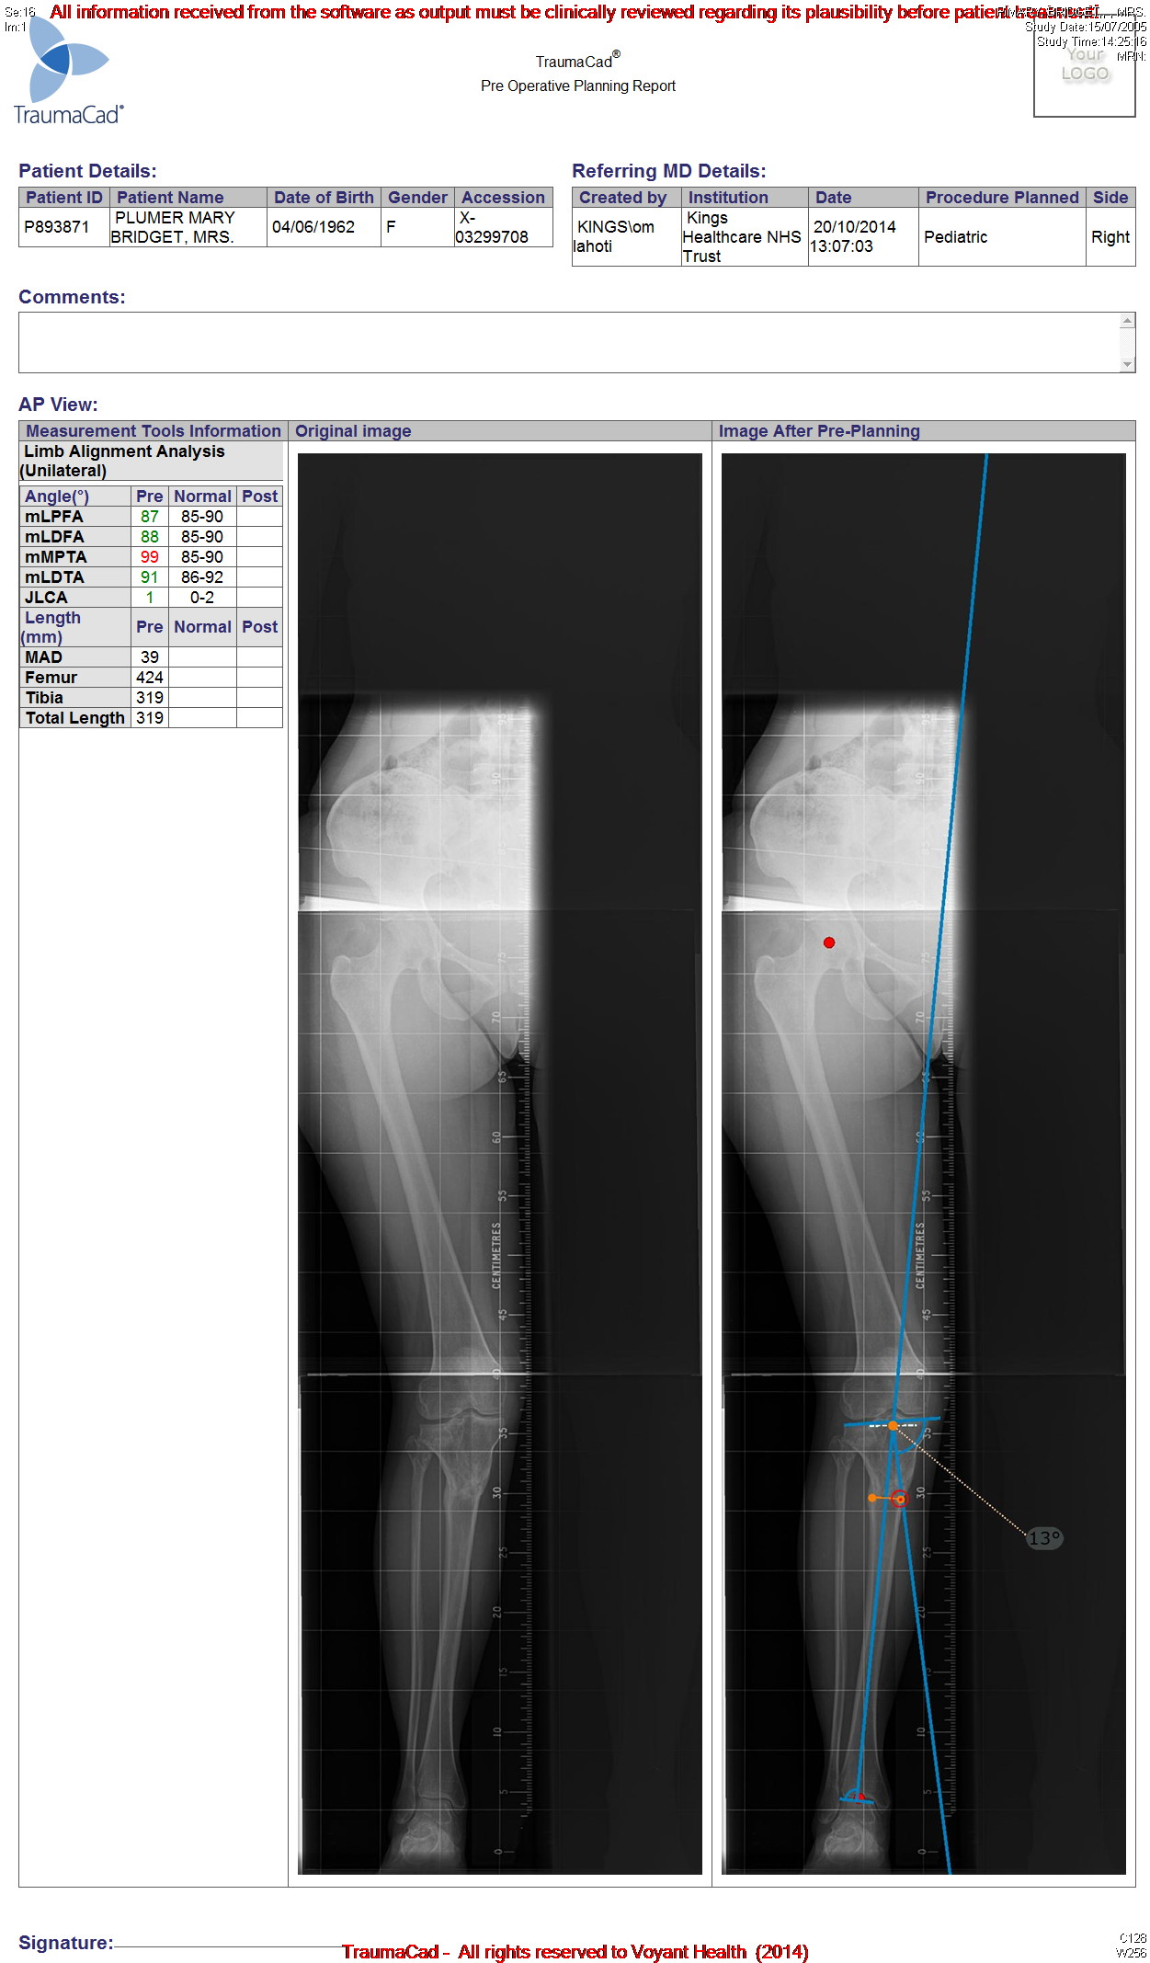

Slide 24
Methods of correction of a deformity
Level, magnitude and multiplanar deformity
Leg Length Descrepancy
Soft tissues
Bone stock/regenerative potential
Expertise
  Plate/Nail/Ex Fix

Slide 25
Osteotomy Rules
Guide to type of correction
End result of correction
Three rules

Slide 26
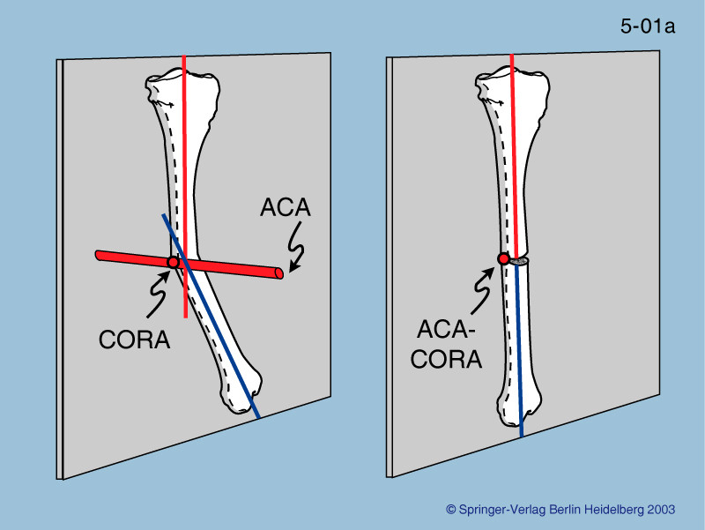
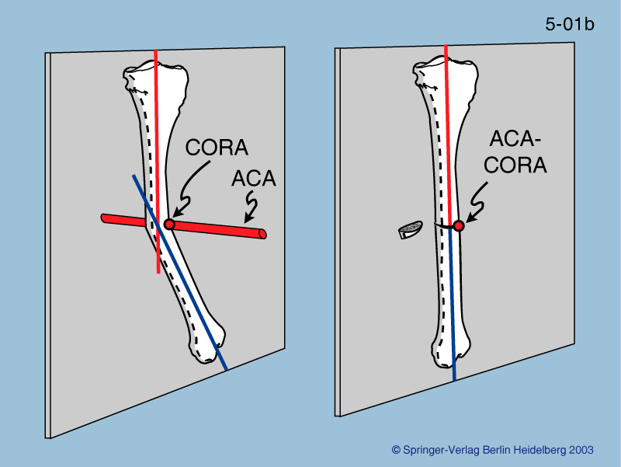
Osteotomy Rule 1
Plane of osteotomy and correction through CORA and ACA

Slide 27
Osteotomy Rule 2
If ACA is at CORA and Osteotomy above or below CORA – angulation and translation occurs at osteotomy

Slide 28
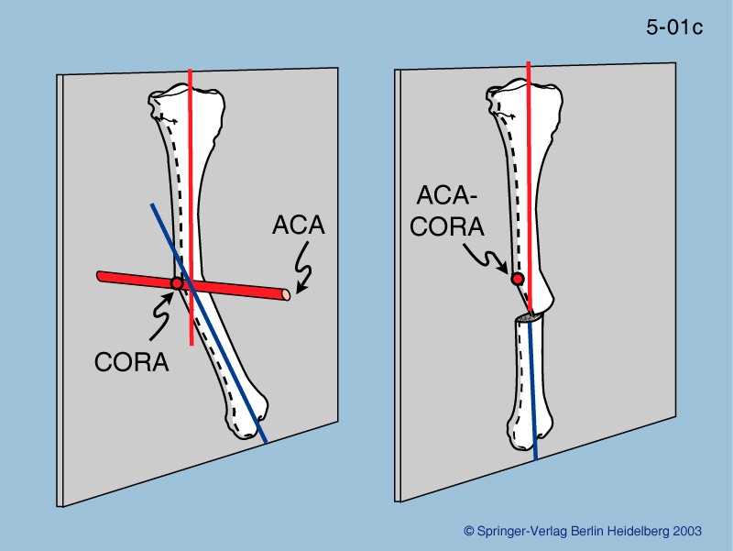
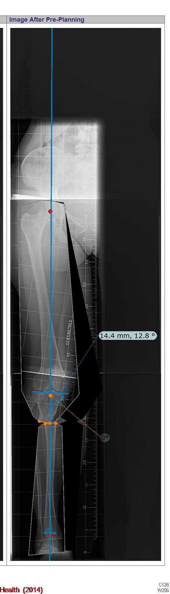
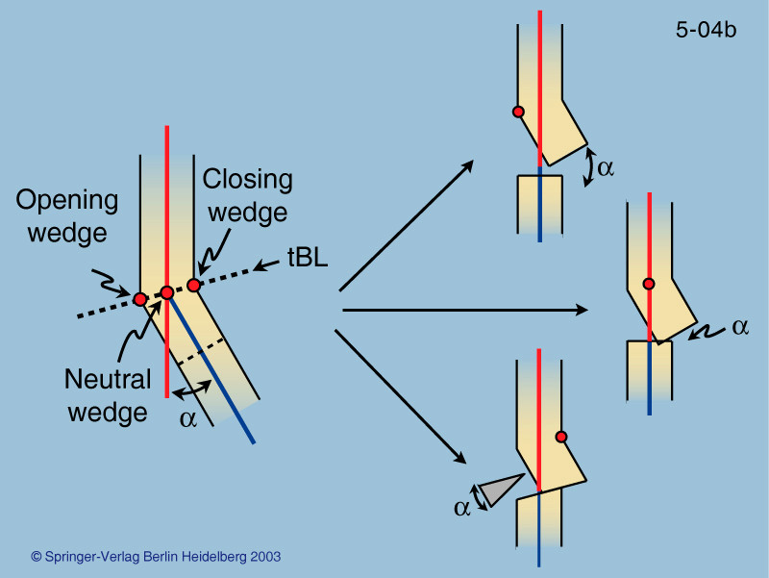

Slide 29
Osteotomy Rule 3
If ACA does not pass through CORA and osteotomy is at a distance from CORA

Slide 30
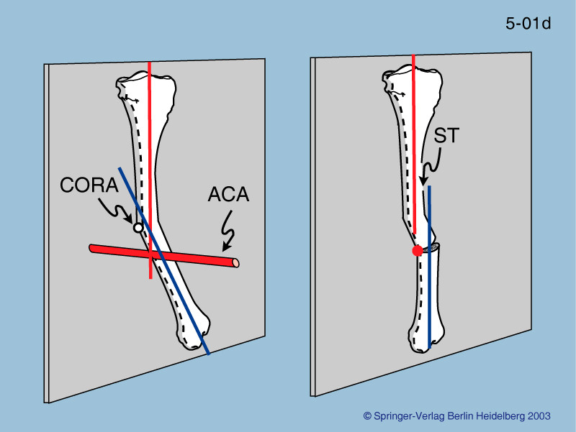

Slide 31
Deformity correction in children
Growth differentiates from adults
Growth can be modulated to correct angulation

Slide 32
Growth Modulation
Epiphyseodesis – Hemi
On the convex side (Apex of the deformity)
Temporary/permanent
Various implants

Slide 33
Hemiepiphyseodesis - controversies
Normal growth pattern assumed
When to do
Which implant
Predictability issues
Overcorrection and Rebound

Slide 34
Timing of Epiphyseodesis
Nearer skeletal maturity – 2yrs of growth
Magnitude of correction
5° angular correction for each yr. tibia
^{7° for femur}
^{(Bowen et al CORR 198, 1985)}

Slide 35
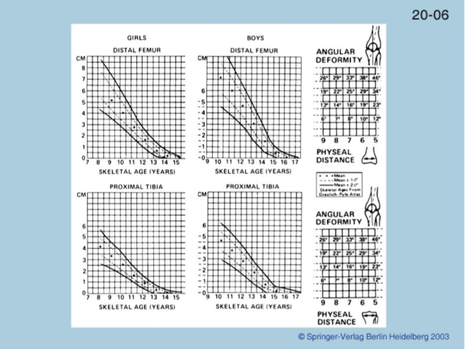

Slide 36
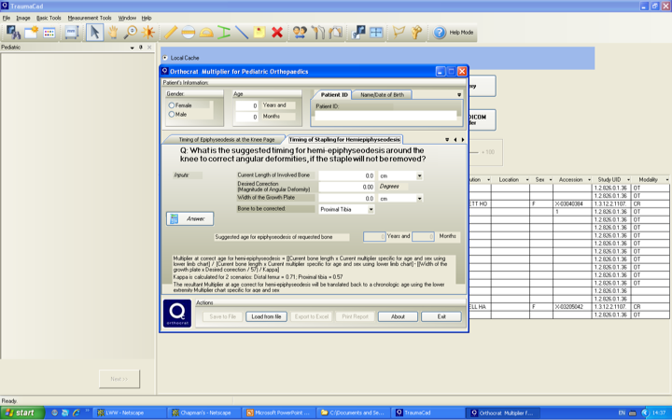

Slide 37
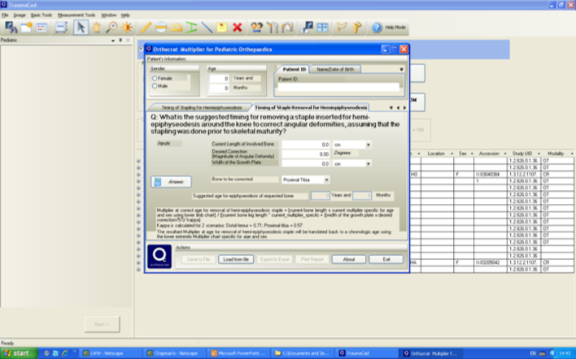

Slide 38
Indications
Un-resolving Genu Valgum in Adolescents
Skeletal dysplasia/multiple osteochondromatosis
Cozen’s fracture
Blount’s

Slide 39
Rule of thumb for G Valgum
Indications (Adolescent cases)
  3” IM distance (10yr G – 12 B)
  12-15 degree valgus
  Avoid surgery before 12yrs of age
  If two years of growth left – femoral
  One year – femur and tibia
  Removal – once limb is neutral

Slide 40
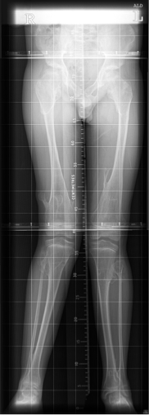
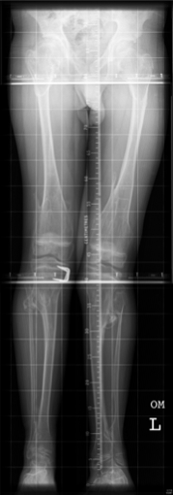

Slide 41
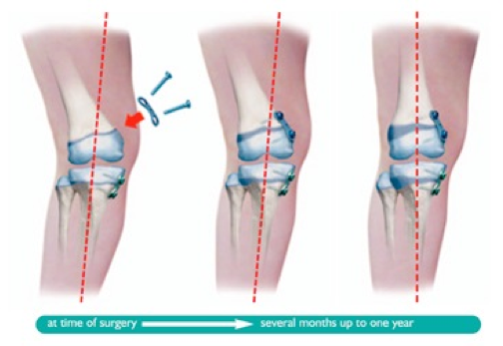
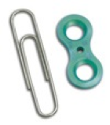

Slide 42
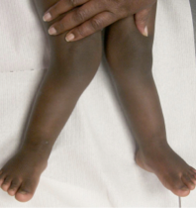
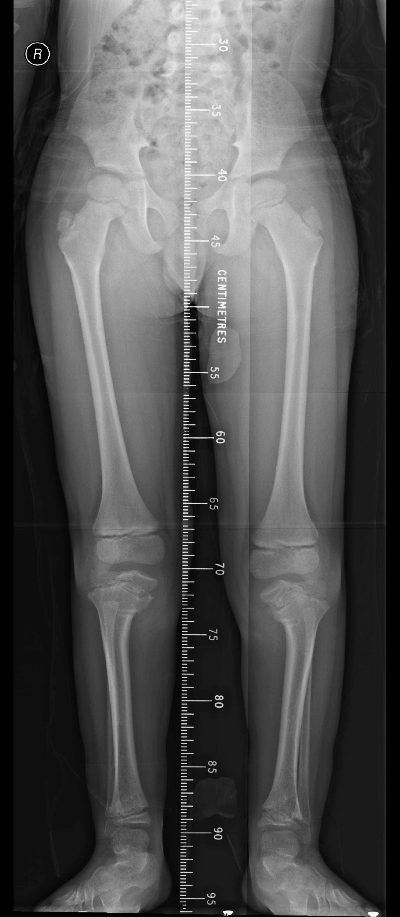
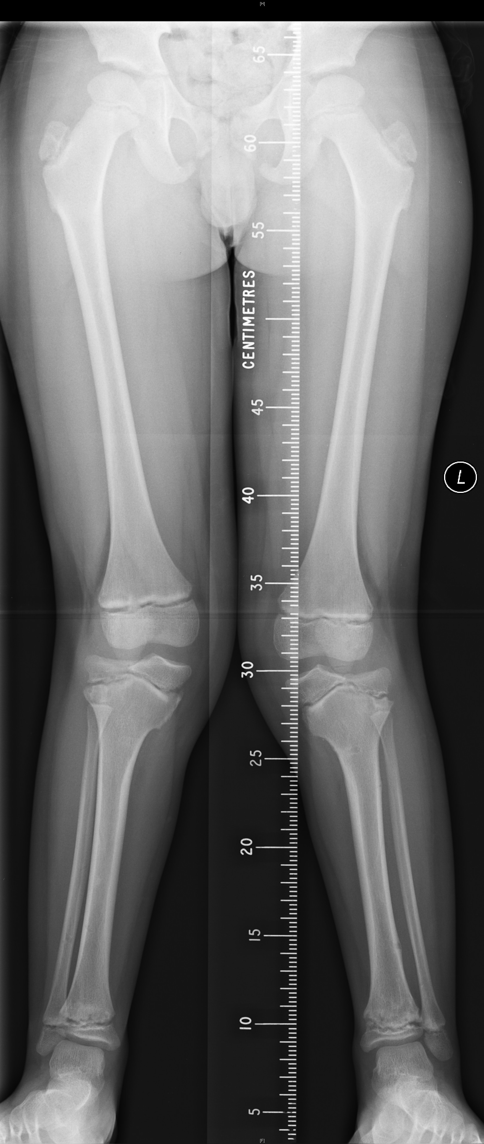
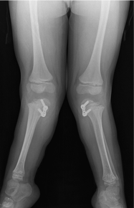
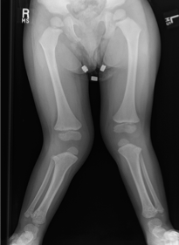

Slide 43
Evaluation of Limb Length Discrepancy
(LLD)
Common in general population
  75% have <1cm LLD
Myths
  Effect on Spine – scoliosis, increased incidence LBP
  Arthritis – high hip uncovering
Significant @ 2.5cm
Notes:
Myths – effect on spine – scoliosis, variable, functional scoliosis, convexity has no relation to short side, LBP is not substantiated, High hip – centre edge angle

Slide 44
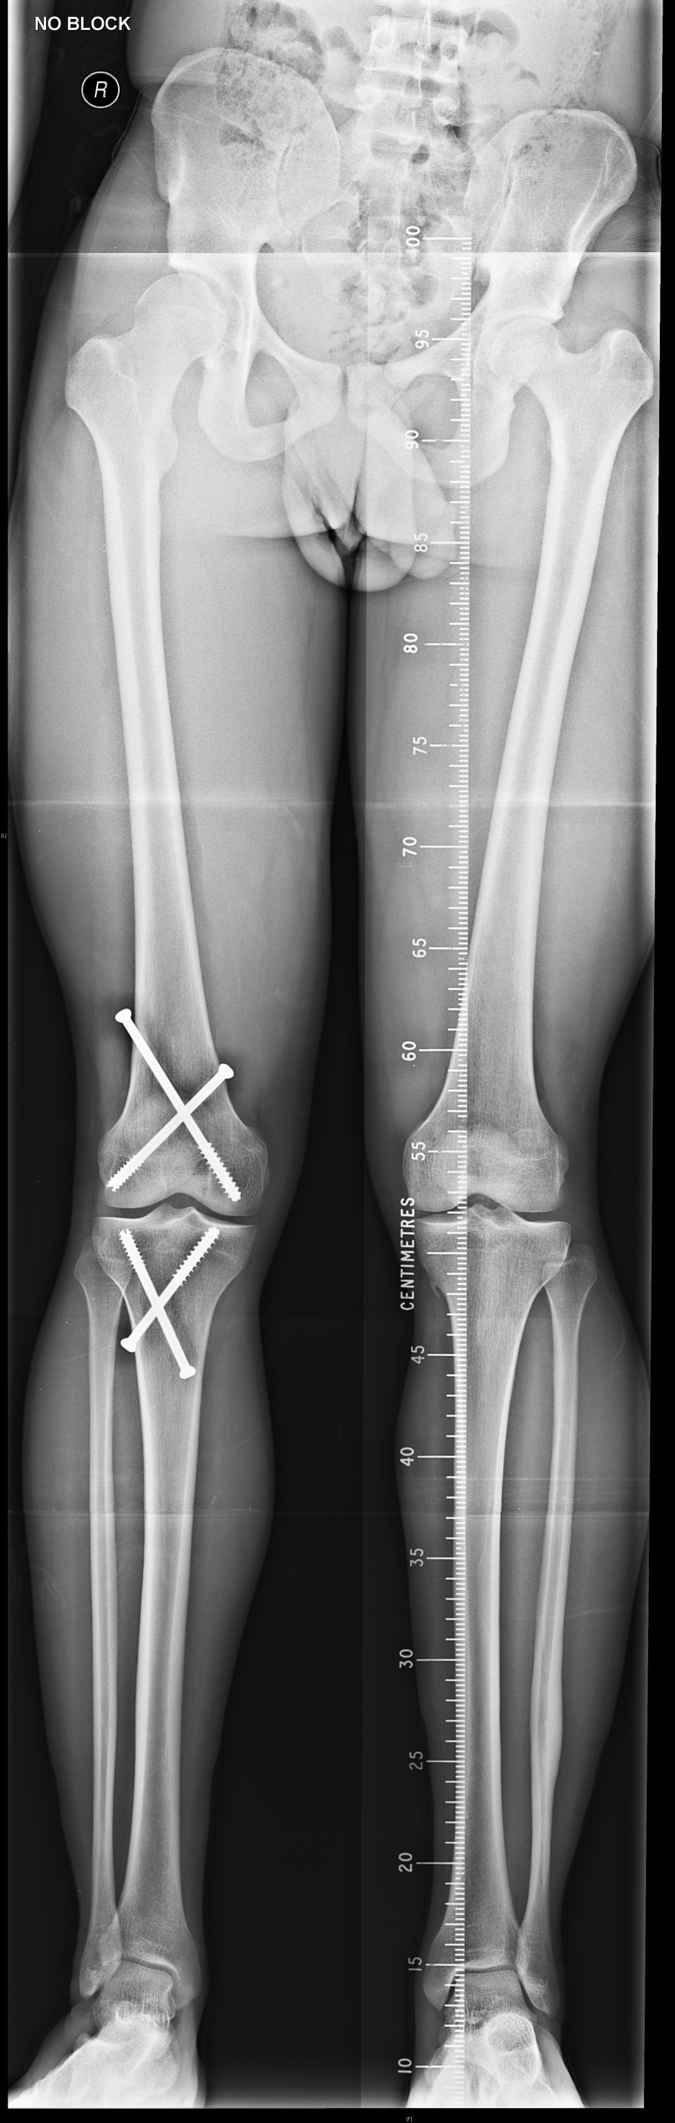

HIGH HIP ‘DYSPLASIA’

Slide 45
Growth in Lower Limbs
Maximum growth around knee – 65%
Distal Femur grows at 1cm per year
Proximal Tibia grows at .6 cm per year
Skeletal Maturity
  Girls 14-16 yrs
  Boys 16 – 18 yrs

Slide 46
Causes of LLD
Affected leg short
Affected leg long
Congenital deficiency
  PFFD
  Fibular hemimelia
Trauma
  Growth Plate Injuries
  Bone Loss
Infection
  Osteomyelitis, Septicaemia
Others
  Polio, Neurological, JCA
Trauma
  Femoral fractures
Infection – Rare
Vascular
  A-V malformations, syndromes
  Neurofibromatosis
Others
  Hemihypertrophy

Slide 47
Shapiro patterns of LLD

Slide 48
Assessment of LLD - History
Birth history, trauma, infections, JCA
Progressive vs. Static
Associated spinal/foot/upper limb deformities
Family history
How is patient compensating for LLD
Secondary effects of LLD

Slide 49
Assessment of LLD - Clinical
Inspection – front, side, back
Gait – short leg, other features
Measure –
  Tape
  Blocks
Range of movement of each joint
Fixed contractures at each level
Orthotics

Slide 50




Slide 51
Radiological Assessment
Long leg weight bearing films with a ruler
CT scannogram
Use the same technique each time
Preferably measured by same individual/method
Bone Age
Notes:
p.145: The first is that the bone age obtained is accurate only within approximately 12 months, and bone ages are notoriously inaccurate before the age of 6 years. Ultimately, however, if evaluations are done sequentially over a number of years, the intrinsic inaccuracy is reduced. Bone age left hand – in conditions that affects left hand – both hands should be exposed

Slide 52
Prediction of Discrepancy
Obtain reproducible data – preferably two measurements six months apart
Accuracy increases with number of observations
Techniques
  Arithmetic method (Menelaus)
  Green-Anderson Growth Remaining and Moseley Straight Line Graph
  Eastwood-Cole
  Paley Multiplier
  Computer assisted (Trauma CAD)

Slide 53

Notes:
p.146: The arithmetic method, or ruleof-thumb method, was first described by White and evaluated by Westh and Menelaus.13 It is based on four assumptions about growth: (1) boys stop growing at age 16; (2) girls stop growing at age 14; (3) the distal femoral physis grows 10 mm yearly; and (4) the proximal tibia grows 6 mm yearly. This method is useful only during the later years, not in young children.

Slide 54


Slide 56


Notes:
In a recent study, Little et al18 compared the accuracy of the Anderson-Green, Westh-Menelaus, and Moseley methods of predicting limb-length discrepancy. No important differences were revealed.

Slide 57
Goals
Leg Length Equalization – level pelvis
Normal Lower Limb Alignment
Good Function

Slide 58
Treatment Options
Multifactorial
Magnitude
  Under 2.5cm
  2.5 to 5 cm
  5cm and above
Predicted height, joint function, neurology, instability

Slide 59

Shoe Modification
2 to 2.5 cm
Weight, Gait
Cosmesis

Slide 60
Epiphysiodesis
2.5 – 5cm
Less morbidity
Operation on long or normal leg
Predictability
Accurate with in 1cm

Slide 61
Acute Shortening
2.5 to 5cm
Invasive
Loss of height
Less morbidity
Reasonably quick recovery

Slide 62
Lengthening Procedures
More than 6 cm
Also in cases of angular/rotational deformities with shortening
Complications
  Infections
  Joint Contractures
  Neurological injury
Notes:
Despite the improvements in gradual-distraction lengthening techniques, the complications of
limb lengthening exceed those of epiphysiodesis or acute shortening. These include joint contracture, joint subluxation or dislocation, muscle weakness, vascular injury, nerve palsy, bone regenerate defor- mation, and pin-site infection

Slide 63
Lengthening Procedures
Distraction Osteogenesis
  Circular Frame (Ilizarov, TSF)
  Monolateral Frame (Orthofix LRS)
Nail – motorized nails
Combination – Lengthening Over Nails

Slide 65



Slide 66


Slide 67



Slide 68


Slide 69


Slide 70



